Slide 1
Basic Statistics for Surveillance
Lauren DiBiase, MS, CIC
Associate Director
Public Health Epidemiologist
Hospital Epidemiology
UNC Health Care

Slide 2
Statistics
The margin of error…
17 in every 100 people…
Men are at 3 times higher risk…
Numbers that describe the health of the population
1 in 9 children…
The science used to interpret these numbers.
39% of the population…
There is a statistically significant difference…
Risk of dying is 8 times higher among...
Notes:
Science of public health rests heavily on statistics to drive evidence-based health programs

Slide 3
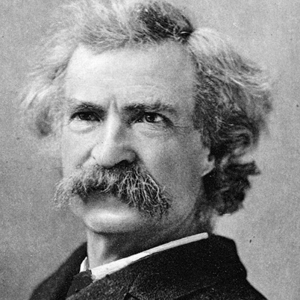
“There are 3 kinds of lies.
Lies, damned lies, and statistics.”
~Popularized by Mark Twain
Describes the persuasive power of numbers, particularly the use of statistics, to bolster weak arguments, and the tendency of people to disparage statistics that do not support their positions.

Slide 4
Descriptive Statistics
Measures of Rates and Ratios
Rate: How fast disease occurs in a population.
Ratio: How much disease compared to standard.
Measures of Central Tendency
Central Tendency: How well the data clusters around an average value.
Measures of Dispersion
Dispersion: How widely your data is spread from the average.

Slide 5
Absolute Measures
Simplest type of measurement
Also known as counts or frequencies
Example:
LTC A: 25 residents with norovirus
LTC B: 10 residents with norovirus
Is norovirus worse at LTC A?
Notes:
Absolute measures are the simplest type of measurement and they are also known as counts or frequencies. If you are measuring disease, then the number of cases would be an absolute measure of the amount of disease.

Slide 6
Relative Measures
Includes a denominator
Useful for comparisons
Examples:
16 cases of C. difficile out of 1000 residents
1 positive C. difficile test out of 7 samples tested
Notes:
Relative measures are absolute measures which are relative to some defined population. All relative measures have both a numerator, which is usually the absolute measure, and a denominator. Think of the denominator as the whole group – such as the whole population being studied or the whole group of samples tested. As we will see in a moment, relative measures are more useful for making comparisons than absolute measures.

Slide 7
Absolute versus Relative
Example: Norovirus among LTC facility residents
Absolute measures
LTC A: 25 residents ill
LTC B: 10 residents ill
Relative measures
LTC A: 25 ill per 100 residents = 0.25 or 25%
LTC B: 10 ill per 25 residents = 0.40 or 40%

Slide 8
What Makes a Rate?
Numerator (top number)
e.g., number of infections
Denominator (bottom number)
e.g., number of residents [proportion]
e.g., number of resident-days, number of device-days [incidence density/rate]
Time Frame
e.g., day, week, month

Slide 9
Denominators
Represent the population at risk of becoming part of the numerator
Often, the most difficult data to obtain, but essential for comparisons
Ideally, should incorporate time and can account for risk factors such as device use (e.g., device-days), length of stay (e.g., resident-days)

Slide 10
What is a Resident/Device-Day?
Resident 1
5 days
Resident 2
7 days
Resident 3
3 days
=15 resident-days, device-days, etc.
More informative than simply saying “3 residents”

Slide 11
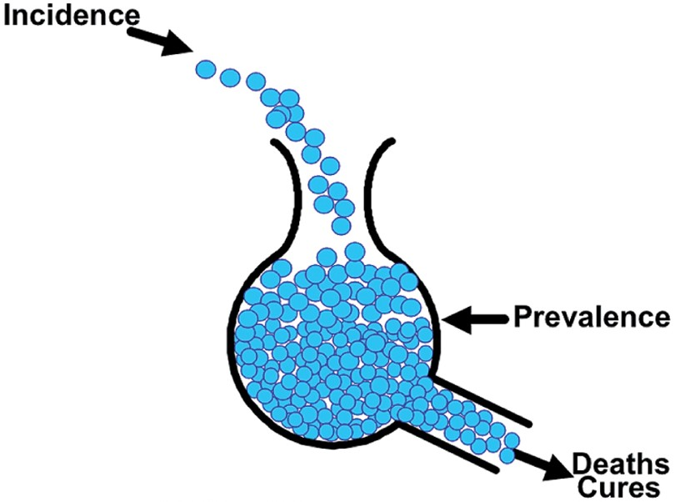
Rate Measures
Prevalence
Incidence
Attack Rate
Notes:
Examples for each one.

Slide 12
Prevalence
Prevalence: the total number of cases of disease existing in a population at a point in time.
e.g., # of MRSA cases per population on March 8
Count of existing cases x constant (e.g., 100 or 1000) =
Number of people at risk
Notes:
Number of people at risk—number of admissions or discharges to a unit during at time period.

Slide 13
Incidence
Incidence: the number of new cases of disease in a population over a period of time.
e.g., # of new MRSA cases per population during March
Count of new cases x constant (e.g., 100 or 1000) =
Number of people at risk
Notes:
Incidence should not be confused with prevalence, which is the proportion of cases in the population at a given time rather than rate of occurrence of new cases. Thus, incidence conveys information about the risk of contracting the disease, whereas prevalence indicates how widespread the disease is.

Slide 14
Attack Rate
Attack Rate: the number of new cases of disease out of the population at risk.
Related to incidence but always uses 100 as the constant, so it is expressed as a percent.
Often used for outbreaks or clusters that occur over a short period of time
e.g., % of residents with MRSA during outbreak in LTC A in March
Count of new cases x 100 =
Number of people at risk

Slide 15
Example 1:
You perform surveillance for urinary tract infections (UTIs) in your 200 resident facility.
During the 1st quarter of the year, you identify 3 new UTIs.
During the 1st quarter, there were 180 residents in the facility with 12,000 resident-days.

Slide 16
Example 1:
In the first quarter, what was the UTI rate?
Incidence or prevalence?
Numerator?
Denominator?
Units?

Slide 17
Example 1: Answers
In the first quarter, what was the UTI rate?
Incidence or prevalence?
Incidence
Numerator?
3
Denominator?
180 residents or 12,000 resident days
Units?
“infections per 100 residents or infections per 1000 resident days”
ANSWER: 1.7 infections per 100 residents or 0.25 infections per 1000 resident days

Slide 18
Example 1:
On April 7, you were worried about the UTI rate so you do a “spot check” on all of the residents of one area of the facility for a UTI.
At that time with a census of 25, you reviewed 20 charts and found 1 healthcare associated UTI.

Slide 19
Example 1:
On April 7th, what was the UTI infection rate at the time of your spot check?
Incidence or prevalence?
Numerator?
Denominator?
Units?

Slide 20
Example 1: Answers
In April, what was the UTI infection rate at the time of your spot check?
Incidence or prevalence?
Prevalence
Numerator?
1
Denominator?
20
Units?
“prevalent infections per 100 residents on April 7th”
ANSWER: 5 prevalent infections per 100 residents on April 7th.

Slide 21
Example 1:
You also routinely track counts of influenza-like illness in your 200 resident facility.
During March, there is a cluster of influenza-like illness. In a short time period, 25 residents become ill and meet your case definition.
During March, there were 180 residents in the facility with 5,000 resident-days.

Slide 22
Example 1:
What is the attack rate of influenza-like illness at your facility during March?
Numerator?
Denominator?
Units?

Slide 23
Example 1: Answers
What is the attack rate of influenza-like illness at your facility during March?
Numerator?
25
Denominator?
180
Units?
“percentage of residents who had influenza-like illness”
ANSWER: 14% of residents with influenza-like illness during outbreak in March

Slide 24
Descriptive Statistics
Measures of Rates and Ratios
Rate: How fast disease occurs in a population.
Ratio: How much disease compared to standard.
Measures of Central Tendency
Central Tendency: How well the data clusters around an average value.
Measures of Dispersion
Dispersion: How widely your data is spread from the average.

Slide 25
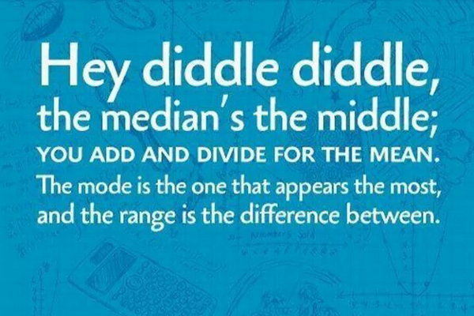
Measures of Central Tendency
Mean: average of a group of numbers
Median: middle number in an ordered group of numbers
Mode: most common value in a group of numbers
Notes:
Mean: the average value
– Useful for descriptive & inferential stats
– Measure of choice if data are normally distributed
• Median: the middle value; 50th percentile
– Useful for descriptive stats
– Measure of choice if data are skewed
• Mode: the most frequently occurring value
– Useful for descriptive stats

Slide 26
Measures of Dispersion
Range: the largest value minus the smallest value
Standard deviation: describes the variability or dispersion in the data set
Notes:
Standard deviation: square root of the sum of the differences between each value and the mean of the data set divided by the number of values in the data set minus 1

Slide 27
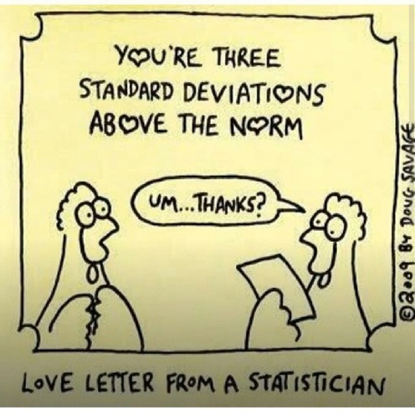
Standard Deviation
In an normally distributed data set,
68% of values + 1 SD
95% of values + 2 SD
99% of values + 3 SD

Slide 28
Example 2:
Your administrator is becoming concerned that compliance with hand hygiene is not as high as it needs to be
She has asked you to provide her with some data to confirm her suspicions

Slide 29
Example 2:
For the past year, once a month, you have been conducting hand hygiene audits in your facility – these are your compliance results:
55%, 92%, 86%, 94%, 91%, 89%, 79%, 93%, 92%, 88%, 87%, 90%
You decide as a first step to calculate the mean, median, mode and range of the monthly data to help describe hand hygiene compliance at your facility

Slide 30
Example 2:
What is the:
Mean?
Median?
Mode?
Range?
HINT: 55%, 79%, 86%, 87%, 88%, 89%, 90%, 91%, 92%, 92%, 93%, 94%
Notes:
Mean: (sum/12)=(1036/12)=86.3%
Median: middle number when sorted by rank=89.5%
Mode: most frequent number = 92%
Range: minimum to maximum: 55%-94% (39%)
Stdev=10.2
Outlier=55%

Slide 31
Example 2: Answers
What is the:
Mean?
86.3%
Median?
89.5%
Mode?
92%
Range?
39% (94%[max]-55%[min])
Standard Deviation?
can use programs like Excel to calculate
10.2%
Notes:
Mean: (sum/12)=(1036/12)=86.3%
Median: middle number when sorted by rank=89.5%
Mode: most frequent number = 92%
Range: minimum to maximum: 55%-94% (39%)
Stdev=10.2
Outlier=55%

Slide 32
Example 2: Central Tendency
Mode
*Outlier
Median
Mean
*outlier: a value that falls outside the overall pattern.

Slide 33
Example 2: Dispersion
Median
1SD
2SD
1SD
Mean

Slide 34
Example 2: Dispersion
2SD
1SD
1SD
2SD
Mean
Notes:
New Means and Std Dev (Minus outlier)
Mean=86.3% (Mean without outlier=89.2%)
Stdev=10.2% (Stdev without outlier=4.0%)

Slide 35
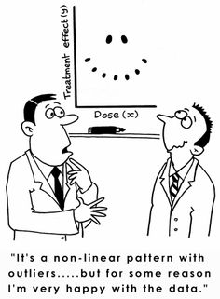
Displaying Surveillance Data

Slide 36
Displaying and Interpreting Surveillance Data
Line lists
Graphs: a visual representation of data on a coordinate system (e.g., two axes)
Tables: a set of data arranged in rows and columns

Slide 37
Line Lists
Allow for record-level review of data
Helpful way to standardize the data you want to routinely collect
Helpful in pinpointing issues in data quality
Can help inform rates or other summarized measures
Can help identify trends
Notes:
Graphical representation of data in a line list/frequency table helpful when presenting data to committees, nurses, external stakeholders

Slide 38
Data Types
Quantitative variables: numerical values
(e.g., number of infections, number of residents)
Categorical variables: descriptive groups or categories
(e.g., areas of the facility, gender, occupational groups)

Slide 39
Features of Graphs and Tables
Graphs and tables should be self-explanatory!
Clear, concise title: describes person, place, time
Informative labels: axes, rows, columns
Appropriate intervals for axes
Coded and labeled legends or keys
Use footnotes to:
Explain codes, abbreviations, and symbols
Note exclusions
Note data source

Slide 40
Graph Types
Bar Graphs
E.g., Histograms (shown in previous example)
E.g., Comparison between categories
E.g., Epidemic Curves
Line Graphs
E.g., To show trends over time
Pie Charts
E.g., As a percentage of a whole
Notes:
Bar graphs are used to compare facts. The bars provide a visual display for comparing quantities in different categories or groups. Bar graphs help us to see relationships quickly. However, bar graphs can be difficult to read accurately. A change in the scale in a bar graph may alter one's visual perception of the data
Line graphs are used to display data or information that changes continuously over time. Line graphs allow us to see overall trends such as an increase or decrease in data over time.
Circle Graphs are used to compare the parts of a whole. Circle graphs represent data visually in the same proportion as the numerical data in a table: The area of each sector in a circle graph is in the same proportion to the whole circle as each item is to the total value in the table. Constructing an accurate circle graph is difficult to do without a computer. This is because you must first find each part of the whole through several elaborate calculations and then use a protractor to draw each angle. This leaves a lot of room for human error. Circle graphs are best used for displaying data when there are no more than five or six sectors, and when the values of each sector are different. Otherwise they can be difficult to read and understand.

Slide 41
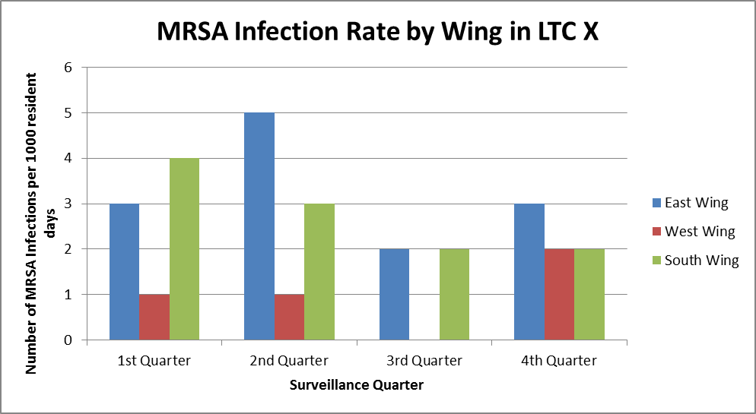
Bar Graph
Notes:
Graph compares the MRSA rate in different areas of the facility by surveillance quarter

Slide 42
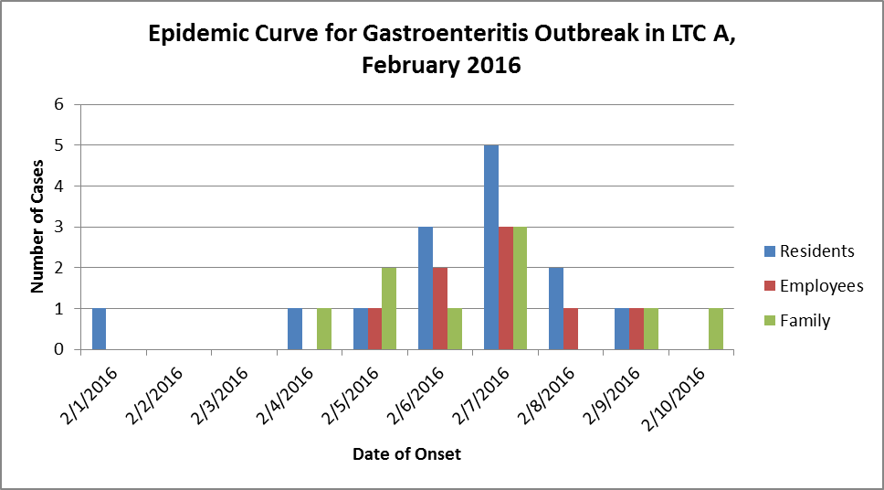
Epi Curve
Notes:
Epi-curve is a type of bar graph that shows the number of new cases (Incident) over a period of time

Slide 43
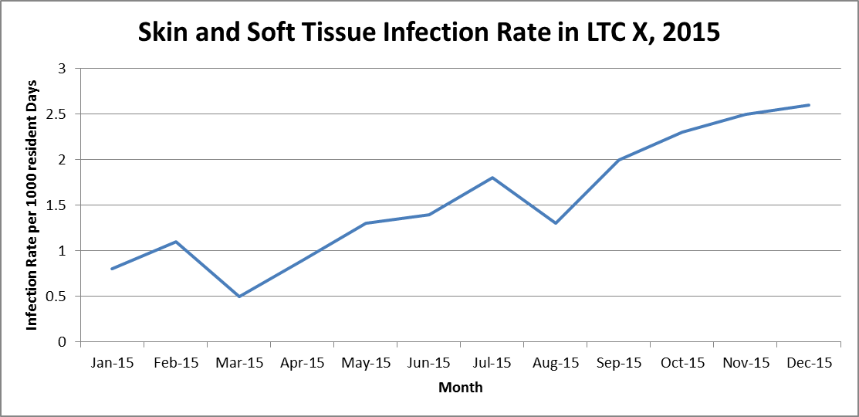
Line Graph

Slide 44
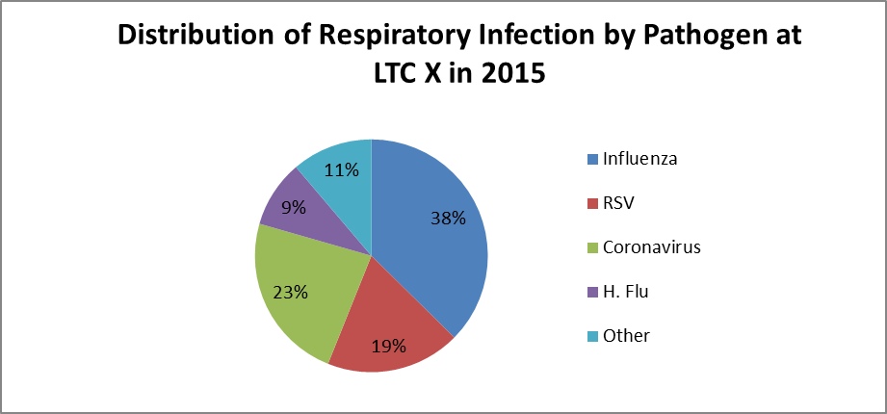
Pie Chart

Slide 45
Tables
Number of UTIs by Age Group, LTC X, 2015
Age Group (Years) | Number of Cases
<50 | 0
51-60 | 2
61-70 | 7
71-80 | 6
81-90 | 3
>90 | 1
Total | 19
Notes:
Now let’s talk about constructing tables. In the very simplest terms, a table is a set of data that are organized into rows and columns. Tables are very useful for organizing and displaying quantitative data, demonstrating patterns, exceptions, differences, and a whole host of other relationships. Every row and column in a table should have corresponding labels that are clear and concise, including specific units of measures.

Slide 46
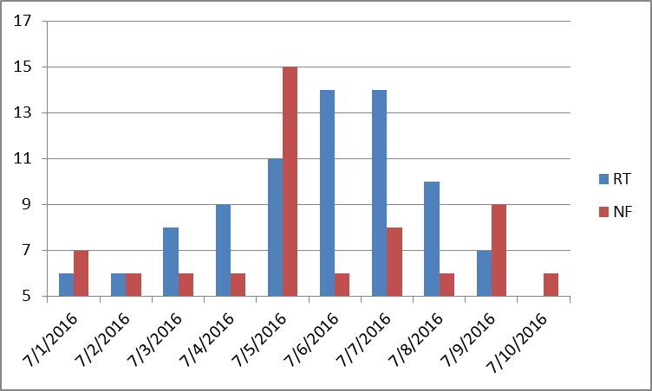
What’s wrong with this picture?
Missing a chart title
Missing axis labels on the x and y axis
The y axis starts at 5 (should start at 0)
No explanation of abbreviations used in the legend

Slide 47
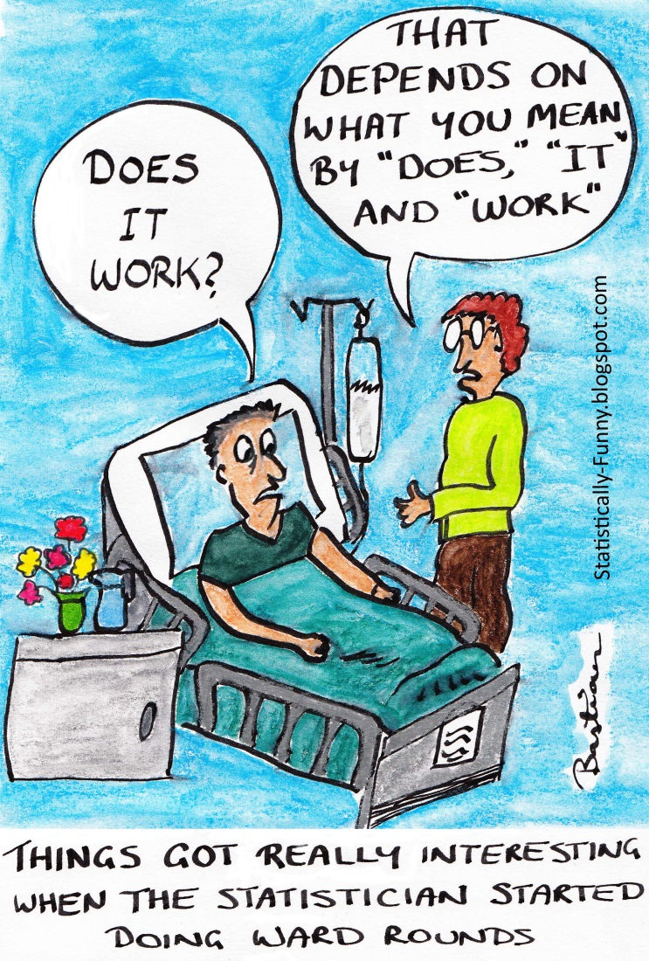
Interpreting Surveillance Data

Slide 48
Why Analyze your Data?
Provide feedback to internal stakeholders
Analyzing HAI data can help facilitate internal validation activities
Reports can help inform prioritization and success of prevention activities
At the end of the day, these are YOUR data – you should know your data better than anyone else

Slide 49
Checklist
Before you begin analyzing your data, ask yourself these questions:
What data are you analyzing?
What is the time period of interest?
Why are you analyzing these data?
Who is the audience?

Slide 50
Data Analysis: Interpreting the Results
Examine trends over time
Assess which risk groups are being most affected
Assess patterns to determine temporality
Identify acute or unusual events which require immediate follow-up
Notes:
When interpreting data, it is important to do the following:
Examine trends over time
Assess which risk groups are being most affected
Assess patterns to determine temporality and
Identify acute or unusual events which require immediate follow-up

Slide 51
National data summary, 2015 *data presented below is fictional and only for example purposes
Infection Data |  |  |  |  | Percentile
Types of Infections | No. Locations | No. of Infections | Resident Days | Pooled Mean | 10% | 25% | 50% (median) | 75% | 90%
UTI Rate | 50 | 150 | 213,535 | 0.70 | 0.11 | 0.34 | 0.55 | 0.86 | 1.20
C. difficile Rate | 45 | 300 | 200,000 | 1.5 | 0.0 | 0.40 | 1.00 | 2.40 | 3.20
MRSA Rate | 30 | 100 | 180,000 | 0.56 | 0.0 | 0.21 | 0.58 | 0.76 | 0.90

Slide 52
What does this data summary tell you?
What is the mean UTI rate reported in 2015?
0.70 UTIs per 1000 resident days
If your facility has a rate of 1.6 C. difficile infections per 1000 residents days—between what percentiles is it compared to the national data?
Between the 50th-75th percentiles
If your facility has a rate of 2.0 MRSA infections per 1000 resident days—between what percentiles is it compared to the national data?
Greater than the 90th percentile

Slide 53
Determine the Significance of Changes to Surveillance Data

Slide 54
Determine the Significance-How?
Practical Significance vs. Statistical Significance
Make comparisons
For example: over time, to other areas of facility, to other facilities (NHSN data)
Remember to choose appropriate data for comparison (i.e., same denominator units)
Apply a type of statistical test
e.g., control charts (for time trends)
Other statistical tests and measures
P-values
95% confidence intervals
Notes:
statistical significance is mathematical - it comes from the data (sample size) and from your confidence (how confident you want to be in your results). Practical significance is more subjective and is based on other factors like cost, requirements, program goals, etc.

Slide 55
Internal Benchmarks
Compare current results to your own prior results
Best way to chart your own progress over time
Select feasible and stretch goals
Note when interventions took place
Use when there is no external benchmark

Slide 56
Control Charts
Tool to determine when infection rates are out of range – user sets control limits. How high is TOO high?

Slide 57
Control Chart Example 3:
Find the mean of the BSI rates for the last year.
Calculate the moving ranges (subtract month 1 from 2, month 2 from 3…) and take absolute values (no negative values).
Calculate the mean of the moving ranges.

Slide 58
Control Chart Example 3: Answers
Find the mean of the BSI rates.
=4.4
Calculate the moving ranges
See table
Calculate the mean of the moving ranges.
=0.5

Slide 59
Control Chart Example 3:
Calculate Upper Control limit= Mean + (2.66 x Mean of Moving Range)
Calculate Lower Control limit= Mean - (2.66 x Mean of Moving Range)
Draw horizontal lines at the mean, UCL and LCL based on your historical data
Then graph your current data and use the limits to identify potential problems.

Slide 60
Control Chart Example 3: Answers
Calculate Upper Control limit= 5.8
Calculate Lower Control limit= 3.0
Draw horizontal lines at the mean, UCL and LCL based on your historical data
Then graph your current data and use the limits to identify potential problems.

Slide 61
Control Chart Example 3:
Notes:
Now, you can focus your investigation on week 12 for the increased rate of bloodstream infections.

Slide 62
Interpretation of Other Statistical Tests
Consider your calculated infection rate to be an estimation of the true rate.
Why an estimation?
You may only do surveillance on a sample of residents in your facility.
If surveillance activities were repeated by other ICPs, your numerators may vary slightly based on interpretation of case definitions, available clinical information in the chart, etc.

Slide 63
Hypotheses
Null hypothesis: values are equal
Alternative hypothesis: values differ
These statements are mutually exclusive
They cover all possible outcomes
In the end, only one can be selected
p=value: The probability that the observed difference (or a more extreme one) was caused by random chance if the null hypothesis was true.

Slide 64
Other Statistical Tests: P Value
Probability that the difference does not reflect a true difference and is only due to chance.
e.g., P=0.05 means that 95 out of 100 times your estimate was truly significant
Generally a level of P<0.05 is
considered “statistically
significant.”
Notes:
The probability value (p-value) of a statistical hypothesis test is the probability of getting a value of the test statistic as extreme as or more extreme than that observed by chance alone, if the null hypothesis H0, is true.
The p-value helps determine rarity – how rare is this outcome that it could not have happened by chance alone

Slide 65
P-Value Example:
“Our study showed that people who washed their hands were less likely to get sick (P=0.06) and more likely to be nurses (P=0.01).”
Notes:
NOTE: p<0.05 is a convenient cut-point that is widely accepted

Slide 66
Other Statistical Tests: 95% Confidence Interval
Means that you are 95% confident that the true average value lies within this interval.
Confidence interval size:
Wide: less confident with that estimate
Narrow: more confident with that estimate
For comparisons:
Overlapping intervals suggest no significant difference
Non-overlapping intervals suggest significant differences

Slide 67
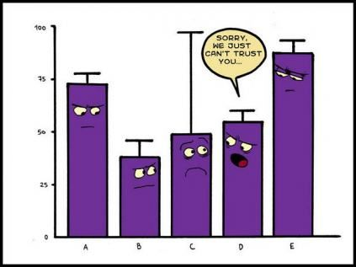

Slide 68
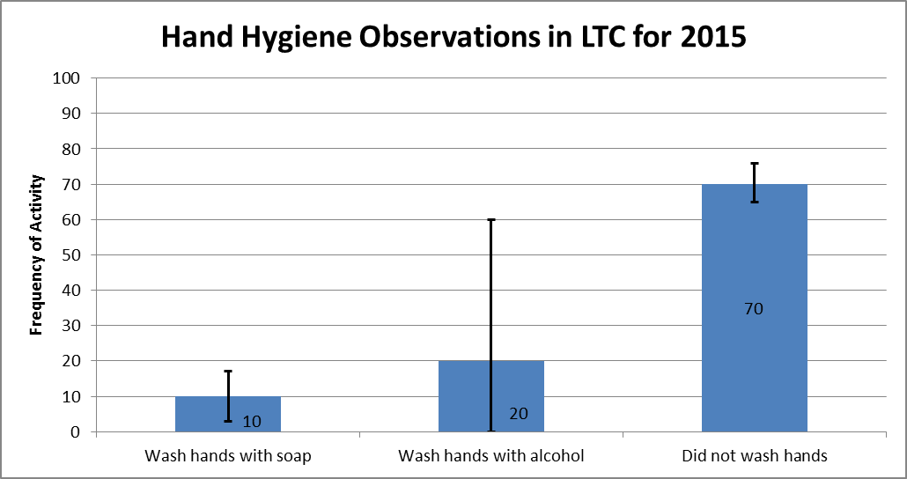
95% Confidence Interval Example:
Is the frequency of not washing hands at this LTC statistically significantly different than the frequency of washing hands with soap?
YES – the 95% CI do not overlap
Is the frequency of washing hands with soap at this LTC statistically significantly different than the frequency of washing hands with alcohol?
NO– the 95% CI overlap

Slide 69
Conclusions
Describe Surveillance Data
Rates, prevalence, incidence, mean, median, mode, SD
Display and Interpret Surveillance Data
Bar graphs, line graphs and tables
Determine the Significance of Changes to Surveillance Data
Benchmarks, control charts, p-values, 95% CI

Slide 70
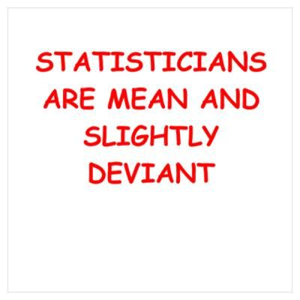
Questions?

