Slide 1
Principles of Disinfection and Sterilization in the dental setting
Module F
Notes:
Welcome to Module F: Principles of Disinfection and Sterilization in the outpatient setting.

Slide 2
Objectives
State the principles of disinfection and sterilization
List the current methods for disinfection and sterilization per CDC guideline recommendations
Notes:
The objectives for this module are to:
State the principles of disinfection and sterilization, and
List the current methods for disinfection and sterilization per CDC recommendations.

Slide 3
Spaulding Classification
Spaulding Classification of Surfaces:
critical – Objects which enter normally sterile tissue or the vascular system and require sterilization
semi-critical – Objects that contact mucous membranes or non-intact skin and require high-level disinfection, which kills all but high-levels of bacterial spores
non-critical – Objects that contact intact skin but not mucous membranes, and require low-level disinfection
Notes:
Over 45 years ago, Dr. Earle Spaulding devised a rational approach to disinfection and sterilization of patient care items based on the item’s intended use. He grouped every patient care item into one of three categories based on risk: critical, semi-critical, and non-critical. The level of disinfection or sterilization depends on the classification of the item. Critical items that contact sterile tissue (like surgical instruments) must be sterilized; semi-critical items that contact mucous membranes (like dental mouth mirrors), or non-intact skin (like wound therapy equipment) require high-level disinfection; and non-critical items that have contact only with intact skin (like stethoscopes) require low-level disinfection.

Slide 4
Order of resistance of microorganisms to disinfectants/Sterilants
Prions (Creutzfeldt-Jakob Disease (CJD), mad cow disease)
Spores (C. difficile)
Mycobacteria (Tb)
Non-enveloped viruses (norovirus)
Fungi (Candida)
Vegetative bacteria (MRSA, VRE)
Enveloped viruses (HIV, HBV)
Hardest to Kill
Easiest to Kill
Notes:
In addition to understanding the classification of items, it is also important to understand why certain disinfection and sterilization products and processes are recommended. The chart shown here shows that certain types of microorganisms have varying levels of resistance to disinfectants and sterilants. At the top are Prions. These are not commonly encountered in the dental setting, but they are highly resistant to disinfectants and sterilants and require special handling and reprocessing measures to eliminate them from a contaminated item.
The most resistant microorganism you are likely to encounter within your practice setting will be spores. These bacteria (like C. difficile) form hard protective coverings when they are in poor nutritive environments. This covering allows them to survive harsh conditions and be very resistant to disinfection. Mycobacterium also secrete a protective waxy coating that protects them from harsh environments and makes them highly resistant to germicides.
Non-enveloped viruses, like norovirus, are resistant to alcohols. This is problematic because alcohol-based hand rubs are widely used, but not effective against norovirus.
The next are fungi, like Candida, followed by common vegetative bacteria like MRSA and VRE and other gram-negative bacteria like Acinetobacter and E. coli. Finally, the easiest to kill are the enveloped viruses like HIV and hepatitis B.

Slide 5
Processing Critical Instruments
Penetrate or enter normally sterile tissue or spaces, including the vascular system
  Surgical instruments (elevators, bone files, rongeurs, forceps, etc.)
Must be sterilized between uses or used as single-use disposable devices
Goal: Sterility = devoid of all microbial life
Notes:
As a reminder, critical items are those items that enter normally sterile tissue or spaces, including the vascular system. These items involve a high risk of infection and transmitting infection if handled improperly, so it is “critical” that they are sterilized between uses. Sterilization kills all microorganisms on the surface of the item being sterilized, rendering it safe to use again.

Slide 6
Processing Semi-critical objects
Contact mucous membranes and non-intact skin
  Mouth mirrors, cheek retractors, handpieces
Must be sterilized or immersed in high-level disinfectant
Goal: High-level disinfection = free of all microorganisms except low numbers of bacterial spores
Notes:
Semi-critical items are those items that contact only mucous membranes or non-intact skin and do not penetrate soft tissues. Intact mucous membranes are generally are resistant to infection by common bacterial spores, but susceptible to other organisms, such as bacteria, mycobacteria, and viruses.

Slide 7
High-Level Disinfectants
Germicide | Concentration
Glutaraldhyde (Cidex®) | ≥ 2.0%
Ortho-phthaladehyde (Cidex OPA®) | 0.55%
Hydrogen Peroxide* (SporoxTM) | 7.5%
Hydrogen Peroxide and peracetic acid* (PeractTM) | 1.0% / 0.08%
Hydrogen Peroxide and peracetic acid* (EndosporTM +) | 7.5% / 0.23%
Hypochlorite (free chlorine)* (Sterilox) | 650-675 ppm
Accelerated hydrogen peroxide (ResertTM XL) | 2.0%
Peracetic Acid (Steris 20TM) | 0.2%
Glutaraldehyde and Isopropanol (Aldahol III®) | 3.4% / 26%
Glutaraldehyde and phenol/phenate (Sporicidin®) | 1.21% / 1.93%
Exposure time ≥8 -45 min (US) and temperature 20-25°C;
*May cause cosmetic and functional damage
Notes:
There are many products on the market that can be used for high-level disinfection of semi-critical items. It is important that you use a product that has been cleared by the FDA as a sterilant and high-level disinfectant. You should follow the manufacturer’s instructions for use to achieve high-level disinfection, specifically in regards to concentration, exposure time and in-use temperatures. Material compatibility is also a factor, so it is important to choose the disinfectant that will not damage the item undergoing high-level disinfection.

Slide 8
Non-critical instruments and devices
Contact intact skin
  BP cuffs, electrocardiogram (EKG) leads, stethoscopes
Disinfect using a low level disinfectant
Goal: Kill vegetative bacteria, fungi, viruses
Notes:
The last category is noncritical items. In contrast to critical and some semi-critical items, most noncritical items may be decontaminated where they are used and do not need to be transported to a central processing area. There is minimal risk of patient infection from contact with contaminated noncritical items used on patients’ intact skin; however, there is a risk of a secondary infection from contact with contaminated noncritical items used during patient care. This can happen by secondary transmission, when healthcare providers handle contaminated noncritical items (like a blood pressure cuff) without performing adequate hand hygiene or not changing gloves, and subsequently touch a patient. Patients can touch contaminated surfaces in their environment and colonize their skin or mucous membranes with multidrug resistant organisms that could lead to a subsequent secondary infection. Risk of infection is increased if the patient has areas of non-intact skin, invasive procedures, indwelling devices, or underlying immune-compromising conditions.

Slide 9
Liquid Disinfectants
Disinfectant Agent | Use Concentration
Ethyl or isopropyl alcohol | 70% - 90%
Chlorine (bleach) | 100ppm
Phenolic | UD
Iodophor | UD
Quaternary ammonium compound (QUAT) | UD
Improved hydrogen peroxide | 0.5%, 1.4%
Exposure time ≥ 1 minute UD = Manufacturer’s recommended use dilution
Notes:
These are examples of the more commonly used hospital disinfectants. It is generally recommended that healthcare provider utilize the manufacturer’s use dilution and contact times specified in the instructions for use. The contact times suggested by the manufacturers vary from 1-10 minutes, but all surfaces should have at least 1 minute of exposure to a disinfectant in order to kill most epidemiologically important pathogens.

Slide 10
Sterilization Process
Notes:
Heat sterilization is the preferred method for reprocessing of critical and semi-critical dental instruments as this provides the highest level of patient protection. As such, we will review this process in detail.

Slide 11
Factors influencing the efficacy of disinfection and sterilization processes
Cleaning of the object
Organic and inorganic load present
Type and level of microbial contamination
Concentration and exposure time to the disinfectant/sterilant
Nature of the object
Temperature, pH, and water hardness
Notes:
There are numerous factors that can influence the effectiveness of the disinfection and sterilization process. The most important factor is cleaning the object to reduce the bioburden and remove the foreign materials (organic and inorganic salts) that can act as barriers and interfere with the disinfectant’s or sterilant’s activity on the surface of the object. Personnel should remove or pre-clean any instruments heavily contaminated with feces, sputum, blood or other secretions before sending it for reprocessing. Failure to do so could make it difficult to clean the items because of dried-on secretions.
Another very important factor to consider, and one that is often overlooked, is that the disinfectant or sterilant is tested to confirm that the concentration and contact time are appropriate and match the manufacturer’s instructions. Inadequate exposure to a disinfectant or sterilant can lead to residual contamination remaining on the item, which could be transmitted to another patient.
The nature of the object is also an important factor to consider when reprocessing. Does the item have hinges, crevices, lumens, or complex moving parts that require special attention or disassembly when cleaning and reprocessing?
The final factors to consider are the temperature and pH of the disinfectant or sterilant. Increases or decreases in these factors can lead to improved or reduced activity of many disinfectants. Similarly, water hardness can reduce the rate of kill of some disinfectants. It is important to check these parameters to ensure optimum kill activity of the disinfectant/sterilant.

Slide 12
Where are you processing your instruments?
Enter
Exit
Decontamination
Holding area
Closed storage of sterile packages
Sterilization and storage
Clean instruments, handpieces
BI incubator and record keeping
Rinse
Sterilization
Dry
Arrange Instruments
Add chemical monitors, BIs, supplies
Wrap cassettes, package items, seal, label
Packaging
Notes:
Many dental facilities are challenged with space limitations when reprocessing reusable patient care items in compliance with CDC recommendations . In the next section, we will review the steps for sterile instrument processing. The room designated for sterile processing should be divided into three areas: Decontamination or instrument cleaning, instrument packaging, and sterilization and storage.
In the cleaning area, reusable contaminated instruments are received, sorted, and cleaned
The packaging area is for inspecting, assembling, and packaging clean instruments in preparation for final sterilization
The sterilization and storage area contains the sterilizers and related supplies, incubators for analyzing spore tests, and can contain enclosed storage for sterile and disposable (single-use) items. Alternatively, storage can be located in another designated room.

Slide 13
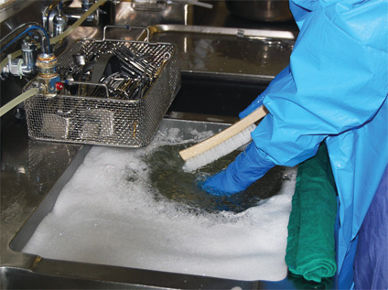
Cleaning instruments
Soak in enzymatic or non-enzymatic detergent
Wear the appropriate PPE
Keep instruments submerged in solution and use a long-handled brush when manually cleaning instruments
Notes:
Cleaning is the first step in all decontamination processes. Cleaning involves the manual physical removal of debris by scrubbing and using water with detergents or enzymatic or non-enzymatic cleaners, or by an automated process such as using washer-disinfectors or ultrasonic cleaners.
For manual cleaning, soak instruments in a rigid container filled with a detergent/disinfectant, enzymatic or non-enzymatic cleaner, or even plain water. This step prevents drying of patient material and makes cleaning easier and less time consuming. Manual cleaning requires a nearly neutral detergent. Enzymes (proteases, lipases, and amylases) are sometimes added to neutral pH detergent solutions to assist in removal of organic material. Enzyme detergents are cleaners, not disinfectants, and some disinfectants may inactivate enzymes. Neutral pH detergents that are compatible with medical instruments may be the best choice for cleaning, especially delicate instruments.
Other issues include:
Do not use high-level disinfectants/sterilants (e.g., glutaraldehyde) as instrument-holding solutions.
To avoid injury from sharp instruments, the provider should wear puncture-resistant, heavy-duty utility gloves (not patient care gloves), and proceed with care when handling or manually cleaning contaminated instruments and devices to avoid a percutaneous injury.
To protect against splashes, a facemask, eye protection or face shield, and a fluid resistant gown should be worn.
Submerge instruments in detergent solution and scrub with a long handled brush to avoid spattering.

Slide 14
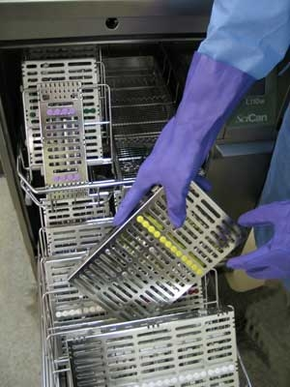
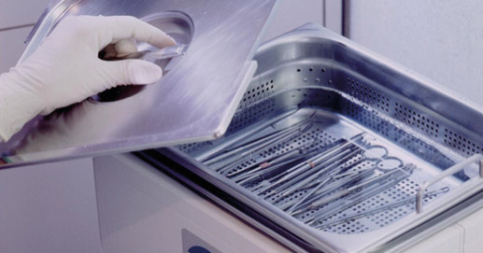
Automated Cleaning
Ultrasonic cleaner
Instrument washer
Washer-disinfector
Regulated by FDA
Household dishwasher NOT recommended
Notes:
Automated or mechanical cleaning equipment, such as ultrasonic cleaners, instrument washers, and washer-disinfectors are commonly used to clean instruments. Automated cleaners improve the efficacy of the cleaning process and reduce the handling of sharp instruments. A more alkaline detergent is generally used with mechanical equipment to compensate for the lack of friction used with manual cleaning. The manufacturer’s recommendations for dilution, temperature, water hardness, and use should be followed. After cleaning, instruments should be rinsed with water to remove chemical or detergent residue.

Slide 15
Preparation and Packaging
Critical and semi-critical items that will be stored should be wrapped before heat sterilization
Hinged instruments opened and unlocked
Place a chemical indicator inside the pack
Wear heavy-duty, puncture-resistant utility gloves
Notes:
After thorough cleaning and drying of instruments, critical and semi-critical instruments that will be stored before use should be wrapped prior to heat sterilization. This step protects items from contamination after the sterilization cycle and during storage.
Open or unlock hinged instruments so that all surfaces are exposed.
Place a chemical indicator inside each wrapped package. If the indicator cannot be seen from the outside, place another indicator (e.g., indicator tape) on the outside of the package.
Always wear heavy-duty, puncture-resistant utility gloves while inspecting and packaging instruments.

Slide 16
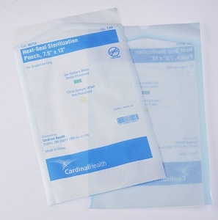
Packaging
Peel packs
Rigid containers
Self seal roll stock
Sterile wraps woven and non-woven
Compatible with sterilization method
Must be FDA approved
Notes:
There are several choices in products to maintain sterility of surgical instruments, including peel packs, rigid containers, roll stock that will self-seal to form a pouch, and woven or nonwoven sterile wraps. Healthcare facilities can choose any of these options. The packaging material must allow penetration of the sterilant, must be compatible with the type of sterilizer, must be puncture resistant and durable, and have FDA clearance.

Slide 17
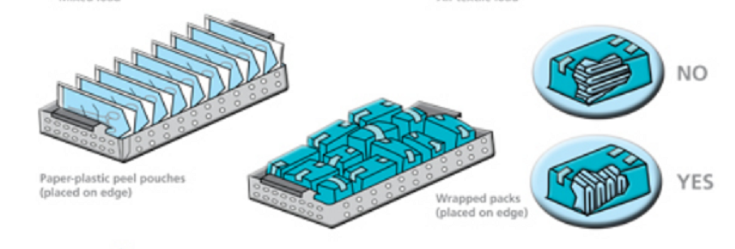
Loading
Place items/packages correctly and loosely into the sterilizer so as not to impede penetration of the sterilant
Peel packs and non-perforated containers (e.g., basins) should be placed on their edge
Notes:
All items to be sterilized should be arranged so that all surfaces will be directly exposed to the sterilizing agent. Thus the loading procedures must allow for free circulation of steam (or another agent) around each item. Due to the variety of textiles and containers on the market, the manufacturers of the sterilizer and wrap or container product should be consulted on pack preparation and density parameters.
There are several important basic principles for loading a sterilizer: allow for proper sterilant circulation; non-perforated trays (like basins) should be placed on their edge; small items should be loosely placed in wire baskets; and peel packs should be placed on their edge in perforated or mesh bottom racks or baskets.

Slide 18
Sterilization
The complete elimination or destruction of all forms of microbial life by either physical or chemical processes.
Notes:
After items are packaged, they are ready to undergo the sterilization process to achieve the complete elimination or destruction of all forms of microbial life by either physical or chemical processes.

Slide 19
Methods of sterilization
High Temperature Methods:
Steam sterilization
Dry Heat
Steam formaldehyde (chemiclave)
Low Temperature Methods:
Hydrogen peroxide gas plasma
Vaporized hydrogen peroxide
Ethylene oxide
Notes:
There are many different methods available to sterilize critical objects and they can be divided into high and low temperature methods. Most medical and surgical devices used in dental settings are made of materials that are heat stable and therefore primarily undergo steam sterilization.

Slide 20
Steam Sterilization
Advantages
Non-toxic
Cycle easy to control and monitor
Inexpensive
Rapidly microbicidal
Rapid cycle time
Least affected by organic/inorganic soils
Penetrates medical packing, device lumens
Notes:
Steam sterilization has several advantages over other types of sterilization processes. It is nontoxic. The cycle is easy to control and monitor with a significant safety margin. It is inexpensive, rapidly microbicidal and the process least affected by contamination with organic or inorganic soils. Finally, steam sterilization penetrates medical packaging and device lumens. For all these reasons, it is the first choice for use with heat tolerant medical instruments.

Slide 21
Steam Sterilization
Disadvantages
Deleterious for heat labile instruments
Inappropriate for heat-sensitive instruments
Inappropriate for moisture-sensitive instruments
  Dulling
  Rusting
Potential for burns
Notes:
There are several disadvantages of steam sterilization as well. Most seriously, steam sterilization will destroy heat or moisture–sensitive instruments and likely damage most heat labile instruments, which are often complex and very expensive. Even heat tolerant items may have dulling or rusting from the steam sterilization process. Another important disadvantage is the chance of burns when handling or removing the instruments from the sterilizer.

Slide 22
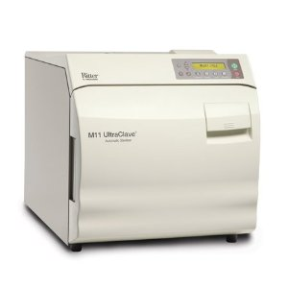
Steam Sterilization
Steam under pressure (autoclaving)
Gravity displacement
Pre-vacuum
Notes:
There are two types of steam sterilization methods commonly used in outpatient settings.
Steam under pressure (autoclaving). There are two types of tabletop steam autoclaves:
In most commonly used gravity displacement sterilizers, steam enters the chamber and unsaturated air is forced out of the chamber through a vent in the chamber wall.
In contrast, pre-vacuum sterilizers are fitted with a vacuum pump to create a vacuum in the chamber and ensure air removal from the sterilizing chamber and load before the chamber is pressurized with steam. This method improves the speed and efficiency of the sterilization process.
Dry heat sterilizers are either static air (convection or FDA-approved oven type) or forced air (rapid heat-transfer).
With all of these methods, always use FDA-approved devices and closely follow the manufacturer’s instructions for proper use.
Table top units should ideally have a printout for time and temperature.

Slide 23
Process times for packaged items
Method | Time (minutes) Does not include drying time | Temperature Range, °C (°F)
Steam autoclave Gravity Prevacuum | 30 15 4 | 121-123ºC (250-254°F) 132-135ºC (270-275°F) 132-135ºC (270-275°F)
Method | Exposure (minutes) | Temperature Range | Dry Time (minutes)
Steam autoclave Gravity Prevacuum | 30 4 | 121ºC 132ºC
Notes:
Each sterilization process method has time and temperature parameters that must be followed depending on the type of sterilizer.
With a gravity displacement autoclave, typical operating temperatures are 30 minutes at 121-123°C (250-254°F) and 15 minutes at 132-135°C (270-275°F).
Tabletop steam sterilizers, used most commonly in doctor’s offices and outpatient settings, are compact gravity displacement steam sterilizers that have a chamber volume of not more than 2 cubic feet and generate steam when distilled or deionized water is added.
The pre-vacuum sterilizer type, because of higher operating temperatures ranging from 132–135°C (270-275°F) and rapid removal of air, make for a shorter cycle time of 4 minutes.

Slide 24
Dry Heat Sterilization
Transfers heat energy from air inside the oven to the instruments
Requires higher temperatures 160-190°C (320º-375ºF)
Good for items that are likely to dull or rust in the autoclave,
Good for powders, cellulose and ink
Packaging must be able to withstand high temperatures
Notes:
Dry heat sterilizers work by transferring heat energy from air inside the oven to the instruments. The lack of vapor pressure requires higher temperatures to achieve sterilization.
Dry heat is good for items that are likely to dull or rust in the autoclave, and it is good for items like powders, cellulose or ink that require sterilization.
However, the packaging used must be able to withstand high temperatures to prevent an accidental fire or charring of contents that could happen inside the sterilizer.

Slide 25
Dry Heat sterilizer Types
Static Air
Heating coils in bottom of chamber
Natural convection as hot air rises in chamber
Takes 1-2 hours for sterilization at 160°C
Forced Air
Rapid heat transfer
Circulates heated air at high velocity throughout chamber
Reduces time to 6-12 minutes at 190°C
Notes:
Static Air type dry heat sterilizers works like an oven, with the heating element on the bottom of the chamber. As the air heats, it fills the chamber by natural convection. Heat energy is transferred from the static air to the instruments, and sterilization occurs after 1-2 hours at 160°C. The sterilization time may vary depending on the load, so spore testing of these units is very important to validate the proper exposure time under the conditions of actual use.
Forced Air dry heat sterilizers are often referred to as rapid heat transfer sterilizers. The sterilizer circulates the heated air at high velocity throughout the chamber. This circulation permits a more rapid transfer of heat energy from the air to the instruments, and reduces the amount of time needed for sterilization to 6-12 minutes at 190°C.

Slide 26
Unsaturated Chemical Vapor Sterilization
Hot chemical vapors (under pressure) kill microorganisms
Active ingredient: formaldehyde+
Vapors extremely irritating to eyes and lungs
Purge system and good ventilation essential
“Harvey” sterilizer or “Chemiclave”
No corrosion is instruments are dry
Must use packaging designed for chemical vapor sterilizers
Notes:
Unsaturated chemical vapor sterilization involves the heating of a special chemical solution in a closed chamber, producing a hot chemical vapor that kills microorganisms. The chemical solution is composed of formaldehyde and alcohols and is a strong irritant to the eyes, skin, and lungs. As such, the appropriate PPE should be worn and these sterilizer should only be operated a well ventilated room. A purge system should also be added to the sterilizer to collect the chemicals from the vapor at the end of the cycle.
Unlike steam and other wet sterilization methods, the positive feature of chemical vapor sterilization is that it greatly reduces or eliminates corrosion of steel instruments. Because the solution used rapidly vaporizes in heat, items processed through this type of sterilizer are essentially dry at the end of the cycle. As with all sterilization processes, it is essential that the packaging used to wrap instruments is compatible with the sterilization medium.

Slide 27
Liquid Chemical Sterilant/Disinfectants
Only for heat-sensitive critical and semi-critical devices
Powerful, toxic chemicals raise safety concerns
http://www.fda.gov/cdrh/ODE/germlab.html
http://www.fda.gov/MedicalDevices/DeviceRegulationandGuidance/ReprocessingofSingle-UseDevices/ucm133514.htm
Notes:
Heat-sensitive instruments that require sterilization or high-level disinfection can alternatively achieve this by soaking them in a liquid chemical sterilant cleared by the FDA. Exposure to these powerful and toxic chemicals can be harmful to healthcare provider and patients if the manufacturer’s instructions for use and safety precautions are not followed precisely. A list of the FDA cleared sterilants and high level disinfectants with label claims for reprocessing reusable medical devices is available at the web addresses on the screen.

Slide 28
Storage of Sterile Items
        Ensure the sterile storage area is a well-ventilated area that provides protection against dust, moisture, and temperature and humidity extremes.
          8 inches from the floor8
          5 inches from ceiling
          18 inches from ceiling if sprinkler head present
          2 inches from outside walls– 10 inches from floor
Sterile items should be stored so that packaging is not compromised.
Label sterilized items with a load number that indicates the sterilizer used, the cycle or load number, and the date of sterilization.
Notes:
Next we will review CDC recommendations for storage of sterile items.
The sterile storage area should be a well-ventilated area that provides protection against dust, moisture, and temperature and humidity extremes. Recommended instances from the floor, ceiling, and walls are outlined in the slide.
Store sterile items so the packaging is not punctured, bent or otherwise compromised. Closed or covered cabinets are preferred
Sterilized items should be labeled with a load number that indicates the sterilizer used, the cycle or load number, and the date of sterilization

Slide 29
Storage of Sterile Items
Event-related shelf life recognizes that the product remains sterile until an event causes it to become contaminated (e.g. moisture).
Packages should be evaluated before use for loss of integrity. Repack and reprocess if compromised.
Notes:
The shelf life of a packaged sterile item depends on the quality of the wrapper, the storage conditions, the conditions during transport, the amount of handling, and other events like exposure to moisture that compromises the integrity of the package. If event-related storage of sterile items is used, then packaged sterile items can be used indefinitely unless the packaging is compromised. Packages should always be inspected and evaluated before use for loss of integrity (e.g. torn, punctured, or wet).
Any package that has fallen on the floor must be inspected for damage to the packaging and contents. If the package is heat-sealed in impervious plastic and the seal is still intact, the package should be considered not contaminated. If undamaged, items in packaged plastic need not be reprocessed. If the integrity of the package is compromised, repack and reprocess the pack before use.

Slide 30
Recommendations
Methods of Sterilization
Cleaning removes salts and proteins and MUST precede sterilization.
Steam is preferred for critical and semi-critical items not damaged by heat
Follow the operating parameters recommended by the manufacturer
Use an “FDA cleared” container, wrapping or packaging system that is compatible with the type of sterilization process used
Use low temperature sterilization technologies for reprocessing critical and semi-critical items damaged by heat
Immediately use critical items that have been sterilized by liquid sterilants (e.g. peracetic acid) immersion process (no long term storage).
Notes:
Important recommendations when implementing sterilization are:
Instruments must be cleaned before being sterilized. Failure to remove salts and proteins on the surface of instruments can interfere with the sterilization process.
Steam is preferred for critical items that won’t be damaged by heat.
Follow the manufacturer’s operating parameters for the equipment or products used.
Use low temperature sterilization technologies for reprocessing critical and semi-critical items that may be damaged by heat.
Immediately use critical and semi-critical items that have been sterilized by an immersion in a liquid sterilant solution like peracetic acid. Do not store these items long term, because they are not wrapped for protection.

Slide 31
Monitoring the effectiveness
of your sterilization equipment
is essential!
Notes:
Monitoring the effectiveness of your sterilization equipment, procedures, and recordkeeping is essential for patient safety, and mandated by several regulatory agencies such as The Joint Commission, Centers for Medicare and Medicaid Services, and NC rule .0206.

Slide 32
Sterilization Monitoring
Physical - cycle time, temperature, pressure
Chemical - heat or chemical sensitive inks that change color when germicidal-related parameters reached
Biological - Bacillus spores that directly measure sterilization
Notes:
The sterilization procedure should be monitored routinely by using a combination of physical, chemical, and biological indicators to evaluate the sterilizing conditions and, indirectly, the microbiologic status of the processed items.
Physical monitors for steam include the daily assessment of cycle time and temperature by examining the temperature record charts or computer readout, and an assessment of pressure via the pressure gauge.
Chemical indicators usually are either heat or chemical sensitive inks that change color when one or more sterilization parameters (such as steam-time, temperature, and / or saturated steam) are present.
Biological indicators are recognized by most authorities as being the closest to the ideal monitors of the sterilization process because they measure the sterilization process directly using the most resistant microorganisms, Bacilllus spores, and not merely by testing the physical and chemical conditions necessary for sterilization.

Slide 33
Monitoring of Sterilizers
Internal Chemical Indicator
Validates the sterilant penetrated the pack or tray
Detect local problem
Notes:
Chemical indicators are convenient, inexpensive, and indicate that the item has been exposed to the sterilization process. Based on current studies, chemical indicators should be used in conjunction with biologic indicators, but should not replace them. While the chemicals indicate sterilization at marginal sterilization time, only a biologic indicator consisting of resistant spores can measure the microbial killing power of the sterilization process.
Chemical indicators are affixed to the outside of each pack to show that the package has been processed through a sterilization cycle. These indicators do not prove sterilization has been achieved – only that an item has been exposed to the sterilization process. A chemical indicator should also be placed on the inside of each pack to verify sterilant penetration.
Chemical indicators have been grouped into six classes based on their ability to monitor one or multiple sterilization parameters. If the internal or external indicator suggests inadequate processing, the item should not be used.
If using a pre-vacuum steam sterilizer, an air-removal test called the Bowie-Dick Test must be performed daily in the empty sterilizer to ensure air removal.

Slide 34
Biological Monitors
Steam - Geobacillus stearothermophilus
Dry heat - B. atrophaeus (formerly B. subtilis)
Ethylene oxide (ETO) - B. atrophaeus
Notes:
Use of a biological indicator is the only process that directly monitors the lethality of a given sterilization process. Spores used to monitor a sterilization process have demonstrated resistance to the sterilizing agent and are more resistant than the bioburden found on medical devices. Geobacillus stearothermophilus spores are used to monitor steam sterilization, hydrogen peroxide gas plasma , and liquid peracetic acid sterilizers. Bacillus atrophaeus (formerly known as Bacillus subtilis) are used to monitor ethylene oxide and dry heat.
Geobacillus stearothermophilus is incubated at 55-60°C and B. atrophaeus at 37°C.

Slide 35
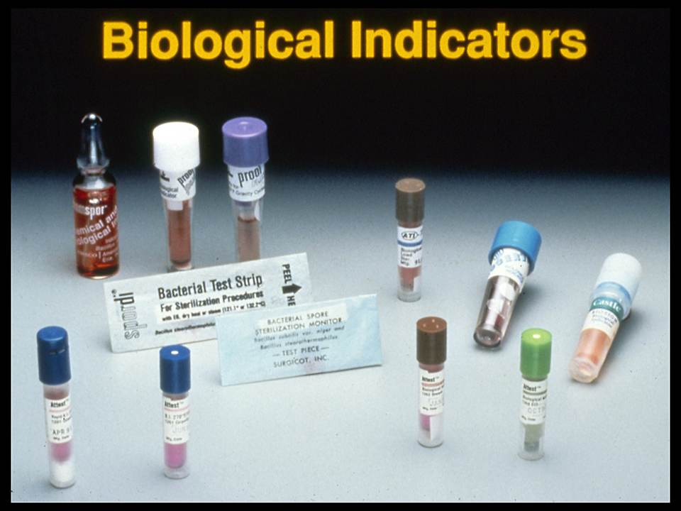
Notes:
An ideal biological monitor of the sterilization process should be easy to use, inexpensive, and not subject to exogenous contamination. In addition, an ideal biological monitor should provide positive results as soon as possible after the cycle so that corrective action may be accomplished. The biological monitor should provide positive results only when the sterilization parameters (such as steam-time, temperature and/or saturated steam, ethylene oxide time, temperature, relative humidity) are inadequate to kill microbial contamination.
Originally, spore strip biological indicators required up to 7 days of incubation to detect viable spores from marginal cycles. The next generation of biological indicators was self-contained in plastic vials containing a spore-coated paper strip and a growth media in a crushable ampoule. This indicator had a maximum incubation of 48 hours but significant failures could be detected in <24 hours. Rapid readout indicators have been available for more than 10 years, and have been shown to be comparable to that of the conventional biologic indicators. The rapid read indicators can be interpreted in 30 min. to 1 hour.
The standard biological indicator used for monitoring full-cycle steam sterilizers does not provide reliable monitoring of flash sterilizers. Biological indicators specifically designed for monitoring flash sterilization are now available, and studies comparing them have been published.

Slide 36
Recommendations
Monitoring of Sterilizers
Monitor each load with physical and chemical (internal and external) indicators.
Use biological indicators to monitor effectiveness of sterilizers at least weekly with spores intended for the type of sterilizer.
Use biological indicators for every load containing implantable items
Notes:
Steam and low temperature sterilizers (such as peracetic acid and hydrogen peroxide gas plasma) should be monitored at least weekly (with the appropriate commercial preparation of spores). Weekly biological monitoring is a requirement in the NC Rule .0206
If a sterilizer is used as frequently as several loads per day, daily use of a biological indicator allows for earlier discovery of equipment malfunctions or procedure errors, minimizing the extent of patient surveillance and product recall needed.
Each load should be monitored with a biological indicator if it contains an implantable object. If feasible, implantable items should not be used until the results of spore tests are known to be negative.

Slide 37
Recommendations
Monitoring of Sterilizers
Following a single positive biological indicator from steam sterilization:
Remove the sterilizer from service and review sterilizer instructions.
Retest the sterilizer.
If spore test negative, put the sterilizer back in service.
If the spore test is positive: do not use until it has been inspected; and recall (to the extent possible) all items processed since the last negative spore test; challenge in three consecutive empty sterilization cycles.
Single positive biological indicator (BI) from other than steam sterilization (e.g., dry heat sterilization)
Treat as non-sterile all items back to last load tested with negative indicator.
Retrieve items and reprocess.
Notes:
Since sterilization failure can occur about 1% of the time for steam sterilization, a procedure to follow in the event of positive spore tests has been provided by the CDC and the Association of Perioperative Registered Nurses. The positive spore test may occur for reasons such as slight variations in the resistance of the spore, or improper use of the sterilizer.
After a single positive biologic indicator test with steam sterilization, remove and retest the sterilizer. Objects other than implantable objects do not need to be recalled unless the sterilizer or the sterilization procedure is defective as determined by the maintenance provider or inappropriate cycle settings are identified. If additional spore tests remain positive, consider the items non-sterile and recall. Then reprocess the items from the implicated load(s).
If patient care items were used before retrieval, the infection preventionist should assess the risk of infection in collaboration with the physician, and if needed, consult an outside reprocessing specialist. The margin of safety in steam sterilization is sufficiently large that there is a minimal risk associated with items in a load that show spore growth, especially if the item was properly cleaned and the temperature was achieved as demonstrated by a chemical and readout chart.
After a single positive biological indicator occurs with a method other than steam sterilization, treat all items that have been processed in that sterilizer as nonsterile, dating from the last sterilization cycle with the negative biological indicator. Retrieve items and reprocess.

Slide 38
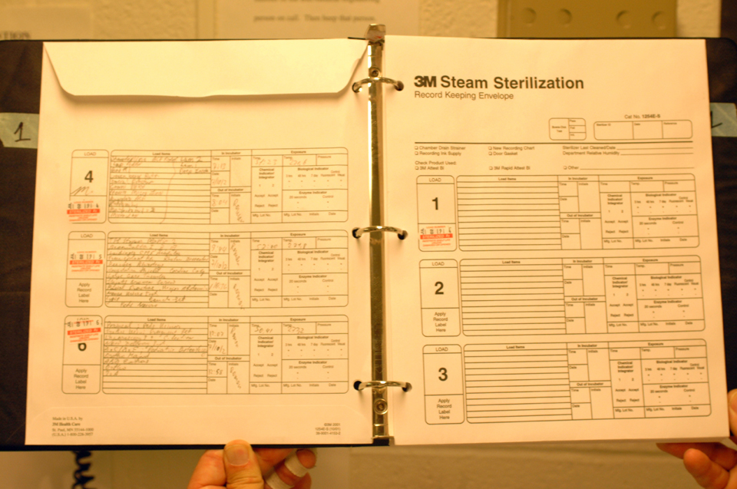
Record-Keeping
Notes:
As part of a quality control program, maintain sterilization records (physical, chemical and biological) for a time period that complies with statutes of limitations, and state and Federal regulations.
For each sterilization cycle, record the type of sterilizer and cycle used, the load identification number, the load contents, the exposure parameters such as time and temperature, the operator’s name or initials, and the results of physical, chemical, and biological monitoring.

Slide 39
Failure to Follow Disinfection and Sterilization Principles
What Do You Do?
Scenario:
Dental Office A discovered that for the past 3 days all surgical instruments were exposed to steam sterilization at 132ºC for 0 minutes rather than the intended 4 minutes. A technician turned the timer to 0 minutes in error.
Notes:
As we stated earlier, things can often go wrong when reprocessing medical devices. When sterilization failures occur or there are shortcuts taken during the process, outbreaks can occur. The next slides will describe what to do in the event that a failure occurs.
In this scenario, Dental Office A discovered that 3 days of surgical instruments were never exposed to sterilization temperatures. They found that this occurred do to a technician turning a knob that set the exposure time to 0 minutes, instead of 4 minutes.
What is the correct protocol?

Slide 40
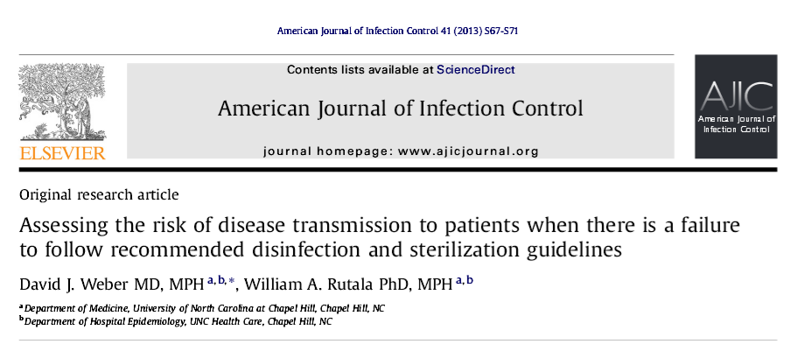
American Journal of Infection Control 41 (2013) S67-S71

Slide 41
Steps in the event of
Disinfection and Sterilization failure
Confirm failure of disinfection or sterilization reprocessing
Immediately embargo any possibly improperly disinfected/sterilized items
Do not use the questionable disinfection/sterilization unit (sterilizer, automated endoscope reprocessor) until proper functioning has been assured.
Inform key stake holders (risk management, management, lawyers)
Conduct a complete and thorough evaluation of the cause of the disinfection/sterilization failure
Prepare a line listing of potentially exposed patients
Assess whether the disinfection/sterilization failure increases a patient’s risk for infection
Inform an expanded list of stakeholders of the reprocessing issue
Develop a hypothesis for the failure and initiate corrective actions
Develop a method to assess potential adverse patient events
Consider notification of appropriate state and federal authorities (health department, FDA)
Consider patient notification
If patients are notified, consider whether such patients require medical evaluation for possible post exposure therapy with appropriate anti-infectives, as well as follow-up and detection of infections (HIV, Hepatitis B and C) if warranted.
Develop a detailed plan to prevent similar failures in the future
Write after-action report.
Notes:
Although exposure events because of possible failures of disinfection or sterilization are often unique, it is important to approach the evaluation of potential reprocessing failures using a standardized approach. As with evaluation of microbial outbreaks, you must be prepared to assess the unique aspects of each possible disinfection or sterilization failure by adapting the recommended sequence of 15 steps that form a general approach to the evaluation of a possible failure of disinfection or sterilization that could result in patient exposure to an infectious agent.
These are typically very stressful for all those involved, but the goal is to systematically assess the failure and to protect patients from further exposure. Throughout the process, communication among key stakeholders is very important. It is also important and ethical to notify patients if there is a risk-be upfront and factual. Once the failure has been assessed, it is important to retrain staff and modify processes and practices to minimize recurrence.

Slide 42
Recommendations for
Quality Control
Provide comprehensive and intensive training for all staff assigned to reprocess medical/surgical instruments
To achieve and maintain competency:
  Staff receive hands-on training
  Work with supervision until competency is documented
  Competency testing should be conducted at commencement of employment and regularly
  Review written reprocessing instructions to ensure compliance
Notes:
Healthcare providers assigned to reprocess critical or semi-critical instruments should receive comprehensive, device-specific training as needed to ensure compliance with proper cleaning and high-level disinfection or sterilization. Competency testing should be performed and documented at least annually, or more often if new devices are introduced. New and temporary employees should not be allowed to reprocess devices independently until competency has been established.

Slide 43
Recommendations for Quality Control
Conduct infection control rounds periodically
Establish a maintenance contract and record of service.
Ensure protocols equivalent to guidelines from professional organizations
Consult Association for the Advancement of Medical Instrumentation (AAMI) and/or manufacturer for preparation and packing of items
Notes:
As part of the quality control program, conduct infection control rounds at least annually in high risk reprocessing areas ( like Gastroenterology or Endoscopy Clinics) to ensure reprocessing instructions are current, accurate and correctly implemented.
Include a sterilizer maintenance contract with records of service, a system of process monitoring, visual inspection of packing materials, and traceability of load contents. Perform preventive maintenance on sterilizers by a qualified healthcare provider who is guided by the manufacturer’s instructions.
Periodically review policies and procedures for sterilization to ensure that they are current and consistent with guidelines.
Consult the Association for the Advancement of Medical Instrumentation and/or the manufacturer for correct preparation and wrapping of materials that may be used with the sterilizer.

Slide 44
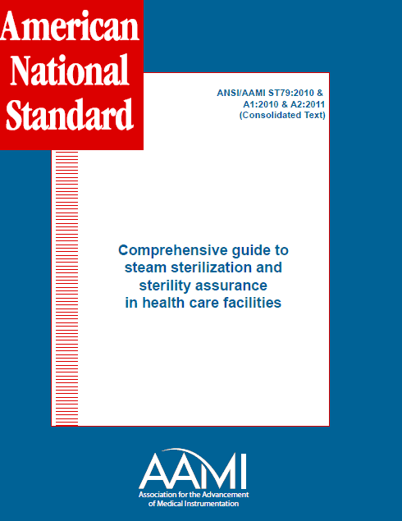
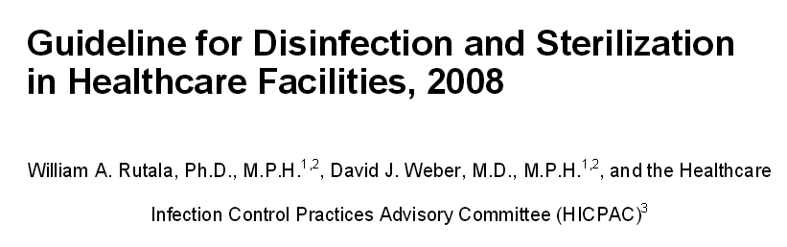
Resources
Notes:
For more information on the topics discussed in this module, refer to the resources listed on the slide. You have completed this module. You are ready to continue to the next module, Application of Cleaning, Disinfection and Sterilization Principles to Patient Equipment in Outpatient Healthcare Settings.

Slide 45
Thank You

