Slide 1

Changes to 10A NCAC 41A .0101
May 5, 2018

Slide 2
Changes to 10A NCAC 41A .0101
Changes to include:
  Carbapenem-resistant Enterobacteriaceae (CRE) – 24 hours
  Candida Auris – 24 hours
Reporting will:
  Facilitate early detection, rapid response and containment
  Prevent transmission
  Provide data to develop and implement prevention and control measures
Contain
Prevent
Detect

Slide 3
What to Report?
Identification of CRE from a clinical specimen associated with either infection or colonization, including all susceptibility results and all phenotypic or molecular test results.

Slide 4
For the purposes of reporting, Carbapenem-Resistant Enterobacteriaceae (CRE) are defined as:
(1) Enterobacter spp, E.coli or Klebsiella spp positive for a known carbapenemase resistance mechanism or positive on a phenotypic test for carbapenemase production; or
(2) Enterobacter spp, E.coli or Klebsiella spp resistant to any carbapenem in the absence of carbapenemase resistance mechanism testing or phenotypic testing for carbapenemase production.

Slide 5
Criteria to Distinguish a New Case from an Existing Case:
Different organisms/species/carbapenemases are counted as separate events from other organisms/species/carbapenemases.
There is at least a 12-month interval from previous notification event for clinical cases.
A person with a clinical case should not be counted as a screening/surveillance case thereafter (e.g., patient with known infection who later has colonization of GI tract is not counted as more than one case).
A person with a screening case can be later categorized as a clinical case (e.g., patient with positive peri-rectal screening swab who later develops blood stream infection would be counted in both categories).

Slide 6
When should organisms be sent to the State Laboratory of Public Health?
Enterobacter spp., E. coli or Klebsiella spp. resistant to any carbapenem in the absence of carbapenemase resistance mechanism testing
When feasible, Enterobacter spp., E. coli or Klebsiella spp. resistant to any carbapenem and positive for carbapenemase production via phenotypic test
If your facility identifies an isolate with discordant phenotypic and molecular results for carbapenemase production
*If the facility is appropriately using recognized testing methods isolates testing positive for a known carbapenemase resistance mechanism do not need to be routinely sent to the State Laboratory of Public Health.*

Slide 7
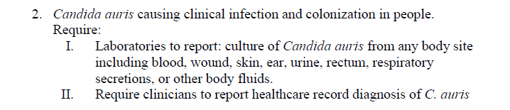

Slide 8
Investigation and Response
Goal: contain or slow spread of novel or rare multidrug-resistant organisms or mechanisms

Slide 9
CRE Case Investigation: Goals
Identify if transmission is occurring
Identify affected patients
Ensure appropriate control measures are promptly implemented
Characterize the organism
Notes:
guide further response actions, patient management, and future response efforts

Slide 10
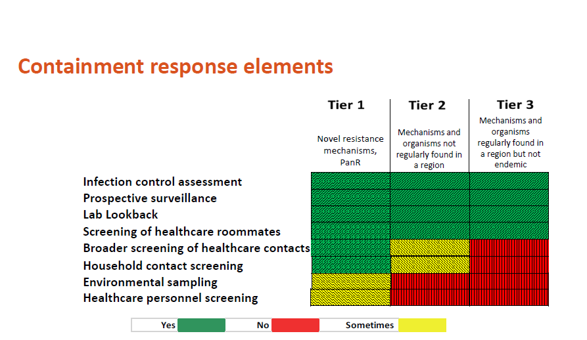

Slide 11
What NC DPH is doing:
Detect MDROs
  Increased awareness
  Rule change
  Testing at SLPH
  Colonization screening
Ensure rapid response & containment
  Systematic response to even single cases
  Infection prevention assessments
  Inter-facility communication
  Screening for colonization
Stewardship efforts
  Antimicrobial resistance subcommittee
  Get Smart Campaign
Education
Notes:
Early detection and aggressive implementation of infection prevention and control strategies are necessary to prevent further spread of CRE, especially novel CP-CRE. These strategies require an understanding of the prevalence or incidence of CRE. Public Health authorities must be notified promptly when cases of CRE are detected in order to contain CRE.
National priority→ now nationally notifiable
ARLN
Position statement
Many states have made CRE reportable

Slide 12
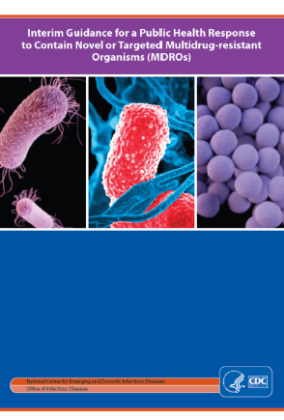
Containment resources:
Management of Multidrug Resistant Organisms in Healthcare Settings, 2006 https://www.cdc.gov/hicpac/mdro/mdro_toc.html
Interim Guidance for a Public Health Response to Contain Novel or Targeted Multidrug-resistant Organisms (MDROs)
https://www.cdc.gov/hai/outbreaks/docs/Health-Response-Contain-MDRO.pdf
NC DPH CRE information for Long-Term Care Facilities http://epi.publichealth.nc.gov/cd/hai/docs/CREinfoLTCfacilities.pdf
Antimicrobial Stewardship http://epi.publichealth.nc.gov/cd/antibiotics/campaign.html
NCHAI@DHHS.NC.GOV

