Slide 1
Use of an interfacility transfer form to prevent MDROs across the continuum of care
May 4, 2018
Katie Steider, HAI Epidemiologist

Slide 2
Overview
Communication between healthcare facilities
Multidrug-resistant organisms (MDROs)
NC DPH Interfacility Transfer Form pilot
Notes:
To begin, I will briefly talk about communication between healthcare facilities. Then, I will give a broad overview of multidrug-resistant organisms, or MDROs, which is a focus of the SHARPPS Program. Then I will review the interfacility transfer form my program developed and describe the results of the pilot of the form we conducted. There will be time at the end of the presentation for questions and discussion.

Slide 3
Communication between Healthcare Facilities
Useful
Patient status/needs
Care plan
Required by CMS
Reform of Requirements for Long-Term Care Facilities
(proposed) Revisions to Requirements for Discharge Planning for Hospitals, Critical Access Hospitals, and Home Health Agencies
Notes:
I think we can all agree that communication between healthcare facilities during patient transfer and discharge is useful. For example, this communication allows the transferring and receiving facilities to discuss a patient’s current status and ongoing needs as well as the patient’s care plan. This can assist the determination as to whether or not a receiving facility will be able to effectively maintain a patient’s level of care.
Communication between healthcare facilities during patient transfer and discharge is also required by CMS. Two examples of such requirements are the Reform of Requirements for Long-Term Care Facilities and a proposed rule, Revisions to Requirements for Discharge Planning for Hospitals, Critical Access Hospitals, and Home Health Agencies. Both of these rules define the minimum information that must be communicated to a receiving facility about a patient at the time of transfer or discharge.

Slide 4
Multidrug-resistant Organisms (MDROs)
Resistant to several kinds of drugs
Intra- and inter-facility spread
Vulnerable patients at risk for infection
Infections are difficult to treat and can be associated with high mortality rates
Examples: CRE, ESBL
Notes:
One of the missions of the SHARPPS Program is to prevent the spread of multidrug-resistant organisms, or MDROs, and antimicrobial resistance.
Multidrug-resistant organisms, or MDROs, are germs that have become resistant to several kinds of drugs that are normally used to treat them.
Because MDROs can be spread from person to person, there is the opportunity for spread within and between facilities by the transfer of patients either infected or colonized with a MDRO. Colonized individuals can spread MDROs to others even though they don’t have any symptoms.
Vulnerable patients may be more likely to contract a MDRO because they are more prone to infection due to increased age and additional comorbidities and healthcare exposures/devices.
Resistance to drugs can make infections with these organisms difficult to treat, which could increase associated morbidity, mortality, and cost of care. For example, mortality rates up to 50% have been reported for blood infections caused by a type of MDRO called carbapenem-resistant Enterobacteriaceae, or CRE. In today’s presentation, I will discuss a recent community wide outbreak of CRE as well as another type of MDRO known as extended-spectrum beta-lactamase producing organisms, or ESBLs.

Slide 5
Benefits of Interfacility Communication Re: MDROs
Protects patients/residents
Contains healthcare costs
Prevents the spread of MDROs
Notes:
Appropriate and timely communication with transferring facilities has been recommended to prevent the spread of MDROs and antimicrobial resistance by CDC and several professional organizations, including the Society for Healthcare Epidemiology of America, the Infectious Diseases Society of America, and the Council of State and Territorial Epidemiologists.
As I just mentioned, MDROs can cause deadly infections in patients and residents. These infections can be costly for healthcare facilities and patients. Communicating the MDRO status of patients during transfer can prevent the spread of MDROs within and between healthcare settings, thereby promoting patient safety and decreasing costs.

Slide 6
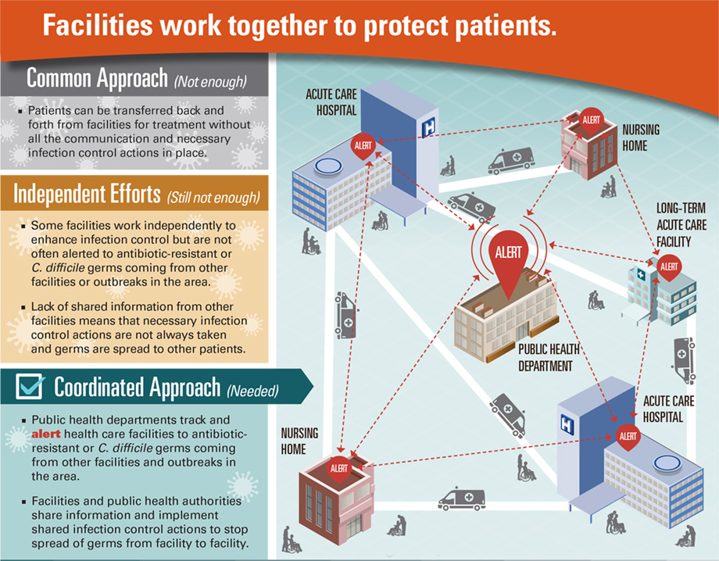
Part of a Coordinated Approach to MDRO Prevention
Notes:
Communicating MDRO status during interfacility transfers is part of a coordinated approach to MDRO prevention. Coordinated approaches to MDRO prevention are necessary to make sure that patients are protected across the continuum of care. Patients are protected when appropriate infection control measures, such as strict hand hygiene and contact precautions, are used during care of a patient who is colonized or infected with a MDRO across the continuum of care.

Slide 7
Coordinated Approaches Prevent MDROs
Notes:
Modeling studies have shown that a coordinated approach to MDRO prevention will decrease the burden of MDROs in communities compared to using common approaches, or independent efforts.
More patients get infections when facilities do not work together, increasing morbidity, mortality, and overall healthcare costs.

Slide 8
NC DPH Interfacility Transfer Form
Developed with input from examples from CDC, state health departments, quality improvement organizations, regulatory agencies
Fillable PDF that autofills in duplicate
Instructions for use
Notes:
The approach that the SHARPPS Program took to facilitate interfacility communication about MDROs was to develop a comprehensive NC DPH Interfacility Transfer Form. The form was developed with input from examples from CDC, state health departments, quality improvement organizations, and regulatory agencies.
The form is a one page form that can be completed by hand and copied. It is also a fillable PDF that can be saved with patient information and printed at a later date. The fillable form autofills in duplicate for a copy to be provided to transport services and the receiving facility.
Instructions for use of the form are also provided.

Slide 9
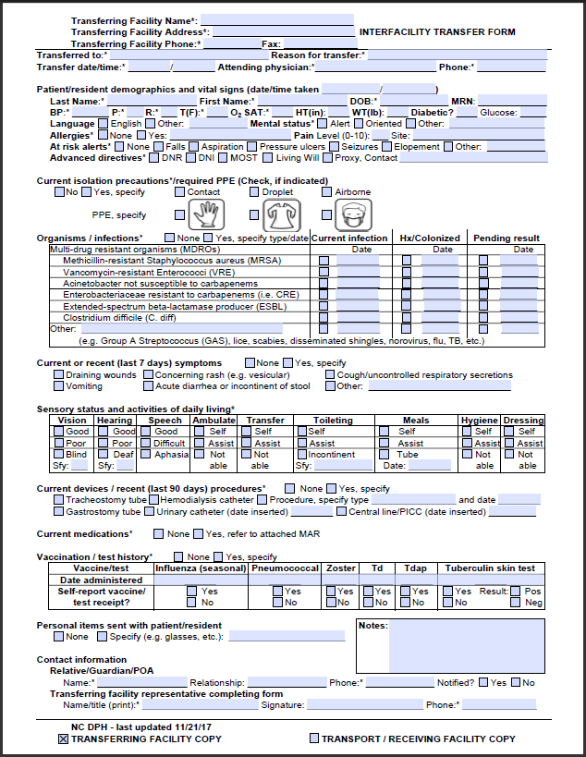
Sections
Transferring facility info
Transfer info
Pt. demographics and VS
Current isolation precautions
Organisms/infections
Current/recent sx.
Sensory status and ADLs
Current devices/recent procedures
Current meds
Vaccination/test hx.
Personal items
Contact information
Notes:
The interfacility transfer form contains several sections. These sections include:

Slide 10
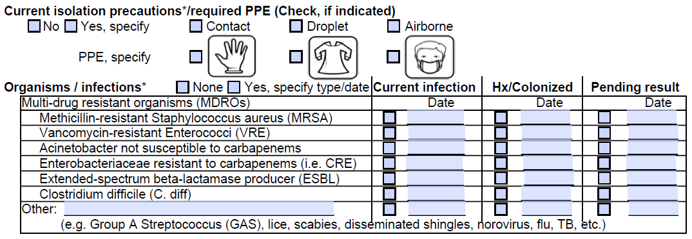
Highlight – Current Isolation/PPE, MDROs
Notes:
I would like to highlight two sections of the form that are sometimes missing from existing transfer forms but are integral to the prevention of MDROs. The current isolation precautions and required PPE section clearly identifies if a patient is currently on isolation precautions (contact, droplet, or airborne) and the type of PPE necessary (gloves, gown, and/or mask). The organisms and infections section describes current or previous infection with a MDRO, if the patient is colonized with a MDRO, or if a lab result is pending for a MDRO. This information is especially useful in determining the type of care a patient should receive and how to prevent the spread of MDROs in a facility.

Slide 11
NC DPH Interfacility Transfer Form
Benefits
Standardized format for interfacility communication of patient MDRO status during transfer
Information needed/desired during transfer all in one place
Complies with Reform of Requirements for Long-term Care Facilities (CMS)
Notes:
The NC DPH interfacility transfer form has several benefits. It offers a standardized format for interfacility communication of patient MDRO status during transfer. Information that is needed or desired during transfer is all in one place; there is no need for an extra form to fill out or to dig through a discharge summary.
The form can also serve as a checklist for what information should be communicated when preparing for transfers/discharges and at the time of transfer/discharge.
The benefit we highlighted for the long-term care facilities that participated in the pilot was that it contained the minimum information required at transfer according to the CMS Reform of Requirements for Long-term Care Facilities.

Slide 12
NC DPH Interfacility Transfer Form Pilot
Apr. 2017
May 2017
Jun. 2017
Aug. 2017
Oct. 2017
Nov. 2017
Sept. 2017
Jul. 2017
Interfacility transfer form pilot
IP notices increase in ESBL cases since Oct. 2016; notifies LHD
LHD requests assistance from SHARPPS Program
Site visits to facilities
Infection prevention and MDRO training
Pilot meeting with facilities
Follow up site visits
Pilot meeting with facilities
Notes:
The SHARPPS Program had been thinking about an interfacility transfer form for a while and was looking for an opportunity to pilot the new form.
That opportunity came in April 2017 when an astute infection preventionist at an acute care hospital notified the local health department that they were seeing an increase in lab results that were positive for ESBLs, a type of MDRO. The local health department approached the SHARPPS Program about the increase and what was originally thought to be only a few cases became over 40 cases over the weekend. This was a community-wide outbreak of ESBL and CRE. The majority of cases were in 3 long-term care facilities, so the SHARPPS Program and the local health department conducted site visits at these facilities. In addition to multiple infection prevention deficiencies, facilities did not routinely use an interfacility transfer form.
The SHARPPS Program contacted 12 healthcare facilities and 2 transport services in the county to participate in an interfacility transfer form pilot and conducted meetings in June and July. An infection prevention and MDRO training was held for facilities in August and the pilot was officially launched in August and continued until November.

Slide 13
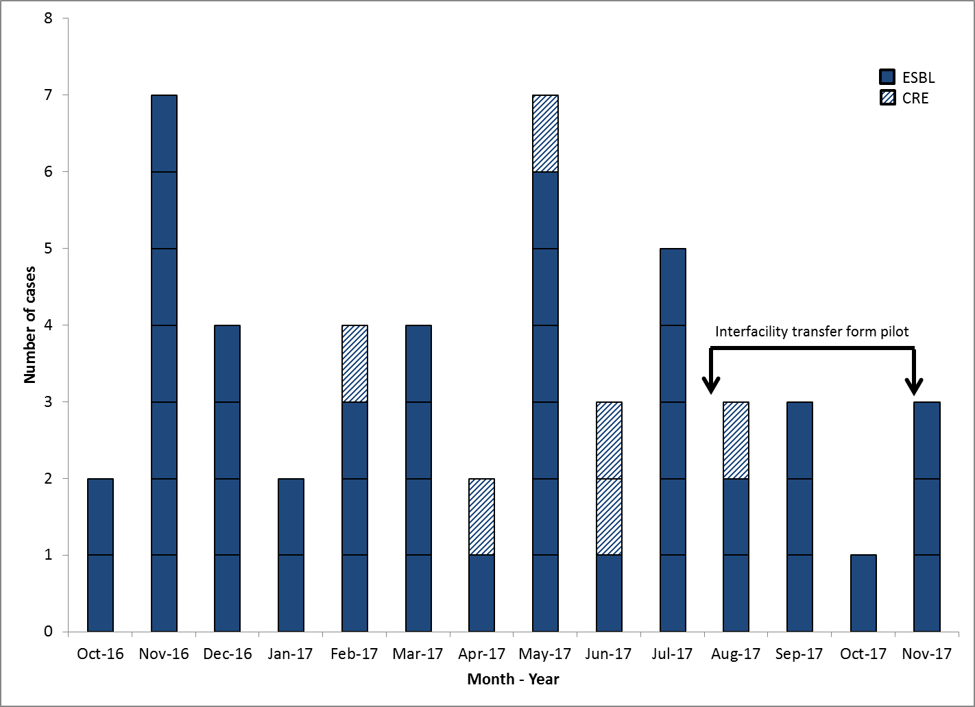
MDRO Outbreak in LTCFs
Notes:
This figure shows the number of new ESBL cases (in dark blue boxes) and CRE cases (in lined boxes) detected in a resident of a long-term care facility in county X between October 2016 and March 2017. This is part of the increase that the infection preventionist observed and prompted her to notify the local health department.

Slide 14
MDRO Outbreak in LTCFs
Notes:
This figure shows the number of cases from April until July 2017 which is before the launch of the pilot. Still seeing an increased number of cases.

Slide 15
Pilot Activities
Preparation
Facility recruitment
Stakeholder meetings
Pilot
Focus groups
Management
Front-line staff
Notes:
The pilot project involved preparation, which included recruiting facilities and holding meetings with stakeholders, in addition to the actual pilot of the interfacility transfer form. After the pilot was completed, focus groups with management and front-line staff were conducted to evaluate the interfacility transfer form.

Slide 16
MDRO Outbreak in LTCFs
Notes:
This figure shows the end of the outbreak. As I mentioned previously, the SHARPPS Program and the local health department worked extensively with facilities to stop this outbreak. The interfacility transfer form was only part of that effort. However, during the months in which the interfacility transfer form was being piloted, the number of cases in facilities did level off. This supports the conclusion that standardized interfacility communication about MDROs county-wide prevents the spread of MDROs.

Slide 17
Focus Group Feedback - Benefits
Identified patients:
With history of MDRO colonization or infection
On isolation precautions and appropriate PPE
Initiated isolation precautions in ambulance and ED
Patient placement based on isolation status
Identified patient needs/baseline status
Assisted in completing other transfer paperwork
Created awareness that certain information should be communicated during transfer/discharge
Notes:
When we spoke with facility representatives during focus groups, they described benefits of the form that help prevent MDROs. For example, the form helped facility staff identify patients with a history of MDRO colonization or infection or who needed to be placed on isolation precautions. A major success of the pilot was that participants initiated isolation precautions and PPE in the ambulance and the emergency department. Facilities used isolation status information to place patients in appropriate rooms on arrival to the receiving facility. Participants said the form helped receiving providers quickly identify patient needs/baseline status and assisted with completing other transfer paperwork. Participants felt using the form helped create an awareness of what information should be communicated during transfer and discharge and served as a reminder for staff.

Slide 18
Questions and Discussion
Interfacility transfer form available from the NC SHARPPS Program webpage: http://epi.publichealth.nc.gov/cd/hai/providers.html.
Please email nchai@dhhs.nc.gov with questions or for more information.
Notes:
Representatives that participated in the pilot, including individuals at an acute care hospital, reported that using a standard interfacility transfer form county-wide was beneficial in communicating information clearly and efficiently between different healthcare facilities. This collaborative approach to interfacility communication reflects CDC recommendations for managing MDROs in healthcare settings and combating antibiotic resistance. To that end, the SHARPPS Program encourages any efforts to standardize interfacility communication between healthcare facilities.
The interfacility transfer form and instructions are available from the SHARPPS Program webpage. We invite any healthcare facility who would like to use the form to do so.
Thank you for your time and attention today.

Slide 19
Contact
Katie Steider, MPH, CPH
katie.steider@dhhs.nc.gov
919-546-1712

Slide 20
Pilot Toolkit – an Important Resource
Tools
Letter of Introduction
Implementation Plan
Suggested Implementation Strategies
Project Charter
Pre-implementation Questions
Training Checklists and Sign-in Sheet
Fax Cover Sheet
References
List of Participating Partners
Submission Schedule
Interfacility Transfer Form Instructions
Notes:
A Pilot Toolkit that was sent out to participating organizations included many tools to assist with pilot activities and forms that were required to be submitted in order to track the progress of the pilot.
The Pilot Toolkit is being finalized for public dissemination.

