Slide 1
PHIT Force: Various DPH Issues
James Lewis
Communicable Disease Branch
North Carolina Division of Public Health
5/10/2019

Slide 2
Overview
C auris/CRE screening
Candida identification
Expanded AST available through ARLN
CRE Surveillance update
SIR calculation error on CDC website
Antibiotic use reporting potential requirement
Travel screening: Ebola and Measles

Slide 3
ARLN Services: C auris/CRE screening
Outbreak/Sentinel event
Roommate
Point Prevalence
Travel:
Overnight Healthcare outside US
CRE screening:Cepheid PCR on rectal swabs
Double tipped, rayon/Eswab compatible with Cepheid
https://health.maryland.gov/laboratories/Pages/ARLNHome.aspx#CRE
C auris screening: PCR on composite axillary/groin swab
Rayon tipped/nylon flocked swab
https://www.cdc.gov/fungal/candida-auris/recommendations.html
https://health.maryland.gov/laboratories/Pages/ARLNHome.aspx#CRE

Slide 4
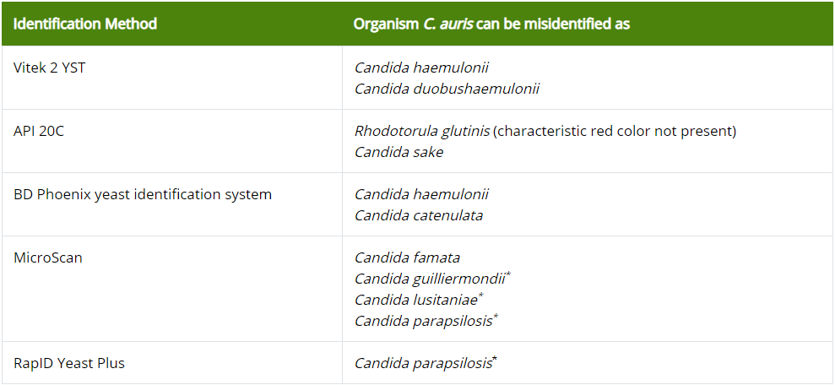
ARLN Services: Candida speciation
Commonly misidentified candida:
https://www.cdc.gov/fungal/candida-auris/recommendations.html

Slide 5
ARLN Services: Expanded AST testing
Hewlett-Packard D300e printer pilot project
https://www.cdc.gov/drugresistance/solutions-initiative/innovative-hp-resistance-testing.html
Can test novel drug combinations (i.e. aztreonam-avibactam)
Year long project
4 labs
Tennessee State Public Health Laboratory, Wisconsin State Laboratory of Hygiene, Minnesota Department of Health Public Health Laboratory, and Wadsworth Center Laboratories
ARLN/DPH gate keepers
Goal 3 day turn around from day of request
“Pan-resistant” MBLs (NDM/IMP/VIM)

Slide 6
ARLN Services: Expanded AST testing

Slide 7
CRE Surveillance

Slide 8
Surveillance in NC
Mar. 2015 – Sep. 2016
Sentinel site surveillance
Nov. 2016 – June 2017
Accepted isolates, no active site recruitment
July 2017 –September 2018
Targeted recruitment for sentinel surveillance, special projects and outbreak response
October 2018 – Present
Reportable, routine surveillance statewide, special projects and outbreak response
Notes:
Sentinel surveillance was occurring long before we made CRE reportable.

Slide 9
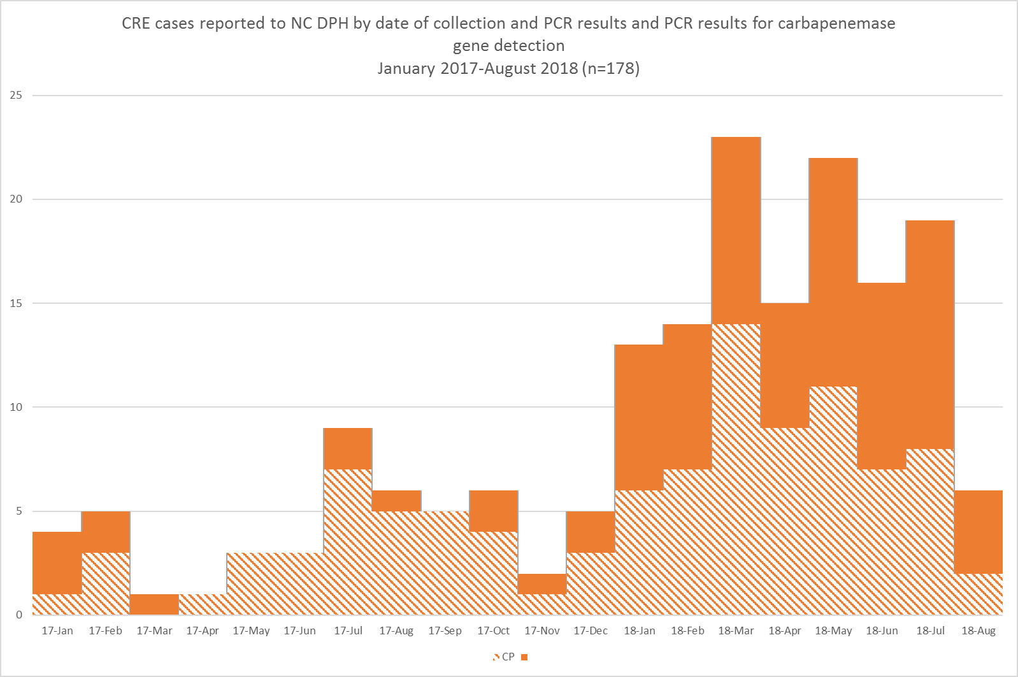
*Excludes duplicate CRE (Same Carbapenemase/organism; repeat clinical isolates in a 12 month period; screening results subsequent to a clinical result)
Notes:
Since we used a different case definition and recruitment strategy during the initial wave of sentinel surveillance, I’m showing here only data from 2017 to present.
We receive an average of 9 CRE isolates per month (median 6) between January 2017 and August 2018 but as you can see, the number of submissions has grown overtime (as we’ve recruited more facilities for sentinel surveillance). Just over half of all isolates test positive for carbapenemase production.

Slide 10
Sentinel Surveillance
57%
of reported CRE reported to NC DPH
are carbapenemase producing

Slide 11
Sentinel Surveillance
~10 CRE per month

Slide 12
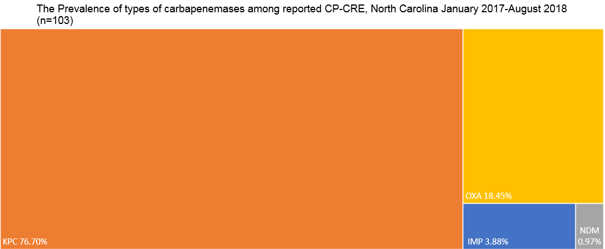
Sentinel Surveillance
OXA-48 18.45%
KPC 76.70%
IMP 3.88%
NDM <1%
Notes:
The majority of CP-CRE detected were KPC. In 2017 we saw our first IMP case. In 2018, we saw our first OXA-48 case.

Slide 13
CRE Surveillance Since October 1, 2018
Updated: February 8, 2019

Slide 14
52% of isolates submitted to the state lab are CP-CRE
97% KPC
0.9% NDM
1.9% OXA-48

Slide 15
Surveillance
~50 CRE per month

Slide 16
Notes:
Since CRE became reportable (October 1, 2018) we’ve seen KPC, OXA-48, and NDM carbapenemases.

Slide 17
Notes:
The majority of isolates tested at the State Lab are Klebsiella spp. KPC is most likely to be detected in a Klebseilla spp but can be detected in E. coli and Enterobacter spp.

Slide 18
As of 2019, NC has seen all 5 carbapenemases
2.5%
0.8%
0.3%
49%
0.1%
Notes:
As of 2019, North Carolina has detected all five carbapenemases. KPC accounted for 49% of all isolates tested at the State Lab.

Slide 19
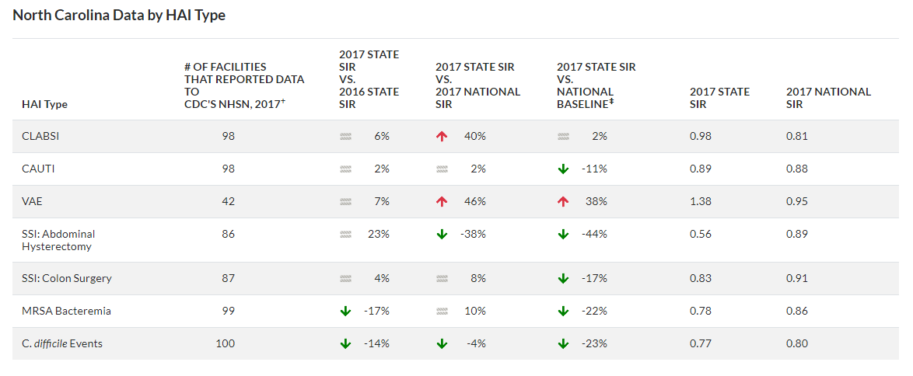
NHSN SIR Calculation error
https://gis.cdc.gov/grasp/PSA/HAIreport.html

Slide 20
NHSN SIR Calculation error
Correct calulation:
(│National SIR – NC SIR │)/National SIR = (0.81-0.98)/0.81 = 0.21 ≠ 0.40
CDC Calulation:
│National SIR – NC SIR/National SIR│
Order of operations = multiplication, division, addition, subtraction
So this comes to │0.81 – 0.98/0.81 │ = │ 0.81 – 1.21 │= 0.40
In short I assume someone forgot to add parentheses in their coding
Being addressed
Same across all states 2016 & 2017 numbers
CLABSI Only

Slide 21
Antibiotic Use reporting
What information did you hear?
No active pursuance of AU reporting in NC at this time
Will likely be required at some point but a requirement is likely at least 3 years out I would imagine
BUT…Its strongly encouraged ☺
Ideally would be through NHSN AUR module
https://www.cdc.gov/nhsn/acute-care-hospital/aur/index.html

Slide 22
Antibiotic Use reporting
From QIN-QIO National LAN Event 5/9/19
Asked about national requirement
“We will see what happens”
We would like to pursue a State requirement like MO/TN

Slide 23
Travel Screening: Ebola and measles
Should hospitals consider heightened surveillance for measles and Ebola (e.g., travel to an endemic state or country-Congo)?
We continue to suggest that hospitals ask about travel history, regardless of circulating or emerging diseases as this can be useful in forming differential diagnoses, determining need for pre-emptive isolation precautions or screening, etc. At the moment, we are not suggesting that hospitals ask specifically about measles or Ebola exposure, but these outbreaks do highlight the importance of ongoing travel screening.
Thus far, the ongoing Ebola outbreak in DRC has been identified as posing high risk regionally but a low risk globally. As I’m sure you are, we are carefully monitoring the situation and will revise recommendations as needed. Since the beginning of the year, we have been working with one NGO to repatriate HCWs providing care in the Ebola-affected areas of DRC. We have worked specifically with this NGO and partners to coordinate care if needed. To date, all returning travelers have been classified as having no known risk of exposure to Ebola.

Slide 24
Travel Screening: Ebola and measles
Ebola and patient triage - would a patient with symptoms and travel history suspicious of Ebola in NC go to the closest hospital for care or to an identified health care facilities with unique capabilities for managing the patient (if so, where)?
The Healthcare Preparedness Program within OEMS is working with 8 major medical centers (regional trauma centers) to assure preparation and ability to provide care as an Ebola Assessment Center. It is our expectation that patients with concerning symptoms and potential exposure to Ebola would be routed to one of these facilities for initial assessment if at all possible.

Slide 25
Travel Screening: Ebola and measles
Summary:
Maintain situational awareness
If a case presents concerning for measles or Ebola we would appreciate a call and will be of assistance
919-733-3419 – Epidemiologist on call 24/7
Concerning patients would ideally be routed to one of the 8 regional trauma centers. If needed can likely arrange for transfer from there to Emory or NIH for further treatment.
Ideally would be aware ahead of time and direct patients to care with pre-notification of the facility, but not always possible.

Slide 26
Measles Clinician memo 5/7/19

Slide 27
Questions?
James Lewis
James.w.lewis@dhhs.nc.gov
919-546-1641

