Slide 1
Environmental assessment in a local health department
“Come Along for the Tour”

Slide 2
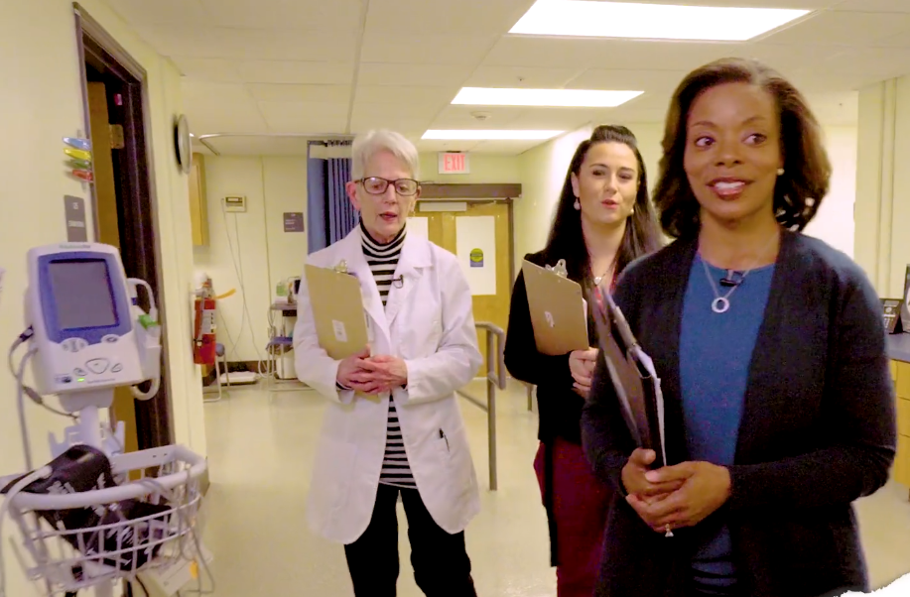
Introduction
An organization’s physical environment is integral to its ability to prevent and control infection.
Environmental rounds provides valuable information about your building, its furnishings and equipment as well as staff practices.

Slide 3
Introduction cont’d
Accrediting organizations, like The Joint Commission for example, require hospitals to conduct environmental rounds twice a year in patient care areas and once per year in non-patient care areas.
While health departments are not generally subject to these requirements, every health department’s mission is to provide a safe, sanitary and comfortable environment for patients and staff.

Slide 4
objectives

Slide 5
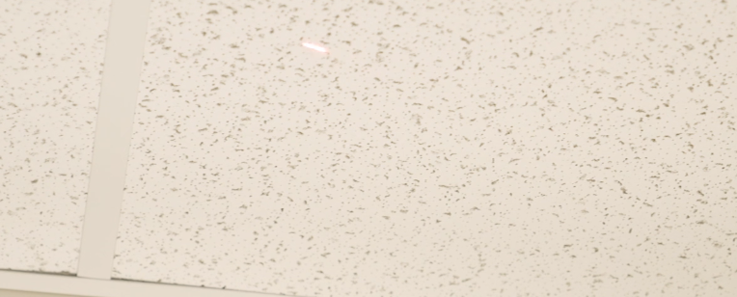
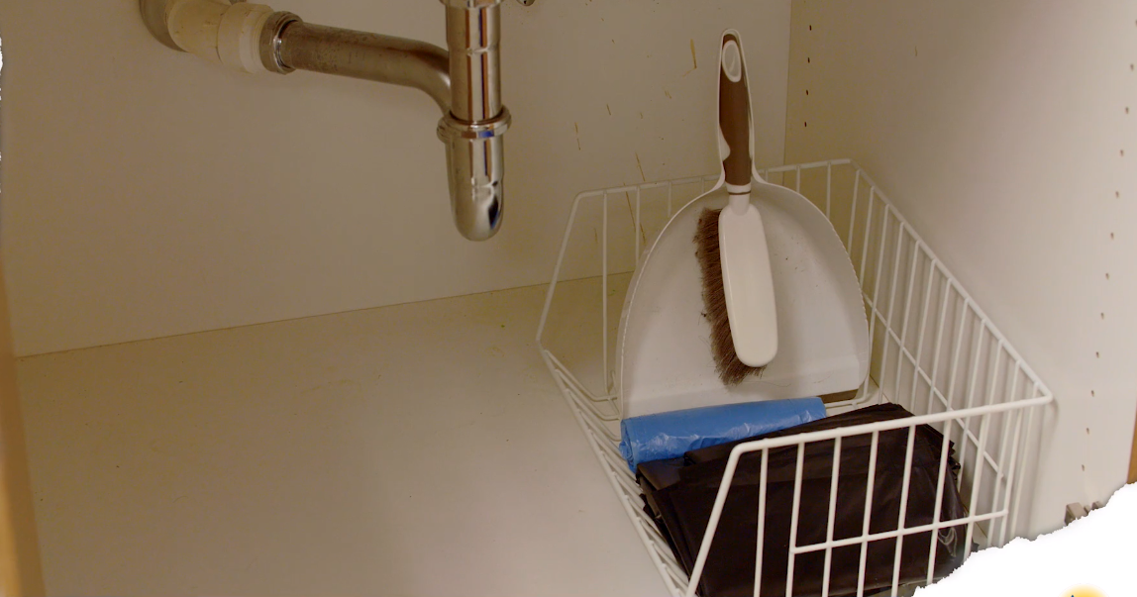
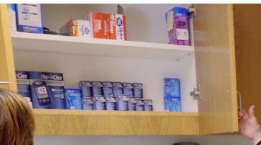
General Themes (Environmental rounds)
Ceiling tiles
Not stained, in place
Evidence of water intrusion around floors
No items under sink exceptions: cleaning supplies, cleaning agents, no patient care supplies and no hand hygiene products
Inventory of supplies, check dates for expiration on a routine schedule
Notes:
Common themes that should be assessed in all locations within your facility include:
Ceiling tiles. In addition to looking around and down, remember to look up. Ceiling tiles should not be stained and have no gaps or open communication with the area above the ceiling. Present of these factors could increase the risk of exposure to agents such as aspergillus.
Areas of plumbing (bathrooms for example) should be assessed for evidence of water intrusion along walls/baseboards. Areas (furnishings) exposed to water ,via flooding or leaking pipes, must be completely dried within 48 hours and if not all material should be replaced.
No clinical supplies or patient care devices should be stored under sinks.
Inventory must be checked routinely for outdated supplies and/or equipment
Environmental rounds can begin in any part of the facility, however it is helpful to begin at the entry point and make your way thru the facility to ensure you don’t miss an area.

Slide 6
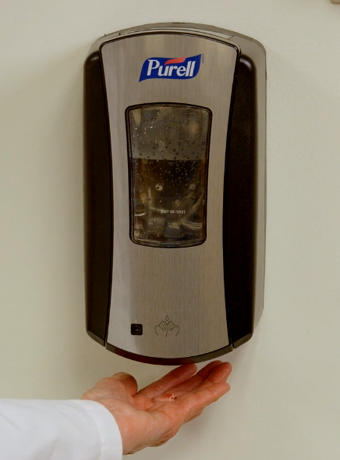
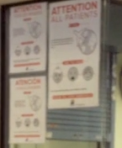
General themes (environmental rounds)
Availability of alcohol based hand rubs (ABHRs)
Hallways and corridors clean and free of clutter
Equipment not stored in hallways
Respiratory Hygiene/Cough Etiquette Stations located at entrance to facility

Slide 7
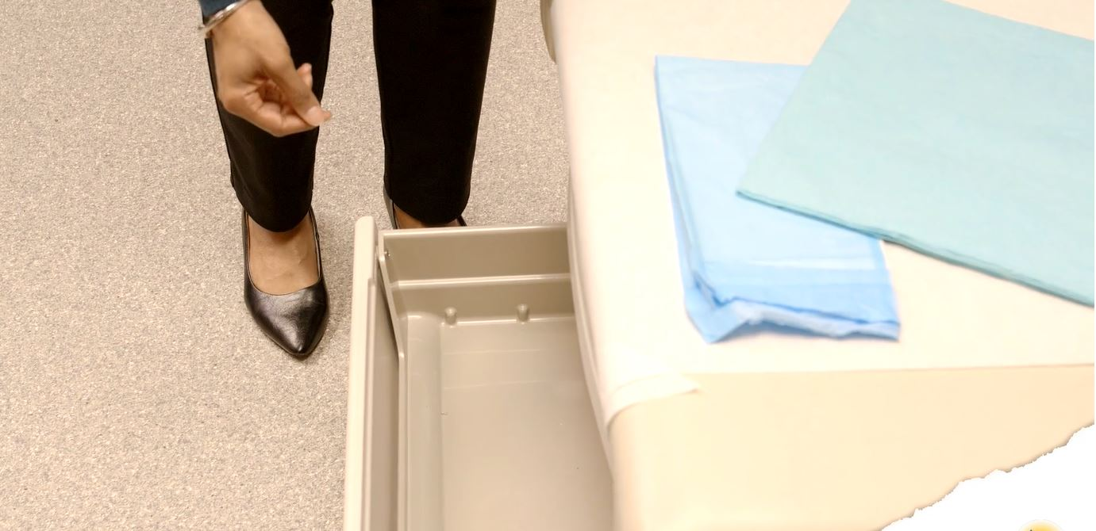
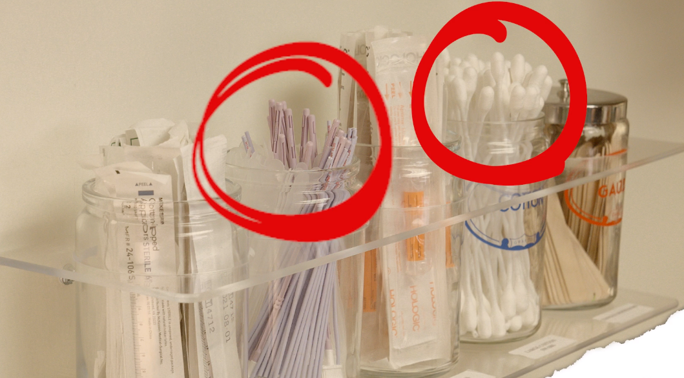
Exam room
Storage of patient care equipment and devices
Supplies protected from dust (not opened or in covered containers)
Storage of devices in exam table drawers (no vaginal specula stored). Risk of perineal shedding and contamination of devices (even if packaged)
Notes:
Supplies in exam/procedure rooms should be stored in a manner that reduces the potential for contamination.
If taken out of their original packaging should be placed in a covered container
Do not store in exam table drawer under the patient
Open supplies being used for a procedure immediately prior to use

Slide 8
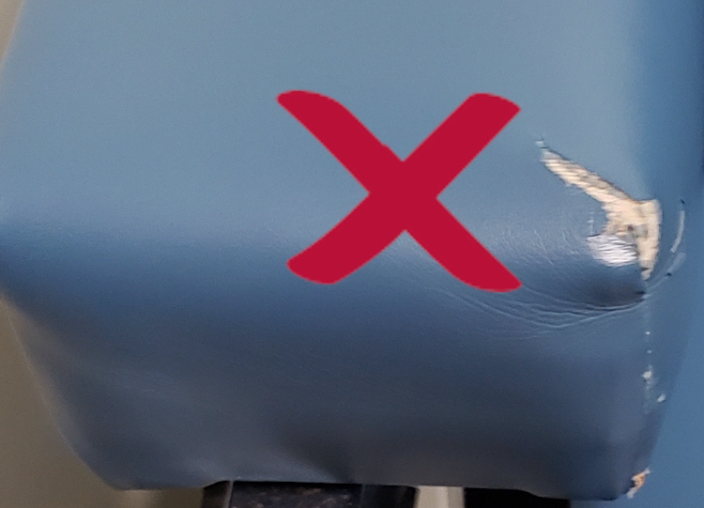
Exam room cont’d
Furniture (i.e., exam tables, chairs, stools) free of tears
Accessibility of ABHRs
Counters clutter free
Sinks
Hand hygiene only
Splash zone (within 3 feet or have a splash guard)
Privacy curtains
Sharps container (affixed, less than ¾ full and nothing stored on top)
Notes:
Ensure all furniture including exam table, chairs etc. Surfaces are not torn, cracked and made of cleanable material
ABHR readily accessible at point of care
Counters clutter free
Sink used for hand hygiene only
No storage within splash zone (3 feet of sink) or install splash guard
Procedure in place for cleaning of privacy curtains (when visible soiled and on a routine schedule)
Sharps container at appropriate height, maintained in upright position (affixed) and nothing stored on top.

Slide 9
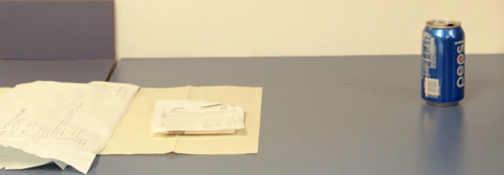
Exam room
Cleaning/Disinfection
Exam table and high-touch surfaces cleaned/disinfected with EPA-registered disinfectant after each patient
Know the appropriate contact time for product used
Room equipment clean
No food or drink in clinical care areas
Notes:
Disposable cover removed and discarded
Exam table and other high touch surfaces disinfected.

Slide 10
re-processing of reusable medical devices
Spaulding’s classification of medical devices:
Contact with sterile body site and must be sterilized
Contact with mucous membranes, non-intact skin and must be high-level disinfected
Contact with intact skin and requires low-level disinfection
Notes:
Level of disinfection or sterilization depends on item’s intended use and what it will come in contact with
Critical items require sterilization
Semi-critical items require high-level disinfection and may include vaginal speculum, vaginal or rectal ultrasound probes and respiratory therapy equipment
Non-critical items require low level disinfection and include stethoscopes, BP cuffs, environmental surfaces

Slide 11
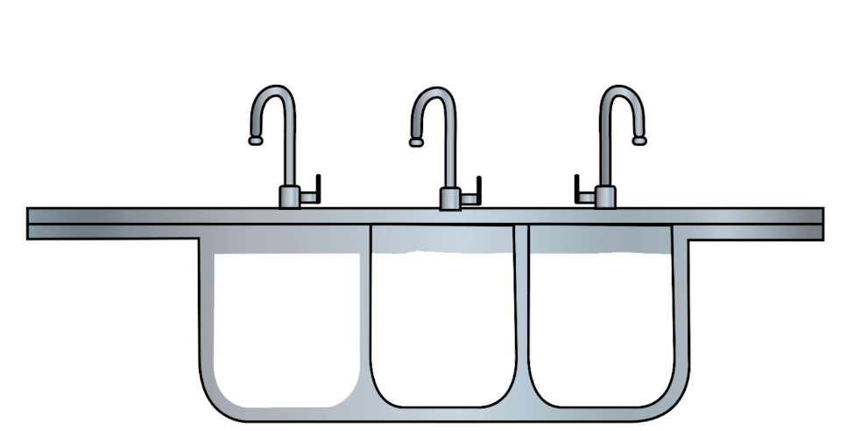
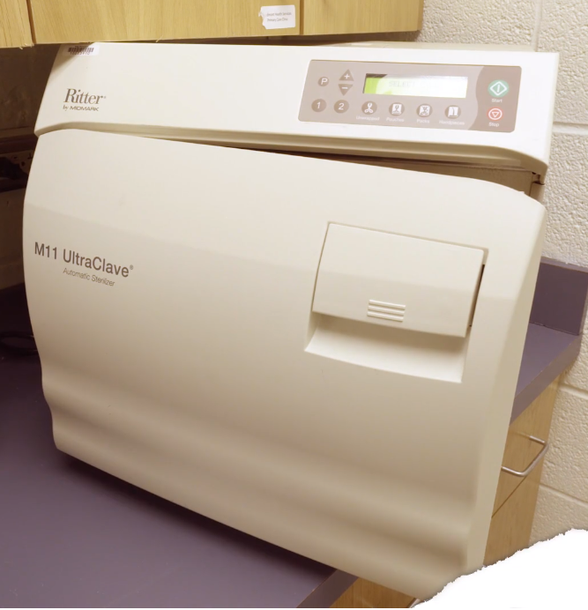
Re-Processing of Reusable medical devices
Staff training and competency
Transport
Pre-clean, rinsing
Cannot use same sink
Packaging (peel packs)
Sterilizer monitoring
Record Keeping
Notes:
Ensure staff have been trained and competency is documented. Steps include:
Contaminated devices should be transported to the decontamination area (NO reprocessing should be done in the sink in the procedure or exam room)
Transport items in a container designed to protect the transporter and others from contents within the container (leak proof, closed appropriately labeled or color-coded, and if sharp must be puncture resistant.
DO NOT transport in gloved hand alone.
Pre-clean device
Appropriate PPE should be worn
All detergents, enzymatic cleaners used according to manufacturer’s instructions for use (IFUs)
Complete and through rinsing
Allow item to completely dry
Packaging/Peel pouches
Used for small lightweight items
Used in accordance with IFUs
Be closed so that all seals are smooth (no folding over at ends)
Labeled with non-toxic ink on non-porous side of the pouch
Should stand on edge with paper side of one pouch next to plastic side of the other pouch in autoclave
Monitoring:
Physical monitors (time, temperature and pressure) recorded by printouts or documentation, every load
Chemical indicators, every load
Biological indicators at least weekly and every load if implant
Record keeping:
The load number
Contents of the load
Exposure time and temperature
Operator identification
Results of BI if applicable
Results of Bowie Dick if applicable
Results of chemical indicator

Slide 12
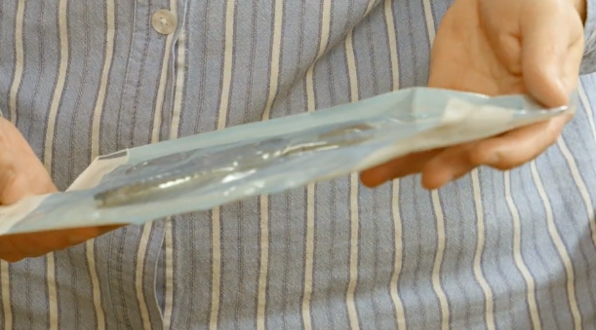
Re-processing of reusable medical devices (Outside Entities)
Visit site
Verify how pre-cleaning is done
Ensure items are appropriately packaged or package yourself
Notes:
If you reprocess items for an outside entity you should visit the site and ensure that items are being appropriately pre-cleaned and packaged.

Slide 13
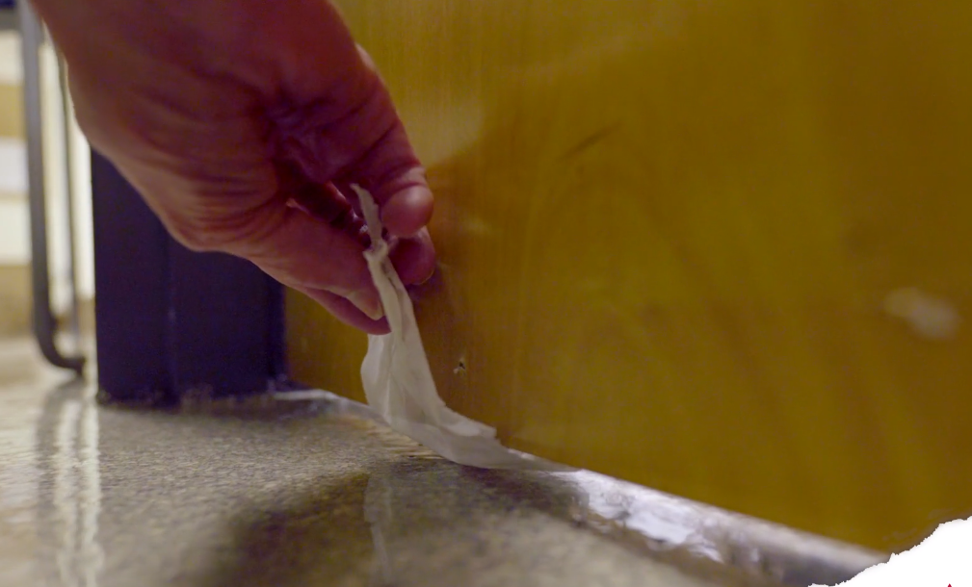
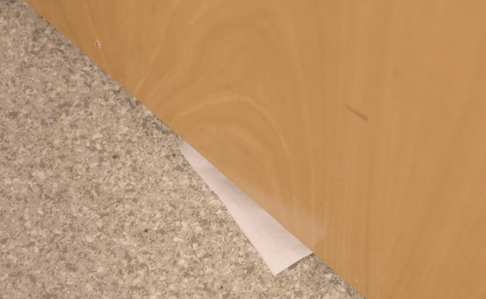
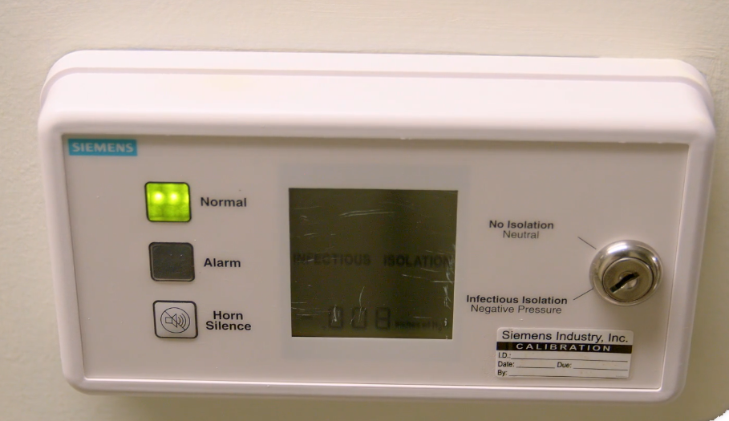
Airborne infection isolation room (AIIR)
TB risk assessment, annually
AIIR requirements
Negative pressure
Door shut
Pressure Monitored
Tissue Test
Visual monitors
Measles
Chickenpox
Notes:
Know what your TB risk category is
The main difference between AIIR room and a regular exam room is the way air flows. In most patient care rooms air is either pushed out of the room into the hallway or is neutral (no strong push into or out of the room). In the AIIR, it is very important the air is pushed into the room from the hallway, we call this negative pressure.
Door must remain shut
Negative pressure
Monitor with tissue test prior to using and daily if used
Outside mechanical monitoring (alarm)
Suspected or confirmed varicella and or measles cases would need AIIR as well

Slide 14
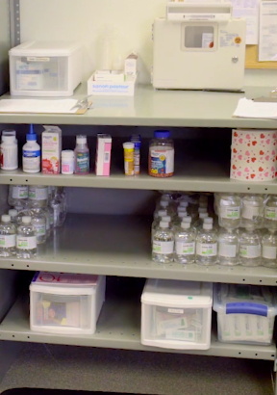
Pharmacy-medication area
Cleanliness of area and no clutter
Single dose
One time-one patient
Multi-dose vials dated
Expiration date 28 days after opening OR
Contamination is suspected or confirmed
No mingling of activities
Medication refrigerators

Slide 15
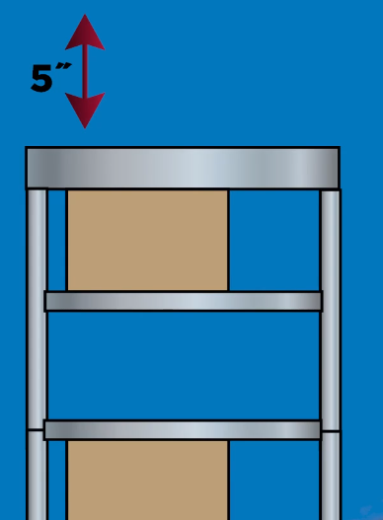
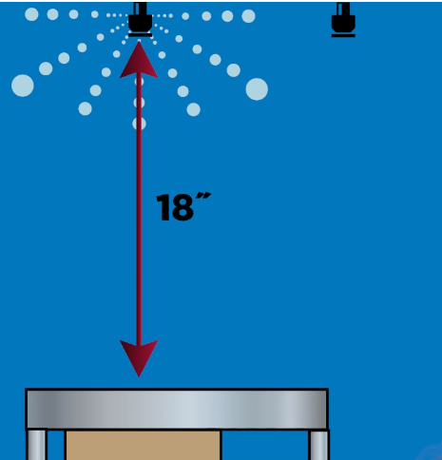
Pharmacy-medication area
Storage requirements:
No corrugated cardboard boxes
Distance from floor
Distance from ceiling
Solid bottom shelves
OR
Notes:
No corrugated cardboard boxes or primary shipping boxes in any clinical area (vermin can lay eggs in areas seen above.
Supplies should be stored:
8” from the floor
5” from ceiling if no sprinkler head
18” from ceiling IF sprinkler head
Shelf unit should have solid bottom shelf (floor can be cleaned underneath with contaminating supplies on bottom shelf

Slide 16
Medication and Vaccine Storage

Slide 17
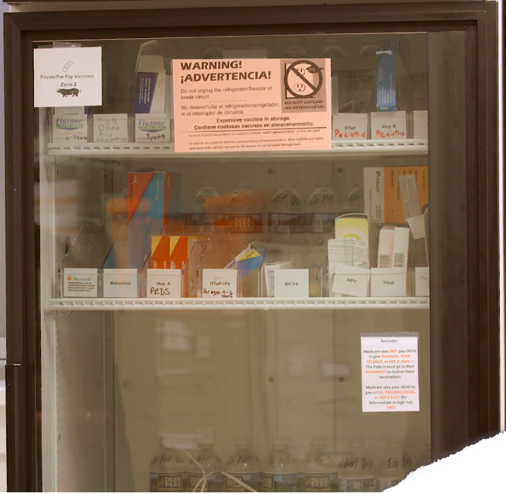
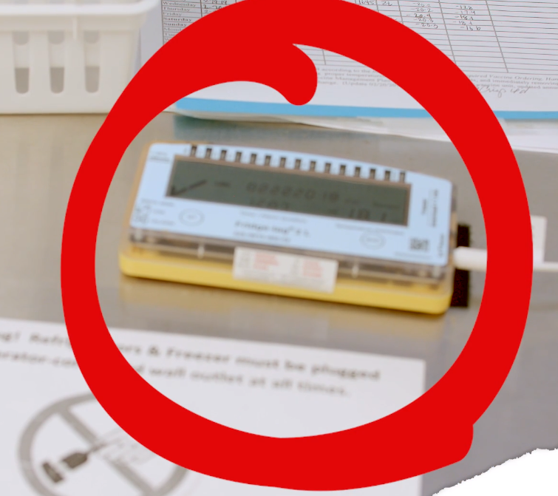
Medication and Vaccine Storage
Temperatures maintained at appropriate range in refrigerators and freezers
Back up generator if power goes out
Documentation system (electronic)
Monitoring and alarm system 24//7

Slide 18
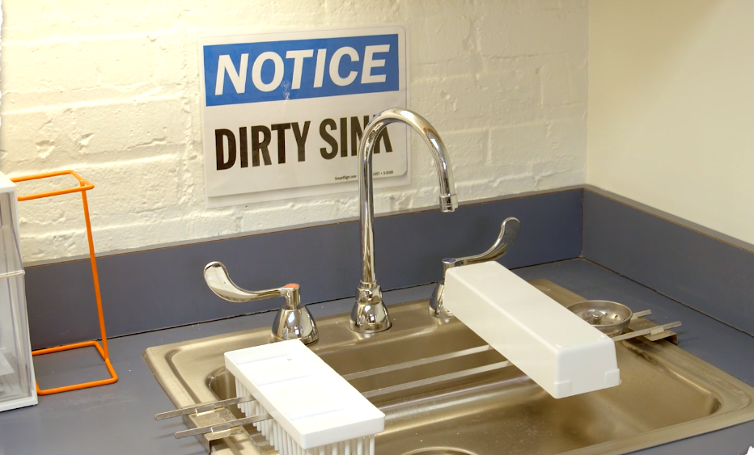
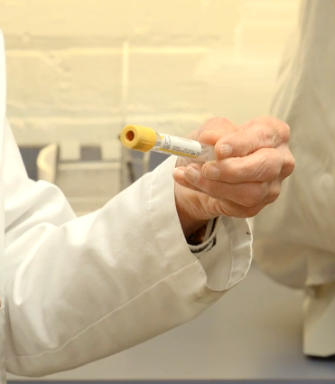
lab
PPE storage
Sharps container
HH sink
Soiled sink
Supplies not within splash zone
Specimen refrigerator
Expiration dates on supplies
Furniture good condition
Notes:
PPE readily accessible
Sharps container maintained in upright position, puncture resistant, leak proof and labeled with bio-hazard label or color coded
Two sinks: one dedicated to HH and one used in specimen disposable or testing procedure. Splash guard in place for sinks OR supplies devices stored 3ft away
Specimen refrigeration has bio-hazard label
Check expiration dates on supplies and don’t forget about lab collection tubes
Furniture in good condition no tears/cracks

Slide 19
Assisted blood glucose monitoring
Assisted blood glucose monitoring, while considered to be a benign procedure, has been identified as a major cause and been the mode of transmission for many hepatitis B outbreaks.
Outbreaks have been linked to the infection control breaches shown here, including:
Sharing of blood glucose meters without disinfection and cleaning between uses, this is the most common breach.
Use of fingerstick devices or insulin pens for multiple people, and
Failure to perform hand hygiene or change gloves between procedures.
Notes:
Blood glucose meters must be disinfected AFTER EVER USE per manufacturer instructions (instructions include product with a HIV, HBV, HCV claim). If the manufacturer does not have appropriate instructions for disinfecting, the meters can not be used on multiple patients
Meters stored in a manner that prevents contamination

Slide 20
Conclusions
An organization’s physical environment is integral to its ability to prevent and control infection.
Environmental rounds provides valuable information about your building, its furnishings and equipment as well as staff practices.
Tips for successful rounding
Use a standardized checklist
Establishing a routine schedule for conducting rounds
Include staff members in the process
Aggregate findings and feed back to staff and leadership

Slide 21
Thanks to the local health department and the NC Division of Public Health for their support in the filming of this video.
https://spice.unc.edu/
https://vimeo.com/336714632

