Slide 1

Inpatient Antimicrobial Stewardship
Session #1
March 8, 2023

Slide 2
Conflict of interest Disclosures
The views and opinions expressed in this series are those of the speakers and do not reflect the official policy or position of any agency of the U.S. or NC government or UNC.
Our speakers have the following financial relationships with the manufacturer(s) and/or provider(s) of commercial services discussed in this activity:
  Dr. Kistler served as a consultant for Base10, Inc on their UTI embedded clinical support tool and received funding from Pfizer to study pneumococcal carriage.
  Dr. Willis has performed contracted research with: Pfizer (pediatric nirmatrelvir-ritonavir and maternal RSV vaccine), Novavax (pediatric COVID-19 vaccine), and Merck (monoclonal antibody for RSV prevention)
  Ms. Doughton owns individual Gilead stock.
The speakers do not intend to discuss an unapproved/investigative use of a commercial product/device in this series, and all COI have been mitigated.
These slides contain materials from a variety of colleagues, Drs. Philip Sloane and David Weber, as well as the CDC, WHO, AHRQ, etc.

Slide 3
Introduction to NC CLASP TEAM Partners
Danielle Doughman, MSPH- project manager
Chrissy Kistler, MD, MASc- Geriatrics researcher and LTC expert
Marian B Johnson, MPH- Senior Research Associate and QI advisor for IHI
Zach Willis, MD, MPH- Infectious disease clinician and HAI/AR expert
Evelyn C. Cook- Associate Director of the North Carolina Statewide Program for Infection Control and Epidemiology
Jim Johnson, PharmD- pharmacist with antibiotic stewardship expertise
Saif Khairat, PhD, MPH- informatics and clinical decision support expert
Notes:
Please introduce yourselves

Slide 4
Introductions
Please put your name, hospital, and location in the chat!
Notes:
Please put your name and your community in the chat

Slide 5
Outline of today’s session
Introductions
CE/CME
NC CLASP refresher
Series Learning Objectives
CDC Core Elements 1 and 2
Discussion and "Homework"

Slide 6

CME and ce credit
CME & CE for participants
  Attendance and active participation per learning session
  Click the link in the chat during the session to document your attendance
  Establish a MyAHEC account
  Complete surveys as requested
Notes:
I wanted to provide a brief overview of the funding source for all the activities we will be discussing today.
Monies were awarded for the 50 states Puerto Rico and six large local health departments.
The NC Department of Health and Human Services (NCDHHS) has contracted with the NC Statewide Program for Infection Prevention/Control and Epidemiology (SPICE) to oversee and perform metrics as outlined in the scope of work and approved by the department.

Slide 7

Setting yourself up for learning
This time is for you and your learning.
One-screen agreement
Hearing and seeing each other
  Cameras on
  Stay muted unless speaking
Use the chat
Let’s use and share our learning, but not in a way that identifies another facility’s pain points.
What would you add?

Slide 8

The North Carolina Clinical Antibiotic Stewardship Partners (NC CLASP)
All the information from today’s session will be on our website https://spice.unc.edu/ncclasp/
Notes:
On the website you will find a form you can complete to indicate your interest in learning more about the types of antibiotic stewardship partnerships we will discussing today.
A member of the CLASP team will reach out to learn more about how CLASP might support your stewardship efforts.
All activities for these projects are funded by CDC and facilities will incur no charges for participation.

Slide 9
NC CLASP OVERVIEW
NC CLASP is a new initiative created to support acute care, outpatient, and nursing home settings to improve antibiotic stewardship and the health of our patients.
NC CLASP is funded by NC DHHS. There is no cost to participate.
Notes:
We are very excited to present a new initiative created to help support our acute care, outpatient, and nursing home settings to improve antibiotic stewardship. We are bringing together experts from a variety of fields to help augment the work that everyone is doing in their own communities to improve the appropriateness of antibiotic prescribing and the health of our patients. Over the next few slides I'm going to review our plans and provide an overview of what we hope NC CLASP can do for you.

Slide 10
Series learning objectives
Discuss CDC Core Elements of Antibiotic Stewardship.
Review the benefits of the NHSN Antimicrobial Use (AU) module.
Identify barriers to improving antimicrobial utilization.
Discuss the significance and roles of pharmacists as part of a multidisciplinary team in promoting antimicrobial stewardship and optimizing antimicrobial use in inpatient settings.
Engage with other team members at their facility to implement antimicrobial stewardship efforts.
Describe commonly used antimicrobial stewardship implementation strategies.
Review the National Healthcare Safety Network (NHSN) hospital annual surveys specific to antibiotic stewardship preparedness.

Slide 11
Antimicrobial stewardship landscape
ASPs began in large hospitals
  Antimicrobial resistance problems; access to experts and data
  Joint Commission Standard went into effect 2017
How to do stewardship in:
  Smaller community hospitals?
  Long-term care facilities?
  Outpatient setting?

Slide 12

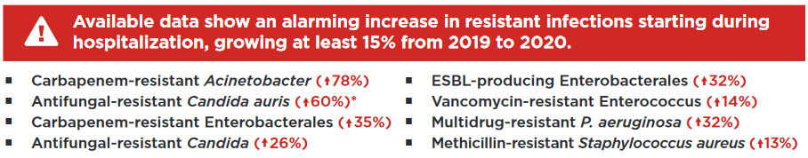
https://www.cdc.gov/drugresistance/pdf/covid19-impact-report-508.pdf

Slide 13
Definition: Antimicrobial Stewardship
Stewardship describes the careful and responsible management of something entrusted to one’s care.
In 1996, John McGowan and Dale Gerding first applied the term antimicrobial stewardship, suggesting a causal association between antimicrobial agent use and resistance.
Antimicrobial Stewardship: the optimal selection, dosing, and duration of antimicrobial treatment resulting in the best clinical outcome with minimal side effects to the patients and minimal impact on subsequent resistance.
Shrestha J, Zahra F, Cannady P. Antimicrobial Stewardship In: StatPearls [Internet]. Treasure Island (FL): StatPearls Publishing; 2022 Jan. PMID: 34283434

Slide 14
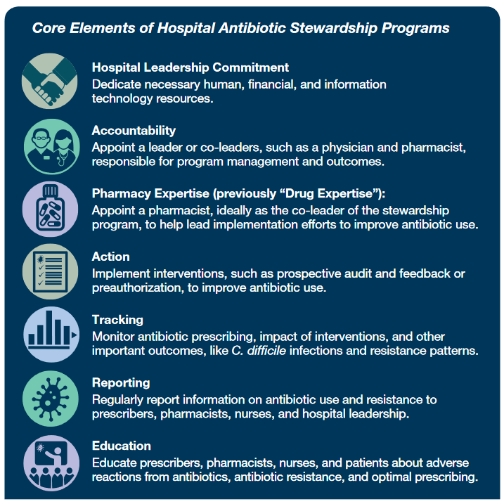
Core Elements overview
CDC. Core Elements of Hospital Antibiotic Stewardship Programs. Atlanta, GA: US Department of Health and Human Services, CDC; 2019. Available at https://www.cdc.gov/antibiotic-use/core-elements/hospital.html.

Slide 15
Core Element #1
Hospital Leadership Commitment
Dedicate necessary human, financial and information technology resources.
Priority examples of hospital leadership commitment emphasize the necessity of antibiotic stewardship programs leadership having dedicated time and resources to operate the program effectively, along with ensuring that program leadership has regularly scheduled opportunities to report stewardship activities, resources and outcomes to senior executives and hospital board.
Some “promoters” of commitment
  Financial impact
  Safety
  Length of stay
  Resistance, C. difficile
Notes:
Speaking the “language” of hospital leadership to bolster support for advancing AS

Slide 16
“…AS programs…. will pay for themselves…”
CDC. Core Elements of Hospital Antibiotic Stewardship Programs. 2019
Beardsley, Williamson, Johnson, Luther, Wrenn, Ohl. Show me the money: long-term financial impact of an antimicrobial stewardship program. Infection control and hospital epidemiology 2012 Apr;33(4):398-400.

Slide 17
Large Academic Medical Center
7 year AS program
Comprehensive program in its day
Standiford, et al ICHE 2012, 33:338

Slide 18
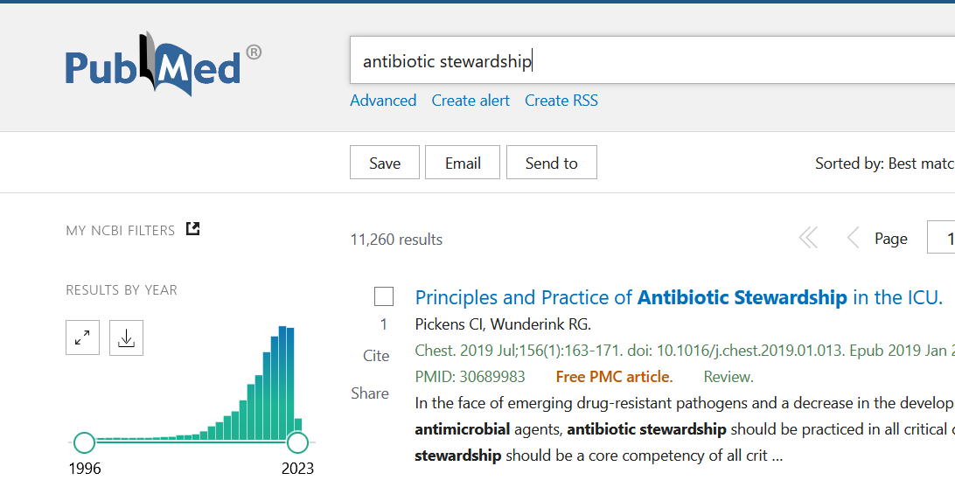
Exploding literature of Antimicrobial Stewardship
Notes:
Once we looked at a few individual studies and experience reports. In 2023, with the explosion of AS research, a number of helpful meta-analyses are surfacing.

Slide 19
Impact of AS programs on safety:
C difficile
Baur, Gladstone, Burkert, et al. Lancet Infectious Diseases; 17:9:990-1001, 2017

Slide 20
Nathwani, et al. Value of Hospital Antimicrobial Stewardship Programs: a systematic review. Antimicrobial Resistance and Infection Control 2019

Slide 21
Nathwani, et al. Value of Hospital Antimicrobial Stewardship Programs: a systematic review. Antimicrobial Resistance and Infection Control 2019

Slide 22
Core Element #2
Accountability
The antibiotic stewardship program must have a designated leader or co-leaders who are accountable for program management and outcomes.
Most hospitals have found a co-leadership model to be effective, for example: a physician and pharmacist.
Strengthening leadership and accountability:
Written policies and expectations
Ready availability of physician leaders to non-physician leaders
Stewardship “rounds”
Engaging prescribers in AS rounds (“handshake stewardship”)
Baker DW, Hyun D, Neuhauser MM, Bhatt J, Srinivasan A. Leading Practices in Antimicrobial Stewardship: Conference Summary. Joint Commission journal on quality and patient safety. 2019 Jul;45(7):517-23.
Hurst AL, Child J, Pearce K, Palmer C, Todd JK, Parker SK. Handshake Stewardship:
A Highly Effective Rounding-based Antimicrobial Optimization Service. Pediatr Inf Dis J 2016;35(10):1104-10.

Slide 23
Breakout session
Leadership Commitment & Accountability
What strategies have you found helpful in strengthening the hospital leadership commitment for your stewardship program?
How are the leaders of the ASP held accountable? How does the ASP demonstrate value to upper management?

Slide 24
Stewardship: A Multidisciplinary Endeavor
•Lead Physician
•Lead Pharmacist
•Clinical Microbiologist
•Infection Preventionist
•Information Technologist
Essential, "Core-Team" Personnel

Slide 25
One possible A.S. team structure
P&T Committee
Larger supervisory Team
Hospital Leadership
Infection Prevention Committee
Clinical Micro Lab
Patient Safety Committee
Core AS team
Infectious Diseases service
Frontline clinicians:
Hospitalists, nurses, pharmacists

Slide 26
Antimicrobial Stewardship:
A Multidisciplinary Endeavor
How is your AS effort structured?
How do you engage these different groups?
What challenges to involvement of key stakeholders have you faced?

Slide 27
“Homework”
  List the members of your ASP and their roles. Compare that to recommended “essential personnel” in slide 24.
    Which members have explicit effort? Do other critical personnel, such as microbiologists, have formal ASP expectations?
  What other stakeholders in slide 25 do you engage with regularly? Which ones are potentially missing? Can engagement with stakeholders be improved without significant additional financial resources?
  What does your program need the most to have the greatest impact? For example, more pharmacy FTE? Physician FTE? Data analytics? What would your program be able to accomplish by filling that need?

Slide 28
Resources
CDC Core Elements of Hospital Antibiotic Stewardship Programs: https://www.cdc.gov/antibiotic-use/core-elements/hospital.html
Implementing an Antibiotic Stewardship Program: Guidelines by the Infectious Diseases Society of America and the Society for Healthcare Epidemiology of America - PubMed (nih.gov)
Value of hospital antimicrobial stewardship programs [ASPs]: a systematic review - PubMed (nih.gov)

