Slide 1
Infection Management and Antibiotic Stewardship Hot Topic Session #3 Antibiotics in COPD Exacerbations
October 25, 2023

Slide 2
Conflict of interest Disclosures
The views and opinions expressed in this series are those of the speakers and do not reflect the official policy or position of any agency of the U.S. or NC government or UNC.
Our speakers have NO financial relationships with manufacturers and/or providers of commercial services discussed in this activity.
Dr. Kistler served as a consultant for Base10, Inc on their UTI embedded clinical support tool and received funding from Pfizer to study pneumococcal carriage.
The speakers do not intend to discuss an unapproved/investigative use of a commercial product/device in this series, and all COI have been mitigated.
These slides contain materials from a variety of colleagues including CDC, WHO, AHRQ, etc.

Slide 3
Today's Team
Philip Sloane, MD, MPH - Geriatrics researcher and LTC expert, UNC School of Medicine
Marian B. Johnson, MPH - Senior Research Associate and Quality Improvement advisor, Institue for Healthcare Improvement
Adrian Austin, MD, MSCR - Geriatric Pulmonary and Critical Care expert, UNC School of Medicine
Chrissy Kistler, MD, MASc - Geriatrics researcher and LTC expert, University of Pittsburgh

Slide 4
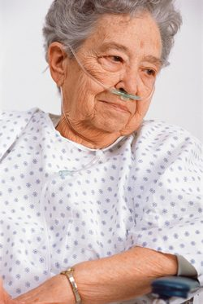
Session Objectives
Review the Definition of COPD exacerbation
Identify practical guidance for antibiotics and COPD exacerbations in the outpatient setting
Provide a one-pager for QI and staff education

Slide 5
Case Vignette
C.B. is a 78-year-old woman, former smoker, with COPD, chronic hypoxic respiratory failure on 2L of O2, and chronic diastolic CHF. She has 5 days of a productive cough. She normally has a dry, chronic cough. She also has increased dyspnea. Pulse ox is 92%. Normally she is 90-94%. HR is 80. She appears tired and has nasal congestion. Her lungs have bilateral wheezes. CXR show no new findings.
Questions
Does she have an acute exacerbation of COPD?
Are antibiotics indicated?

Slide 6
Differential Diagnosis
Acute exacerbation of COPD
CHF exacerbation
Influenza
COVID-19
PNA
Anxiety
Pain

Slide 7
COPD Exacerbation
GLOBAL Initiative for Chronic Lung Disease (GOLD) Guidelines Definition:
Acute event (Worsens over ≤ 14 days):
Increased dyspnea and/or
Increased cough and sputum production
May be accompanied by tachypnea or tachycardia

Slide 8
Red Flags for Potential Hospitalization
Severe dyspnea (i.e. inability to complete sentence without breath, pursed lip breathing, tripoding)
Increased RR
Confusion above baseline
Cyanosis
Acute respiratory failure→Increase in O2 requirement and/or decreased oxygen saturation
Signs of other organ involvement (i.e. arrhythmias)
Factor in patient and caregiver’s preferences!!!
Notes:
More than 80% of exacerbations are managed as outpts.

Slide 9
Which COPD Exacerbations Benefit from Antibiotics?
Cochrane systematic review (2018):
large beneficial effects patients admitted to an ICU
For outpatients and non-ICU inpatients, results inconsistent
Vollenweider, Database of Systematic Reviews; 2018

Slide 10
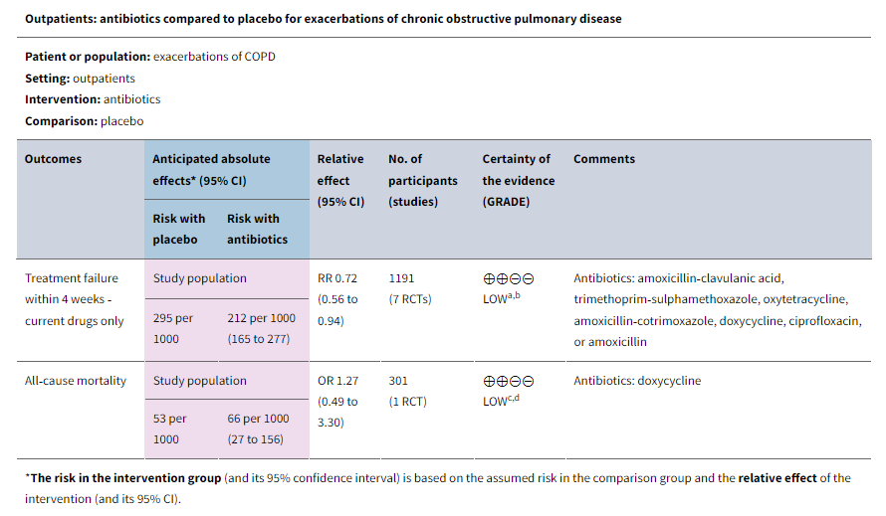
Source: Vollenweider, Database of Systematic Reviews; 2018

Slide 11
Outpatient Approach
Mild disease (outpatient management): start with inhaled bronchodilators (albuterol), consider oral steroids. If inadequate relief, consider antibiotics
Mild disease=
<3 cardinal symptoms (dyspnea, productive cough, purulent sputum)
No purulent sputum
Notes:
More than 80% of exacerbations are managed as outpts.

Slide 12
Case Vignette
C.B. is a 78-year-old woman, former smoker, with COPD, chronic hypoxic respiratory failure on 2L of O2, and chronic diastolic CHF. She has 5 days of a productive cough. She normally has a dry, chronic cough. She also has increased dyspnea. Pulse ox is 92%. Normally she is 90-94%. HR is 80. She appears tired and has nasal congestion. Her lungs have bilateral wheezes. CXR show no new findings.
Questions
Does she have an acute exacerbation of COPD?
Are antibiotics indicated?

Slide 13
Antibiotic Selection
FDA Drug Safety Communication: FDA advises restricting fluoroquinolone antibiotic use for certain uncomplicated infections; warns about disabling side effects that can occur together | FDA. Accessed 10.20.23

Slide 14
Antibiotic Selection
1st line: Macrolide (azithromycin) OR Second or third generation cephalosporin (eg, cefuroxime, cefpodoxime, cefdinir)
If history of Pseudomonas colonization, consider ciprofloxacin (RARE EXCEPTION)
Notes:
More than 80% of exacerbations are managed as outpts.

Slide 15
Antibiotic Duration
3-5 days duration
REASSESS after 3-5 days
If not improving, consider evaluation for other etiologies and/or hospitalization
Notes:
More than 80% of exacerbations are managed as outpts.

Slide 16
Case Vignette
C.B. is a 78-year-old woman, former smoker, with COPD, chronic hypoxic respiratory failure on 2L of O2, and chronic diastolic CHF. Dx’ed with COPD exacerbation. Gave 3 days of oral azithromycin, oral prednisone, TID albuterol nebulizers. Increased nursing monitoring to qshift.
Patient improved by day 3 and was back to prior baseline.

Slide 17
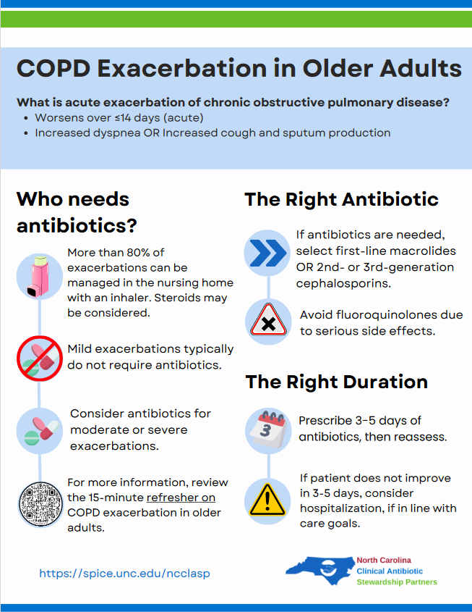
Downloadable One-Pager for Staff Education and Quality Improvement
Notes:
GOLD criteria→Abx→Duration→F/u

Slide 18
Questions and Discussion
Find session slides at https://spice.unc.edu → ncclasp → nursing homes

Slide 19
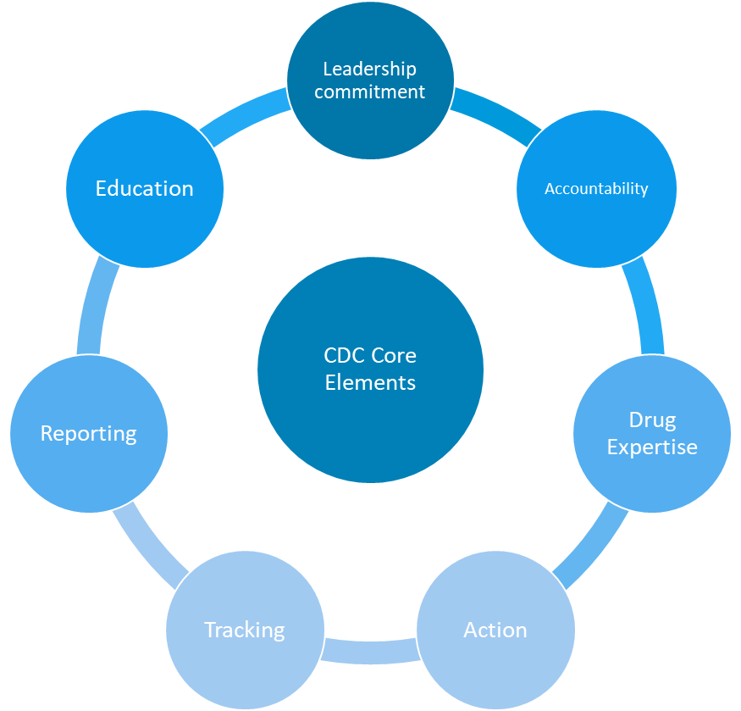
QAPI and QI SUPPORT
Now we'd like to help you! What stewardship projects are you working on and what do you need help with?

Slide 20
upcoming November learning sessions
Leadership + QI Communication November 1, 2023 | 11:30-12:30 PM
CE available
Hot Topics in Stewardship: UTIs – U/A Challenges November 8, 2023 | 11:30-12:30 PM No CME
Hot Topics in Stewardship: Communication with Families from Diverse Backgrounds November 29, 2023 | 11:30-12:30 PM No CME

