Slide 1
Long-term care communities antibiotic stewardship: Education + bridging the know-do gap
April 17, 2024
Notes:
Good morning, everyone, I am Evelyn Cook, Associate Director for the NC SPICE. –For those of you who may not be familiar with SPICE our mission is to promote infection prevention and control efforts in all healthcare setting across NC thru education and consultation
I would like to welcome everyone joining us on the webinar today. We sincerely appreciate you taking time out of your busy schedule to be here, and we hope that you take this opportunity to ask any questions you have related to our presentation on antibiotic stewardship.
A few housekeeping tips-
For technical issues please type in the chat box
Please enter all questions in the Q&A box. We hope to have time at the end of the webinar to answer questions and we also respond to some in the chat box.
Next, I would like to introduce our presenters.
Introductions for Evelyn, Zach, Chrissy, Danielle

Slide 2
Conflict of interest Disclosures
The views and opinions expressed in this series are those of the speakers and do not reflect the official policy or position of any agency of the U.S. or NC government or UNC.
Our speakers have NO financial relationships with manufacturer(s) and/or provider(s) of commercial services.
The speakers do not intend to discuss an unapproved/investigative use of a commercial product/device in this series, and all COI have been mitigated.

Slide 3
Outline of today’s session
Antibiotic Stewardship Presentation and Discussion: Education for Staff, Family, and Prescribers
Quality Improvement Presentation and Discussion: - Ask 5 and 5 Whys - Reliable processes
Clinical Case

Slide 4
POLL
Does your facility provide educational resources and materials about antibiotic resistance and stewardship?
❑ Yes
❑ No
If yes, to whom?
❏ Clinical providers (e.g., MDs, NPs, PAs, PharmDs)
❏ Nursing staff (e.g., RNs, LPNs, CNAs)
❏ Residents and families
❏ Other:_____

Slide 5
Education
CDC Core Elements
Leadership commitment
Accountability
Drug Expertise
Education
Action
Tracking
Reporting
Effective educational programs:
address both nursing staff and clinical providers
Address the goal of an antibiotic stewardship intervention
Address responsibility of each group for ensuring its implementation
Mechanisms for disseminating antibiotic education to staff:
flyers,
pocket-guides,
newsletters or electronic communications
**interactive academic detailing (e.g., face-to-face interactive workshops) has the strongest evidence for improving medication prescribing practices.
Notes:
We know that tackling antibiotic stewardship can feel daunting at times. we will be using the CDC's core elements of antibiotic stewardship to help you review your own unique healthcare setting and help you identify your internal antibiotic stewardship priorities. As part of this effort, we will provide assistance with data and analytics to help give you the tools to do this work, such as Monitoring and tracking the prescribing patterns in your setting.

Slide 6
Education
CDC Core Elements
Leadership commitment
Accountability
Drug Expertise
Education
Action
Tracking
Reporting
To Sustain Improvement:
Incorporate both education and feedback to providers.
One nursing home antibiotic stewardship intervention demonstrated a sustained reduction in antibiotic use for two years after the intervention by linking education with feedback on physician prescribing practices. (1)
Another study showed a 64% reduction in inappropriate antibiotic use (i.e., prescriptions which did not adhere to guidelines), by providing feedback on individual physician prescribing practices and adherence to the guidelines over 12 months (2)
But How?
Notes:
Education for providers: The researchers provided educational sessions for physicians, nurses, and pharmacists on appropriate antimicrobial prescribing and monitoring. This included information on common infections, antimicrobial resistance, and guidelines for antimicrobial use.
Feedback to providers: The researchers monitored antimicrobial use and provided regular feedback to providers on their prescribing patterns. This allowed them to identify areas for improvement and adjust their practices accordingly.
Multidisciplinary approach: The intervention involved collaboration between physicians, nurses, and pharmacists to ensure a coordinated effort to optimize antimicrobial use.
Schwartz DN, Abiad H, DeMarais PL. et al. An educational intervention to improve antimicrobial use in a hospital-based long-term care facility. J Am Geriatr Soc. 2007; 55(8), 1236-1242. 25.
Monette J, Miller MA, Monette M, et al. Effect of an educational intervention on optimizing antibiotiotic prescribing in long-term care facilities. J Am Geriatr Soc. 2007; 55(8), 1231-1235

Slide 7
Education
CDC Core Elements
Leadership commitment
Accountability
Drug Expertise
Education
Action
Tracking
Reporting
Engage Residents and Families
Working with residents and families will reduce the perception that their expectations may be a barrier to improving antibiotic use in nursing homes.
Education around use empowers the family and resident

Slide 8
STAFF 1/3
Disease specific education
Communication tips from AHRQ
https://www.ahrq.gov/antibiotic-use/long-term-care/best-practices/posters.html
https://www.cdc.gov/antibiotic-use/core-elements/nursing-homes/implementation.html
Conflict mediation
“How to” information
How to collect a culture, etc
Notes:
Provide information for the education gaps - Beyond diagnostics
The webpage provides Antibiotic Stewardship Toolkits for different healthcare settings like acute care hospitals, ambulatory care, and long-term care, focusing on best practices and guidelines for practitioners
It includes materials such as pocket cards and posters for healthcare practitioners and nursing staff to aid in the management of conditions like urinary tract infections, respiratory tract infections, skin or soft tissue infections, and identifying delirium

Slide 9
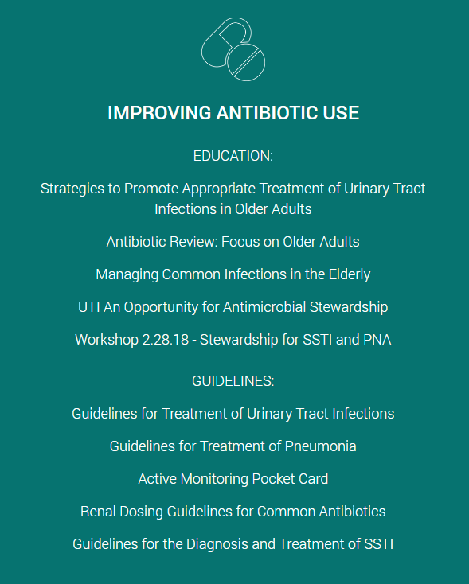
STAFF 2/3
Rochester Nursing Home Collaborative Treatment Guidelines:
https://www.rochesterpatientsafety.com/index.cfm?Page=For%20Nursing%20Homes
Notes:
The webpage aims to provide resources and tools for nursing homes to reduce the incidence of C. difficile infection through antimicrobial stewardship interventions
It offers general antibiotic stewardship principles, policy implementation tools, guidelines for treating infections in the elderly, and educational materials for improving antibiotic use
includes tracking worksheets and instructions for monitoring antibiotic use, as well as educational resources for residents, families, and nursing staff

Slide 10
STAFF 3/3
Antibiotic harm education
https://www.ahrq.gov/antibiotic-use/long-term-care/improve/discuss-family.html
Notes:
how to discuss the potential harms of antibiotic use with family members​.
Address end-of-life care as it relates to antibiotic use​.
Presents supportive and comfort care measures for residents who are uncomfortable (which may not involve antibiotics)​.

Slide 11
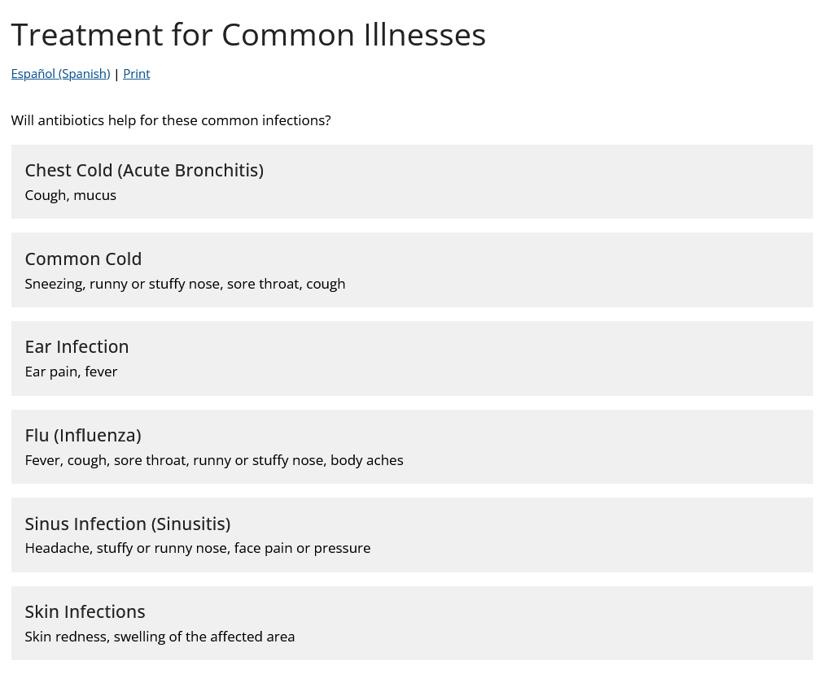
Residents and families 1/2
Disease-specific education
https://www.cdc.gov/antibiotic-use/common-illnesses.html
Notes:
Antibiotics are not always needed for common infections like chest colds, colds, ear infections
These common infections are often caused by viruses, which do not respond to antibiotics. Antibiotics are only effective against bacterial infections
Treating these common infections often involves managing symptoms, getting plenty of rest, and staying hydrated. Antibiotics are not the appropriate treatment unless there are signs of a bacterial infection
Overusing antibiotics can lead to antibiotic resistance, which makes infections harder to treat. It's important to only use antibiotics when necessary and as directed by a healthcare provider

Slide 12
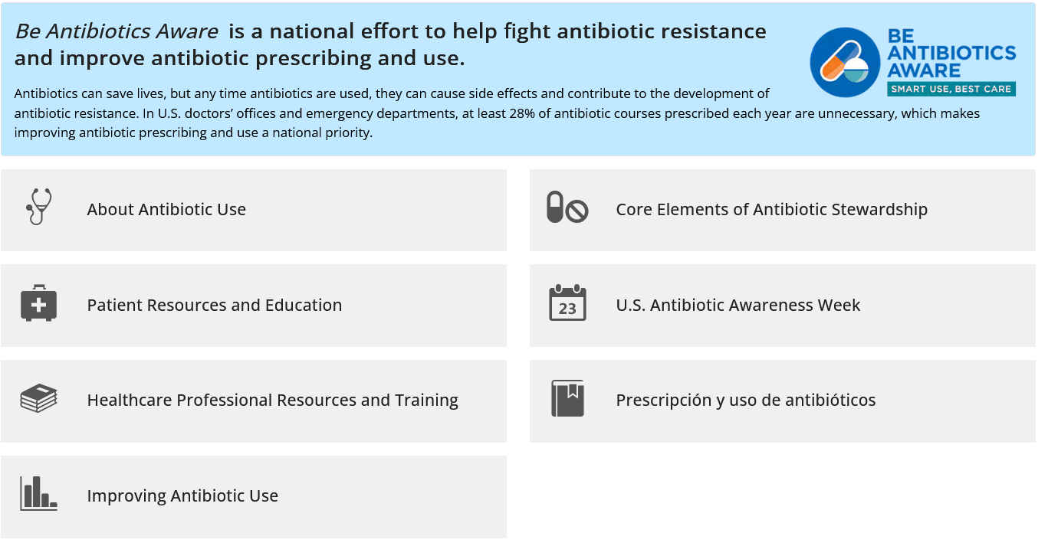
Residents and families 2/2
CDC Antibiotic harm education https://www.cdc.gov/antibiotic-use/
Notes:
Antibiotics can save lives, but any time they are used, they can cause side effects and contribute to the development of antibiotic resistance
In the U.S., at least 28% of antibiotic courses prescribed each year in doctors' offices and emergency departments are unnecessary, making improving antibiotic prescribing and use a national priority
racking and reporting data on antibiotic use helps identify where healthcare settings need stewardship interventions the most.

Slide 13
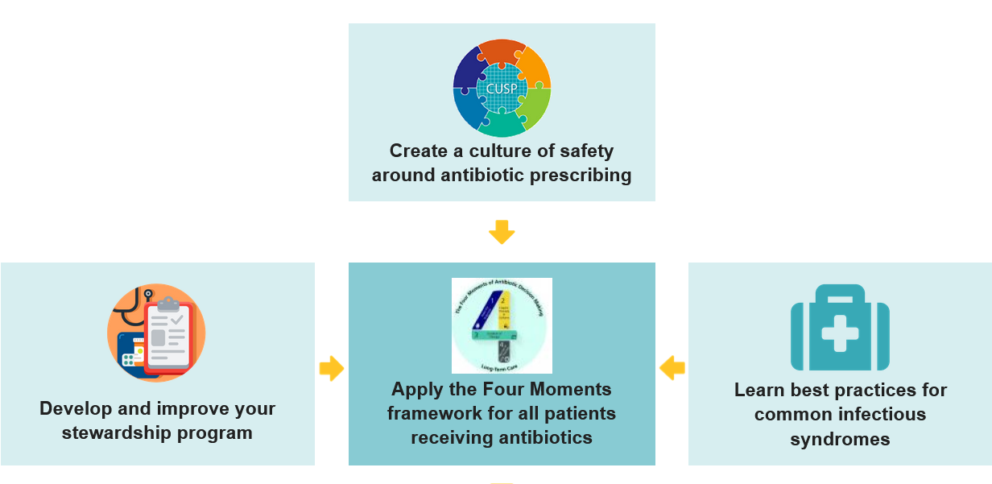
MEDICAL prescribers
Disease-specific education, with nine modules (free CME)
https://www.train.org/cdctrain/training_plan/3697
Pocket cards and one-pagers for healthcare providers
https://www.ahrq.gov/antibiotic-use/long-term-care/best-practices/posters.html
Tool Kit on antibiotic harm education
https://www.ahrq.gov/antibiotic-use/long-term-care/index.html
Notes:
TRAIN platform provides a structured way for administrators to assign and track training plans for users, while giving users some flexibility in managing their own personal training plans.
https://www.cdc.gov/antibiotic-use/index.html

Slide 14
Please type in the chat: One new educational intervention for antibiotic stewardship that you can potentially tackle in your nursing home.
Notes:
Drop into chat: https://unc.az1.qualtrics.com/jfe/form/SV_bQt1I08nFiniC10

Slide 15
Ask Why and ask 5: reliable Processes
Notes:
We talked about how to have conversations when we're starting and conducting our smart aims. Our last session was on the Core Element of Action and so it's important to continuously communicate during your QI actions. We briefly touched on the Ask 5 and the 5 Whys and today we're going to go more into that. We want to make sure that whatever you're doing and intervening on, the process is reliable, so

Slide 16
Clinical case- from event to outcome Prescriptive POST-Prescriptive
Mrs. Smith’s son is concerned his mother did not sound like herself on the phone. He is worried that his mother may have a UTI and needs an antibiotic.
Evaluation by
R.N. or M.D.
RN evaluates resident. She is less talkative today.
No complaints of dysuria or urgency, no other symptoms suggestive of an infection.
Exam negative for fever, lung findings, or abdominal tenderness. Her urine is dark and cloudy.
WHAT WOULD YOU DO?
Decision To Prescribe Antibiotic
Leading diagnosis is dehydration. The culture comes back with >100k CFU of e. coli. Nursing tries to tell the son that we will push oral hydration and monitor her closely for the next 72 hours. Son is angry about this news. MD also tries to explain we will consider IV fluids and asymptomatic bacteriuria but son says he's never heard of this.
WHAT WOULD YOU DO?
Clinical Event
Son calls NH to report patient's "not herself". Wants to know if she has a UTI?
WHAT WOULD YOU DO?
Outcome
WHAT DO YOU WANT TO HAPPEN? WHAT DO YOU DO?
How should we educate our families? What's a good process for ASB education?

Slide 17
Bridging the KNow-Do Gap
We KNOW overuse of antibiotics:
Can be harmful to the patient
Can build resistance
Unneccessary cost
Are often prescribed due to "ease" or for liability purposes
What we can DO to prevent inappropriate use:
EDUCATION
Conversation
Direct Feedback

Slide 18
High Impact
Psychological Safety
Integrating working styles conversations into team norms
Adoption of guidelines for individual and team behavior. Revisit at each quarterly working meeting
Continuous feedback ingrained in how we do work (e.g., diff ways of giving feedback)
Lead by example - leaders speak up if there’s an issue that concerns them
Learn from examples of good and bad reactions/levels of support to identify patterns
Understand the team’s desired leadership behaviors
Reflection on how we could best live up to IHI values
More conversation about the culture we want for our team
5
16
4
10
3
14
1
2
Quick Wins
Transformational Initiatives
17
13
11
Choice & Autonomy
Easy to Adopt
6
9
Hard to Adopt
Clarify roles, expectations, and scope to empower staff to take ownership of work/decisions
Budget more time per project to build in the space to think (may result in less projects per person)
Each meeting has a purpose and an agenda; if neither can be identified, cancel the meeting or send an email update
Add a day, a week, or another increment to every deliverable completion date
Block writing/thinking day that you work in your most productive environment
15
18
8
7
12
Camaraderie & Teamwork
Low-Hanging Fruit
Low-Value Efforts
RA working time - dedicated blocked time for Research Associates to engage each other in peer support
Protected team time - “coffee breaks”, outings
Get to know one another individually (Origin story? M4M?)
Foster a culture of humility by sharing our failures and fumbles
Transparent leadership communication (e.g., how projects are selected or get leadership support, selection for projects to become programs, invitation to leads call)
Nursing Communication Example of an Intervention Matrix
Low Impact

Slide 19
Where to start?
​
Leadership Preparation, Training, and Mentorship
Antibiotic Stewardship Week
In-service Training on Disease-specific infections
Interactive academic detailing
Antibiotic Stewardship contract with education
Universal handwashing
“Quick Wins”
“Transformational Initiatives”
Low Impact ← Impact on Resident Care← High Impact
ASB Hand-outs​ or Posters
ASB Announcements
Listening and Recognition
Programs (e.g. DAISY)
Daily vitals
In-service on how to perform perineal care
Daily hydration
“Low-Hanging Fruit”
“Low Value Efforts”
Easy to Adopt← Ease of Adoption ← Hard to Adopt

Slide 20
Smart aim: In the next six months, improve residents’ and families’ understanding of appropriate antibiotic use to reach 75% of residents.
Notes:
So let's say you want to focus on the core element of education and want to come up with a Smart Aim to improve the education of yoru residents and families. NOW, you could have decided on an "Action Aim" or Leadership Aim, like implementing an antibiotic time-out or a Antibiotic Stewardship Contract on admission to the nursing home, BUT let's say you feel that your residents and families don't understand asymptomatic bactereuria and you know that while education is NOT sufficient for change, it is necessary.

Slide 21
What is our current process for Educating residents and families about appropriate use of antibiotics?
Ask 5 staff
WHO does it
WHEN should it be done
WHERE is it done
HOW is it done
WHAT is needed to do it
If all staff can provide consistent answers, high likelihood it is reliable and working well.
Notes:
So when you are thinking of

Slide 22
What is our current process for educating residents and families? Is it reliable?
Common failure
Infrequent failure
(2 or more of the 5 people cannot articulate the process)
Don’t rely too heavily on EDUCATION as THE FIX
Get CURIOUS to determine WHY this is occurring
Inform staff on the WHY:
WHY is this process important
WHY do we do it this way
Get CURIOUS – WHY is the process NOT being followed???
Develop a plan to fix ONE attribute
Keep it SIMPLE!
(Only 1 of 5 or less cannot articulate the process)
Infrequent does NOT mean you have a bad process.
Don’t try to make it perfect – you will use up too many precious resources.
Talk to that one person to reeducate or determine WHY it is occurring.
Determine if there is a simple fix
MOVE ON to focus on another process

Slide 23
Goal: Improve education with families and residents about appropriate antibiotic use.
If you have a current process that does NOT work so well...
Determine if it is a COMMON or INFREQUENT failure.
OBSERVE the process or review 3 recent cases to see where the failure points occurred.
Fix ONE PIECE at a time- Keep your SMART aim SMART!
It’s more important to have a standard process than a perfect process—when you design for perfection, you get overly complex protocols.

Slide 24
Clinical case- from event to outcome Prescriptive POST-Prescriptive
Mrs. Smith’s son is concerned his mother did not sound like herself on the phone. He is worried that his mother may have a UTI and needs an antibiotic.
Evaluation by
R.N. or M.D.
RN evaluates resident. She is less talkative today.
No complaints of dysuria or urgency, no other symptoms suggestive of an infection.
Exam negative for fever, lung findings, or abdominal tenderness. Her urine is dark and cloudy.
WHAT WOULD YOU DO?
Decision To Prescribe Antibiotic
Leading diagnosis is dehydration. The culture comes back with >100k CFU of e. coli. Nursing tries to tell the son that we will push oral hydration and monitor her closely for the next 72 hours. Son is angry about this news. MD also tries to explain we will consider IV fluids and asymptomatic bacteriuria but son says he's never heard of this.
WHAT WOULD YOU DO?
Clinical Event
Son calls NH to report patient's "not herself". Wants to know if she has a UTI?
WHAT WOULD YOU DO?
Outcome
WHAT DO YOU WANT TO HAPPEN? WHAT DO YOU DO?
How should we educate our families? What's a good process for ASB education?

Slide 25
Small group discussion
What is your current process for educating residents and families about the appropriate use of antibiotics? (Who, when, where, what, how?)
Is it reliable?
What changes can you make to standardize and improve the process?

Slide 26
Next Wednesday's session
Hot Topics in Stewardship: Health IT Tools
Saif Khairah, PhD
April 24, 2024 | 11:30 AM -12 PM
Notes:
Phil slide

Slide 27
Antibiotic Stewardship Conference
Wednesday, May 22, 2024 | 9 am - 4 pm
Enterprise Center
Winston-Salem, NC
More information at spice.unc.edu/ncclasp/
Notes:
Phil slide
Note the date change from the 16th to the 15th

