Slide 1




Module B
Notes:
Welcome to Complying with the Occupational Health and Safety Administration’s Bloodborne Pathogen Final Rule. We are going to review what you will need to do to comply with OSHA’s bloodborne pathogen rule.
NOTE TO PRESENTER: Whenever you see CLICK in bold, you must click to animate in the next part of the slide. When you see AUTO, no clicks are needed, the segments will automatically advance.
If nothing is bolded there is no animation in that slide.

Slide 2





Objectives
Provide an overview of the Bloodborne Pathogen (BBP) Standard
Discuss bloodborne pathogen risks
Review the Exposure Control Plan Requirements
Discuss OSHA’s definition of Regulated Medical Waste
Discuss other measures used for control of bloodborne pathogen
Notes:
Our objectives for this module will be to
CLICKs
1 Give an overview of the OSHA rules
2 Discuss bloodborne pathogen risks
3 Review the Exposure Control Plan and its requirements
4 Discuss Regulated Medical Waste (OSHA’s definition)
5 Talk about other measures used for control of BBPs

Slide 3


OSHA
On December 29, 1970, President Nixon signed the Occupational Safety and Health Act of 1970 (OSH Act) into law, establishing OSHA.
Under the OSHA law, employers are responsible for providing a safe and healthful workplace for their workers.
OSHA Rule is required compliance under Federal Law
Notes:
On December 29, 1970, President Nixon signed the Occupational Safety and Health Act of 1970 (OSH Act) into law, establishing OSHA. Under the OSHA law, employers are responsible for providing a safe and healthful workplace for their workers. OSHA’s mission is to protect employees and today, we are specifically talking about healthcare employees.
OSHA’s regulatory focus is to have employers comply with OSHA Rules, under the authority of Federal Law.
3

Slide 4


OSHA and OSHA-NC
1970
Occupational Safety and Health Act (OSHA) General Duty Clause
“requires that employers provide every employee with a safe and healthful workplace”
1973
Occupational Safety and Health Act of North Carolina (OSHANC)
Notes:
The Occupational Health and Safety Administration (OSHA) general duty clause, requires that employers provide every employee with a safe and healthful workplace. CLICK
In addition to federal OSHA some states, including North Carolina, have a state program, which may have additional requirements.
4

Slide 5
OSHA’s Federal Regulations:
Bloodborne Pathogens
December 6th, 1991 – Standard 1910.1030; Final Rule on Occupational Exposure to Bloodborne Pathogens
January 18th, 2001 - Occupational Exposure to Bloodborne Pathogens; Needlestick and Other Sharps Injuries; Final Rule.
Additions to the exposure control plan
Sharps injury log required
Notes:
There are two major Federal Regulations addressing bloodborne pathogens:
CLICKs
The first regulation was published in the Federal Register In 1991 and was titled: Final Rule on Occupational Exposure to Bloodborne Pathogens.
The second regulation, the only revision to the original standard was published in 2001. This standard added new requirements for employers, including additions to the exposure control plan and keeping a sharps injury log .
The revision does not impose new requirements for employers to protect workers from sharps injuries; but does, however, specify in greater detail the engineering controls, such as safer medical devices, which must be used to reduce or eliminate worker exposure.
Links to both OSHA regulations are included in your resource page

Slide 6
OSHA’s Definition - “Occupational Exposure”
Includes
Healthcare employees whose duties involve “reasonably anticipated contact” with blood or other potentially infectious material
Contaminated sharps
Non-intact skin
Medical waste
Plumbing
Human bites that break the skin
Notes:
Before we move along any further, it is important to understand what OSHA means by “occupational exposure”.
CLICKs OSHA’s definition of “occupational exposure” includes those healthcare employees whose job or duties involve “reasonably anticipated contact” with blood or other potentially infectious material.
Examples may include potential or actual contact with contaminated needles, medical waste, non-intact skin or plumbing.
Also included are exposures that can occur from human bites that break the skin of a healthcare worker.
6

Slide 7
OSHA’s Definition - “Occupational Exposure”
Does not include
Healthcare employees whose duties do not involve “reasonably anticipated contact”
Good Samaritan acts, encourages voluntarily providing follow-up
Receptionist/Business Managers
Notes:
Occupational exposure does not include healthcare providers whose duties do not involve “reasonably anticipated contact”.
CLICK For example, a receptionist or business manager who may provide a Good Samaritan act.

Slide 8




BBP Standard Scope & Application
Applies to:
All private sector employees
All public sector employees
Students receiving compensation (teaching/graduate assistants, internships)
Does not include:
Self-employed persons (sole practitioners/partners)
Students not receiving compensation
Workplace hazards regulated by another federal agency (Department of Energy for example)
Employee
Self-employed
Notes:
The bloodborne pathogen standard applies to all employees that are at risk for occupational exposure to blood borne pathogens. This includes all private and public sector employees as well as any students receiving compensation.
CLICK
Employees not covered under the standard include self employed persons and students not receiving compensation. Employees exposed to workplace hazards, regulated by other federal agencies, Department of Energy for example are also not covered.
CLICK In the dental setting, if your physician is a sole practitioner and owns the practice he would not be covered under the standard, however his employees would be.

Slide 9
Contract Provided Services
Employer Paying for Contract Services
(Host)
Employer Providing for Contract Services
(Contractor)
Site or department specific bloodborne pathogen training
Providing department specific personal protective equipment (PPE) and training on use
Primary responsibility for control of potential exposure conditions
General bloodborne pathogen training at time of hire and annually thereafter
Offer HBV vaccination
Follow up on occupational exposure
Notes:
Sometimes employers are confused about who is responsible, under OSHA, for contract employees.
CLICKs
Both the host and the contract employer share responsibilities for assuring the employee is protected from workplace hazards.
The host employer is responsible for:
Site specific bloodborne pathogen training,;
Providing department specific personal protective equipment and training on use; and
Primary responsibility regarding the control of potential exposure conditions.
The contract employer is responsible for:
General bloodborne pathogen training at time of hire and annually;
Offering HBV; and
Providing follow up in the event an occupational exposure occurs.
Contracts should clearly describe the responsibilities of both parties.

Slide 10

Knowledge Check
True or False?
OSHA’s rules apply to:
All private sector employees
Students receiving compensation
Self employed persons
True
False
Notes:
CLICK for answer
The answer is false: OSHA does not cover self employed persons

Slide 11


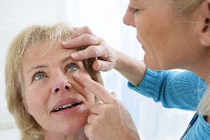
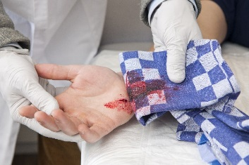
Types Of Occupational Exposures To Bloodborne Pathogens
Percutaneous injury (PI)
Mucous membrane
Non-intact skin
Notes:
11
Healthcare employees work in a high risk environment, and have the potential for exposure to a variety of potentially infectious body fluids that can harbor bloodborne pathogens.
CLICKs
Occupational exposure may occur via
percutaneous injury (needlesticks)
mucus membrane (splashed in eyes or mouth)
or non-intact skin

Slide 12

Body Fluids Linked to Transmission of HBV, HCV and/or HIV
Other Potentially Infectious Material (OPIM) includes:
semen
vaginal secretions
cerebrospinal fluid
synovial fluid
pleural fluid
pericardial fluid
peritoneal fluid
amniotic fluid
saliva in dental procedures
Blood
any body fluid that is visibly contaminated with blood, and all body fluids in situations where it is difficult or impossible to differentiate between body fluids
Notes:
Blood may be the most common body fluid linked to transmission of HBV, HCV and/or HIV
CLICK
but other body fluids, known as other potentially infectious material (or OPIM) are also recognized by the CDC as being linked to transmission

Slide 13
Bloodborne Pathogens
1910.1030(b)
Pathogenic organisms that are present in human blood and
Can cause disease in humans
Includes but is not limited to:
Hepatitis B virus (HBV)
Hepatitis C virus (HCV)
Human immunodeficiency virus (HIV)
Notes:
It is important to remember that bloodborne pathogens include any pathogenic organism, present in human blood or body fluids that can cause disease in humans.
In healthcare settings, three pathogens of most concern, for bloodborne transmission, are HIV, Hepatitis B virus and Hepatitis C virus.

Slide 14

Knowledge Check
True or False:
Bloodborne pathogens include any pathogenic organism that is found in the human blood and is capable of causing disease in humans.
True
False
Notes:
CLICK for answer
The answer is true, while HIV, HBV and HCV are the most common, any disease-causing pathogen counts.

Slide 15


Written Exposure Control Plan (ECP)
Bloodborne Pathogen Exposure Plan MUST:
Be reviewed/updated annually
Be updated when procedures or equipment change
Be made accessible to all staff
Contain all components of BBP rule
Notes:
We have discussed OSHA’s intent to protect healthcare personal from exposure to bloodborne pathogens and now we are going to cover what is required of the employer.
Every healthcare facility is required to have a written bloodborne pathogen exposure control plan.
CLICKs
The plan must:
be reviewed and updated annually, within 365 days of the last review,
and whenever procedures or equipment are changed or modified
The plan must be made accessible to all staff.
And the plan must contain all the required components specified in the bloodborne pathogen rule.
15

Slide 16
Exposure Control Plan
Contains:
Exposure determination
Methods of Compliance
Hepatitis B Vaccination and Post-Exposure Evaluation and Follow-up
Communication of Hazards to Employees
Recordkeeping requirements
Procedure for evaluating circumstances surrounding exposure incidents.
Notes:
As we just mentioned the OSHA Final Rule specifically states that the exposure control plan should include all the following elements:
CLICKs
How the facility is going to decide employees that might be at risk for exposure
Outline methods, for example engineering controls, that are going to be used to ensure compliance
Description of the HBV vaccination and post-exposure follow up program
How hazards are going to be communicated to staff, for instance bio-hazard signs
What and how long are records to be kept and maintained
How circumstances around exposure incidents are going to be evaluated
On the next few slides, we will discuss each of these in more detail

Slide 17

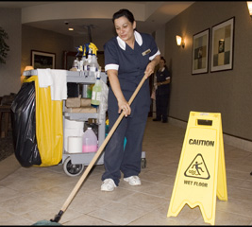

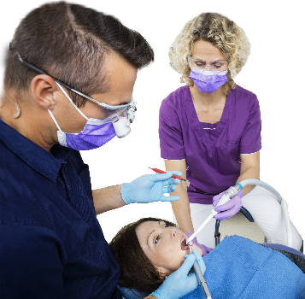
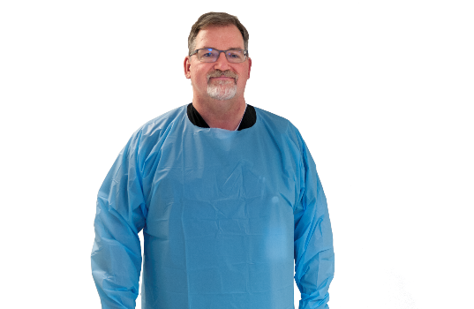
Exposure Determination
Physicians and surgeons
Housekeeping workers
Clinical/diagnostic laboratory workers
Medical technologists
Dentists and dental workers
Nurses
Notes:
AUTO The first component included in the plan is making a determination which employees have anticipated occupational exposure. This means that as part of their normal job duties and responsibilities they are likely to come in contact with blood and/or any of the other body fluids we discussed.
All job classifications in which employees have occupational exposure to blood and other potentially infectious materials should be identified and included in the plan.
Exposure determination should be made without regard to the use of personal protective equipment.
Above are just a few examples of employees who may be at risk at your facility

Slide 18



Methods of Compliance (MOC)
ID
OSHA
Requires
implementation of specific measures
Specifies order of measures
Notes:
Once at-risk employees have been identified,
CLICKs OSHA not only requires implementation of specific measures to protect them, but also specifies in what order the measures should be implemented.

Slide 19

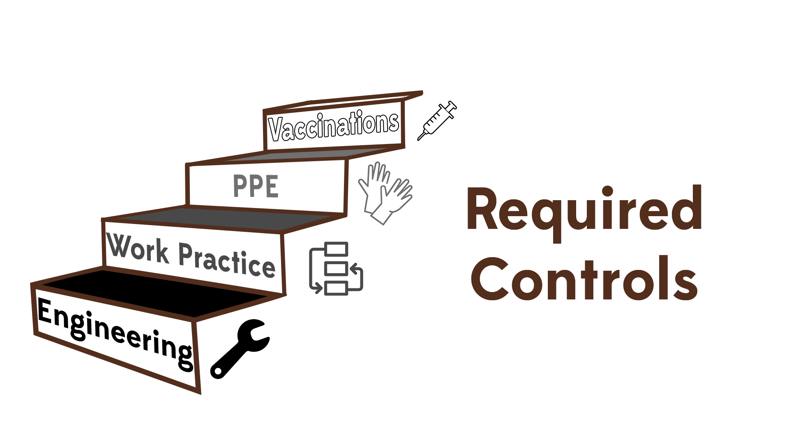
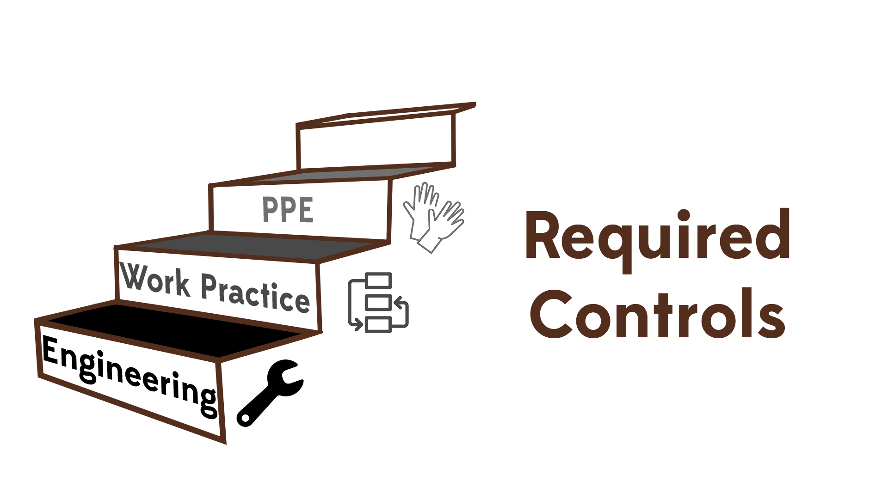


Methods of Compliance (MOC)
Notes:
The required controls, in order of implementation are:
CLICKs
Engineering controls
Work Practice controls
Personal Protective Equipment, or PPE
And Vaccinations

Slide 20
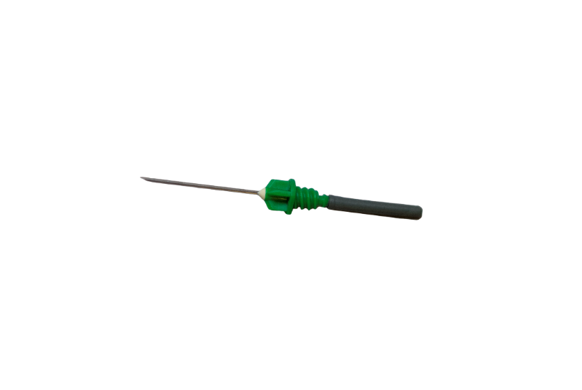
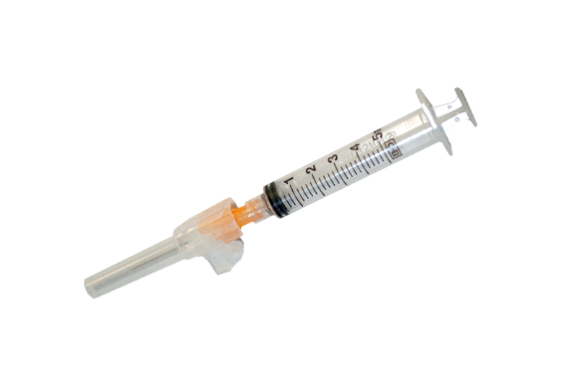
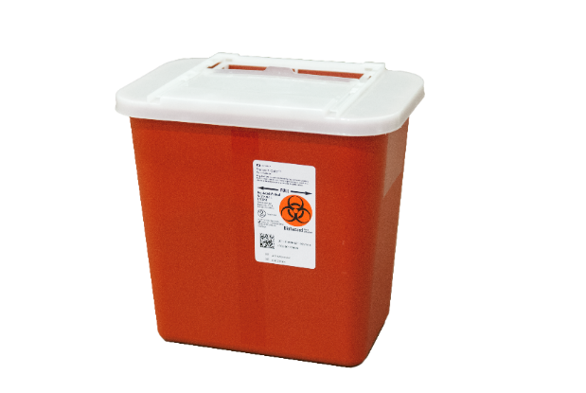

Engineering Controls
Remove the hazard from the employee
Should be used in preference to other controls
Employer must:
Review annually
Train employee on use
Document in ECP
Needless
devices
Safety needles
Safety sharps
Sharps containers
Required by OSHA
Notes:
Engineering controls are defined as controls that isolate or remove the hazard from the workplace and are required by OSHA as the first line of defense to eliminate or minimize employee exposure.
Some common examples CLICK of engineering controls include safety needles, other safety sharps, sharps disposal containers and needless devices.
CLICKs
Employers are required
to review and evaluate any available new engineering control devices, annually,
train the employees on use and disposal and
document evaluation and implementation in the exposure control plan (ECP)

Slide 21




Needlestick Safety and Prevention Act (2001)
2001
Act
Revised BBP standard
Requires documentation of frontline provider (non-managerial) participation in the evaluation of safety devices and decision making in product purchasing.
Directs OSHA to revise BBP standard to clarify requirement for employers to evaluate safer needles and involve employees in identifying and choosing devices.
Notes:
As a result of increasing concern over sharps injuries in healthcare settings, Congress passed the Needlestick Safety and Prevention Act directing OSHA, to revise the bloodborne pathogens standard and require employers to identify and make use of effective and safer medical devices. This revision became effective April 18, 2001.
CLICK
A major component of this revision requires documentation of non-managerial employee participation in the evaluation of safety devices and decision making in product purchasing.
21

Slide 22
OSHA Enforcement Revision – Action List
Collect data on device-related injuries including:
How exposure occurred
Type and brand of device
Circumstances of injury
Job category
Use information on injuries to guide the selection and implementation of safety devices
Notes:
The 2001 OSHA Enforcement Revision also requires employers collect data on device-related injuries including:
CLICKs
how exposure occurred,
the type and brand of device,
the circumstances involved with the injury ( i.e. what time of day it was and the location where the injury occurred),
type of sharp injury (i.e. puncture versus cut),
the procedure or activity when injury occurred, and
the job category of the injured healthcare provider.
Findings from this evaluation should be used to guide the selection and implementation of safety devices for your facility.
22

Slide 23

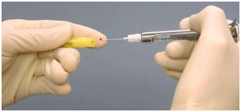


(MOC): Work Practice Controls
Alterations in the manner in which a task is performed to reduce likelihood of exposure
Perform hand hygiene as soon as possible after glove removal or contact with body fluids
All PPE removed as soon as possible after leaving work area and placed in designated container for storage, decontamination, or disposal
Used needles and sharps shall not be sheared, bent, broken, recapped or resheathed by hand.
Notes:
Engineering controls can not remove all hazards in the work place. As a result OSHA specifies that Work Practice Controls should be the next measure to protect employees.
CLICKs
Work Practice Controls are defined as “alterations in the manner in which a task is performed to reduce the likelihood of BBP exposure”. exposure.
Some examples of work practices include
performing hand hygiene as soon as possible after glove removal or contact with body fluids,
removing all PPE as soon as possible after leaving work area and placing in a designated container for storage, decontamination, or disposal,
removing devices that may allow used needles and sharps to be sheared, bent, broken, recapped or re-sheathed by hand.
23

Slide 24

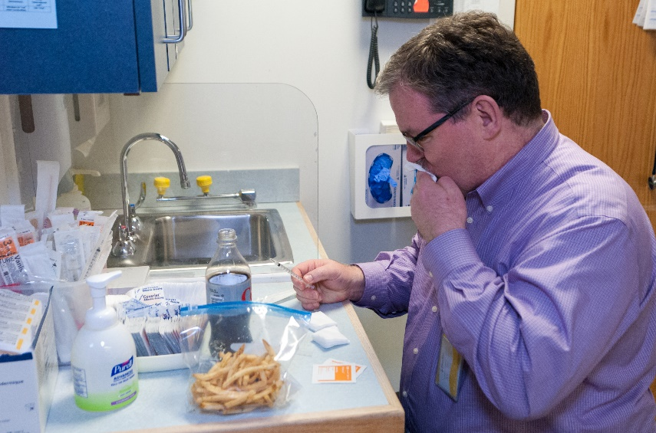
(MOC): Work Practice Controls
Eating, drinking, smoking, applying cosmetics or lip balm and handling contact lenses are prohibited in work areas where there is a reasonable likelihood of occupational exposure.
Notes:
AUTO Eating and/or drinking should not be allowed in work areas when there is a reasonable likelihood of an occupational exposure. In dental settings staff should be educated and aware of appropriate locations for food and drink (staff lounges for example)

Slide 25

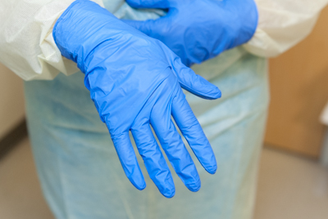

(MOC): Personal Protective Equipment (PPE)
Gloves, masks, protective eyewear
Puncture-resistant gloves
Ventilation Devices
Employers must provide
and assure use
Notes:
When exposure risks cannot be mitigated by engineering controls with safety devices or reduced by work practice changes and the risk of exposure to BBP remains possible, then the use of personal protective equipment (PPE) is the last in the hierarchy of control measure categories.
CLICK
PPE is specialized clothing or equipment used by healthcare providers to protect themselves from direct exposure to blood or other potentially infectious material.
CLICK
Employers must first provide and also assure that the employee uses the appropriate PPE such as gloves, gowns, fluid resistant aprons, face shields or masks, and eye protection.
Personal protective equipment must be removed before leaving the work area (generally considered to be an area where work involving occupational exposure occurs or where the contamination of surfaces may occur).
For example, in a dental operatory.
25

Slide 26

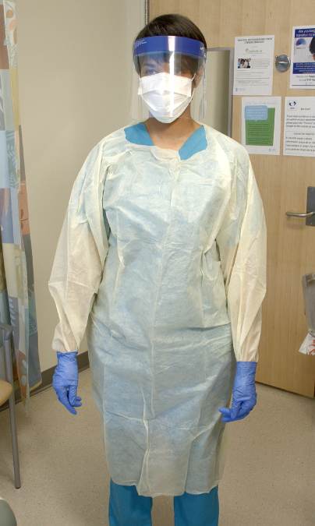
Personal Protective Equipment: The Rules
Mechanism must be in place for cleaning, laundering or disposing of employees’ protective clothing.
Must be provided by the employer at no cost, in appropriate sizes and housed in accessible locations for the employee.
Mechanism must be in place for replacement or washing of an employee-owned uniform or clothing if it becomes contaminated.
(OSHA required)
Notes:
In addition to ensuring employees use PPE, employers must also:
CLICKs
Provide, clean, launder and dispose of PPE, at no cost to the employee.
Make available in appropriate sizes, and make available in accessible locations for employees
In the event an employee’s personal clothing should become contaminated there should be a mechanism in place to provide replacement clothing at time of event and to launder the employee’s personal clothing.
26

Slide 27
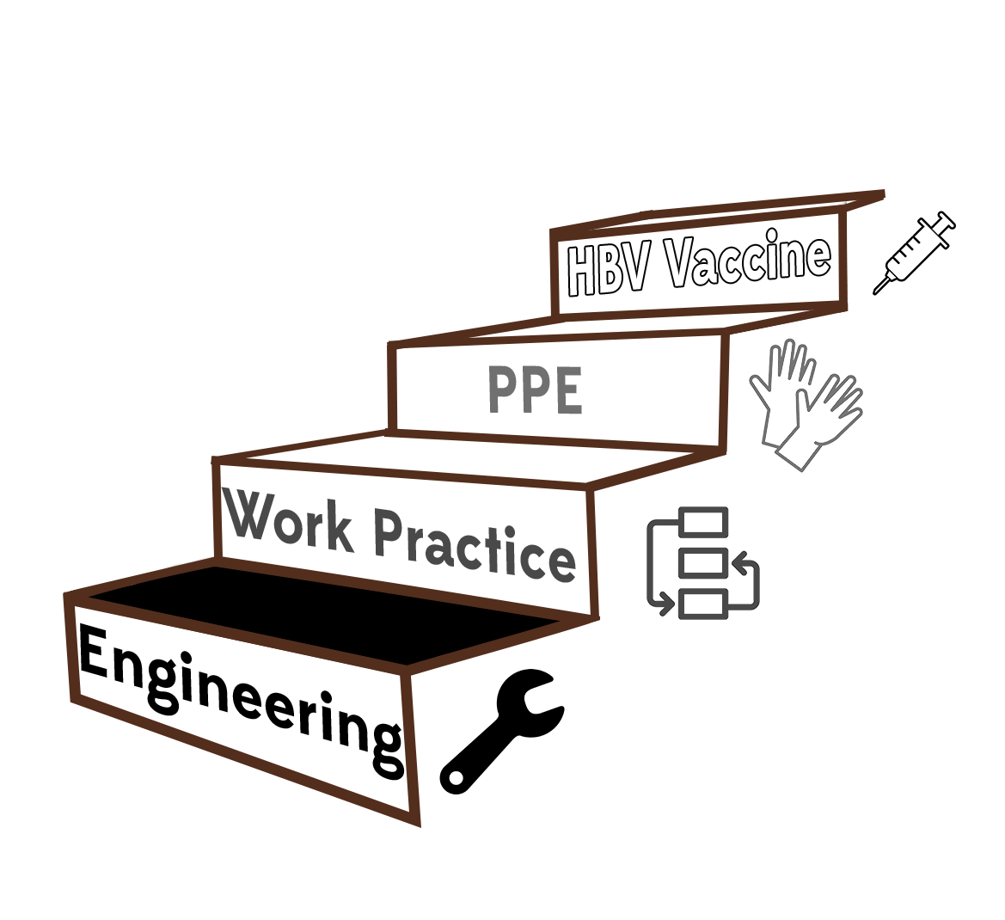
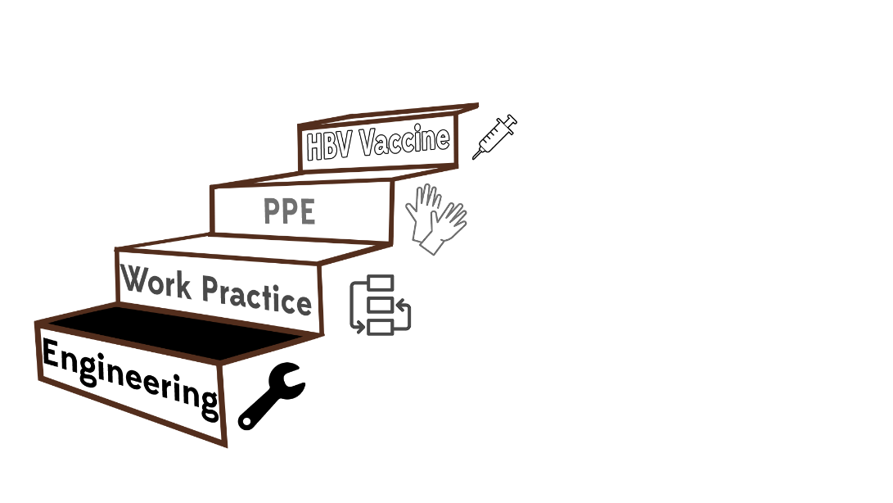
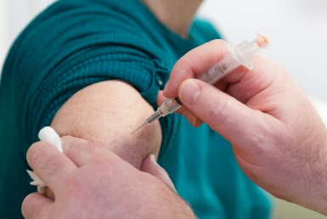

(MOC): HBV Vaccination
HBV vaccination has to be:
Offered at no cost
Offered after training
Within 10 days assignment
Vaccinations given according to recommendations for standard medical practice.
A declination form must be signed by employee who refuses the HBV vaccination (including those who do not complete the recommended series).
Notes:
Now we are going to discuss the requirements for HBV vaccination
CLICKs
Hepatitis B vaccination has to be:
offered, at no cost to the employee,
after training is provided on the epidemiology of Hepatitis B virus and the efficacy of the Hepatitis B vaccine, and
within 10 days of initial job assignment.
Given in accordance with recommendations for standard medical practice
Employees who refuse the hepatitis B vaccine for any reason or do NOT complete the entire recommended series immunization must sign a declination form. This means that if the employee receives the first vaccination but fails to return for any of the remaining vaccinations employers must obtain a declination form for any of the missing HBV immunizations.
27

Slide 28
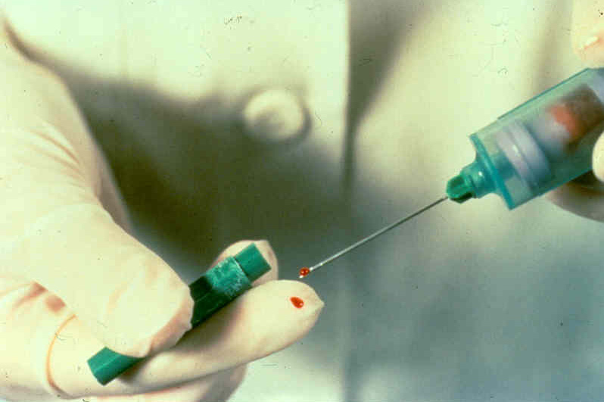
Module B
Notes:
Despite employers and healthcare providers best efforts using all the control measures just described, exposures sometimes do still happen. Employers who have employees at risk for BBP exposure must have a post-exposure policy in place.
28

Slide 29
Post - Exposure Evaluation and Follow Up
Following a report of an exposure incident, the employer shall make:
Immediately available to the employee a confidential medical evaluation and follow-up including the following:
Document the route of exposure
Document the HIV, HBV and HCV status of source person, if known
Notify the source person an exposure has occurred
Test the source person for HIV, HBV and HCV (unless status known)
Offer baseline testing to employee
Offer counseling and post exposure prophylaxis, if indicated
Notes:
The following steps must take place when it is determined that an exposure has occurred.
CLICKs
Immediately provide the employee with a confidential medical evaluation and follow up
Document the route of exposure
Document the HIV, HBV and HCV status of the source person, if known
Notify the source person that an exposure has occurred
Test the source person for HIV, HBV and HCV (unless status known)
Offer baseline testing for the exposed person
Offer counseling and post exposure prophylaxis if indicated
29

Slide 30
Post Exposure and Follow Up
Notes:
Once the post-exposure evaluation has been completed the employer should obtain a copy from the evaluating healthcare professional and provide it to the employee within 15 days . Facilities should identify the healthcare professional responsible for the post-exposure evaluation (physician, urgent care center, employee health etc.,) and include that information in your ECP

Slide 31
Record Keeping Requirements
Medical Records
Record keeping requirements
Must maintain and keep confidential an accurate record for each employee with occupational exposure
Name and SS #
HBV status
Copy of results of post-exposure follow up
Copy of the healthcare professional’s written opinion
Must maintain for at least the duration of employment plus 30 years
Notes:
OSHA also requires every employer to establish and maintain an accurate record for each employee with occupational exposure and the record must be maintained in a confidential manner. Medical records should not be filed with the employee’s regular personal file.
File should contain the information you see in the slide and those records must be maintained for the duration of employment PLUS 30 years

Slide 32
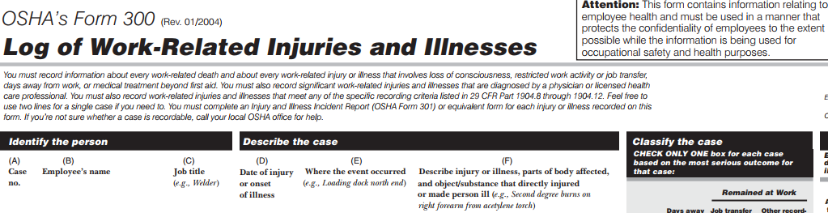
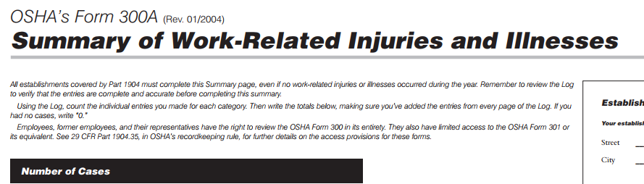
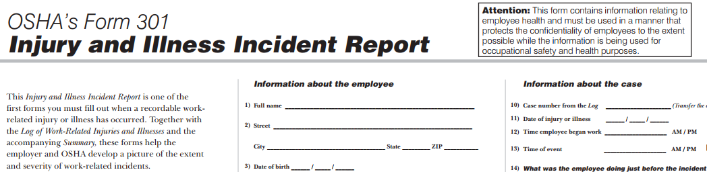
Revisions to OSHA’s Recordkeeping Rule, 2001, Requires a Record of All Sharps Injuries
Notes:
AUTO A record of all sharp injuries in your facility, must be maintained. OSHA sharps injury log(s) that can be obtained from their website include Form 300; form 300A and Form 301.
The website link is included in your list of resources.
https://www.osha.gov/recordkeeping/new-osha300form1-1-04-FormsOnly.pdf
32

Slide 33

Knowledge Check
The written exposure control plan must include:
A list of jobs in which employees have anticipated occupational exposure to blood
A description of the existing engineering controls
Procedures for follow-up if an exposure occurs
A description of work practice controls
All of the above
Select the correct response
Notes:
CLICK for answer
Correct response E, all of the above

Slide 34
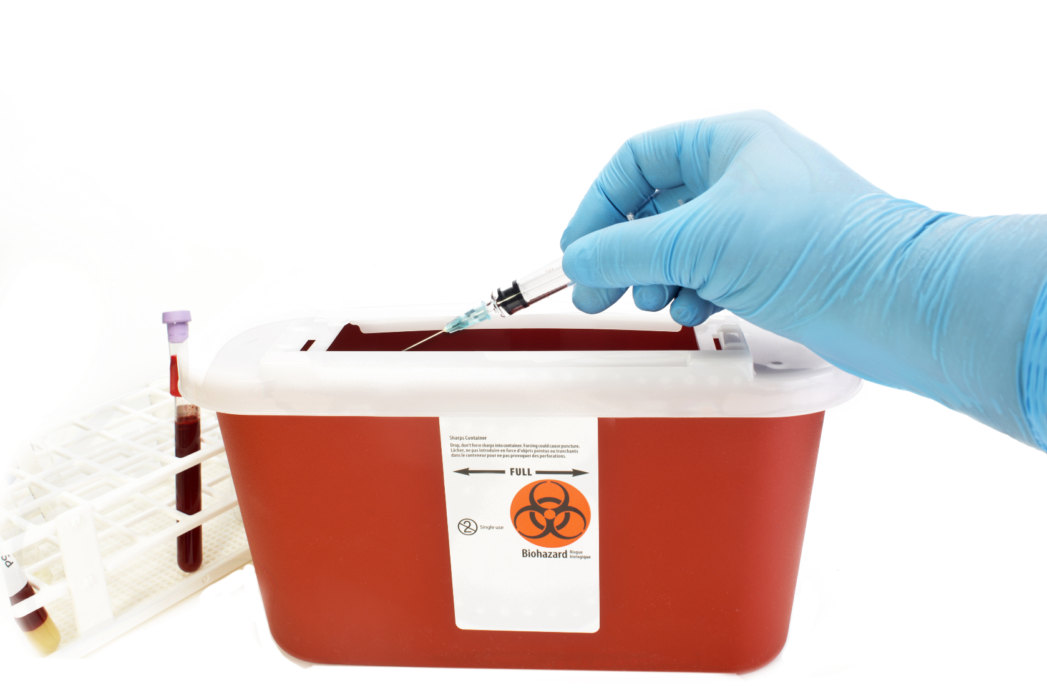
Definition of Regulated Medical Waste: OSHA
OSHA regulates identification and labeling of medical waste
Notes:
So far, we have discussed several OSHA requirements to ensure employee safety. An additional OSHA requirement is items that could potentially be a source of exposure must be easily recognizable by the employee. You’ll recall that in module A we discussed medical waste with regard to North Carolina law. While North Carolina regulates the disposal of medical waste, OSHA regulates identification and labeling of medical waste to protect the employee.

Slide 35
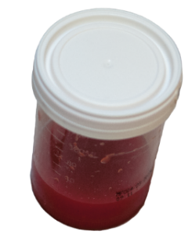
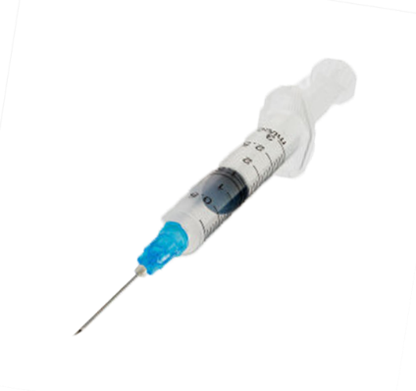


Definition of Regulated Medical Waste: OSHA
Regulated Waste means:
Liquid or semi-liquid blood or other potentially infectious materials
Contaminated items that would release blood or other potentially infectious materials in a liquid or semi-liquid state if compressed
Items that are caked with dried blood or other potentially infectious materials and are capable of releasing these materials during handling
Contaminated sharps
Pathological and microbiological wastes containing blood or other potentially infectious materials
Notes:
OSHA’s definition of regulated medical waste includes items that may pose a risk to the employee and therefore must be labeled to communicate that risk. This definition includes the following:
CLICKS
Liquid or semi-liquid blood or other potentially infectious material
Contaminated items that would release blood or other potentially infectious material if compressed
Items that are caked with dried blood or other potentially infectious materials and are capable of releasing these materials during handling
Contaminated sharps
Pathological waste
Microbiological waste
Examples of OSHA regulated medical waste may include items like bloody gauze, saturated dressings and bloody tubing
In the next few slides we will talk about how to manage items OSHA considers to be regulated medical waste

Slide 36
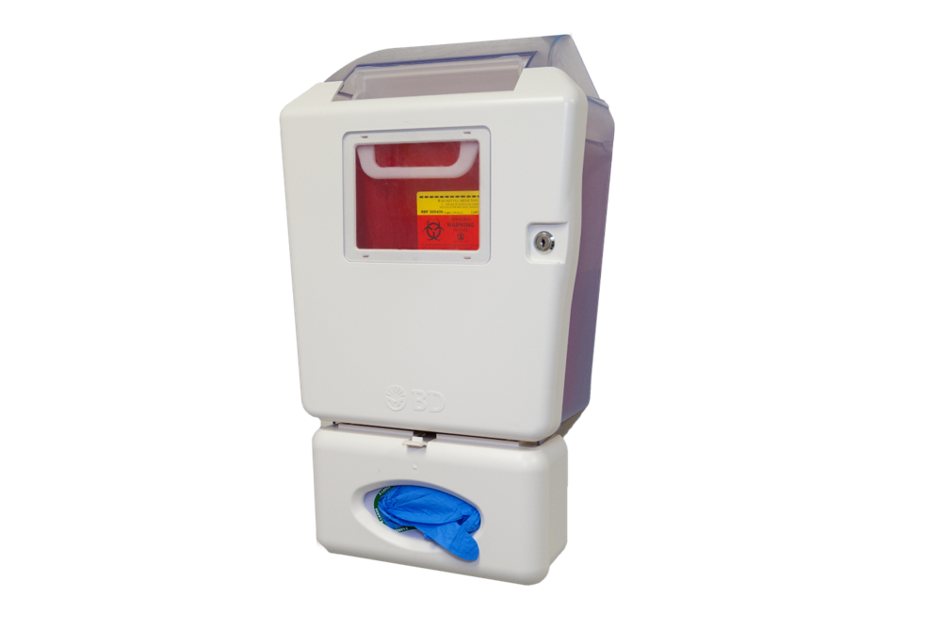
Packaging of Regulated Medical Waste
Sharps containers shall be:
Other regulated medical waste containers shall be:
Closable
Puncture Resistant
Leak-proof on sides and bottom
Labeled
Readily accessible
Maintained in an upright position
Replaced routinely and not allowed to overfill
Closable
Constructed to contain all contents and prevent leakage
Labeled
Closed prior to removal
Placed in a secondary container if outside of container becomes contaminated
Notes:
All regulated medical waste, including sharps must be placed in containers that will reduce the risk of exposure to the employee.
Sharps must be placed in containers that are closable, puncture resistant, leak proof on sides and bottom, labeled with a biohazard symbol or be red in color, maintained in an upright position, readily accessible and not allowed to overfill
CLICK
Other items meeting OSHA’s definition of regulated medical waste must be placed in containers that are closable, constructed to contain all contents and prevent leakage, must be labeled with a biohazard symbol or be red in color, closed prior to removal and if the outside of the container becomes contaminated must be placed in a secondary container.

Slide 37


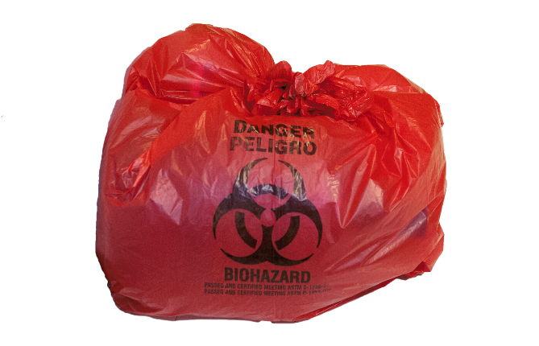
Comprehensive Hazard Communication Program
Warning labels shall be affixed to:
Containers of regulated medical waste
Refrigerators and freezers containing blood or other potentially infectious material
Other containers used to store, transport or ship blood or other potentially infectious materials
Notes:
OSHA requires warning labels be placed on:
CLICKs
Any container of regulated medical waste
Refrigerators/freezer that contain blood or other potentially infectious material
Any other container used to store, transport or ship blood or other potentially infectious material

Slide 38
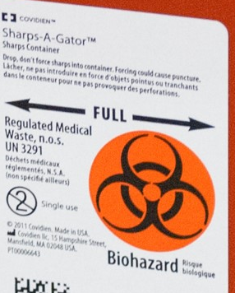
Comprehensive Hazard Communication Program
Labels must be:
Containers of regulated medical waste
Refrigerators and freezers containing blood or other potentially infectious material
Other containers used to store, transport or ship blood or other potentially infectious materials
Fluorescent orange or orange-red
With lettering and symbols in contrasting color
Shall include the word biohazard or the symbol
Red bags or red containers may be substituted for labels
Notes:
Those warning labels must be fluorescent orange or orange-red, must contain the word biohazard or the symbol and the lettering/symbols should be in contrasting colors
Red bags or red containers may be substituted for the labels
There are, however, a few exceptions. For example, blood and/or blood components that have been released for transfusion do not have to be labeled. Additionally, regulated medical waste that has been decontaminated does not have to be labeled.

Slide 39
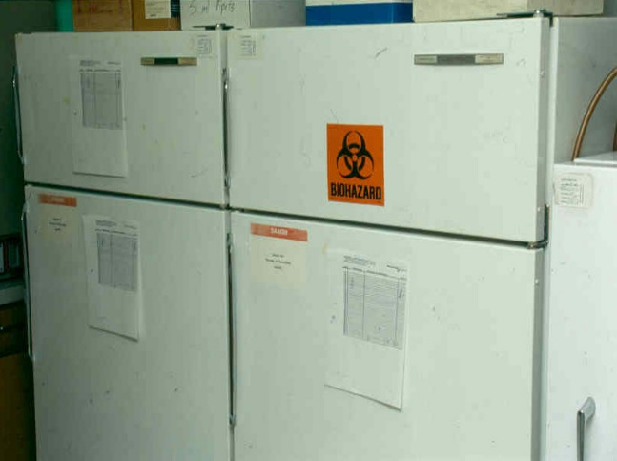

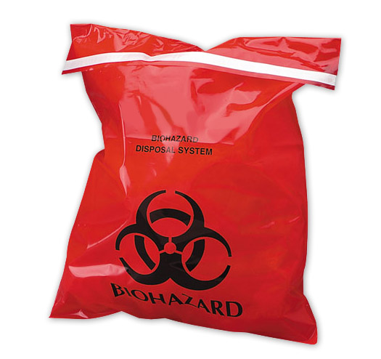
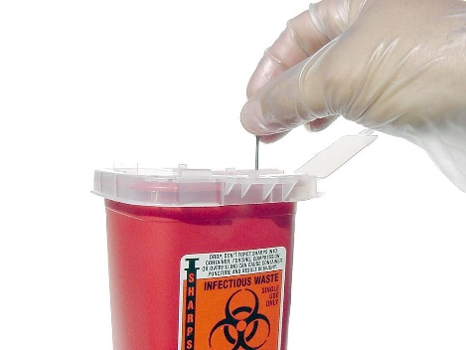
Tags, Labels, and Bags
Notes:
AUTO Here are some examples of tags, labels, containers and bags.
Another point to remember is equipment that may be contaminated with BBPs should be completely decontaminated prior to being shipped offsite for repairs or returned to the rental company. If the equipment or parts of it cannot be completely cleaned and disinfected prior to transport, it must be tagged with a biohazard label, to communicate the hazard.
39

Slide 40


Handling Specimens
Specimens collected and transported inside the facility do not need to be labeled, if employees are trained and compliant with Universal (Standard) Precautions
Employers MUST label or color-code specimen containers whenever they leave the facility.
Notes:
Specimens collected and transported inside the facility do not need to be labeled as long as all staff members have been trained and are compliant with Standard Precautions.
CLICK
However, employers must label or color-code specimen containers whenever they leave the facility.
40

Slide 41
Knowledge Check
True or False:
OSHA’s definition of regulated medical waste includes all of the following:
Blood and other potentially infectious material
Dressings with dried blood that can be flaked off
Contaminated sharps
True
False
Notes:
CLICK for answer
The answer is true,

Slide 42
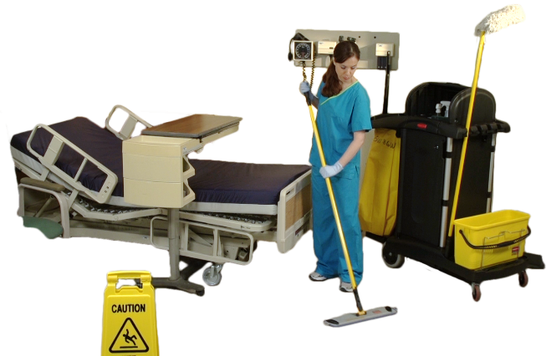
Housekeeping Practices
Employer shall assure that the worksite is maintained in a clean and sanitary condition.
Employer shall determine and implement an appropriate cleaning schedule for rooms at risk for BBP
contamination, depending on the site, type of surfaces, and amount of soil present.
Employer shall ensure that staff wear appropriate PPE during all cleaning of BBP and decontamination procedures.
Notes:
Healthcare employee’s physical environment may also serve as a source of exposure.
CLICKs
Employers must assure that the worksite is maintained in a clean and sanitary condition.
Determine an appropriate cleaning schedule
Ensure that staff wear appropriate PPE
42

Slide 43
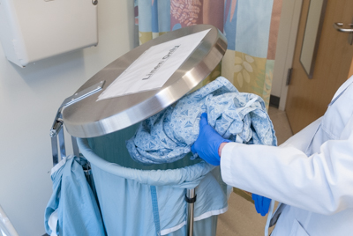
Laundry Practices
Use of appropriate PPE during handling and sorting of contaminated linen
Contaminated laundry bagged at point of use
Use standard precautions when handling all contaminated laundry
Notes:
In addition to the environment contaminated linen may be a potential source of exposure to healthcare employees. Laundry should be managed safely to reduce that risk.
CLICKs
Appropriate PPE should be used when handling and sorting contaminated linen
Linen should be bagged at point of use (not carried by hand to a soiled utility room) and
Standard Precautions should be used for all contaminated linen.
43

Slide 44

Education and Training
Employers must train at-risk employees:
At no cost and on paid time
At time of initial assignment and
At least annually thereafter
If new occupational exposure is recognized from the literature
Or new procedure or use of a new type of equipment is introduced
Notes:
We have almost arrived at the end of this module, but OSHA also has requirements for employee education and training, including:
Employers must train employees:
CLICKs
at no cost and on paid time
at the time of initial assignment
at least annually thereafter,
if a new source of occupational exposure is recognized from reports in the literature, or
a new procedure or type of equipment is initiated in the facility or the organization.
44

Slide 45
Employee Training
Training requirements:
Be conducted by someone knowledgeable in the subject matter covered and how it relates to the workplace
Provide an opportunity for interactive questions and answers with the individual conducting the session.
Notes:
It is very important to remember that the person conducting the training shall be knowledgeable in the subject matter and the employee has the opportunity for interactive Q&A session with the individual conducting the session.

Slide 46


Accessible copy of regulatory text
Information on types, proper use, location, removal, handling and disposal of PPE
Explanation of epidemiology and symptoms of BBP
Explanation of modes of transmission
13
topics
Information on appropriate actions to take and persons to contact in an emergency involving blood or OPIM
Explanation of employer’s ECP and how to get a copy
Information on post-exposure evaluation
Explanation of procedure for post exposure follow up
Explanation of how to recognize task that may involve exposure
Explanation of the basis for PPE selection
Explanation of appropriate use of engineering controls, work practice and PPE
Explanation of the signs and labels and/or color coding required
Information on Hepatitis B vaccine
Notes:
AUTO There are 13 topics that must be included in the OSHA training. Those are:

Slide 47
Recordkeeping
The employer must keep training records with the following information:
The dates of the training session
The contents or a summary of the training session
The names and qualifications of the persons conducting the training
The names and job titles of all persons attending the training sessions
Employers must keep these records for 3 years from the date of the training session
Notes:
We have presented a lot of very important information, and we have one more topic to cover. OSHA requires that all healthcare organizations must keep training records with the following information:
CLICKs
The dates of the training session,
The contents or a summary of the training session,
The names and qualifications of the persons conducting the training,
The names and job titles of all persons attending the training sessions
Employers must keep these records for 3 years from the date of the training session and OSHA will request these records if they survey your facility.
47

Slide 48
OSHA: North Carolina
Deputy Commissioner - (919) 707-7800
Consultative Services - (919) 707-7846
ASK OSH - (919) 707-7876
NC Department of Labor – 800-NCLABOR
Notes:
If you would like to contact NC OSHA directly, this slide contains some pertinent phone numbers. OSHA also provides consultative services to answer questions about OSHA rules and implementation.
48

Slide 49



Notes:
Before me move on to the next module, are there any additional questions regarding OSHA BBP Pathogen Standard?

