Slide 1

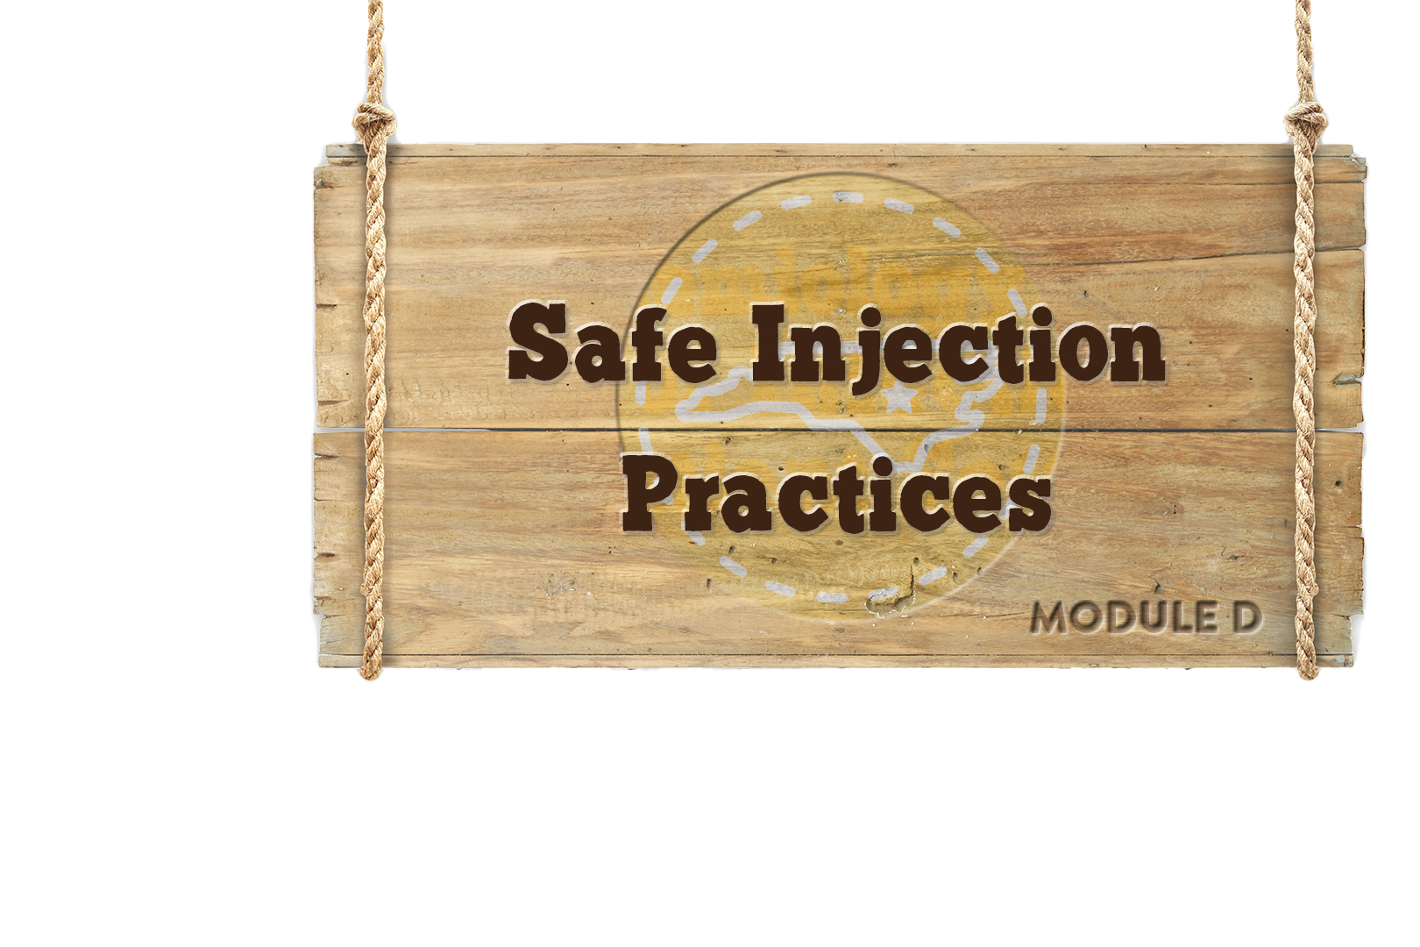


Module D

Slide 2



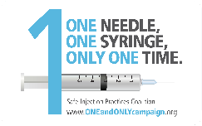
Objectives
Discuss the consequences of unsafe injection practices
Describe outbreaks
Discuss safe injection best practices
Describe One and Only Campaign
Notes:
In this module we will:
Discuss some of the large outbreaks, (causes and consequences) that have occurred due to unsafe injection practice
Discuss recommended best practices for safe injections and blood glucose monitoring
Describe One and Only Campaign.

Slide 3

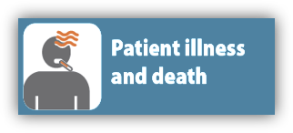




Unsafe Injection Practices
Notes:
AUTO When unexpected, adverse events, like outbreaks, happen in healthcare the results are devastating, sometimes resulting in patient illness and deaths.
Often times many patients have to be contacted and told that they may have been exposed to an infectious agent while receiving healthcare. As you can image this creates a great deal of stress and anxiety for patients and their families, even if no actual transmission has occurred.
In addition to patients being harmed healthcare providers may have their professional license revoked , be sued for malpractice and even have criminal charges filed.

Slide 4
Outbreaks in Outpatient Settings
Outbreaks and patient notifications have occurred in a variety of settings including:
  Primary care clinics
  Pediatric offices
  Cosmetic surgery centers
  Pain remediation clinics
Infection Prevention breaches included but may not have been limited to the following:
  Reuse of syringes
  Failure to properly reprocess
  reusable equipment
  Lack of aseptic technique while
  preparing medications
  Cancer (oncology) clinics
  Pain Management clinic
  Dental practices
  Reuse of single dose vials
  Drug diversion by a healthcare provider
Notes:
Just to give you an example of outbreaks and patient notifications in outpatient settings:
CLICK
CDC notes that these events occur in a variety of outpatient settings including primary care clinics, pediatric offices, cosmetic surgery centers, pain remediation clinics, dental practices, imaging facilities, and cancer (oncology) clinics.
For example, in a pain management clinic hepatitis B and C transmission occurred and resulted in over two thousand patient notifications.
CLICK
Infection Prevention breaches included, but not limited to:
Reuse of syringes to access medication vials used for > 1 patient
Failure to properly reprocess reusable equipment
Lack of aseptic technique while preparing medications
Reuse of single dose vials
Drug diversion by a healthcare provider

Slide 5

NC Viral Hepatitis Outbreaks
Healthcare Setting | Breach in Infection Prevention
Long Term Care | Assisted blood glucose monitoring (ABGM)
 | Exposed - 504 Infections - 31 Deaths - 6
Cardiology Clinic | Syringe reuse and contaminating multi-dose vials
 | Exposed - 1200 Infections - 5
Reported To CDC 2008-2017
Notes:
Unfortunately, outbreaks related to unsafe injections and glucose monitoring have occurred right here in North Carolina. State and local public health agencies have investigated 5 outbreaks: one hepatitis C outbreak at a cardiology clinic due to syringe re-use, and four outbreaks in long term care facilities due mainly to unsafe diabetes care.

Slide 6

Knowledge Check
Which of the following statements is correct?
CDC reports that most outbreaks occur in the hospital
Outbreaks of HIV are the most common type of outbreak
CDC reports that most outbreaks occur in non-hospital settings and are associated with breaches in infection prevention, including unsafe injection practices
Notes:
C is correct, Most reported outbreaks occur in outpatient settings and are associated with breaches in infection prevention including unsafe injection practices

Slide 7
Dental Outbreaks 2002-2013
Study | Year Reported Practice Setting | Pathogen (# infected) | # Notified for Screening | Dental Treatment Provided | Known or Suspected Mode of Transmission
2007 Redd and Colleagues | 2002 Oral surgeon’s practice | HBV (1) | 27 | Extractions with IV Sedation | Environmental contamination with blood due to lack of adequate cleaning
2013 Radcliffe and Colleagues | 2009 Free dental clinic conducted in school gymnasium | HBV (5) | >1,500 | Extraction and restorations | Multiple infection breaches including inadequate preparation and sterilization of instruments
2015 Bradley | 2013 Oral surgeon’s practice | HCV (1) | 5,810 | Extraction, bone graft, implant with IV sedation | Multiple infection breaches including unsafe injection practices; improperly sterilized dental equipment and environmental contamination
Notes:
Despite the CDC “Guidelines for Infection Control in Dental Health-Care Settings” there are ongoing reports of adverse events, including patient notifications, resulting from health care and dental personnel failing to adhere to standard precautions and basic infection control practices. In dental settings, failures include reuse of disposable needles and syringes used for IV sedation.
The CDC has reported three outbreaks specific to dental practice settings, the first occurred in 2002 and the most recent occurred in 2013. As a result, greater than seven thousand individuals had to be notified of possible exposure and seven individuals were reported to have acquired viral hepatitis as a result of the exposure.
https://www.cdc.gov/OralHealth/infectioncontrol/pdf/safe-injection-practices.pdf

Slide 8
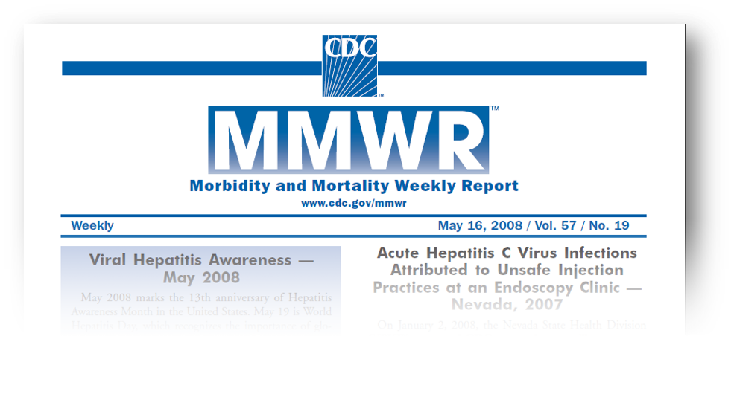
Why Do Outbreaks Happen?
Notes:
Next we are going to go over the major reasons outbreaks happen

Slide 9






The Big Five
THE BIG 5
Syringe re-use, directly or indirectly
Inappropriate use of single dose or single use vials
Failure to use aseptic technique (contamination of injection equipment)
Unsafe diabetes care/ assisted blood glucose monitoring (ABGM)
Drug diversion
Notes:
The ‘big 5’ causes that lead to these outbreaks are:
CLICKS
Syringe re-use, either directly or indirectly
Inappropriate use of single dose or single use vials
Failure to use aseptic technique. In this case, we are referring to contamination of injection equipment
Unsafe diabetes care, specifically the assisted blood glucose monitoring.
And drug diversion
Outbreaks often involve more than one of these breaches and we are going to discuss each of these in more detail.

Slide 10
Syringe Re-use
Most common cause of outbreaks is inappropriate use of syringes:
  Direct reuse:
    Using the same syringe to administer medication to more than one patient, even if the needle is changed or the injection was administered through an intervening length of tubing
  Indirect reuse or “double dipping”:
    Accessing a medication vial or bag with a syringe that has already been used to administer medication to a patient, then reusing the contents from the vial or bag for another patient
Syringe Re-use
Notes:
The first common cause of outbreaks, that we are going to discuss is inappropriate use of syringes, and this can include two kinds, either direct reuse or indirect reuse.
CLICK When we talk about direct reuse of syringes, just as it sounds, involves the use of a single syringe to administer medication for multiple patients, for example insulin pens or when the same syringe is used to administer vaccines to multiple patients
CLICK Indirect re-use or “double dipping” is the most common cause for large numbers of viral hepatitis outbreaks and occurs when you have taken a vial of medication, withdrawn some medicine from the vial, administered that to the patient and then you would come back and re-access that vial with the same syringe. You have now contaminated the contents pf the vial of the medication so anyone who receives medication afterwards can potentially become infected

Slide 11
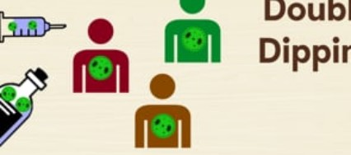
Video Clip: Start the video by clicking on the image below.
Syringe Re-use
Syringe Re-use
Notes:
CLICK to play video
This is the narration on the video:
This is a critical point, so we’re going to go over it one more time. Here’s how double dipping works. You start with a new needle, new syringe, and new vial. All good so far. You then inject a patient infected with HCV. This contaminates both the needle and the syringe. But instead of discarding both, only the needle is changed. When the vial is accessed again, the HCV virus is transferred from the old syringe into the vial. From that point forward, every patient who receives medication from that vial is potentially exposed to the virus. Just changing the needle is not enough. The needle AND the syringe must be replaced every time.

Slide 12

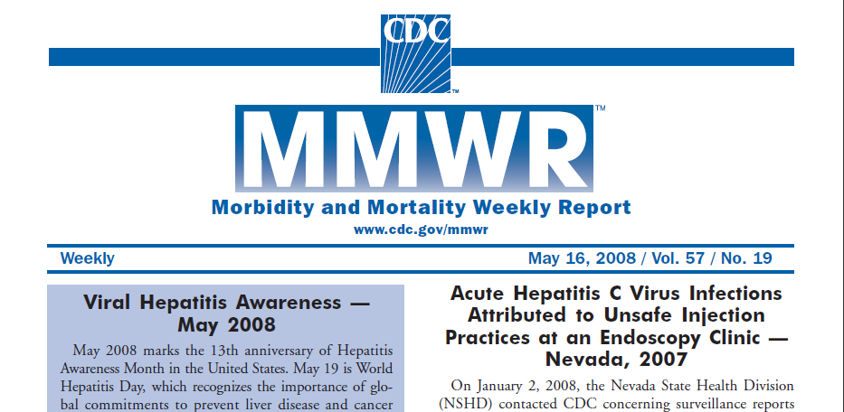
Endoscopy Center, Nevada (2008)
9 clinic-associated hepatitis C virus cases
106 possible clinic-associated cases
63,000 potential exposures
$16–21 million total cost
Syringe Re-use
Notes:
This is an unfortunate example of what can happen in this “double dipping” situation. This was a hepatitis C outbreak that occurred in 2008 in an endoscopy center in Nevada.
This outbreak resulted in 9 confirmed cases and 106 possible cases of hepatitis C. There were 63,000 people potentially exposed, and the outbreak resulted in $16 to $21 million dollars in public health costs.
The link to this outbreak has been added to your resource page

Slide 13

Dangerous Misperceptions
Changing the needle makes a syringe safe for reuse.
Syringes can be reused as long as an injection is administered through an intervening length of IV tubing.
If you don't see blood in the IV tubing or syringe, it means that those supplies are safe for reuse.
Once they are used, both the needle and syringe are contaminated and must be discarded!
Syringe Re-use
Notes:
Unfortunately some dangerous misperceptions still exist in healthcare settings and include:
CLICKS
Changing the needle makes a syringe safe for reuse
Syringes can be reused if there is a sufficient length of tubing between the patient and the injection site and
Lack of visible blood means the syringe is safe for reuse.
All of these are false and once a needle and syringe are used, both are contaminated and must be discarded!

Slide 14
Inappropriate Use of
Single-dose/Single-use Vials
Vials labeled as single use:
  NO PRESERVATIVE
  Can be accessed one time only and for one patient only and remaining contents must be discarded
CDC is aware of at least 19 outbreaks involving single dose vial use
  All occurred in outpatient settings with almost half in pain remediation clinics
Inappropriate use of single dose/use vials
Notes:
The second cause of large outbreaks in health care setting is misuse of single-dose/single-use vials.
CLICK Vials labeled as single use do not contain ANY preservative and can be accessed one time only and for one patient only. Remaining contents must be discarded
CLICK The CDC is aware of at least 19 outbreaks involving single dose vial misuse, with seven outbreaks involving bloodborne pathogens and twelve outbreaks involving bacterial infections.
All these outbreaks occurred in outpatient settings, with almost half in pain remediation clinics where injections are performed frequently, and medications are often packaged in large-volume single-dose vials.
Link to outbreaks are included in your resource listing

Slide 15
Single Dose Vials:
CDC Position Statement, 2012
Vials labeled by the manufacturer as “single dose” or “single use” should only be used for a single patient
Ongoing outbreaks provide ample evidence that inappropriate use of single-dose/single-use vials causes patient harm.
Leftover parenteral medications should never be pooled for later administration
  In times of critical need, contents from unopened single dose vials can be repackaged for multiple patients in accordance with standards in United States Pharmacopeia General Chapter ‹797›
Inappropriate use of single dose/use vials
www.cdc.gov/injectionsafety/CDCposition-SingleUseVial.html
Notes:
As a result of outbreaks resulting from single dose vial misuse, the CDC restated its position on the use of single-dose/single-use vials in 2012.
The CDC stated that:
CLICKS
Vials labeled by the manufacturer as “single dose” or “single use” should only be used for a single patient.
Ongoing outbreaks provide ample evidence to support that this misuse results in patient harm.
Leftover medications should not be pooled or stored for later administration.
And, in times of shortage, medications can be repackaged ONLY if it’s done in accordance with established standards.

Slide 16

When Failure To Use Aseptic Technique Happens!
Two women diagnosed with HBV infection, receiving chemotherapy at the same physician practice
Multidisciplinary team investigation
Office closed; physician license suspended
2,700 patients notified
29 outbreak-associated cases of HBV
Failure to use aseptic technique
Notes:
The third cause of large outbreaks is failure to use aseptic technique .
In this example, two women, aged 60 and 77 years, were diagnosed with acute hepatitis B virus (HBV) infection; both received chemotherapy at the same physician’s office.
Due to suspicion of health care associated HBV transmission, a multidisciplinary team initiated an investigation of the hematology-oncology office practice.
Patients who visited the office practice between January 1, 2006 and March 3, 2009 were advised to seek testing for bloodborne pathogens.
Deficient infection prevention policies/procedures and failure to use aseptic technique were identified as primary breaches and cause of the outbreak.

Slide 17
Knowledge Check
Which of the following statements is false?
Syringes can be used on more than one patient if the needle is changed.
Single dose vials can be used more than one time if it has not been contaminated
Blood glucose meters do not have contact with patients and do not need to be cleaned
If there is no visible blood the syringe is safe to reuse.
All the above
Notes:
E is correct. All those statements are false and dangerous misconceptions

Slide 18
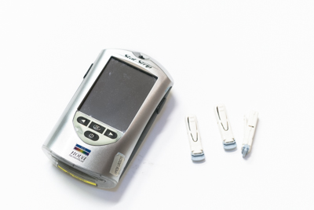


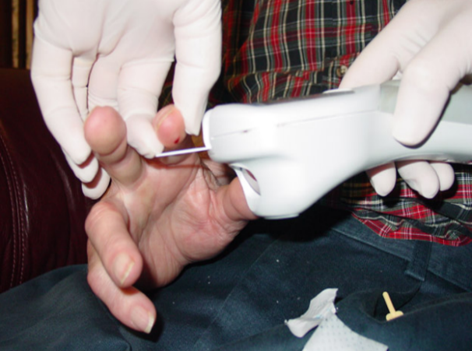
Unsafe Diabetes Care
Use of fingerstick devices or insulin pens on multiple persons
Fingerstick
Devices/Insulin Pens
Sharing of blood glucose meters without cleaning and disinfection between uses
Failure to perform hand hygiene or change gloves between procedures
Hand
Hygiene
Failure
Blood
Glucose
Meters
Diabetes care
Patel et al. ICHE 2009; 30:209-14,Thompson et al. JAGS 2010, MMWR 2005; 54:220-3
Notes:
The fourth cause of outbreaks that we are going to discuss is Unsafe Diabetes Care. This underappreciated area of risk has been the mode of transmission for many hepatitis B outbreaks.
As noted earlier, large numbers of Hepatitis B outbreaks, reported to CDC were associated with breeches in infection control during assisted monitoring of blood glucose (AMBG)
Outbreaks have been linked to the infection control breaches shown here, including:
CLICKS
Sharing of blood glucose meters without disinfection and cleaning between uses, this is the most common breach.
Use of fingerstick devices or insulin pens for multiple people, and
Failure to perform hand hygiene or change gloves between procedures.

Slide 19

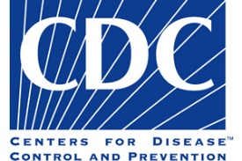
Drug Diversion
5. Drug diversion
When prescription medicines are obtained or used illegally, it is called drug diversion. Healthcare personnel who steal prescription medicines or controlled substances for their own use put patients at risk.
Substandard care delivered by an impaired provider
Denial of essential pain medication or therapy
Risks of infection
  Bloodborne pathogen
  Bacterial contaminants
CDC and state and local health departments have assisted in investigations.
Notes:
The final cause of outbreaks that we will discuss is Drug Diversion.
CLICK CDC notes the following: “When prescription medicines are obtained or used illegally, it is called drug diversion. Healthcare personnel who steal prescription medicines or controlled substances for their own use put patients at risk.”
The CDC and state and local health departments have assisted in the investigation of infection outbreaks stemming from drug diversion that involved healthcare personnel who tampered with injectable drugs.
CLICK
Drug diversion can harm patients in multiple ways.

Slide 20

New slide
Year | Cases | Outbreak
2018 | 12 | HCV infections associated with an emergency department nurse
2018 | 6 | Sphingomonas paucimobilis bacteremia associated with a nurse at a cancer center
2015 | 7 | HCV infections associated with a nurse at a hospital
2014 | 5 | Serratia marcescens bacteremia associated with a nurse in a post-anesthesia care unit at a hospital
2012 | 45 | HCV infections associated with a radiology technician at hospitals in NH, Kansas and Maryland
2011 | 25 | Gram negative bacteremia associated with a nurse at a Minnesota hospital
2009 | 18 | HCV infection associated with a surgical technician at a Colorado hospital
2008 | 5 | HCV infections associated with a radiology technician at a Florida hospital
2006 | 9 | Achromobacter xylosoxidans bacteremia associated with a nurse at an Illinois hospital
2004 | 16 | HCV infections associated with a certified registered nurse anesthetist at a Texas hospital
1999 | 26 | Serratia marcescens bacteremia associated with a respiratory therapist at a Pennsylvania hospital
1992 | 45 | HCV infections associated with a surgical technician at a Texas ambulatory surgical center
1985 | 3 | Pseudomonas pickettii bacteremia associated with a pharmacy technician at a Wisconsin hospital
Drug diversion
Notes:
Here are some of the outbreaks that have occurred due to drug diversion. Because safe injection practices may not be followed during diversion events, the greatest risk of patient exposure to infectious pathogens comes from injectable medications. Thus, drug diversion can directly expose patients to HIV, HBV, HCV or other BBPSs

Slide 21
Safe Injections: Best Practices
Misuse of single-dose/single-use vials
Never administer medications from the same syringe to multiple patients
Do not reuse a syringe to enter a medication vial or solution
Limit the use of multi-dose vials and dedicate them to a single patient whenever possible
Syringe reuse (direct and indirect)
Do not administer medications from a single dose vial or IV solution bag to more than one patient, more than one time
Notes:
Because this topic is so important and can potentially save lives, we want to summarize these key points:
CLICKS
Never administer medications from the same syringe to multiple patients
Do not re-use a syringe to enter a medication vial or solution
Limit the use of multi-dose vials and dedicate them to a single patient whenever possible
Regarding single dose vials:
Do not administer medications from a single dose vial or IV solution bag to more than one patient.

Slide 22
Safe Injections: Best Practices
Failure to use aseptic technique
Use aseptic technique when preparing or administering medications
  Keep contaminated items and surfaces away from the preparation area.
  Designate a ‘clean’ medication preparation area that is not adjacent to contaminated items
  Perform hand hygiene before handling medications.
Unsafe diabetes care
Use insulin pens and lancing devices for only one patient
Dedicate glucometers to a single patient. If they MUST be shared, clean and disinfect after each use
Notes:
Use aseptic technique when preparing or administering medications.
CLICKS
Keep contaminated items and surfaces away from the preparation area.
Designate a ‘clean’ medication preparation area that is not adjacent to areas where potentially contaminated items are placed.
Perform hand hygiene before handling medications.
Insure that the rubber septum is disinfected with alcohol prior to piercing it.
And, lastly, with diabetes care –
Use insulin pens and lancing devices for only one patient.
Dedicate blood glucose meters to a single patient. If they must be shared, clean and disinfect after each use per manufacturer's instructions. If there are no instructions, it cannot be shared.

Slide 23

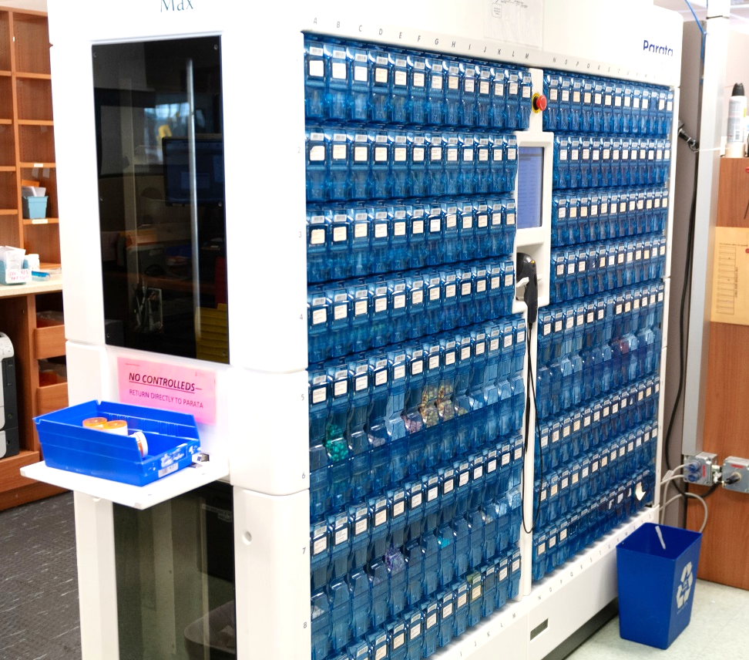
Safe Injections: Best Practices
Drug Diversion
Institute drug diversion monitoring systems and security measure to assist in averting and/or identifying diversion activity.
Notes:
Institute drug diversion monitoring systems and security measure to assist in averting and/or identifying diversion activity.

Slide 24


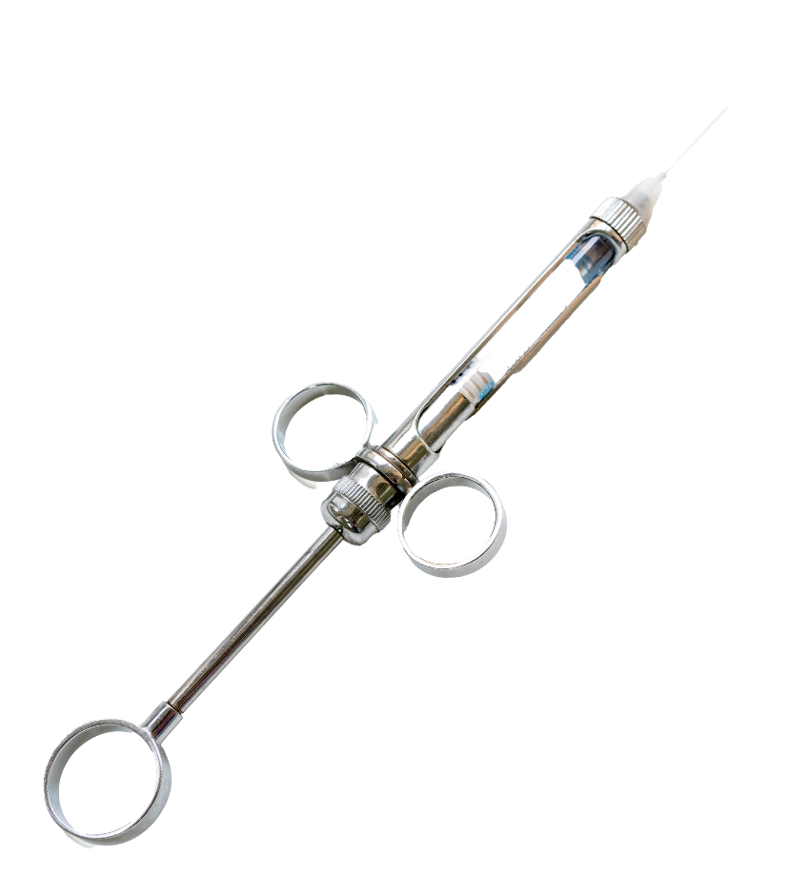







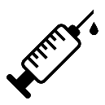



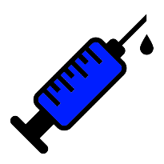



Safe Injections: Best Practices
The following Dental practices that are critical for patient safety:
Never administer medications from the same syringe to more than one patient, even if the needle is changed or if you are injecting through an intervening length of IV tubing.
After a syringe or needle has been used to enter or connect to a patient’s IV, it is contaminated and should not be used on another patient or to enter a medication vial.
Never enter a medication vial, bag, or bottle with a used syringe or needle.
Never use medications packaged as single-dose or single-use for more than one patient—this includes ampoules, cartridges, and bags or bottles of intravenous solutions.
Assign medications packaged as multi-dose vials to a single patient whenever possible.
Never use bags or bottles of intravenous solution as a common source of supply for more than one patient.
Follow proper infection control practices during the preparation and administration of injected medications.
Never combine the leftover contents of a syringe or single-use vials for later use.
When using a dental cartridge syringe, needles and anesthetic cartridges are considered single-use disposable items and should be used for one patient only and then discarded. The metal dental cartridge syringe is a reusable item and should be cleaned and heat sterilized between patients.
used
Notes:
Safe injection practices are essential for patient safety. For all the reasons we have discussed the CDC reminds dental practitioners of the following practices that are critical for patient safety:
CLICKs
Never administer medications from the same syringe to more than one patient, even if the needle is changed or if you are injecting through an intervening length of IV tubing.
After a syringe or needle has been used to enter or connect to a patient’s IV, it is contaminated and should not be used on another patient or to enter a medication vial.
Never enter a medication vial, bag, or bottle with a used syringe or needle.
Never use medications packaged as single-dose or single-use for more than one patient—this includes ampoules, cartridges, and bags or bottles of intravenous solutions.
Assign medications packaged as multi-dose vials to a single patient whenever possible.
Never use bags or bottles of intravenous solution as a common source of supply for more than one patient. •Follow proper infection control practices during the preparation and administration of injected medications.
Never combine the leftover contents of a syringe or single-use vials for later use.
When using a dental cartridge syringe, needles and anesthetic cartridges are considered single-use disposable items and should be used for one patient only and then discarded. The metal dental cartridge syringe is a reusable item and should be cleaned and heat sterilized between patients.
Add to resource page: https://www.cdc.gov/dental-infection-control/hcp/dental-ipc-faqs/index.html

Slide 25





Most Outbreaks are Never Detected
Under-reporting of cases
Asymptomatic infection
Under-recognition of healthcare as risk
Long incubation period;
difficult to identify single healthcare exposure
Barriers to investigation, resource constraints
Notes:
25
Unfortunately, the outbreaks described so far are just the tip of the iceberg. Most outbreaks are never detected for a variety of reasons including:
CLICKS
Hepatitis B and C can be asymptomatic infections.
They have long incubation periods of up to 6 months, making it difficult to identify a single healthcare exposure.
Even if an infection is diagnosed, the case might not be reported and healthcare might not be recognized as a risk factor and,
There are barriers and resource constraints, making investigation of potential healthcare-associated outbreaks difficult.

Slide 26
Survey of Physician and nurse Practices around injection safety
  370 Physicians
  320 Nurses
  Eight States Included
    NC, NY, NJ, Nevada, Colorado, Tennessee, Wisconsin, Montana
  Types of healthcare settings:
    Acute care, long term care, outpatient settings
https://www.sciencedirect.com/science/article/pii/S0196655317306806?via%3Dihub
Notes:
Fortunately, most healthcare professionals do practice safe injection techniques with every injection; however, a survey published in September 2017, of physician and nurse knowledge, attitudes, and practices around injection safety produced alarming results. The survey included:
370 physicians,
320 nurses,
8 states and
All types of healthcare settings.

Slide 27
Survey findings
Topic Is Acceptable Practice | Physician Response | Nurse Response
Reuse of syringe for > one patient | 12.4% | 3.4%
Reentering a vial with a used needle/syringe | 12.7% | 6.7%
Using SDVs for multiple patients | 34% | 16.9%
Using source bags as diluent for multiple patients | 28.9% | 13.1%
Notes:
Results include the following:
12.4% of physicians and 3.4% of nurses reused a syringe on more than one patient
12.7 % of physicians and 6.7% of nurses re-enter a medication vial with a used needle and/or syringe
34% of physicians and 16.9% of nurses use a single dose vial more than one time and
28.9 % of physicians and 13.1 % of nurses use a source bag for more than one patient

Slide 28

Knowledge Check
True or False?
Because there have been so many outbreaks, ALL healthcare providers do the right thing every time with safe injection practices.
True
False
Notes:
CLICK for answer That’s right! It’s false! Unfortunately, not all healthcare providers do the right thing every time, but hopefully with modules like these we can work toward that goal.

Slide 29


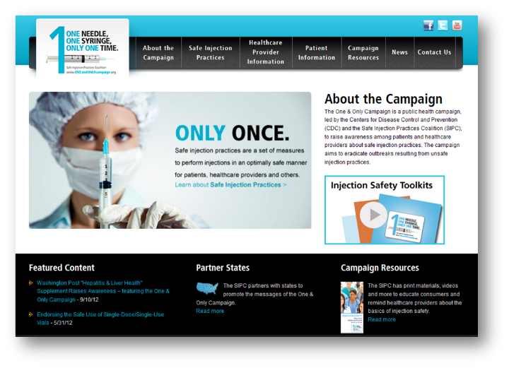

Best Practice
  Designate someone to provide ongoing oversight
  Develop written infection control policies
  Provide training
  Conduct quality assurance assessments
  Knowledge
  Prevention
Speak Up!
Notes:
By learning more and becoming more aware of these issues, we can make great strides toward preventing outbreaks.
Here are some practical policies you can implement:
CLICK
Designate someone to provide ongoing oversight
Develop written infection control policies
Provide training
Conduct quality assurance assessments
CLICK
And lastly, speak up if you see someone not following safe injection practices. You are not only protecting your patients - you are protecting your colleagues as well.

Slide 30
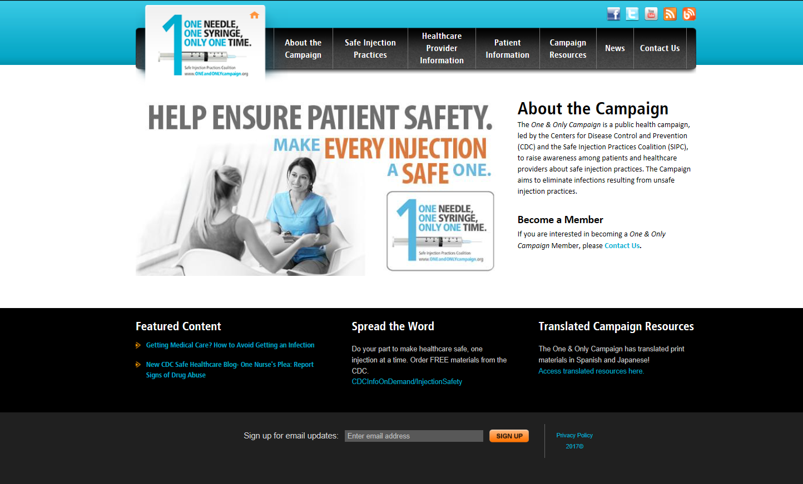
One and Only Campaign
Notes:
The One & Only Campaign is a public health campaign, led by the Centers for Disease Control and Prevention (CDC) and the Safe Injection Practices Coalition (SIPC), to raise awareness among patients and healthcare providers about safe injection practices. The Campaign aims to eliminate infections resulting from unsafe injection practices.

Slide 31
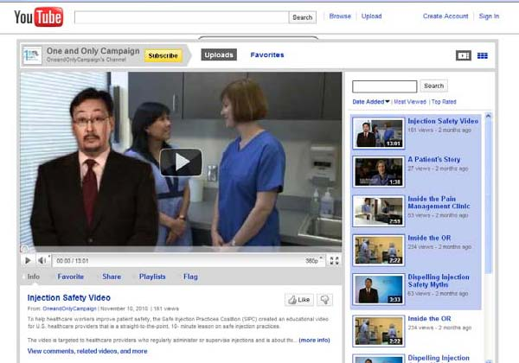
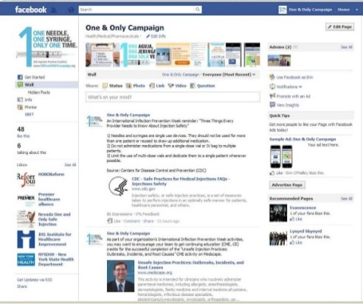
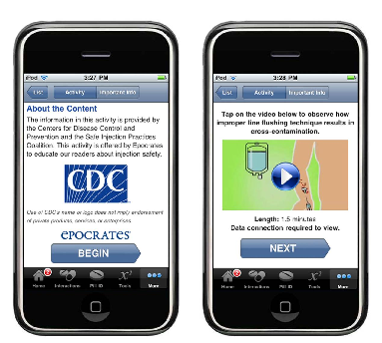
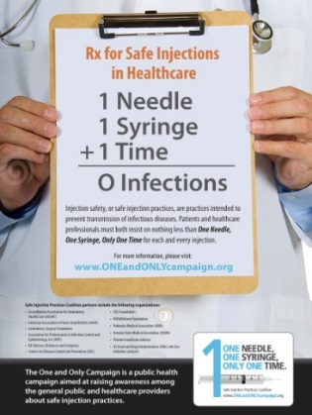

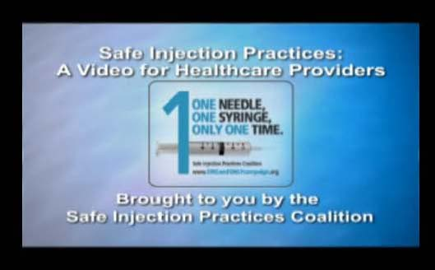
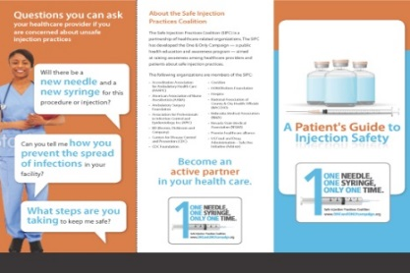
Campaign Resources
  Print Materials
  Audio & Visual
  Social Media
  Toolkits
Notes:
AUTO The campaign utilizes many mediums and materials to deliver their messages. In addition to the numerous print materials available on the website, they also have several healthcare provider videos and an injection safety “app.”
They use social media, including Facebook and Twitter, to get relevant and engaging materials out to target audience. And, recently, they have developed toolkits to help healthcare providers educate themselves and their staff.
All of the materials are free and available either on the campaign website or can be ordered through CDC Info. There are actually quite a few new resources, such as a new video, infographic and bloodborne pathogen training.

Slide 32




