Slide 1

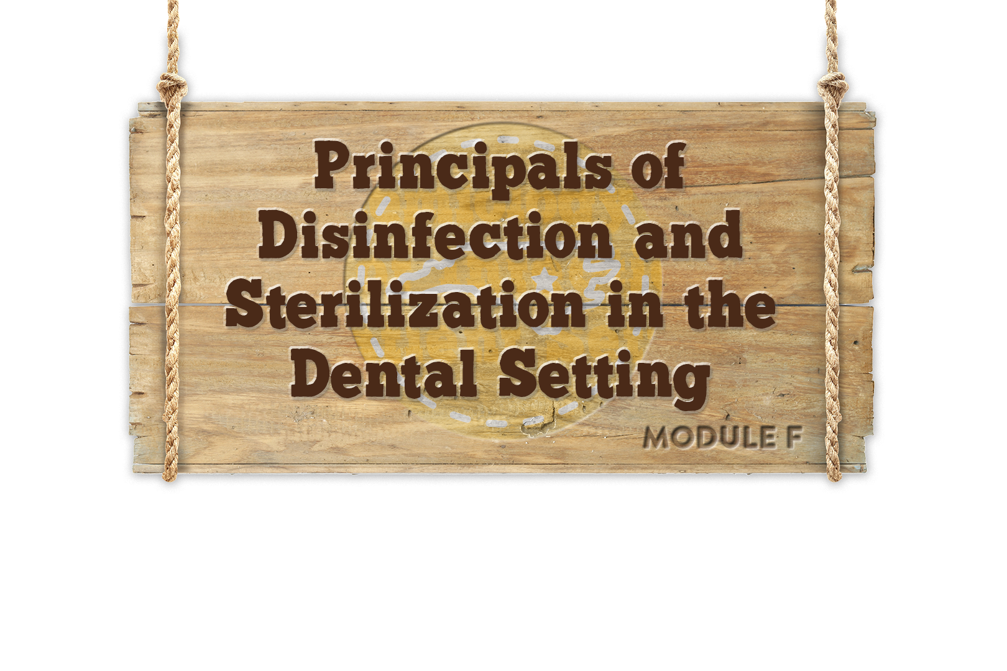


Module F
Notes:
NOTE TO PRESENTER: Whenever you see CLICK in bold, you must click to animate in the next part of the slide. When you see AUTO, no clicks are needed, the segments will automatically advance.
If nothing is bolded there is no animation in that slide.

Slide 2
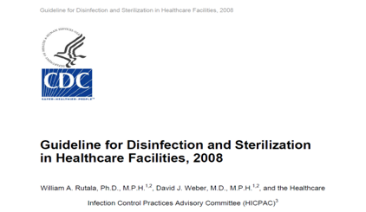



Objectives
Describe the principles of disinfection and sterilization
Provide an overview of current methods for disinfection and sterilization
Discuss training and quality control methods and required documentation
Notes:
The objectives for this module are to:
Describe the principles of disinfection and sterilization
To provide an overview of current methods for disinfection and sterilization per CDC recommendations,
And to discuss the training and quality control methods required to maintain proper standards
CLICK
In 2008 the CDC published
“Guidelines for Disinfection and Sterilization in Healthcare Facilities”. The link is included on your resource page

Slide 3

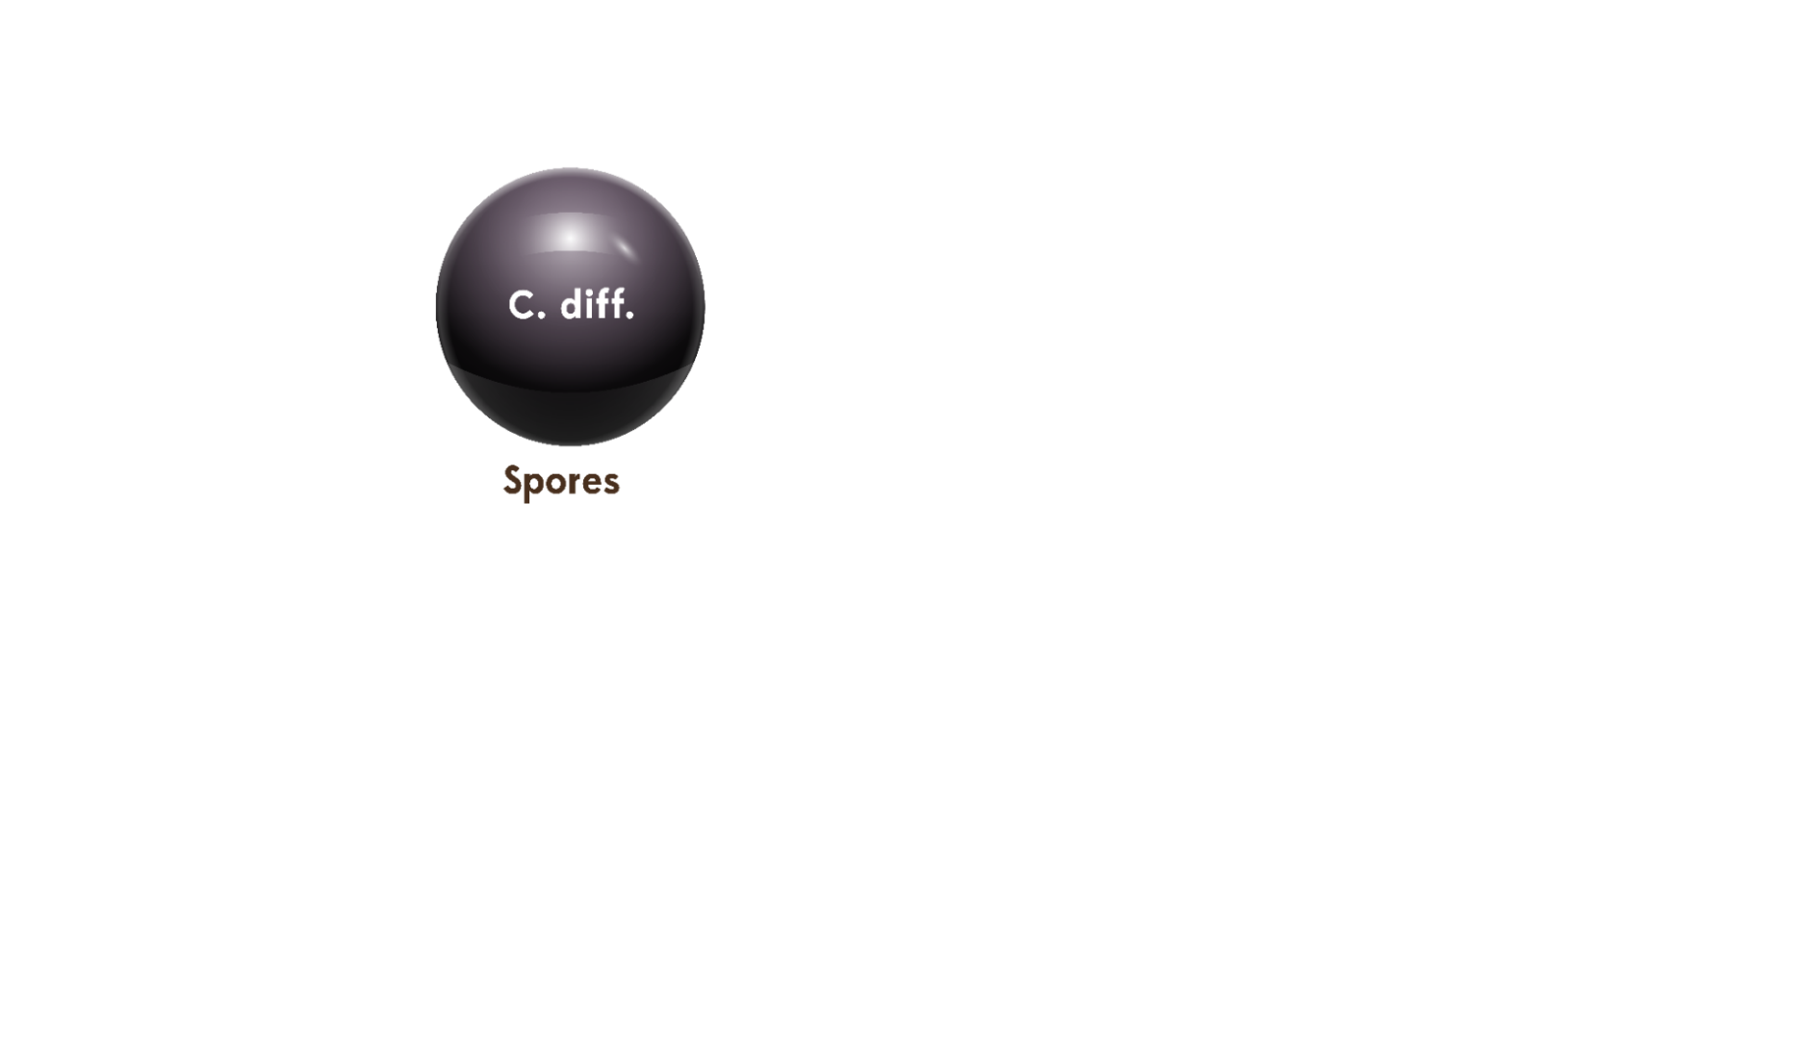
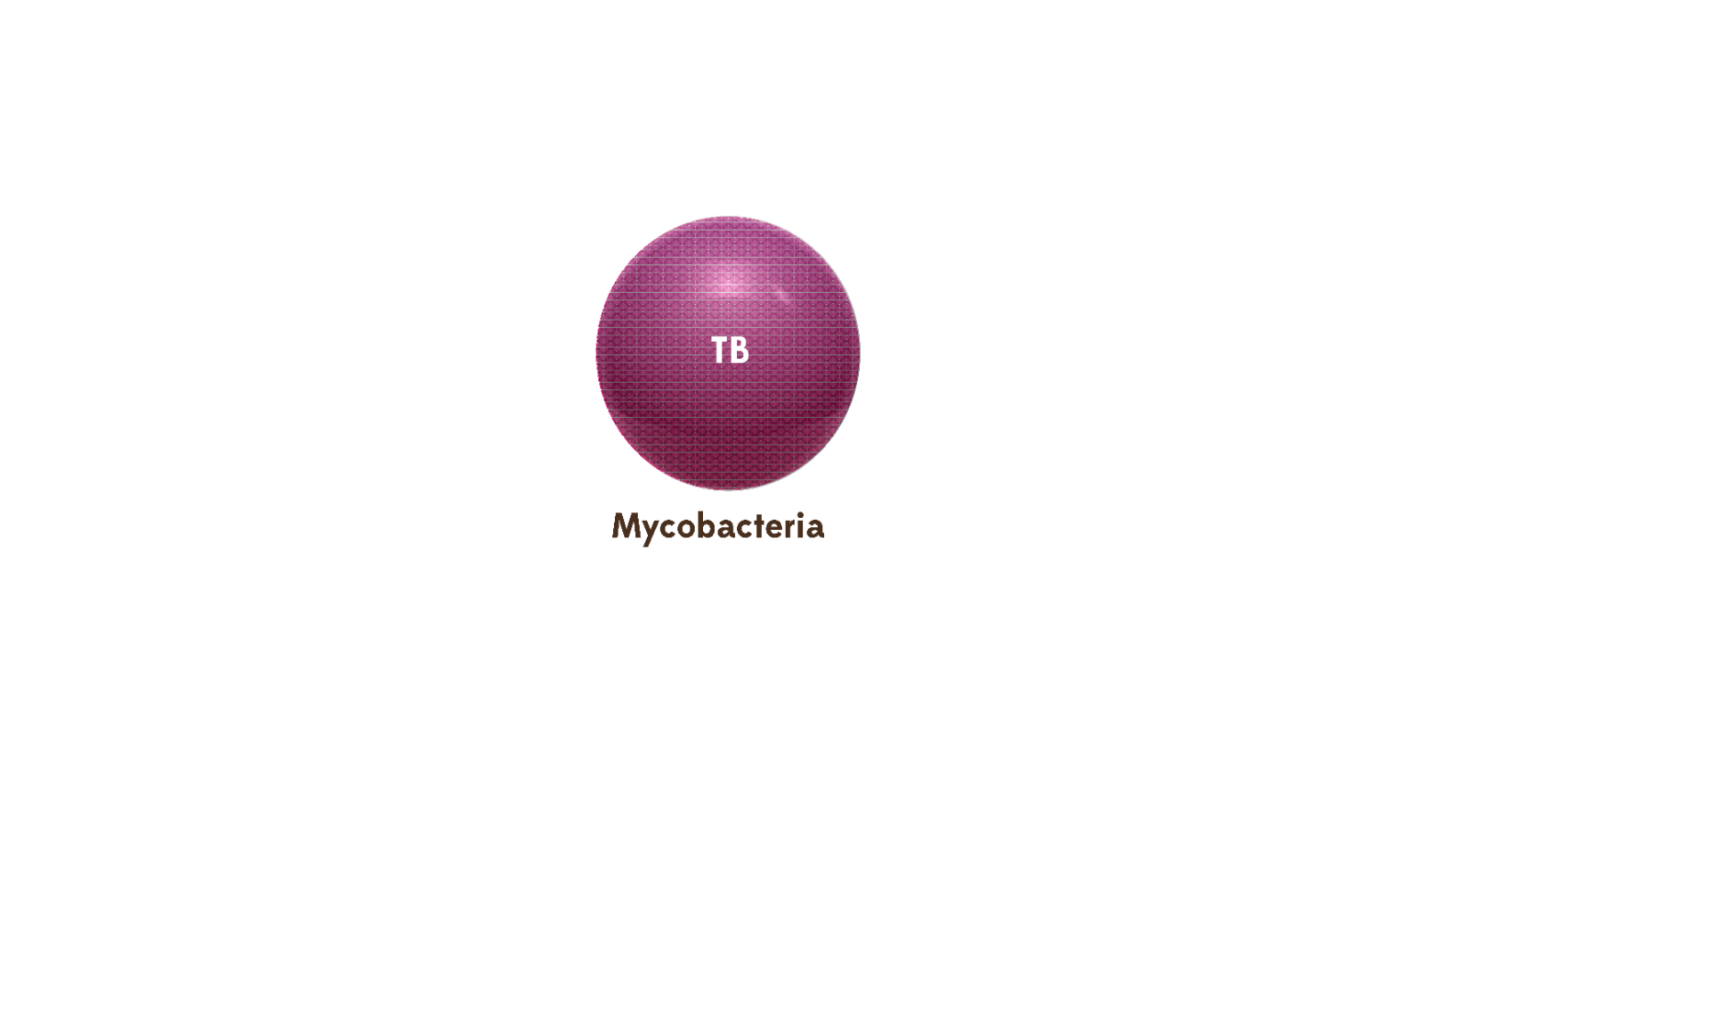
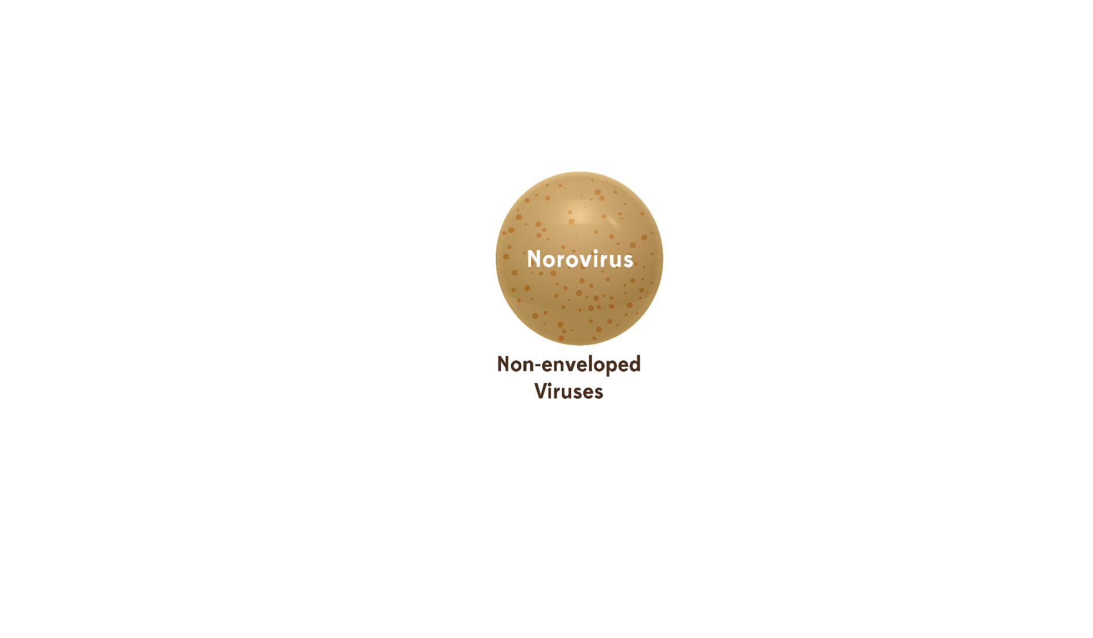
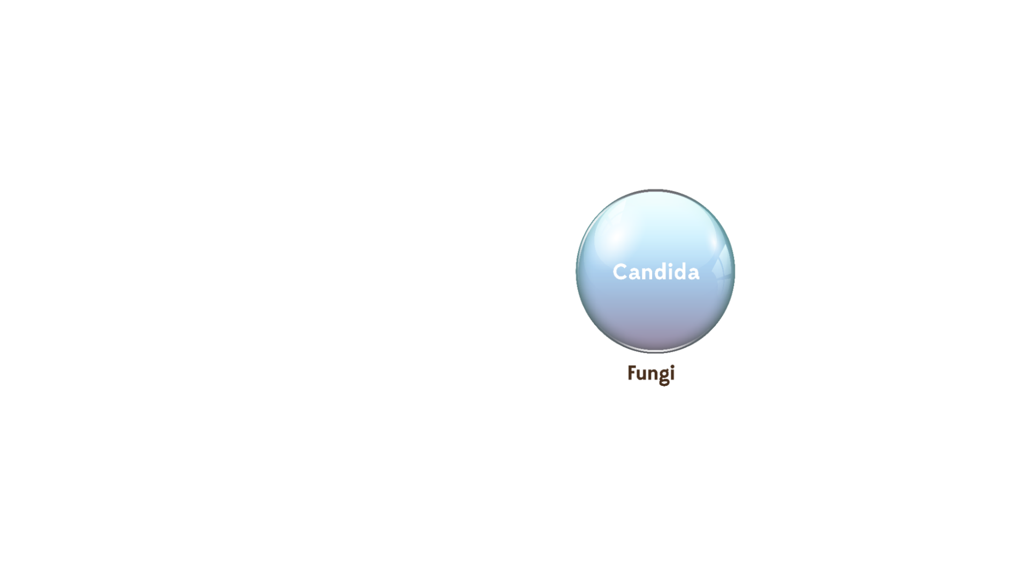
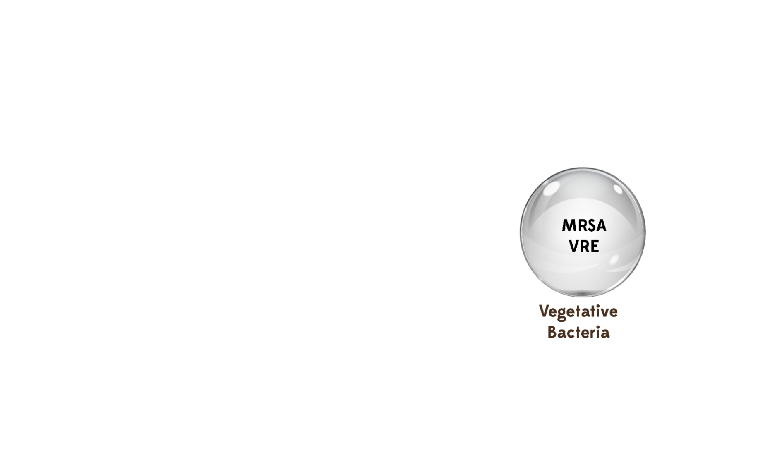


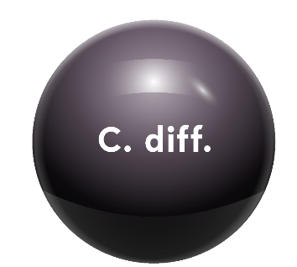

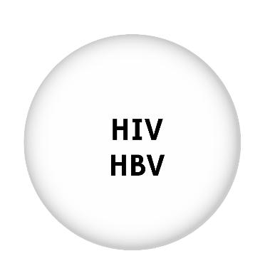
Objectives
Norovirus
Alcohol resistant
Hardest to Kill
HIV
HBV
Easiest to Kill
Prions
Spores
Resistant to
disinfectants
Notes:
As we start our discussion it is important to remember that all microorganisms are not equal. Various types of microorganisms have differing levels of resistance to disinfectants and sterilants.
CLICK
The hardest microorganisms to kill are Prions. You will not likely encounter this in your facility.
CLICK
The most resistant microorganism you are likely to encounter within your practice setting will be spores. These bacteria (like C. difficile) form hard protective coverings, which allow them to survive harsh conditions and be resistant to routine environmental disinfection products.
CLICK
Certain viruses, like norovirus, are not the hardest to kill but they are resistant to alcohols. This is important to know because alcohol-based hand rubs are widely used in healthcare but are not effective against norovirus.
CLICK
HIV and Hepatitis B are among the “easiest to kill” viruses

Slide 4
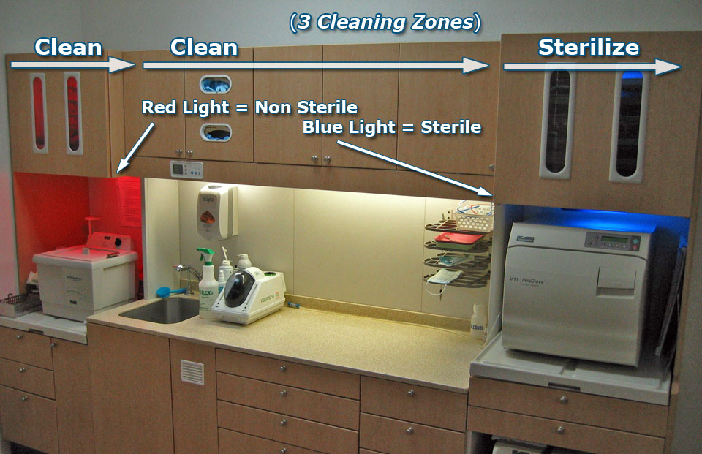






Principles
Packaging area
Inspecting
Assembling
Packaging
Sterilization/storage area
Sterilizers/supplies
Incubators
Enclosed storage
Notes:
Many dental facilities are challenged with space limitations when reprocessing reusable patient care items in compliance with CDC recommendations . In the next section, we will review the steps for sterile instrument processing. The room designated for sterile processing should be divided into three areas: Decontamination or instrument cleaning, instrument packaging, and sterilization and storage.
CLICKs
In the cleaning or decontamination area, reusable contaminated instruments are received, sorted, and cleaned
The packaging area is for inspecting, assembling, and packaging clean instruments in preparation for final sterilization
The sterilization and storage area contains the sterilizers and related supplies, incubators for analyzing spore tests, and can contain enclosed storage for sterile and disposable (single-use) items. Alternatively, storage can be in another designated room.

Slide 5

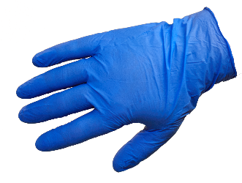
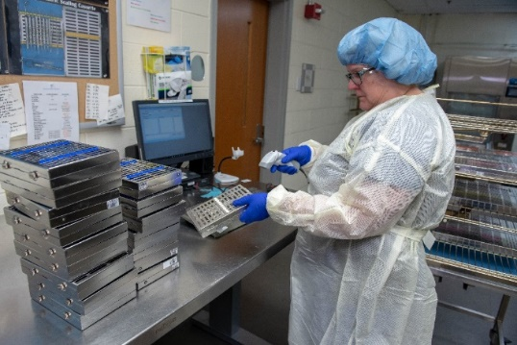
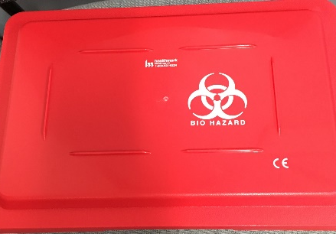
Principles
Management of reusable contaminated items:
      Handle as little as possible
      Use appropriate PPE
      Remove gross soil or debris at the point of use (gauze sponge moistened with water/disinfectant wipe for example)
      Immediately contain and transport to the decontamination area or soiled utility room where cleaning procedures can be accomplished away from patient care
Notes:
Once you have identified the location for re-processing contaminated items you need to have a policy and procedure on how those contaminated items are managed.
CLICKS
Contaminated reusable items should be:
Handled as little as possible
Staff should wear appropriate PPE
Gross debris should be removed at point of use
Soiled items should be removed immediately after use and not left in the patient care area

Slide 6
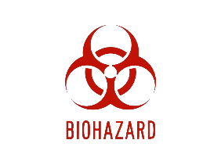
Principles
Transport of contaminated items:
Must be contained. The type of container depends on the item being transported:
  Puncture-resistant, leak-proof, closable containers must be used for devices with edges or points capable of penetrating container or skin
  Must have a bio-hazard label or be red in color (never via gloved hands alone)
Items should be kept moist during transport by adding a towel moistened with water (not saline) or a foam, spray or gel product specifically intended for this use
Avoid transporting contaminated items in a liquid
Reusable collection containers for holding contaminated items should be made of material that can be effectively decontaminated
Use separate collection containers for contaminated versus re-processed or clean items
Notes:
There are also several requirements that must be met when transporting instruments and/or medical devices that are contaminated.
CLICKs
Items must be transported in a container that is selected based on the type of contaminated item. Containers may include bins, trays and/or carts but must meet the requirements outlined on the slide
Items must be kept moist during transport but not submerged in a liquid and the collection containers should be made of material that can effectively be decontaminated
Avoid transporting contaminated items in a liquid
Reusable collection containers for holding contaminated items should be made of material that can be effectively decontaminated
Use separate collection containers for contaminated versus re-processed or clean items

Slide 7

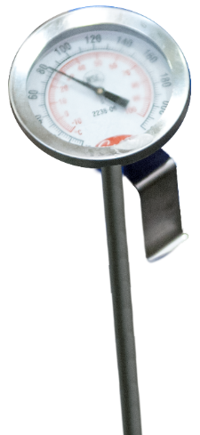
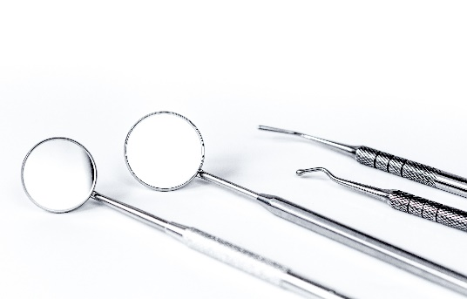
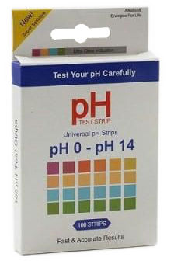
Principles
Factors influencing the efficacy of disinfection and sterilization
      How well the object is cleaned/type and amount of material
      Testing of the disinfectant
        Solution concentration
        Exposure time
      Design of object
      Temperature and pH of disinfectant
Notes:
There are numerous factors that can influence the effectiveness of the disinfection and sterilization process outcomes.
CLICKs
The most important factor is cleaning of the object to reduce the bioburden and remove the foreign materials (organic and inorganic salts) that can act as barriers and interfere with the disinfectant’s or sterilant’ s activity on the surface of the object. For instance, you would want to remove or pre-clean any instruments heavily contaminated with sputum, blood or other secretions before sending it for reprocessing. Failure to do so could make it difficult to clean the items because of dried-on secretions.
Another very important factor to consider, and one that is often overlooked, is that the disinfectant or sterilant is tested to confirm that the concentration and contact time are appropriate and match the manufacturer’s instructions. Inadequate exposure to a disinfectant or sterilant can lead to residual contamination remaining on the item, which could be transmitted to another patient.
The nature of the object is also an important factor to consider when reprocessing. Does the item have hinges, crevices, lumens, or complex moving parts that require special attention or disassembly when cleaning and reprocessing?
The final factors to consider are the temperature and pH of the disinfectant or sterilant. Increases or decreases in theses factors can lead to improved or reduced activity of many disinfectants. Similarly, water hardness can reduce the rate of kill of some disinfectants. It is important these parameters are checked to ensure optimum kill activity of the disinfectant/sterilant.

Slide 8
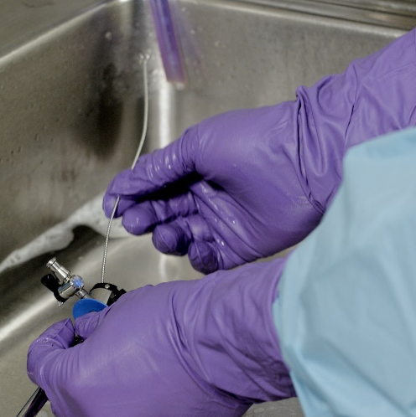
Cleaning Instruments - Manual
    Medical equipment/devices MUST be pre-cleaned prior to high level disinfection or sterilization.
    Contaminants such as dirt, blood or other body fluids, if present, can act as a barrier.
    If manual cleaning is performed:
      Use work practice controls to reduce the chance of injury from sharp objects
      Never reach into trays or container holding sharp instruments that cannot be seen
      Use a long-handled brush to keep the scrubbing hand away from sharp instruments
      Wear puncture-resistant, heavy-duty gloves
    After cleaning, instruments should be rinsed with water to remove chemical detergent residue.
Notes:
Before anything is disinfected and sterilized, it is critical that the device or equipment is pre-cleaned.
CLICKs
When contaminants such as dirt, blood or other body fluids are present they can act as a barrier to disinfection or sterilization of the item. Cleaning and decontamination should be done as soon as possible after the items have been used to avoid allowing material to dry on the device
Use all chemical disinfectants according to manufacturer's instructions for use, including immersion time.
If manual cleaning is performed:
Use work practice controls to reduce the chance of injury from sharp objects
Never reach into trays or container holding sharp instruments that cannot be seen
Use a long-handled brush to keep the scrubbing hand away from sharp instruments
Wear puncture-resistant, heavy-duty gloves
After cleaning, instruments should be rinsed with water to remove chemical detergent residue

Slide 9
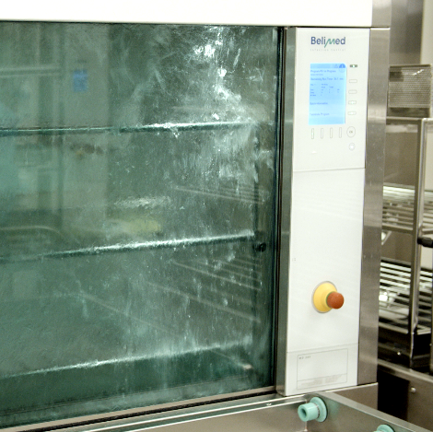
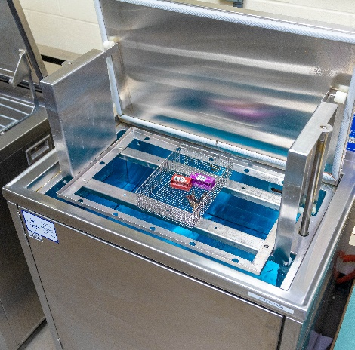
Cleaning Instruments - Automated
Benefits:
Improve efficacy of cleaning process
Reduce handling of sharp instruments
Reduce risk of employee exposure
Follow manufacturer’s recommendations:
Dilution
Temperature
Water hardness
Use
After cleaning, rinse with water
Automated cleaning equipment
Ultrasonic cleaner
Instrument washer
FDA regulated instrument washer
Notes:
The other and most efficient method of cleaning is using automated or mechanical cleaning equipment, such as ultrasonic cleaners, instrument washers, and washer-disinfectors.
CLICK
Automated cleaners:
Improve the efficacy of the cleaning process
Reduce the handling of sharp instruments.
Reduce the risk of employee exposure
CLICK
The manufacturer’s recommendations for dilution, temperature, water hardness, and use (designed for use in washer-disinfectors) should be followed.
CLICK
After cleaning, instruments should be rinsed with water to remove chemical or detergent residue.

Slide 10

Knowledge Check
Which of the following statements is true?
Manual cleaning of objects is safer than automated cleaning
Pre-cleaning is the most important factor in reprocessing objects
Objects do not need to be pre-cleaned if they are going to be sterilized
Household dishwashers can be used for pre-cleaning of instruments.
Notes:
CLICK for answer The correct response is B: precleaning is the most important factor in reprocessing objects

Slide 11
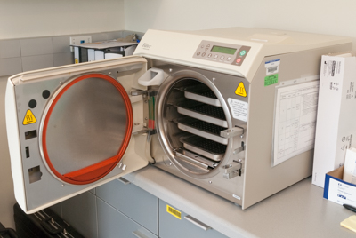
Methods Used for Disinfection
and Sterilization
Notes:
Now let’s move on to the Methods used for disinfection and sterilization

Slide 12
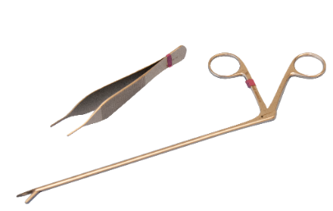
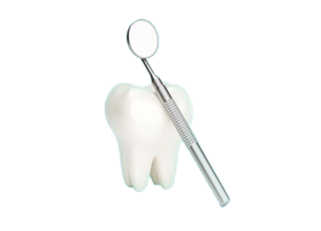
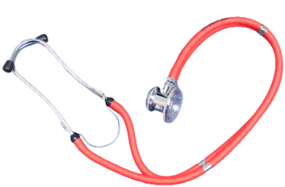
Spaulding Classification
Spaulding Classification of Surfaces:
– Objects which enter normally sterile tissue or the vascular system and require sterilization
– Objects that contact mucous membranes or non-intact skin and require high-level disinfection, which kills all but high-levels of bacterial spores
– Objects that contact intact skin but not mucous membranes, and require low-level disinfection
Critical
Semi-critical
Non-critical
Spaulding Classification
Notes:
Over 45 years ago, Dr. Earle Spaulding devised a rational approach to disinfection and sterilization of patient care items based on the item’s intended use. He categorized every patient care item into one of three categories based on risk:
CLICK
critical, semi-critical, and non-critical. The level of disinfection or sterilization depends on the categorical classification of the item. We are going to start with critical items.
CLICKs
These items contact sterile tissue, for example sterile instruments and must be sterilized
Semi-critical items that contact mucous membranes, like dental mouth mirrors, or non-intact skin, require high-level disinfection;
and non-critical items that have contact only with intact skin, like radiograph heads or BP cuffs, require low-level disinfection.

Slide 13
Processing Critical Instruments
Critical Items:
  Penetrate or enter normally sterile tissue or spaces, including the vascular system (Surgical instruments, cardiac catheters, IV devices, urinary catheters)
  High risk of transmitting infection if handled improperly
  Must be sterilized between uses or used as single-use disposable devices
Critical
Goal: Sterility = devoid of all microbial life
Notes:
As a reminder, critical items are those items that enter normally sterile tissue or spaces, including the vascular system. These items involve a high risk of infection and transmitting infection if handled improperly, so it is “critical” that they are sterilized between uses. Sterilization kills all microorganisms on the surface of the item being sterilized, rendering it safe to use again.

Slide 14




Processing Critical Instruments
Four activities involved in the sterilization and disinfection of critical objects
  Sterilization/Disinfection
  (Steam, dry heat, liquid chemical)
  Monitoring
  Packaging
  (Wrapping, record keeping, loading)
  Storage
Critical
Notes:
There are 4 activities involved in the sterilization and disinfection of critical objects:
CLICKs
• Sterilization or disinfection of items
• Monitoring
• Packaging of items, which includes:
• Record keeping
• Packaging, and
• Loading
• And proper storage of items

Slide 15
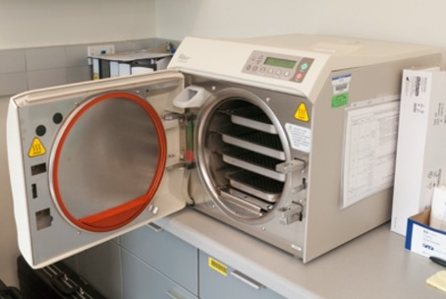
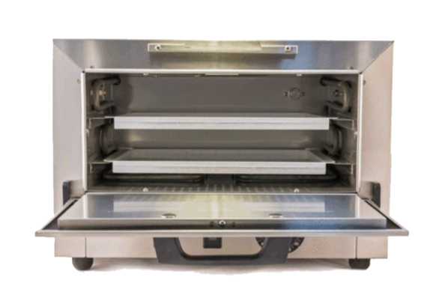
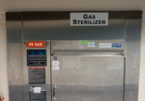
Sterilization
Steam sterilization
Hydrogen peroxide gas plasma
  Ethylene oxide
  Ozone
Vaporized hydrogen peroxide
  Steam formaldehyde
(most common in dental setting)
high temperature
low temperature
Sterilization
Notes:
AUTO The sterilization process achieves the complete elimination or destruction of all forms of microbial life by either physical or chemical methods.
There are many different methods available to sterilize critical objects and they can be divided into high and low temperature methods. Most medical and surgical devices used in dental settings are made of materials that are heat stable and therefore primarily undergo steam sterilization.

Slide 16

Steam Sterilization
Advantages
  Non-toxic
  Cycle easy to control and monitor
  Inexpensive
  Rapidly microbicidal
  Rapid cycle time
  Least affected by organic/inorganic soils
  Penetrates medical packing, device lumens
Sterilization
Notes:
Of all the methods available for sterilization, moist heat in the form of saturated steam under pressure is the most widely used and the most dependable.
The advantages of steam sterilization include the following:
CLICK
It is non-toxic;
Its Cycle is easy to control and monitor
It is inexpensive
It is rapidly microbicidal
It is least affected by organic or inorganic salts
and it penetrates medical packing and device lumens

Slide 17

Steam Sterilization
Disadvantages
  Deleterious for heat labile instruments
  Inappropriate for heat-sensitive instruments
  Inappropriate for moisture-sensitive instruments
  Dulling
  Rusting
  Potential for burns
Sterilization
Notes:
There are several disadvantages of steam sterilization as well. Most seriously, steam sterilization will destroy heat or moisture–sensitive instruments and likely damage most heat labile instruments, which are often complex, and very expensive instruments. Even heat tolerant items may have dulling or rusting from the steam sterilization process. Another important disadvantage is the potential of healthcare providers to get burned when handling or removing the instruments from the sterilizer.

Slide 18

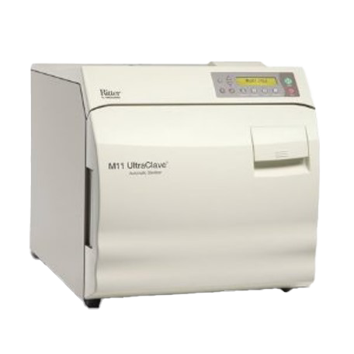
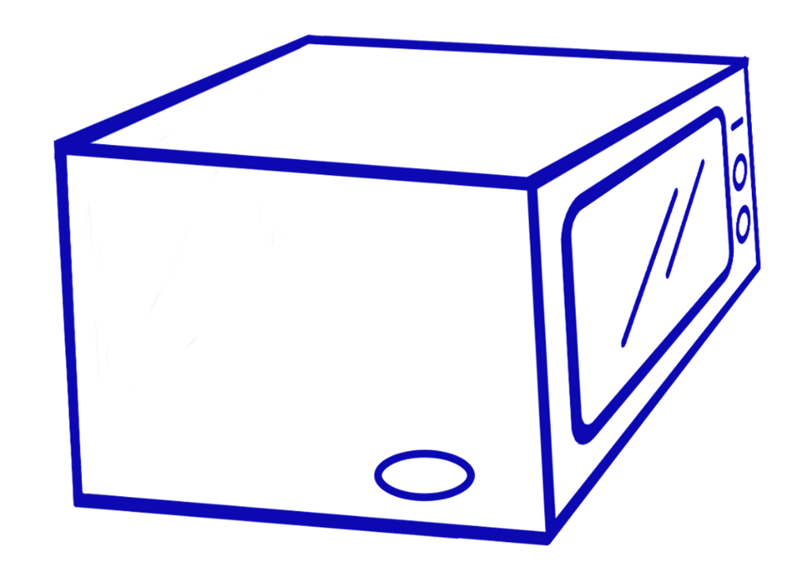
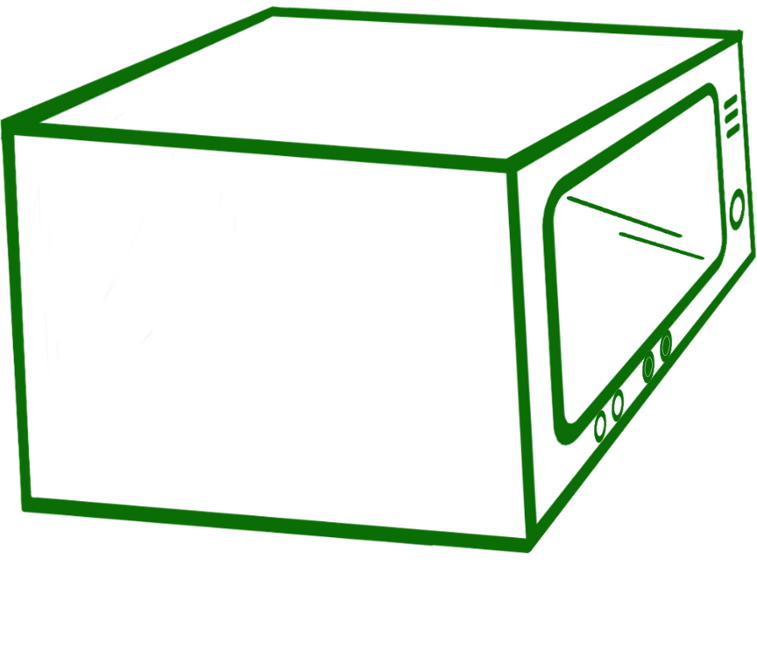


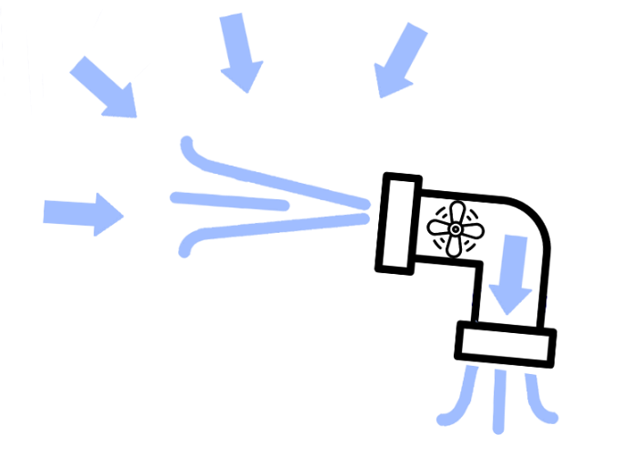
Steam Sterilization
2 types of steam sterilization
Steam under pressure (autoclaving)
  Gravity displacement:
    Exposure: 30 minutes
    Temperature: 121oC
  Pre-vacuum:
    Exposure: 4 minutes
    Temperature: 132oC
Steam under pressure (autoclaving)
  Gravity displacement:
    Exposure: 30 minutes
    Temperature: 121oC
  Pre-vacuum:
    Exposure: 4 minutes
    Temperature: 132oC
Steam under pressure (autoclaving)
  Gravity displacement:
    Exposure: 30 minutes
    Temperature: 121oC
  Pre-vacuum:
    Exposure: 4 minutes
    Temperature: 132oC
Steam
Steam
Sterilization
Notes:
There are two types of steam sterilization methods commonly used
CLICK
The first method is a gravity displacement sterilizer, where the steam enters the chamber and unsaturated air is forced out of the chamber through a vent in the chamber wall. This requires an exposure time of 30 minutes and a temperature of 121 degrees C.
CLICK
The second method is a pre-vacuum sterilizer. These are fitted with a vacuum pump to create a vacuum in the chamber and ensure air removal from the sterilizing chamber and load before the chamber is pressurized with steam. This method improves the speed and efficiency of the sterilization process and requires an exposure time of 4 minutes with a temperature of 132 degrees C.
With both methods, always use FDA-approved devices and closely follow the manufacturer’s instructions for proper use.

Slide 19
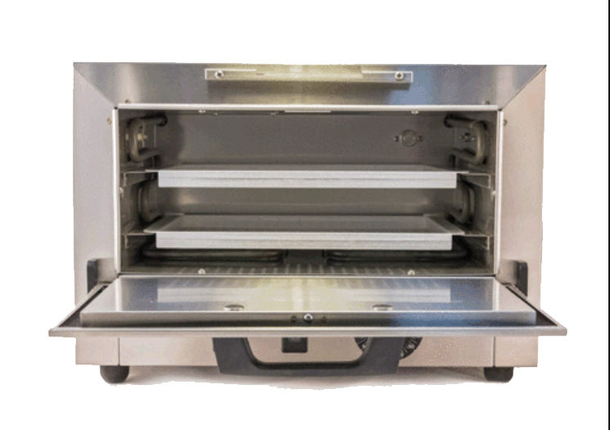
Dry Heat Sterilization
  Transfers heat energy from air inside the oven to the instruments
  Requires higher temperatures
  Good for items that are likely to dull or rust in the autoclave,
  Good for powders, cellulose and ink
  Packaging must be able to withstand high temperatures
Sterilization
Notes:
Dry heat sterilizers work by transferring heat energy from air inside the oven to the instruments. The lack of vapor pressure requires higher temperatures to achieve sterilization.
Dry heat is good for items that are likely to dull or rust in the autoclave, and it is good for items like powders, cellulose or ink that require sterilization.
However, the packaging used must be able to withstand high temperatures to prevent an accidental fire or charring of contents that could happen inside the sterilizer.

Slide 20
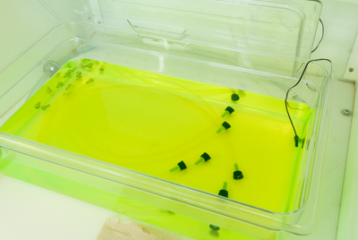
Liquid Chemical Sterilants/Disinfectants
  Only for heat-sensitive critical and semi-critical devices
  Exposure can be harmful to providers and patients
  Can not be stored
  Heat tolerant or disposable alternatives are available
Sterilization
Notes:
An alternative sterilization method for heat-sensitive instruments is soaking them in a liquid chemical sterilant cleared by the FDA. However, exposure to these powerful and toxic chemicals can be harmful to healthcare providers and patients if the manufacturer’s instructions for use and safety precautions are not followed precisely. These items are not wrapped and therefore can not be stored. For these reasons, CDC encourages the use of heat-tolerant or disposable alternatives.
A list of the FDA cleared sterilants and high-level disinfectants with label claims for reprocessing reusable medical devices is available and a link has been included in your list of resources

Slide 21
Sterilization Review
  Steam is preferred for critical items not damaged by heat
  Follow the operating parameters recommended by the manufacturer
  Use low temperature sterilization technologies for reprocessing critical items damaged by heat
  Items immersed in chemo-sterilizer solutions should be used immediately
Sterilization
Notes:
To review, steam is preferred for critical items not damaged by heat.
Follow the operating parameters recommended by the manufacturer for the equipment or products used.
Use low temperature sterilization technologies for reprocessing critical items that may be damaged by heat.
Items that have been sterilized by immersion in a chemo-sterilizer solution such as glutaraldehyde or ortho-phthalaldehyde (OPA) should be used immediately. These items are not wrapped for protection and therefore should not be stored long term.

Slide 22

Knowledge Check
Patient care equipment and devices should be disinfected/sterilized based on:
Items intended use
What the item is going to come in contact with
The number of patients you have scheduled for the day
What the dental provider tells you to do
Choose
1 and 4
2 and 4
1 and 2
3 and 4
Notes:
CLICK for answer The correct response is C. Use and contact are the basis for sterilization decisions

Slide 23
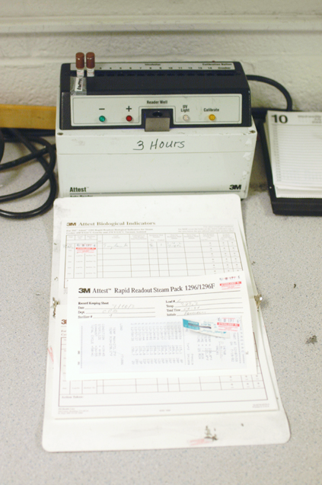

Monitoring
  Centers for Medicare and Medicaid Services (CMS)
  10A NCAC 41.0206 (NC Rule .0206
  The Joint Commission (TJC)
Monitoring
Notes:
Next, we will discuss monitoring. Monitoring the effectiveness of your sterilization equipment, procedures, and recordkeeping is essential for patient safety, and mandated by several regulatory agencies- Centers for Medicare and Medicaid Services (CMS), and 10A NCAC 41A .0206 (NC rule .0206) and accreditation bodies -The Joint Commission (TJC)

Slide 24
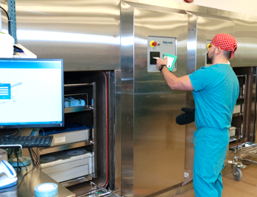
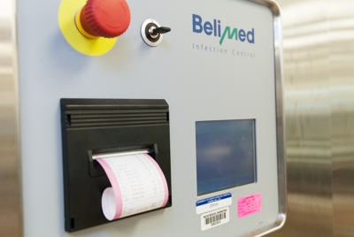
Sterilization Monitoring
Sterilization monitored routinely by combination of physical, chemical, and biological parameters
  Physical - cycle time, temperature, pressure
  Chemical - heat or chemical sensitive inks that change color when germicidal-related parameters reached
  Biological - Bacillus spores that directly measure sterilization
Sterilization monitored routinely by combination of physical, chemical, and biological parameters
  Physical - cycle time, temperature, pressure
  Chemical - heat or chemical sensitive inks that change color when germicidal-related parameters reached
  Biological - Bacillus spores that directly measure sterilization
Monitoring
Notes:
The sterilization procedure should be monitored routinely by using a combination of physical, chemical, and biological indicators to evaluate the sterilizing conditions and indirectly, the microbiologic status of the processed items.
CLICK
The physical monitors for steam include the daily assessment of cycle time and temperature by examining the temperature record charts or computer readout, and an assessment of pressure via the pressure gauge.

Slide 25
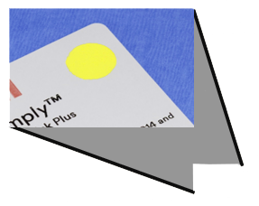

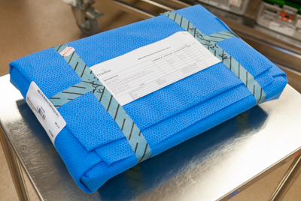
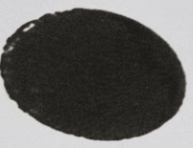
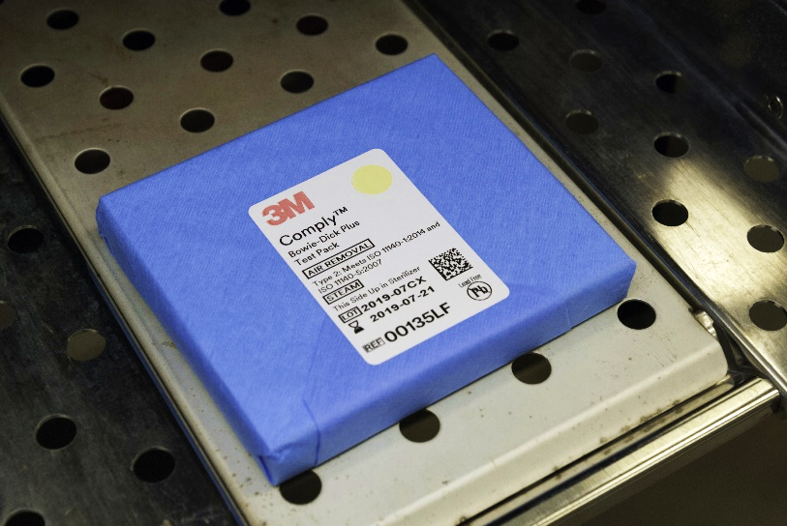
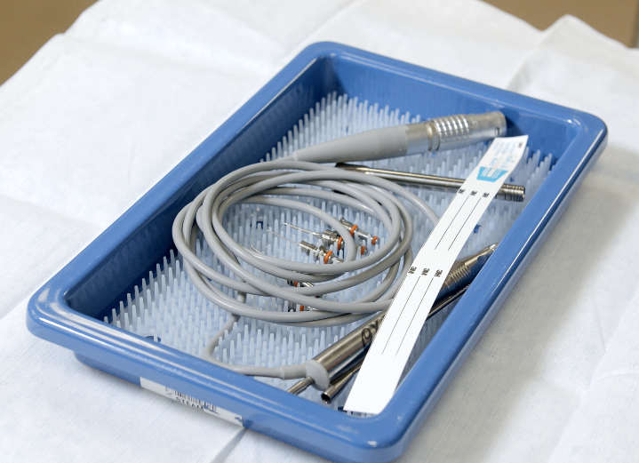

Monitoring Of Sterilizers
Internal Chemical Indicator
  Validates the sterilant penetrated the pack or tray
  Advantage of the pack control monitor is that it is inside each pack in multiple locations
  Detect local problem
Monitoring
Notes:
Chemical indicators are convenient and usually are either heat or chemical sensitive inks that change color when one or more sterilization parameters (e.g., steam-time, temperature, and or saturated steam) are present.
They indicate that the item has been exposed to the sterilization process, but these indicators do not prove sterilization has been achieved.
CLICK
Chemical indicators are affixed to the outside of each pack and preferably should also be placed on the inside of each pack to verify sterilant penetration.
Chemical indicators have been grouped into six classes based on their ability to monitor one or multiple sterilization parameters. If the internal or external indicator suggests inadequate processing, the item should not be used.

Slide 26
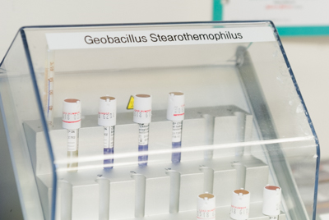
Monitoring Of Sterilizers
Biological Monitors
Steam
Geobacillus stearothermophilus
Dry heat
B. atrophaeus (formerly B. subtilis)
Ethylene oxide (ETO)
B. atrophaeus
Monitoring
Notes:
Biological indicators are recognized by most authorities as being the closest to the ideal monitors of the sterilization process because they measure the sterilization process directly using the most resistant microorganisms (i.e., Bacilllus spores) and not merely by testing the physical and chemical conditions necessary for sterilization. They are the only process that directly monitors the lethality of a given sterilization process. Because spores used in BIs are more resistant and present in greater numbers than the
common microbial contaminants found on patient-care equipment; an inactivated BI indicates other potential pathogens in
the load have been killed. Geobacillus stearothermophilus spores are used to monitor steam sterilization, hydrogen peroxide gas plasma , and liquid peracetic acid sterilizers. Bacillus atrophaeus formerly known as Bacillus subtilis at are used to monitor Ethylene oxide (ETO) and dry heat.
Geobacillus stearothermophilus is incubated at 55-60°C and B. atrophaeus at 37°C.

Slide 27
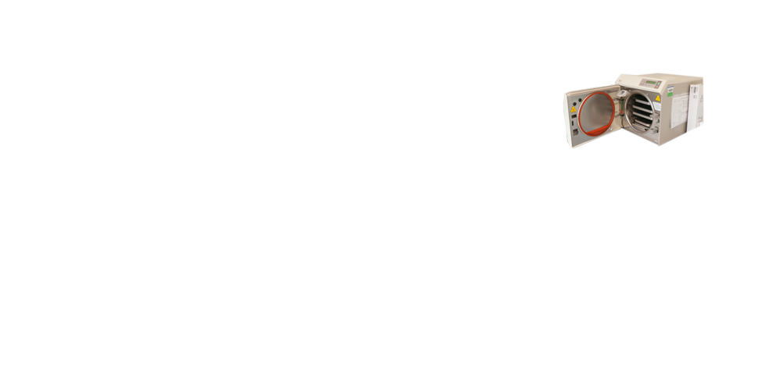








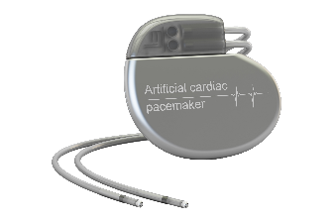
Monitoring of Sterilizers
Steam sterilization
IF biological indicator is positive (after sterilization cycle)
Remove
Retest
Do not use until inspected
Follow CDC and AORN procedures
Return to service
Next test
After single
Recall implantable items
Run 3X
Recall items if still positive
Reprocess
Defective procedures possible
Notes:
In the event a biological indicator is positive (after the sterilization cycle) follow the procedure provided by the CDC and the Association of Perioperative Registered Nurses (AORN).
CLICKs
For steam sterilization, after a single positive biological indicator test:
Remove the sterilizer from service and review sterilizer instructions
Retest the sterilizer
Recall all implantable items.
If additional spore tests are negative, return the sterilizer to service
If the spore test is positive: do not use the until the unit has been inspected;
Run 3 consecutive spore tests for validation. If the test is still positive, recall (to the extent possible) all items processed since the last negative spore test.
Reprocess the items from the implicated loads.
Note that the problem could also be a result of defective procedures which may be determined by a maintenance provider or by identification of inappropriate cycle settings.

Slide 28
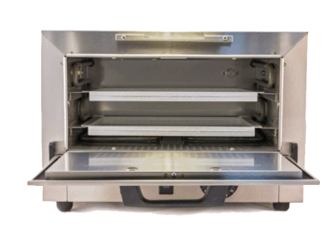

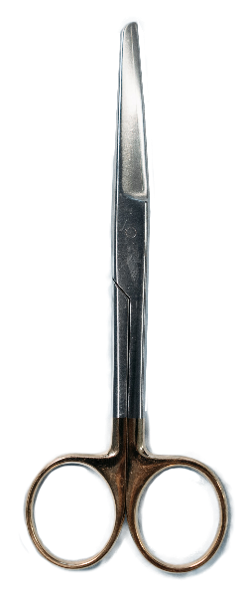



Monitoring of Sterilizers
Other Sterilization Methods
Steam sterilization
There is a minimal risk associated with items in a load that show spore growth, especially if the item was properly cleaned and the time, temperature and pressure was achieved (as demonstrated by a chemical indicator and monitoring documentation).
If patient care items were used before retrieval, the infection preventionist should assess the risk of infection in collaboration with the physician, and if needed, consult an outside reprocessing specialist.
Treat as non-sterile all items that have been processed in that sterilizer, dating from the last sterilization cycle in which there was a negative biological indicator.
Retrieve the items and reprocess.
After single
If item was used
Assess risk
Notes:
If patient care items were used before retrieval, the infection preventionist should assess the risk of infection in collaboration with the physician, and if needed, consult an outside reprocessing specialist. CLICK
The margin of safety in steam sterilization is sufficiently large that there is a minimal risk associated with items in a load that show spore growth, especially if the item was properly cleaned and the time, temperature and pressure was achieved (as demonstrated by a chemical indicator and monitoring documentation.
CLICK
After a single positive biological indicator used with a method other than steam sterilization, treat as nonsterile all items that have been processed in that sterilizer, dating from the last sterilization cycle with negative biological indicator. Retrieve items and reprocess.

Slide 29
Monitoring Review
Monitor each load with physical and chemical (internal and external) indicators.
Use biological indicators to monitor effectiveness of sterilizers at least weekly with spores intended for the type of sterilizer.
Use biological indicators for every load containing implantable items
Policy for management of positive BI indicator
Monitoring
Notes:
Monitor each sterilizer load with physical and chemical indicators
CLICKs
Use biological indicators to monitor effectiveness of sterilizers at least weekly. A schedule for and documentation of maintenance and microbiological monitoring is a requirement in the NC Rule .0206. If a sterilizer is used frequently (e.g., several loads per day), daily use of biological indicator allows for earlier discovery of equipment malfunctions or procedure errors, minimizing the extent of patient surveillance and product recall needed in the event of a positive biological indicator.
Each load should be monitored with a biological indicator if it contains an implantable object. If feasible, implantable items should not be used until the results of spore tests are known to be negative.
Have a policy in place for management of a positive BI indicator

Slide 30
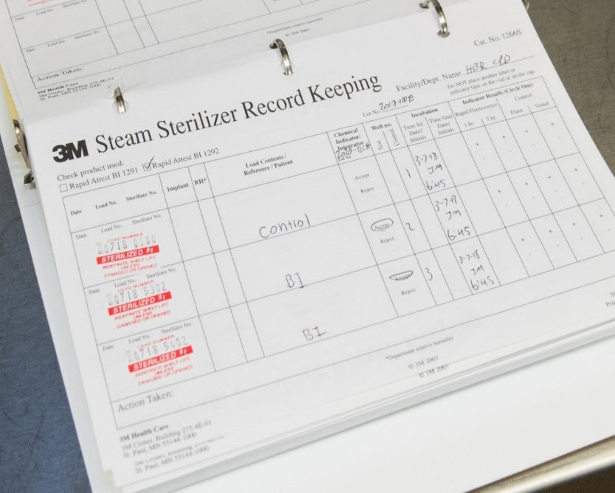
Record-Keeping
Maintain sterilization records (physical, chemical and biological)
for each sterilization cycle record
the type of sterilizer and cycle used
the load identification number
the load contents
the exposure parameters (time and temperature)
the operator’s name or initials
the results of physical, chemical, and biological monitoring
Packaging
Notes:
As part of a quality control program, the CDC Guidelines for Disinfection and Sterilization in healthcare facilities recommends the following record-keeping:
Maintain sterilization records (physical, chemical and biological) for a time period that complies with state and/or federal statues of limitations and if applicable accreditation standards (e.g., 3 years to meet the Joint Commission visitation schedule).
For each sterilization cycle record the type of sterilizer and cycle used;
CLICKs
the load identification number;
the load contents,
the exposure parameters (time and temperature);
the operator’s name or initials;
and the results of physical, chemical, and biological monitoring

Slide 31

Packaging
Packaging
Notes:
CLICK to play video
This is the narration on the video:
Once items are cleaned, dried, and inspected, those requiring sterilization must be wrapped or placed in rigid containers and should be arranged in instrument trays or baskets according to the guidelines provided by the Association of Medical Instrumentation (AAMI) and other professional organizations. These guidelines state that hinged instruments should be opened and items with removable parts should be disassembled unless the device manufacturer or research suggest otherwise. Follow manufacturer’s instructions for preparing instruments such as concave surfaces placed downward and heavy items placed below light items to avoid damage. The wrapping should be done in a manner to prevent gaps and tenting.
There are several choices in products to maintain sterility of surgical instruments, including peel packs, rigid containers, roll stock that will self seal to form a pouch, and woven or nonwoven sterile wraps. Healthcare facilities can choose any of these options. The key is the packaging material must allow penetration of the sterilant, must be compatible with the type of sterilizer, and must be puncture resistant, durable, and have FDA clearance.

Slide 32

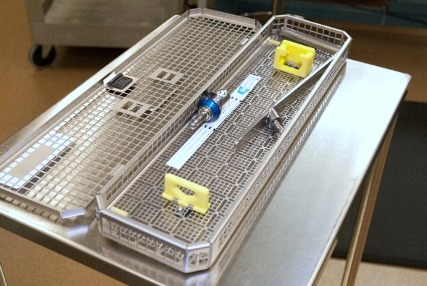
Loading
Place items/packages correctly and loosely into the sterilizer so as not to impede penetration of the sterilant
Peel packs and non-perforated containers should be placed on their edge
Peel packs:
  Be used, filled and opened according to the pouch manufacturer’s instructions
  Be of a size and strength to accommodate the item being packaged
  Be closed so that all pouch seals are smooth (i.e., without folds, bubbles or wrinkles)
  Be written only on the non-porous side of the pouch
Packaging
Consult manufacturer’s recommendations
Notes:
All items to be sterilized should be arranged so that all surfaces will be directly exposed to the sterilizing agent.
CLICK
Thus, the loading procedures must allow for free circulation of steam (or another agent) around each item. Place items/packages correctly and loosely into the sterilizer so as not to impede penetration of the sterilant
CLICK
Peel packs and non-perforated containers should be placed on their edge
Peel packs:
CLICKs
Be used, filled and opened according to the pouch manufacturer’s instructions
Be of a size and strength to accommodate the item being packaged
Be closed so that all pouch seals are smooth (i.e., without folds, bubbles or wrinkles)
Be written only on the non-porous side of the pouch
Due to the variety of textiles and containers on the market, the manufacturers of the sterilizer and wrap or container product should be consulted on pack preparation and density parameters.

Slide 33
Summary Methods
Steam is preferred for critical (and semi-critical) items not damaged by heat
Always follow manufacturer’s operating instructions
Use an “FDA cleared” container, wrapping or packaging system that is compatible with the type of sterilization process used
Do not overload the chamber
Notes:
A summary of recommendations for sterilization include that steam is preferred for critical and semi-critical items that are not damaged by exposure to high heat.
It is vital to always follow the manufacturer’s operating instructions for sterilizers, products, and equipment.
It is also important to use “FDA cleared” containers, wrapping, or packaging system that is compatible with the type of sterilization process used.
And it is critical for successful sterilization to not overload the sterilizer chamber.

Slide 34
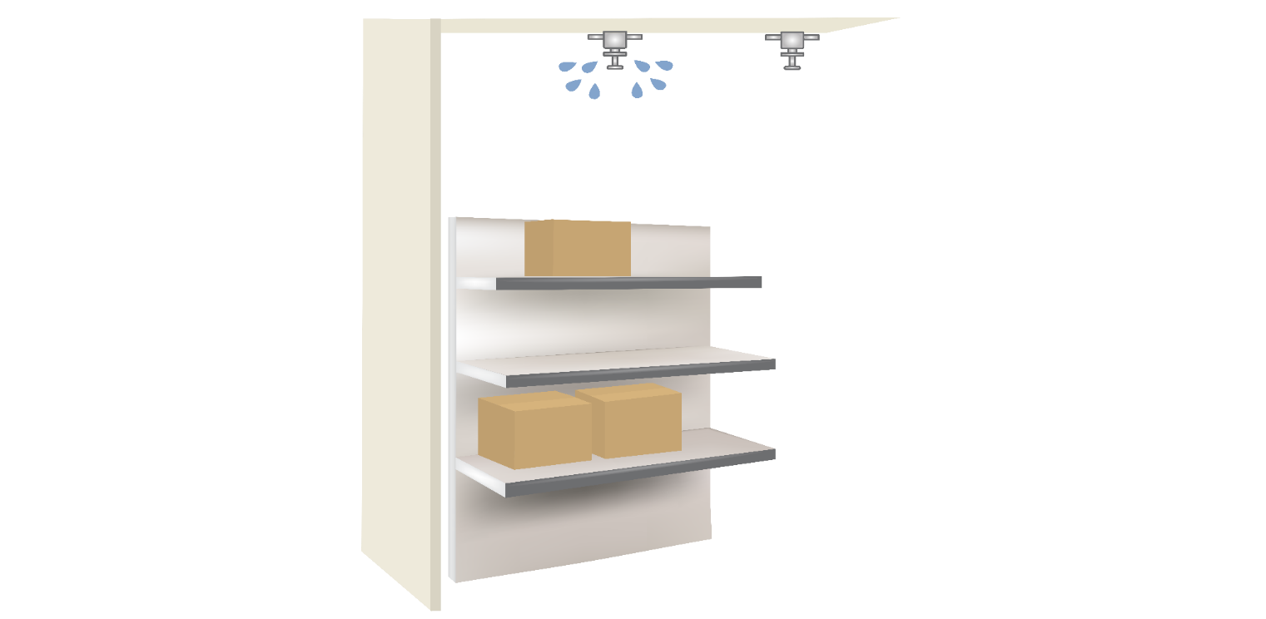



Storage Of Sterile Items
Ensure the sterile storage area is a well-ventilated area that provides protection against dust, moisture, and temperature and humidity extremes.
Sterile items should be stored so that packaging is not compromised.
Label sterilized items with a load number that indicates the sterilizer used, the cycle or load number, the date of sterilization, and if applicable the expiration date.
Storage
Notes:
Make sure the storage area for sterile items provides protection against dust, moisture, and temperature and humidity extremes and follows these guidelines for spacing between items and the surrounding environment
CLICKs
8 inches from the floor
18 inches from ceiling if there is a sprinkler
2 inches from outside walls

Slide 35




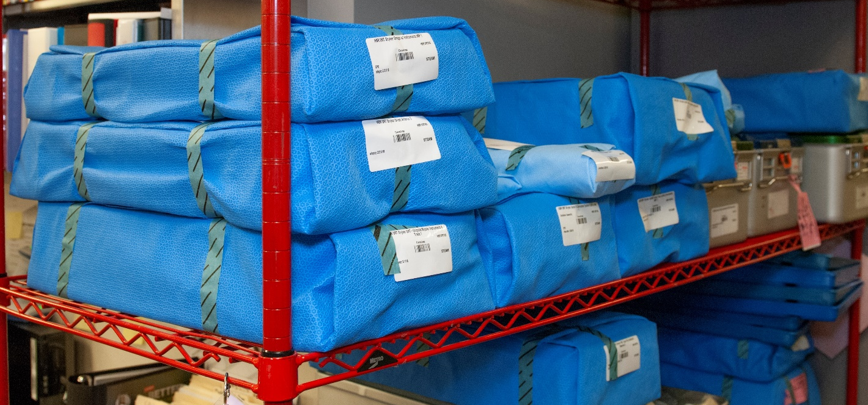
Storage Of Sterile Items
Shelf life =
Event-related shelf life recognizes that the product remains sterile until an event causes it to become contaminated (e.g. moisture).
Packages should be evaluated before use for loss of integrity. Repack and reprocess if compromised.
If time related storage of sterile items is used, label the pack at the time of sterilization with an expiration date. Once this date expires, reprocess the pack.
Storage
Notes:
The shelf life of a packaged sterile item depends on the quality of the wrapper, the storage conditions, the conditions during transport, the amount of handling, and other events like exposure to moisture that compromises the integrity of the package.
CLICKs
If event-related storage of sterile items is used, then packaged sterile items can be used indefinitely unless the packaging is compromised.
Packages should always be inspected and evaluated before use for loss of integrity (e.g., torn, punctured, or wet). If the integrity of the package is compromised, repack and reprocess the pack before use.
If using time-related storage, items remain sterile for varying periods depending on the type of material used to wrap the item/tray. If time-related shelf life (less common) is used, label the pack at the time of sterilization with an expiration date. Once the expiration date is met the pack should be reprocessed.

Slide 36
General Guidelines
All patient care items must be stored at least 8” off the floor
Open rack storage should have a bottom shelf (plexi-glass for example)
Stored at least 18” below the ceiling or the sprinkler head (according to fire code)
Stored at least 2” inches from outside wall
Items should be stored in areas of limited traffic
Stored in an area with controlled temperature and humidity
Outside shipping containers and corrugated cartons should not be used as storage containers
Items should not be stored under sinks or exposed water/sewer pipes
Windowsills should be avoided
Closed or covered cabinets are preferred
Storage
Notes:
In addition to the specific recommendations for storage of sterile items there are some general guidelines that should be followed for all healthcare equipment and supplies.
These guidelines are listed on the slide.

Slide 37


Spaulding Classification
Spaulding Classification of Surfaces:
– Objects which enter normally sterile tissue or the vascular system and require sterilization
– Objects that contact mucous membranes or non-intact skin and require high-level disinfection, which kills all but high-levels of bacterial spores
– Objects that contact intact skin but not mucous membranes, and require low-level disinfection
– Objects which enter normally sterile tissue or the vascular system and require sterilization
– Objects that contact mucous membranes or non-intact skin and require high-level disinfection, which kills all but high-levels of bacterial spores
Critical
Semi-critical
Non-critical
Semi-critical
Notes:
The next classification of medical devices/equipment we are going to discuss is semi-critical items.

Slide 38


Semi-critical Instruments
Semi-Critical Items:
  Contact mucous membranes or non-intact skin (mouth mirrors, cheek retractors, hand pieces, reusable dental impression trays and amalgam condensers)
  Risk of transmitting infection if handled improperly
  CDC notes because most semi critical items used in dentistry are heat-tolerant, they also should be sterilized by using heat
  If heat sensitive item should at a minimum be processed using high-level disinfection or used as single-use disposable devices
Semi-Critical Items:
  hand pieces*
*Although dental handpieces are “by definition” considered a semi-critical item, they should always be heat-sterilized between uses
Semi-critical
Goal: High-level disinfection = free of all
microorganisms except high numbers of bacterial spores
Notes:
Semi-Critical objects;
CLICKs
Have contact with mucous membranes or non-intact skin, items commonly seen in dental settings include (mouth mirrors, cheek retractors, hand pieces* reusable dental impression trays and amalgam condensers)
Risk transmitting infection if not handled properly and CDC notes because most semi critical items used in dentistry are heat-tolerant, they also should be sterilized by using heat
If heat sensitive item should at a minimum be processed using high-level disinfection or used as single-use disposable devices
CLICK
The goal with respect to semi-critical objects is to remove all microorganisms except high numbers of bacterial spores
CLICK

Slide 39
High-level Disinfectants
Germicide | Concentration
Glutaraldhyde (Cidex) | ≥ 2.0%
Ortho-phthaladehyde (Cidex OPA) | 0.55%
Hydrogen Peroxide* (Sporox) | 7.5%
Hydrogen Peroxide and peracetic acid* (Peract) | 1.0% / 0.08%
Hydrogen Peroxide and peracetic acid* (Endospore +) | 7.5% / 0.23%
Hypochlorite (free chlorine)* (Sterilox ©) | 650-675 ppm
Accelerated hydrogen peroxide (Resert XL) | 2.0%
Peracetic Acid (Steris 20) | 0.2%
Glutaraldehyde and Isopropanol (Aldahol III) | 3.4% / 26%
Glutaraldehyde and phenol/phenate (Sporicidin) | 1.21% / 1.93%
Semi-critical
Exposure time ≥8 -45 min (US) and temperature 20-25°C;
*May cause cosmetic and functional damage
Notes:
There are many products on the market that can be used for high-level disinfection of semi-critical items. It is important that you use a product that has been cleared by the FDA as a sterilant and high-level disinfectant. You should follow the manufacturer’s instructions for use to achieve high-level disinfection, specifically regarding concentration, exposure time and in-use temperatures. Material compatibility is also a factor, so it is important to choose the disinfectant that will not damage the item undergoing high-level disinfection.

Slide 40



Processing Semi-critical Instruments
Manufacturer’s instructions for dilution and quality control testing must be followed.
  Submerge the test strip into the solution prior to each use to monitor minimum effective concentration (MEC)
  Remove excess by standing upright on paper towel
  Read results according to manufacturer’s instructions (recommended time period and change in color of the test strip)
  Document findings
Semi-critical
Must use correct test strip for solution!
Notes:
Manufacturer’s instructions must be read and followed completely. Instructions will vary depending on the type of high-level disinfectant used.
General steps will include:
CLICKs
Remove a test strip and submerge in the disinfectant prior to each use to ensure the minimum effective concentration
Remove excess solution by standing upright on a paper towel
Read results after the time period recommended by the manufacturer (for example 75-90 seconds)
Document findings
CLICK
It is important that you purchase the correct test strip for the correct solution. If the chemical indicator on the test strip indicates that the concentration is less than the minimum effective concentration (MEC), the solution should be discarded, even if it is before the use-life of the solution (typically 14 – 28 days, depending on the manufacturer).

Slide 41

Spaulding Classification
Spaulding Classification of Surfaces:
– Objects which enter normally sterile tissue or the vascular system and require sterilization
– Objects that contact mucous membranes or non-intact skin and require high-level disinfection, which kills all but high-levels of bacterial spores
– Objects that contact intact skin but not mucous membranes, and require low-level disinfection
Critical
Semi-critical
Non-critical
Non-critical
Notes:
The final classification of medical devices/equipment is non-critical items.

Slide 42
Non-critical Instruments
Non-Critical Items:
  Objects that contact intact skin but not mucous membranes (BP cuffs, counter tops, exam chairs)
  Minimal risk of transmitting infection if handled improperly
  Must be low-level disinfected on a routine basis
Non-critical
Notes:
Non -Critical objects;
Have contact with intact skin and not mucus membranes, objects commonly seen in the dental setting include both patient care devices such as blood pressure cuffs, as well as patient environment, such as counter tops and exam chairs.
Minimal risk of transmitting infection if not disinfected properly and
Must be low level disinfected on a routine basis

Slide 43

Voice change
Role of the Environment
Non-critical
Notes:
According to numerous studies published in the literature, many pathogens can live from days to several months on dry surfaces. As you can see not all organisms are the same, some like MRSA can survive for long periods of time while HIV can only survive for a very short period of time.

Slide 44
Liquid Disinfectants
Disinfectant Agent | Use Concentration
Ethyl or isopropyl alcohol | 70% - 90%
Chlorine (bleach) | 100 ppm
Phenolic | UD
Iodophor | UD
Quaternary ammonium compound (QUAT) | UD
Improved/Accelerated hydrogen peroxide | 0.5%, 1.4%
Non-critical
UD = Manufacturer’s recommended use dilution
Notes:
These are examples of commonly used disinfectants in healthcare. A quaternary ammonium compound is a commonly used product, but there are new products on the market including an improved or accelerated hydrogen peroxide.
Most of these preparations come in ready to use forms that do not require any additional mixing of dilution.
Refer to module E for a complete demonstration of room cleaning procedures

Slide 45

Properties of an Ideal Disinfectant
  Broad Spectrum
  Fast Acting
  Non-Toxic
  Surface Compatibility
  Easy to Use
  Acceptable odor
  Economical
Non-critical
Notes:
Here are some things to consider when selecting the “ideal” disinfectant for your specific practice:
The product should be broad spectrum and be effective against a wide range of organisms
It should be fast acting and nontoxic
It should be compatible with the surface of the object you are disinfecting
It should be easy for staff to use
It should not have any obtrusive odor and
It should be economical

Slide 46



Other Environmental Issues
Blood and Body Fluid Spills
Contaminated work surfaces shall be decontaminated with an appropriate disinfectant
  After completion of procedures
  Immediately or as soon as feasible when surfaces are overtly contaminated
  After any spill of blood or other potentially infectious materials
  At the end of the work shift if the surface may have become contaminated since the last cleaning
When there are large spills of blood and/or body fluids it is important to clean or remove the spill prior to disinfecting the area
  The first step is to clean and decontaminate the area promptly.
  If the spill contains large amounts of blood or body fluids, clean the visible matter with disposable absorbent material, and discard the contaminated materials in appropriate, labeled container (treat as OSHA regulated medical waste)
  Use EPA-registered disinfectants labeled tuberculocidal or EPA registered germicides with specific label claims for HIV or hepatitis B virus (HBV) in accordance with label instructions to decontaminate spills of blood and other body fluids
  Use appropriate PPE
Notes:
Another important process to understand is how to clean-up blood and body fluid spills. OSHA requires, as part of the bloodborne pathogen standard,
CLICKs
Contaminated work surfaces shall be decontaminated with an appropriate disinfectant
after completion of procedures;
immediately or as soon as feasible when surfaces are overtly contaminated
or after any spill of blood or other potentially infectious materials;
and at the end of the work shift if the surface may have become contaminated since the last cleaning.
When there are large spills of blood and/or body fluids it is important to clean or remove the spill prior to disinfecting the area
The first step is to clean and decontaminate the area promptly.
If the spill contains large amounts of blood or body fluids, clean the visible matter with disposable absorbent material, and discard the contaminated materials in appropriate, labeled container (treat as OSHA regulated medical waste)•
Use EPA-registered disinfectants labeled tuberculocidal or EPA registered germicides with specific label claims for HIV or hepatitis B virus (HBV) in accordance with label instructions to decontaminate spills of blood and other body fluids.

Slide 47
Knowledge Check
Contaminated reusable items should be:
Handled as little as possible
Placed in a bio-hazard labeled container and left in room until end of the workday
Pre-cleaned in sink in the exam room
Transported immediately after use and not left in the patient care area
Choose
1 and 3
3 and 4
1 and 4
1, 2, 3, 4
Notes:
CLICK for answer That’s right. Contaminated items should be handled as little as possible and transported immediately. They should never be left in the exam room.

Slide 48


Training and Quality Control
  Provide comprehensive and intensive training for all staff assigned to reprocess medical/surgical instruments
  To achieve and maintain competency:
  Staff receive hands-on training
  Work with supervision until competency is documented
  Competency testing should be conducted at commencement of employment and no less than annually
  Training and competencies should be documented
Notes:
Regardless of the level of sterilization and/or disinfection preformed in your facility personnel performing these functions should receive comprehensive and intensive training.
CLICKs
For staff to achieve and maintain competency they should:
Receive hands-on-training
Work with supervision until competency is documented
Competency testing should be conducted at commencement of employment and no less than annually
Competency testing should be performed at least annually or more often if new responsibilities are introduced.
All training and competencies should be documented.

Slide 49
Training and Quality Control
Conduct monitoring/observations of process measures such as hand hygiene, use of PPE, environmental cleaning and disinfection sterilization
Ensure all products used for disinfection and/or sterilization have been approved by infection prevention
Follow manufacturer instructions for use (IFUs)for preparation and packing of items
Notes:
As part of the quality control program:
Conduct monitoring/observations of process measures such as hand hygiene, use of PPE, environmental cleaning and disinfection sterilization
Ensure that all products used in the facility have been approved by designated individuals with oversight over infection prevention.
Follow manufacturer instructions for use for preparation and packing of items

Slide 50



Additional Resources
https://www.cdc.gov/infectioncontrol/pdf/guidelines/disinfection-guidelines.pdf
https://www.cdc.gov/oralhealth/infectioncontrol/pdf/safe-are2.pdf
https://www.cdc.gov/mmwr/PDF/rr/rr5217.pdf
Notes:
For more information on the topics discussed in this module, links to these resources have been added to your resource page

Slide 51




