Slide 1

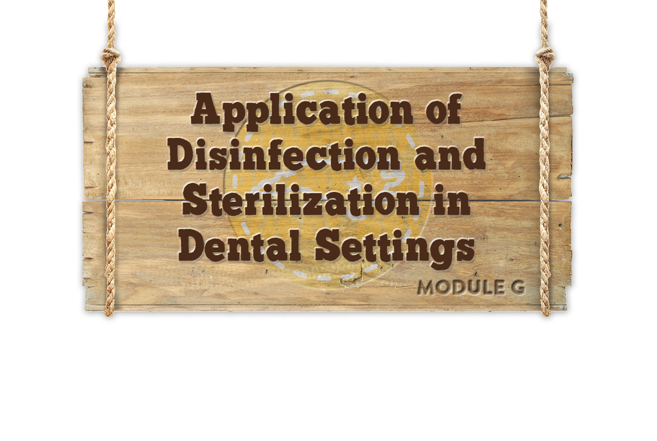



Module G
Module G
Notes:
Hi, welcome to Module G, Application of Cleaning, Disinfection, and Sterilization Principles

Slide 2
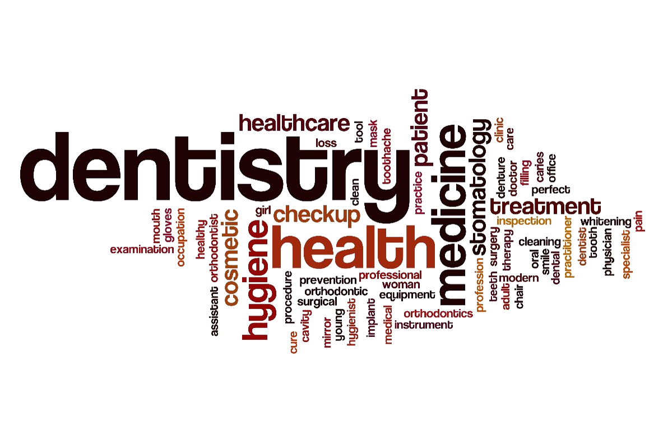

Objectives
Review Management of :
Housekeeping/Clinical Contact Surfaces
Medical Waste
Dental Unit Waterlines
Radiology/Laser/Electrosurgery
Notes:
We’re going to review a variety of activities you may encounter and discuss how to apply the principals of disinfection and sterilization to each of these:
Housekeeping and Clinical Contract environmental surfaces
Medical Waste
Dental Unit Water lines
Radiology/ laser and electrosurgery.
2

Slide 3
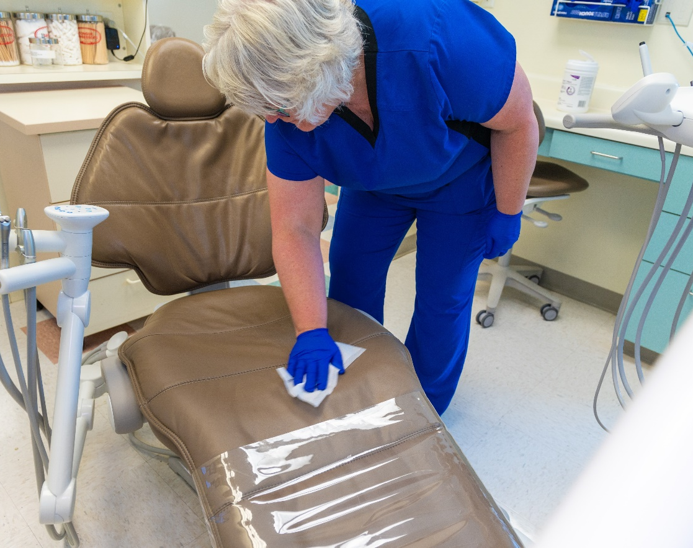
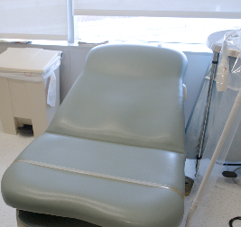
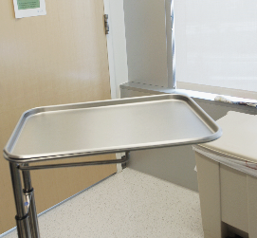
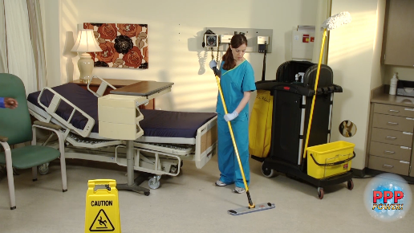
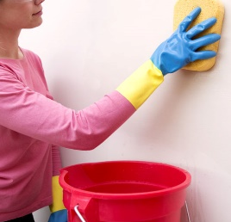
Role of the Environment
Clinical
 | Housekeeping
Facilities should establish polices and procedures for routine cleaning and disinfection of environmental surfaces in dental health care settings.
High potential for direct contamination
Spray or splatter
Frequent contact with healthcare personnel’s hands
No direct contact with patients or devices
Little risk of transmitting infections
Notes:
Facilities should establish polices and procedures for routine cleaning and disinfection of environmental surfaces in dental health care settings
CLICK
In module E we discussed the role of the environment and the difference in clinical contact surfaces and housekeeping surfaces.
As a reminder:
CLICKs
Clinical contact surfaces have a high potential for direct contamination from patient secretions, especially during procedures that generate spray or splatter and have frequent contact with healthcare personnel’s hands.
Housekeeping surfaces generally have no direct contact with patients or medical devices and have little risk of transmitting infections.
3

Slide 4
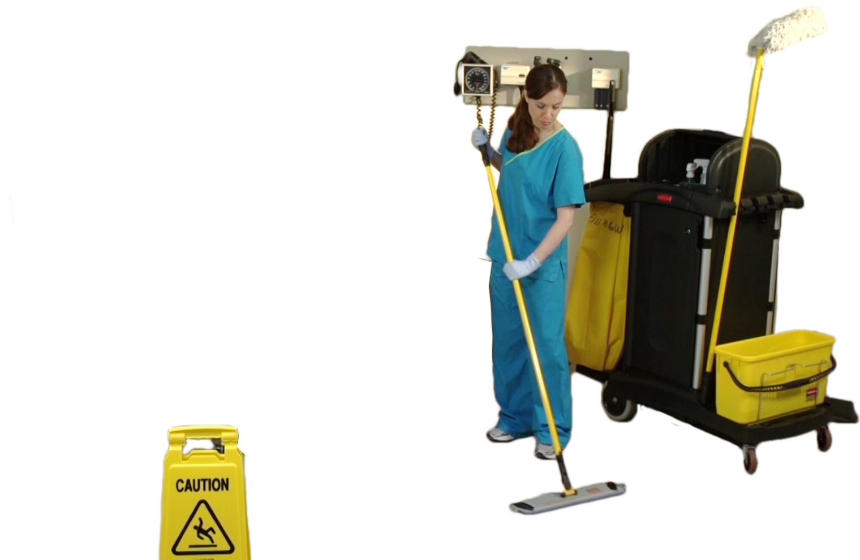
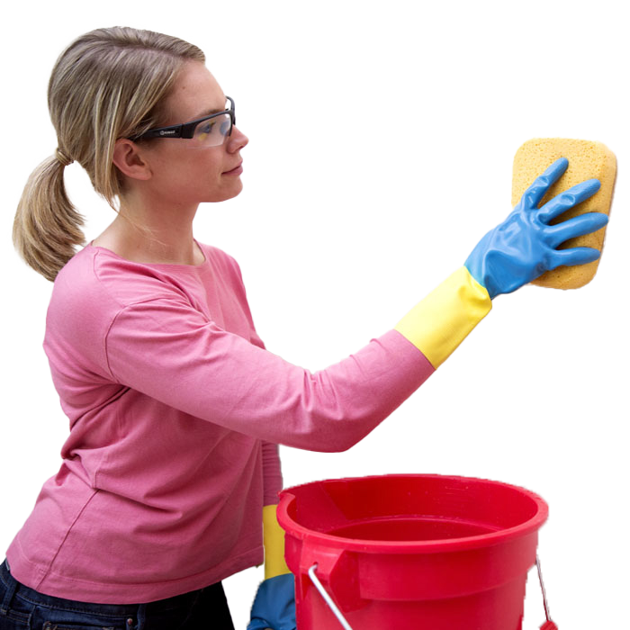

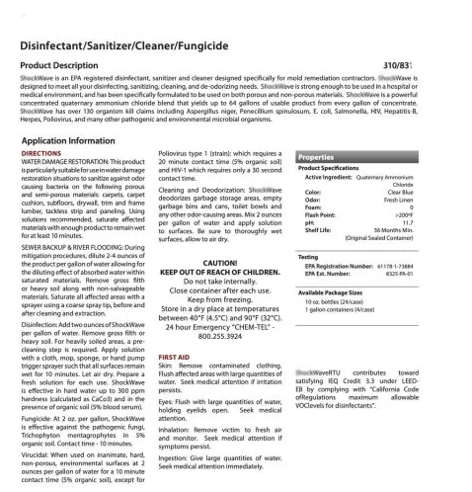
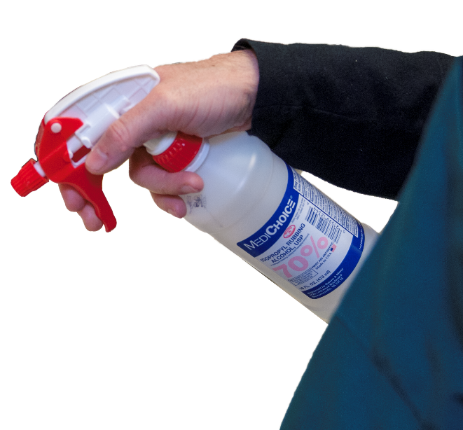
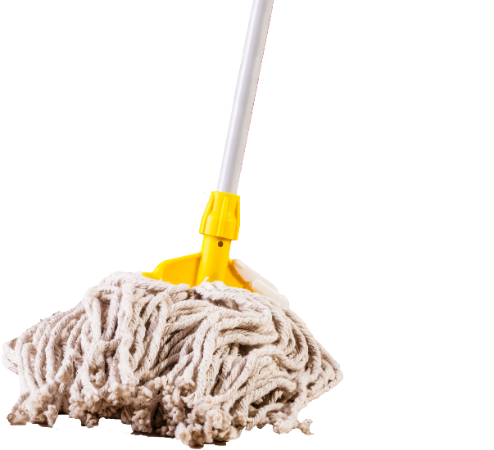
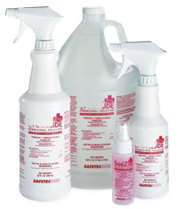

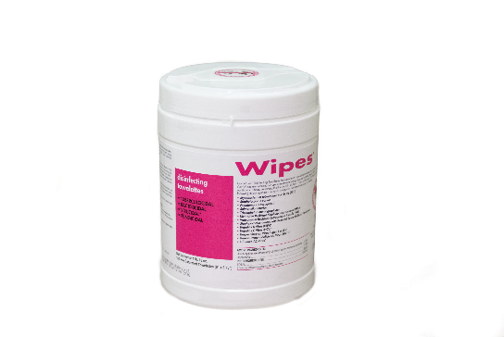
Management of Housekeeping Surfaces
Housekeeping surfaces do not come into contact with patients or devices used in dental procedures.
Reusable mops and cloths should be cleaned after use and allowed to dry before reuse. Alternatively use single-use mops.
Prepare fresh cleaning and disinfection solutions daily and according to the manufacturer’s recommendations.
Notes:
Reusable mops and cloths should be cleaned after use and allowed to dry before reuse. Alternatively use single-use mops.
CLICK
Prepare fresh cleaning and disinfection solutions daily and according to the manufacturer’s recommendations.
CLICK
Housekeeping surfaces, such as floors, walls, and sinks, do not come into contact with patients or devices used in Dental procedures.
CLICK
These Surfaces can be cleaned with detergent and water or cleaned and disinfected if visibly contaminated with blood (use an EPA-registered disinfectant detergent per manufacturers instructions for use (or IFUs)
4

Slide 5
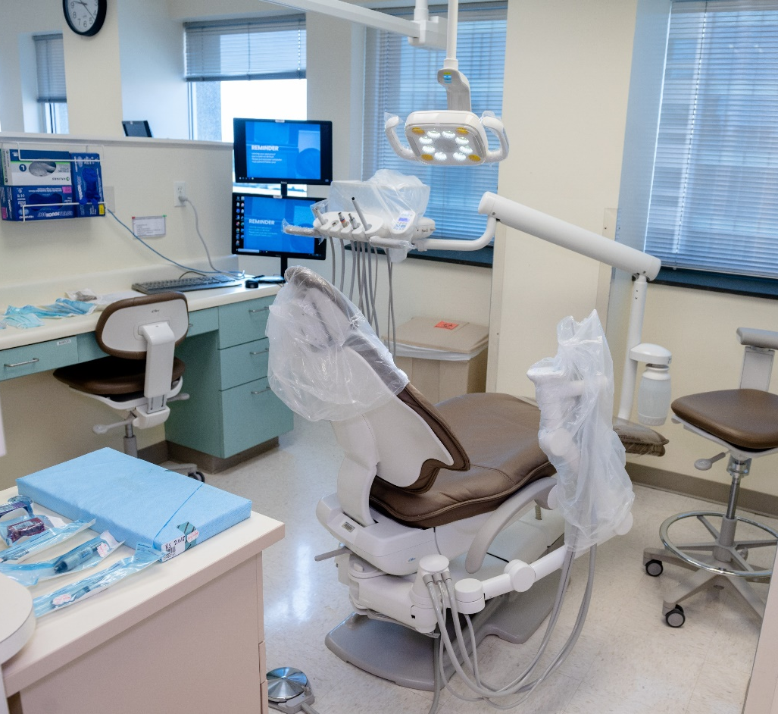
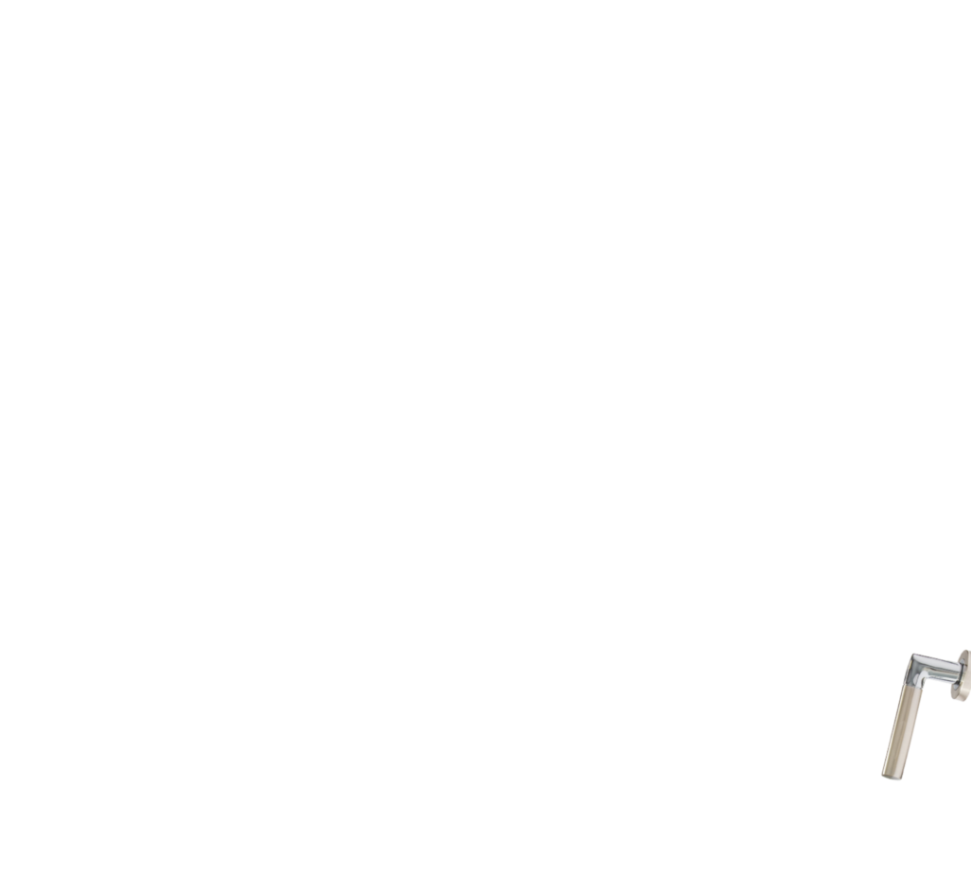










Management of Clinical Contact Surfaces
Clinical contact surfaces must be disinfected prior to care of the next patient
Clinical contact surfaces have a high potential for direct contamination from patient materials
direct
spray/splatter
contact with
gloved hands
instruments
devices
hands
gloves
Notes:
Clinical contact surfaces have a high potential for direct contamination from patient materials either by direct spray or splatter generated during dental procedures or by contact with gloved hands during patient care, and can subsequently contaminate instruments, devices, hands, or gloves.
CLICK
Clinical contact surfaces need to be disinfected before they become involved in the care of the next patient. Here you can see some examples of clinical contact surfaces, including a light handle, countertop, bracket tray, dental chair, and door handle.

Slide 6
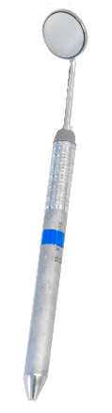
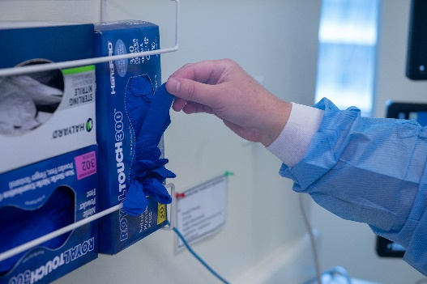
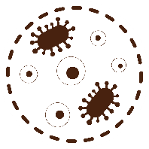



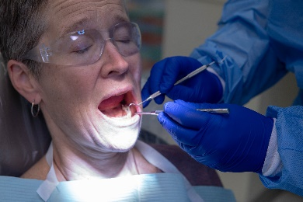

Contamination of Clinical Contact Surfaces via:
Contaminated gloves and hands of dental healthcare personnel
Contaminated instruments or other inanimate objects
Aerosol/splatter
Notes:
Clinical contact surfaces can become readily contaminated
CLICKs
via the soiled gloves or hands of dental healthcare personnel,
via contaminated instruments or other devices placed on these surfaces,
and/or via aerosol or splatter generated during routine patient care activities – all of which can result in cross-contamination of clean hands, gloves, instruments and devices.

Slide 7
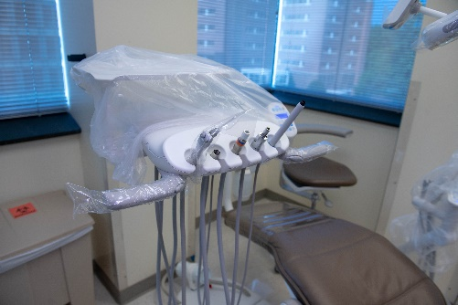
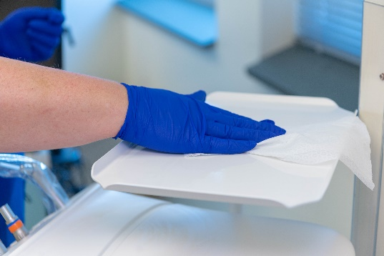
Management of Clincal Contact Surfaces
Surface Protection
Surface Disinfection
Notes:
There are two general approaches to management of clinical contact surfaces:
CLICK
Barrier protection of surfaces and equipment can prevent contamination of clinical contact surfaces but is particularly effective for those that are difficult to clean.
CLICK
If barriers are not used, surfaces should be cleaned and disinfected between patients.
Most dental settings use a combination of both approaches.
7

Slide 8
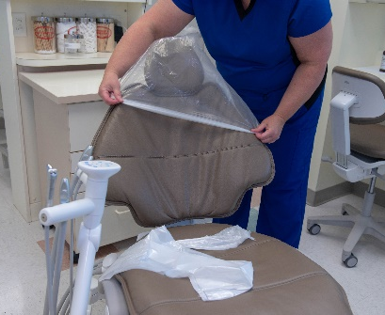
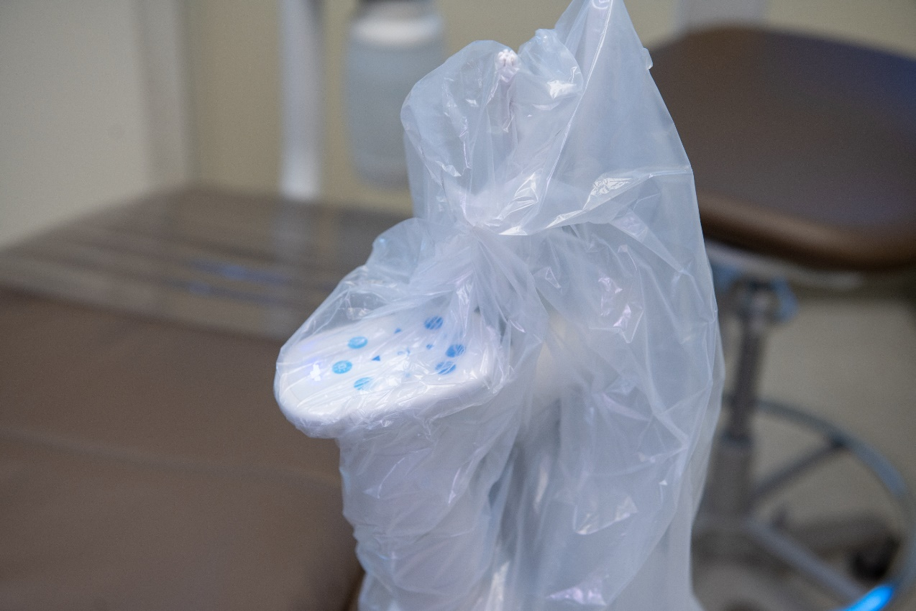

Surface Protection of Clinical Contact Surfaces
Surface covers should be impervious to fluids
Examples: clean plastic wrap, bags, tubes, and plastic backed paper
Barriers should be changed between each patient
If a barrier fails, disinfect the underlying surface
FDA Approved
Barrier Protection
Notes:
Ideally, clinical contact surfaces, especially those that are hard to clean, should be barrier protected with a Food and Drug Administration (FDA)-approved surface barrier.
CLICKs
Surface covers should be impervious to fluids to keep microorganism in saliva, blood and other liquids from soaking through to contact the surface.
Examples of appropriate materials for surface covers include clean plastic wrap, bags, tubes, and plastic backed paper.
Barriers should be changed between each patient. After removing the barrier, examine the surface to make sure it did not become soiled.
If it is contaminated, the surface needs to be cleaned and disinfected before the next patient.
8

Slide 9
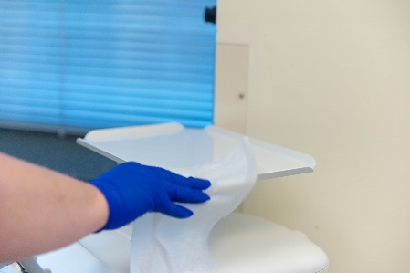
Surface Cleaning/Disinfection of Clinical Contact Surfaces
If barriers are not used, use an EPA-registered hospital disinfectant effective against HIV/HBV or effective against TB
Required for clinical surfaces after treating an individual patient
Required if surfaces become contaminated since their last cleaning
General cleaning and disinfection are also recommended for clinical contact surfaces, dental unit surfaces and countertops at the end of the day
Notes:
If surface barriers cannot be used, the surface should be cleaned or disinfected with an EPA-registered hospital disinfectant effective against HIV and Hepatitis B, or effective against TB.
CLICKs
Disinfection is required for clinical surfaces, after treating an individual patient,
and if the clinical surface becomes contaminated since it was last clean.
General cleaning and disinfection is also recommended at the end of the day.

Slide 10
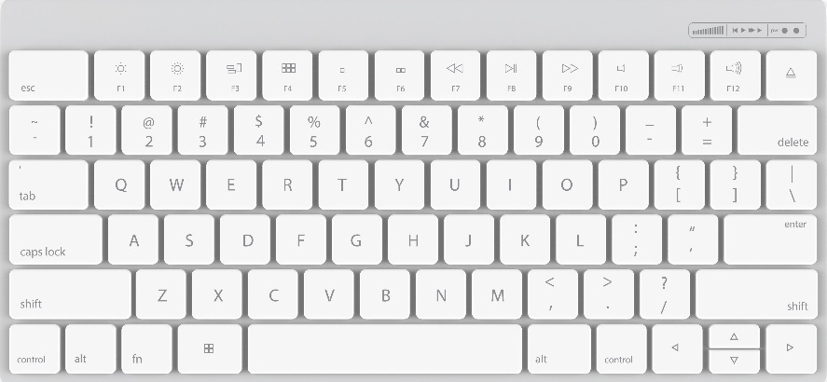

Disinfection of Computer Keyboards
Keyboards can be effectively disinfected using most EPA registered disinfectants (for example):
Quaternary ammonium compounds
70% isopropyl alcohol
Phenolic
Current recommendations are to disinfect keyboards daily and when visible soiled
Notes:
Another frequently contacted item in dental settings is computer keyboards, which can also serve as reservoir for pathogens and can lead to cross transmission if not properly disinfected routinely. A study evaluating the cleaning of keyboards found that keyboards could be effectively disinfected using most commercially available EPA-registered disinfectants.
CLICK
It is recommended that keyboards be disinfected at least daily and when visibly soiled.

Slide 11
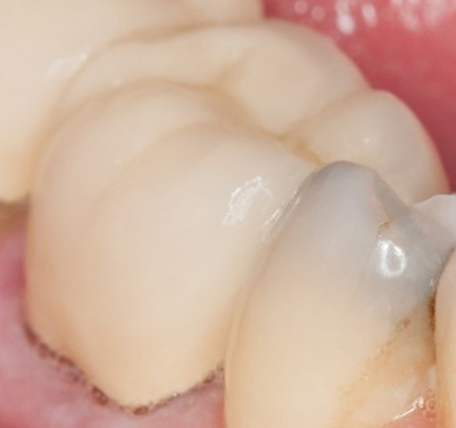
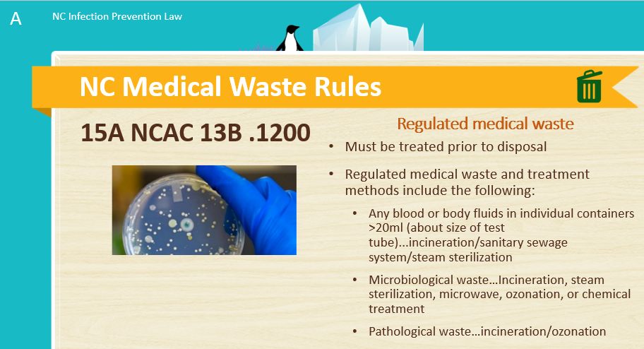
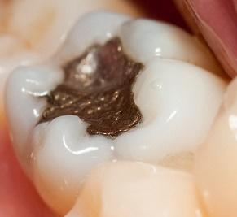
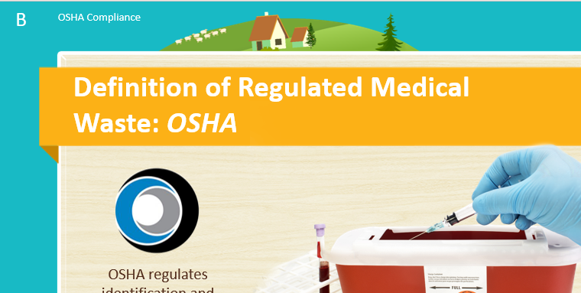
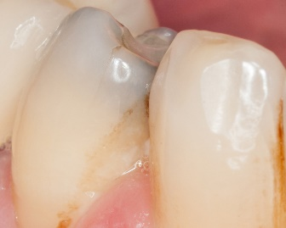
Medical Waste- Extracted Teeth
Without amalgam:
Not considered regulated medical waste
Can be discarded in regular trash
With amalgam:
No incineration for final disposal
Consult state and local regulation
Shade comparison:
Disinfect with intermediate level EPA-registered hospital grade disinfectant before sending to the laboratory
Notes:
If you remember we discussed NC Regulated Medical Waste Laws in Module A and OSHA’s definition of regulated medical waste in Module B.
One item rather unique to dental settings is disposable of extracted teeth.
CLICKs
Extracted teeth, not containing amalgam, are not considered regulated medical waste and can be discarded in regular trash
Extracted teeth containing amalgam should not be placed in a medical waste container that uses an incinerator for final disposal. State and local regulations should be consulted regarding disposal of amalgam.
Extracted teeth used for shade comparison should be cleaned and the surface disinfected with an intermediate-level EPA-registered hospital grade disinfectant before sending to the laboratory and transported in a manner consistent with OSHA regulations
If patients request their own extracted teeth, the tooth fairy wins:
OSHA regulations no longer apply once the tooth has been returned to the patient. However, for the safety of others who may come into contact with the tooth, it should be cleaned and disinfected before it is returned to the patient.
11

Slide 12
Medical Waste-Extracted Teeth
Handling extracted teeth in educational setting
Remove visible blood and debris
Maintain hydration
Heat autoclave (teeth with NO amalgam)
If tooth has amalgam, do not heat sterilize, alternatively immerse in 10% formalin (review the manufacturer MSDS) for two weeks
Use Standard Precautions
Notes:
Extracted teeth are occasionally collected and used for preclinical educational training.
CLICKs
Extracted teeth should be cleaned of visible blood and debris
and maintained in a hydrated state in a well-constructed closed container (water or saline can be used). Label the container with a biohazard symbol.
Using teeth without amalgam is preferred because teeth can be safely autoclaved.
If extracted teeth that contain amalgam must be used, DO NOT heat sterilize since this will produce harmful mercury vapors; Instead, immerse in 10% formalin for 2 weeks before use. If using formalin manufacturer MSDS should be reviewed for occupational safety and health concerns and to ensure compliance with OSHA regulations.
Even though the inside of the pulp chamber is now safe to touch, CDC suggests that students use Standard Precautions, because preclinical exercises should simulate clinical practice.
12

Slide 13

Knowledge Check
True or False?
Strategies for cleaning and disinfection of dental surfaces should consider all the following :
Potential for patient contact
Degree/frequency for hand contact
Potential for contamination of surface
True
False
Notes:
CLICK for Answer
The answer is True-all these factors should be considered.
13

Slide 14


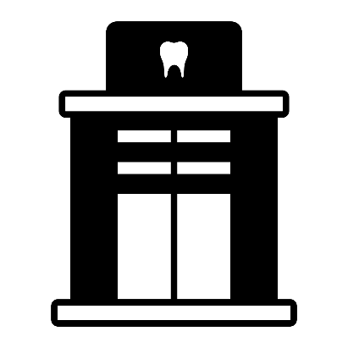

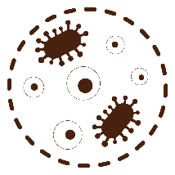

Dental Unit Waterlines
Untreated dental units cannot reliably produce water that meets drinking water standards
High numbers of common water bacteria can be found in untreated dental unit water
Bacteria can cause serious, sometimes life-threating infections
Contaminated water from dental units has been linked to outbreaks of Mycobacteria in children
Exposing patents to water of uncertain microbiological quality is inconsistent with infection control principles
https://www.cdc.gov/dental-infection-control/hcp/dental-ipc-faqs/best-practices-dental-unit-water-quality.html
Notes:
Water enters the dental office from municipal supplies or from wells and is then routed to various sites including dental units.
CLICKS
Water from municipal sources must meet EPA drinking water quality standards of <500 colony forming units per milliliter, so the water entering the dental unit is not sterile
High numbers of common water bacteria can be found in untreated dental unit water systems, including Legionella, Pseudomonas aeruginosa, and nontuberculous Mycobacteria. These bacteria can cause serious, sometimes life-threating infections.
Contaminated water from dental units has been linked to outbreaks of Mycobacteria infections in children.
These reports highlight the need for training to improve understanding of the underlying principles of dental unit water quality maintenance and monitoring, recommended practices, and their implementation in dental settings.
https://www.cdc.gov/dental-infection-control/hcp/dental-ipc-faqs/best-practices-dental-unit-water-quality.html
14

Slide 15
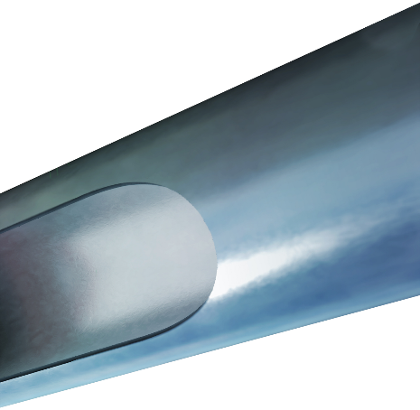
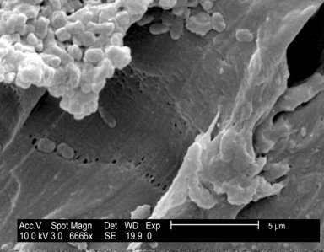

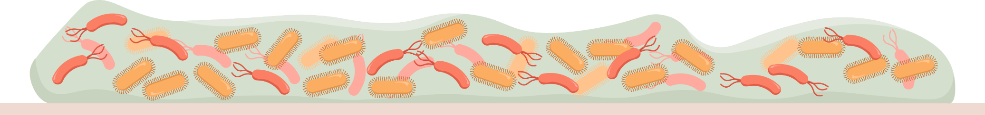
Dental Unit Waterlines and Biofilm
Microbial biofilms form in small bore tubing of dental units
Biofilms serve as a microbial reservoir
Biofilm is a thin, slimy film of bacteria that sticks to moist surfaces
Notes:
Biofilm is a thin, slimy film of bacteria that sticks to moist surfaces. Dental unit waterlines have unique characteristics that make them prone to biofilm formation, including long, small-diameter tubing, low flow rates, and frequent periods of stagnation.
CLICKs
Biofilms, comprised of colonies of microorganisms attached to a surface, can form on the inside of the small-bore plastic tubing that transports water within the dental unit to handpieces and air-water syringes.
Once formed, a biofilm serves as a reservoir that may dramatically increase the number of free-floating microorganisms in water used for dental treatment.
15

Slide 16
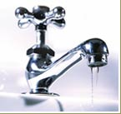
Dental Water Quality
Dental unit waterlines should be treated regularly with disinfectants to meet the Environmental Protection agency (EPA) regulatory standards for drinking water*
* <500 CFU/mL of heterotrophic water bacteria
Notes:
CDC recommends that water used for routine dental treatment be treated regularly with disinfectants to meet regulatory standards for drinking water (fewer than 500 CFU/mL of heterotrophic water bacteria).
16

Slide 17
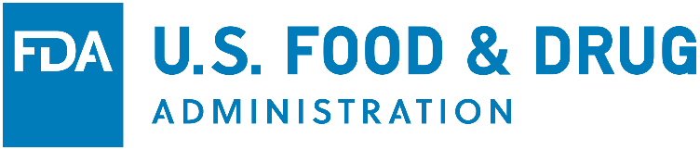
Tips for Dental Practitioners
Establish written standard operation procedures to guide dental personnel in performing infection control procedures
Follow the manufacturer’s instructions to clean and disinfect the dental unit at recommended intervals.
Monitor the water quality and microbial contamination using standardized culturing methods at appropriate intervals to keep bacterial counts lower than 500 CFU/mL of water
For units using separate water reservoirs, purge the waterlines each night and when ever units are out of service
Discharge water and air lines for a minimum of 20-30 seconds after each patient
Monitor waterlines for damage or visible contamination and replace if needed or per manufacturer recommendations
Notes:
Establish written standard operation procedures to guide dental personnel in performing infection control procedures
CLICKs
Follow the manufacturer’s instructions to clean and disinfect the dental unit at recommended intervals-contact the manufacturer to obtain the most up to date instructions or with any questions regarding the reprocessing of the dental unit
Monitor the water quality and microbial contamination using standardized culturing methods at appropriate intervals to keep bacterial counts lower than 500 CFU/mL of water
For units using separate water reservoirs, purge the waterlines each night and when ever units are out of service
Discharge water and air lines for a minimum of 20-30 seconds after each patient to physically flush out material that might have entered the dental water system during treatment.
Monitor waterlines for damage or visible contamination and replace if needed or per manufacturer recommendations
17

Slide 18
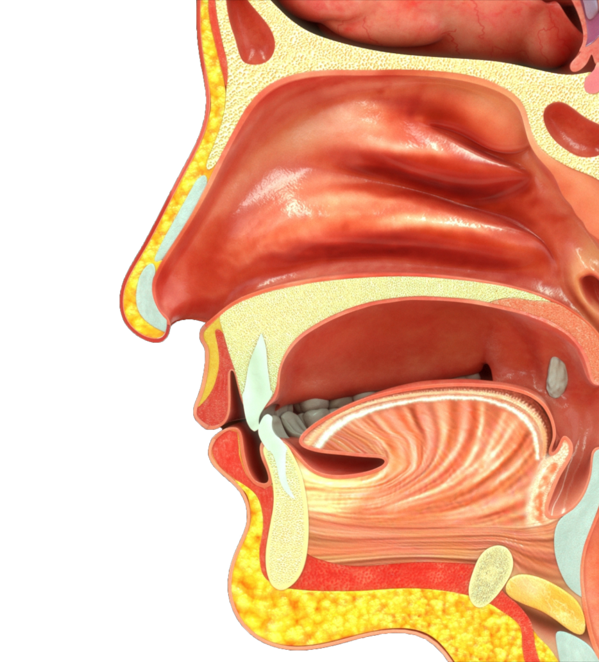
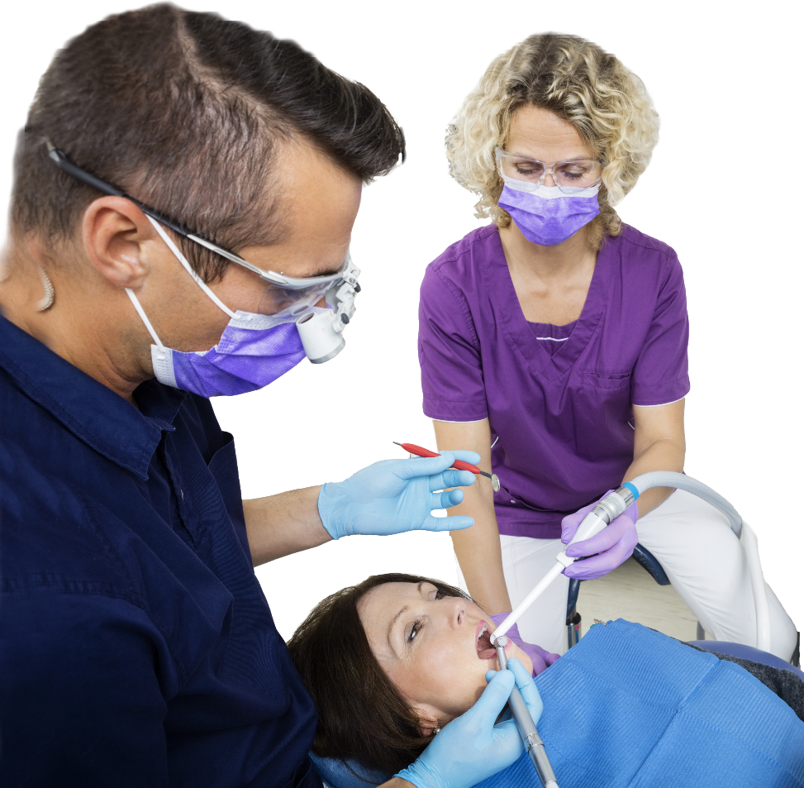
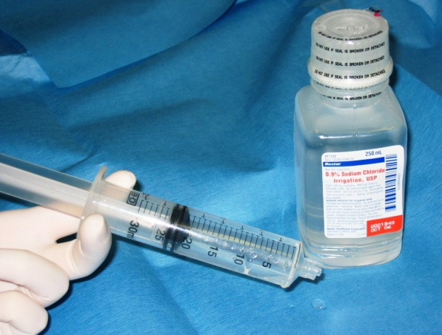
Sterile Irrigating Solutions
Use sterile saline or sterile water as a coolant/irrigator when performing surgical procedures
Use devices designed for the delivery of sterile fluids
Notes:
During oral surgical procedures, microorganisms may enter the bloodstream and other normally sterile areas of the oral cavity (e.g., bone or subcutaneous tissue).
CLICKs
For this reason, sterile solutions (e.g., sterile saline or sterile water) should be used as a coolant/irrigator when performing surgical procedures.
Conventional dental units cannot reliably deliver sterile water even when equipped with independent water reservoirs containing low-microbial or sterile water because the water-bearing pathway cannot be reliably sterilized. Sterile water delivery devices, such as bulb syringes; sterile, single-use disposable products; or sterile water delivery systems that bypass the dental unit by using sterile single-use disposable or sterilizable tubing should be used to deliver sterile water.
18

Slide 19
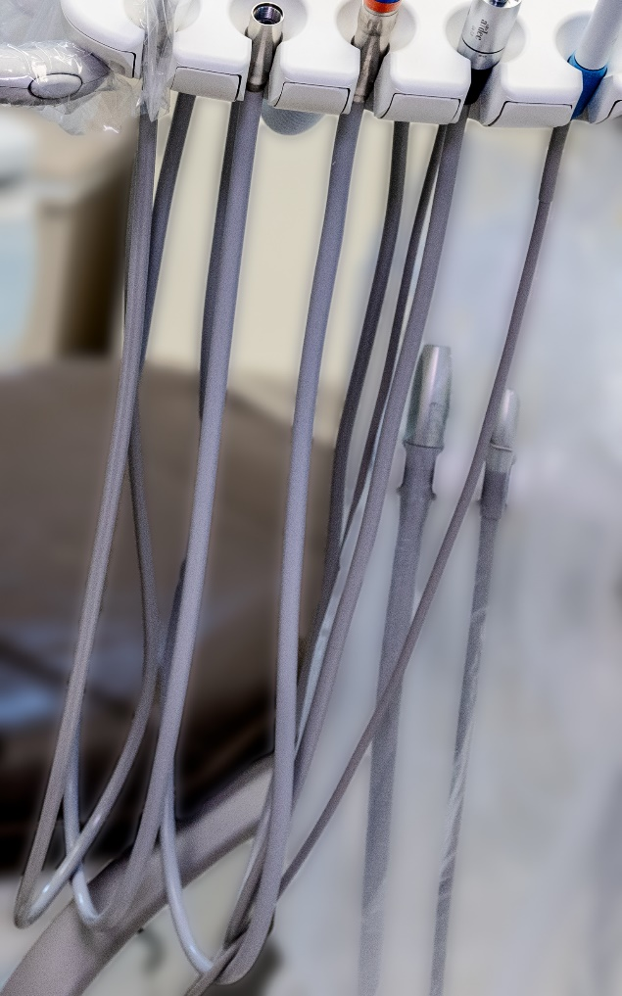

Disease Transmission-DUWL
2011
2015 2016
2022
82-year-old female, diagnosed with legionellosis and died two day later
Mycobacterium abscessus odontogenic infections in children undergoing pulpotomy (24 cases)
Nontuberculous Mycobacteria (NTM) odontogenic infections in children undergoing pulpotomy (71cases)
CDC notified of a new cluster of suspected NTM infections in children following dental procedures at a pediatric dental clinic
Only known risk was two dental appointments; Molecular testing identified DUWL as source
Suspected source of the Mycobacterium was contaminated water from dental unit waterlines
Municipal water stored in a pressurized bladder holding tank used to fill dental unit water bottles.
Investigation still ongoing
Notes:
The risk for disease transmission from Dental Unit Waterlines is tragically very real.
CLICKs
In 2011 an 82-year-old woman was diagnosed with legionellosis and died 2 days later. The patient’s only known risk of exposure for Legionella infection were two dental appointments. Molecular testing identified the dental unit waterlines as the source of the bacteria.
2015 and 2016, an outbreak of Mycobacterium abscessus odontogenic infections was reported in children receiving pulpotomy treatment. The suspected source of the Mycobacterium was contaminated water from dental unit waterlines. Outbreaks also resulted in litigation.
In 2022 CDC was notified of a new cluster of suspected NTM infections in children following dental procedures at a pediatric dental clinic, investigation ongoing.
Case reports also document infections with Mycobacteria and Legionella following endodontic procedures, third molar extractions, and general dental work. In these reported cases, water samples taken from the dental clinics demonstrated levels of bacteria much higher than the recommended levels and reported breakdowns in infection prevention procedures to maintain and monitor dental water quality.
19

Slide 20
Special Considerations
Dental handpieces
Other devices attached to air and waterlines
Saliva ejectors
Single-use (disposable) Devices
Pre-procedural mouth rinses
Notes:
There are several additional issues to consider related to dental handpieces, saliva ejectors, single-use products and devices, and pre-procedural mouth rinses
20

Slide 21
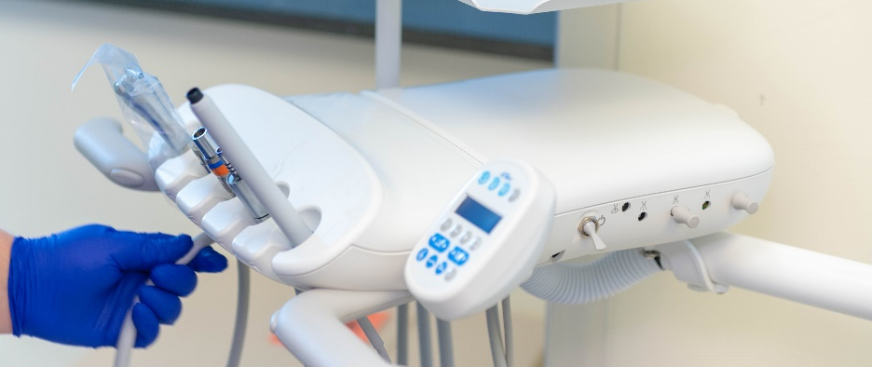
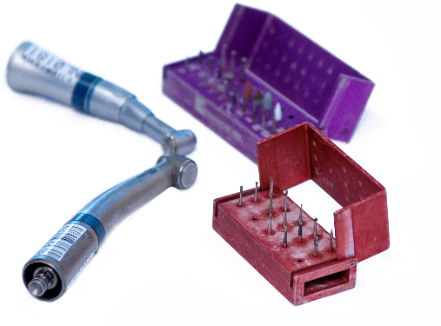
Dental Handpieces
Dental handpieces include:
High-speed
Low-speed
Electric
Endodontic
Surgical handpieces and attachments (i.e., prohy angles and nose cones)
Always be heat sterilized between patients
If a dental handpiece cannot be heat sterilized and does not have FDA clearance with validated instructions for reprocessing, DHCP should not use that device
Notes:
Dental handpieces include:
High-speed
Low-speed
Electric
Endodontic
Surgical handpieces and attachments (i.e., prophy angles and nose cones)
CLICKs
Always be heat sterilized between patients
If a dental handpiece cannot be heat sterilized and does not have FDA clearance with validated instructions for reprocessing, DHCP should not use that device
21

Slide 22
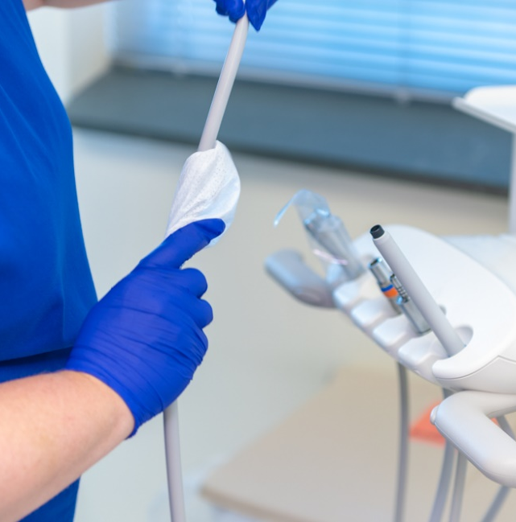
Devices Permanently Attached to Air and Waterlines
Some components are permanently attached to dental unit waterlines that do not enter the patient's mouth but may still be contaminated
Examples:
Handles or dental unit attachments of saliva ejectors
High-speed air evacuators
Air/water syringes
Use barriers and change between uses
Clean and intermediate-level disinfect the surface of devices if visibly contaminated
Notes:
Some parts of dental instruments are permanently attached to dental unit waterlines and while these items do not enter the patient’s mouth, they are likely to become contaminated with oral fluids during treatment procedures.
CLICKs
Some examples include handles or dental unit attachments of saliva ejectors,
high-speed air evacuators,
and air/water syringes.
These components should be covered with waterproof barriers and changed after each use.
If the item becomes visibly contaminated during use, clean and disinfect with an EPA-registered hospital disinfectant with a tuberculocidal claim (intermediate-level disinfectant) before using it with the next patient.
22

Slide 23
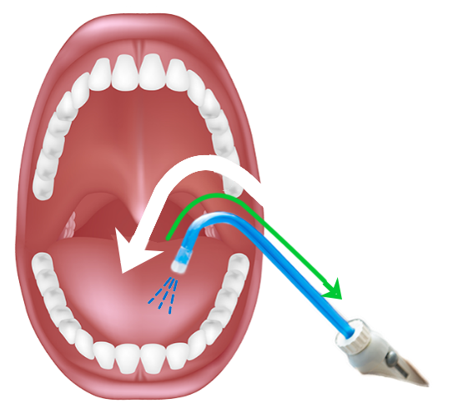
Salvia Ejectors
Previously suctioned fluids might be retracted into the patient’s mouth when a seal is created
Although there have been no reports of any adverse health issues, practitioners should be aware that in certain situations, backflow could occur when using a saliva ejector
Notes:
Backflow, meaning reverse flow, can occur when the pressure in the patient’s mouth is less than that in the evacuator for example, when the patient uses the saliva ejector as a straw. When this happens, material from the mouth of a previous patient might remain in the vacuum line of the saliva ejector and be aspirated into the mouth of the next patient being treated and be a potential source of contamination.
Although there have been no reports of any adverse health issues, practitioners should be aware that in certain situations, backflow could occur when using a saliva ejector.
23

Slide 24
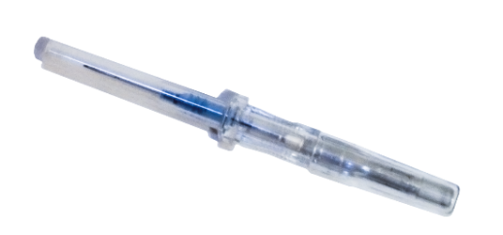
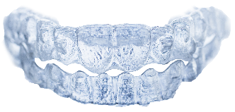
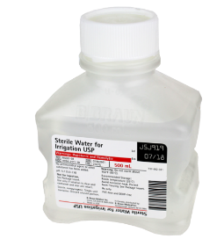
Single-Use (Disposable) Devices
Intended for use on one patient during a single procedure
Usually not heat-tolerant
Cannot be reliably cleaned
Examples:
Syringe needles
Prophylaxis cups
Plastic orthodontic brackets
Sterile irrigation water
FDA Law prevents reuse or reprocessing of “labeled” single use patient products or devices
Notes:
A single-use device, also referred to as a disposable device, is intended for use on one patient. It was never intended to be cleaned, disinfected, or sterilized and used on another patient.
CLICKs
Single-use devices used in dentistry are usually not heat tolerant and cannot be reliably cleaned.
Examples of such items include syringe needles, prophylaxis cups and brushes, plastic orthodontic brackets and sterile saline and water for irrigation

Slide 25
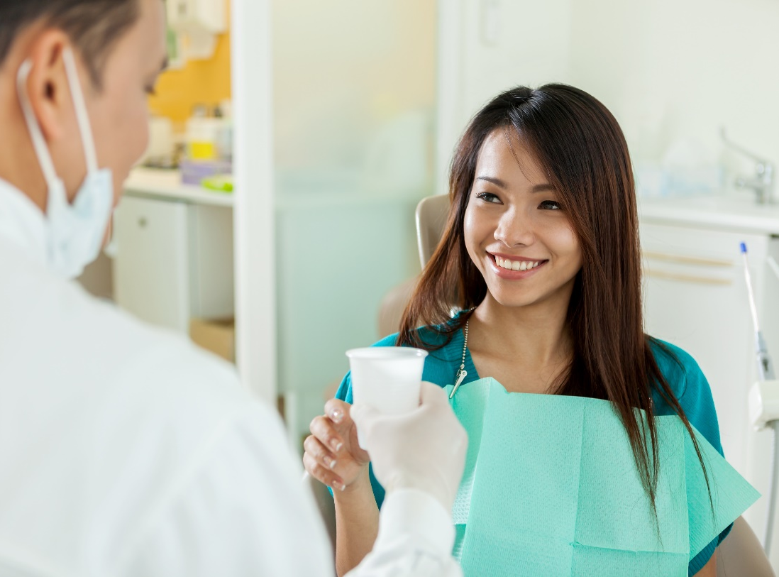
Pre-Procedural Mouth Rinses
Antimicrobial mouth rinses prior to a dental procedure
Reduce number of microorganisms in aerosols/spatter
Decrease the number of microorganisms introduced into the bloodstream
Unresolved issue–no evidence that infections are prevented
Notes:
Preprocedural mouth rinsing is the use of an antimicrobial mouth rinse by the patient prior to a dental procedure. These mouth rinses can contain, for example, chlorhexidine gluconate, essential oils, and povidine-iodine.
CLICKs
Studies have shown that preprocedural mouth rinses can reduce the number of aerosolized bacteria, and in some cases, the number of bacteria introduced into the bloodstream. However, there is no scientific evidence that this practice can prevent clinical infections among patients or healthcare personnel.
Although there is no harm in using preprocedural mouth rinses because of the lack of evidence that clinical infections are prevented, no recommendation is made.

Slide 26

Knowledge Check
Which statement about single use devices is true?
They can be cleaned and disinfected and reused
If they are not visibly contaminated, they can be reused
They are intended for use on one patient during a single procedure
Notes:
CLICK for answer That’s right! The answer is 3, single use devices can be used one time and for one patient only

Slide 27



Radiology-Laser-Electrosurgery
Notes:
Our course is almost complete! We are going to discuss radiology, laser, and electrosurgery- and then we will be done.

Slide 28

Dental Radiology
Gloves should be worn when taking radiographs and handling contaminated film packets
Other PPE should be used if spattering of blood or other body fluids is anticipated
Use aseptic technique to prevent cross-contamination of equipment and surfaces
Heat tolerant versions of intraoral radiograph accessories are available and should be heat sterilized before patient use
Semi-critical items that cannot be sterilized or high level disinfected should at a minimum:
Be barrier protected by using an FDA-cleared barrier
Cleaned with EPA registered hospital disinfectant after barrier removed
Notes:
When taking radiographs, the potential to cross-contaminate equipment and environmental surfaces with blood or saliva is high if aseptic technique is not practiced.
CLICKs
Gloves should be worn when taking radiographs and handling contaminated film packets
Other PPE should be used if spattering of blood or other body fluids is anticipated
Heat tolerant versions of intraoral radiograph accessories are available and should be heat sterilized before patient use
Semi-critical items that cannot be sterilized or high level disinfected should, at a minimum, be barrier protected by using an FDA-cleared barrier and cleaned with EPA registered hospital disinfectant after barrier removed

Slide 29

Laser/Electrosurgery-Plumes and
Surgical Smoke
Another potential risk for DHCP
Destruction of tissue creates smoke that may contain harmful by-products
Infectious materials may contact mucous membranes of nose
No evidence of HIV/HBV transmission
Need further studies
Notes:
Laser plumes or surgical smoke represent another potential risk for DHCP.
CLICKs
Lasers or electrosurgical units can cause thermal destruction of tissue and create a smoke by-product containing particles, gases (e.g., benzene, hydrogen cyanide) tissue debris, viruses and offensive odors.
One concern is that aerosolized infectious material,) in the laser plume may contact the nasal mucosa of the laser operator and nearby healthcare personnel.
No evidence exists that HIV or HBV have been transmitted via aerosolization and inhalation.

Slide 30


Laser/Electrosurgery-Plumes and
Surgical Smoke
Practical to follow NIOSH recommendations and practices developed by the Association of perioperative Registered Nurses (AORN):
Standard precautions (e.g., high-filtration surgical masks and possible full-face shields
Central room suction units with in-line filters
Dedicated mechanical smoke exhaust systems with a high-efficiency filter
Use standard precautions
Notes:
It is practical to follow NIOSH recommendations and those developed by AORN:
CLICKs
Standard precautions (e.g., high-filtration surgical masks and possible full-face shields
Central room suction units with in-line filters
Dedicated mechanical smoke exhaust systems with a high-efficiency filter
Local smoke evacuation systems have been recommended by consensus organizations and these systems can improve the quality of the operating field.
However, this concern remains unresolved in dental practice and no recommendations are provided in the CDC guidelines.

Slide 31
References
CDC. Guidelines for infection control in dental health-care settings, 2003. MMWR 2003;52 (RR-17):1-68
https://stacks.cdc.gov/view/cdc/6743
CDC. Summary of Infection Prevention Practices in Dental Settings: Basic Expectations for Safe Care, 2016
https://www.cdc.gov/dental-infection-control/hcp/summary/index.html
Rutala WA, Weber DJ, HICPAC. CDC guideline for disinfection and sterilization in healthcare facilities., 2008
https://www.cdc.gov/infection-control/media/pdfs/Guideline-Disinfection-H.pdf
CDC Best Practices for DUW Quality
https://www.cdc.gov/dental-infection-control/hcp/dental-ipc-faqs/best-practices-dental-unit-water-quality.html

Slide 32




Congratulations on completing the modules!
Notes:
That completes the Infection Control Course for meeting compliance with NC Rule .0206 Infection Control in healthcare Settings. Thank you for your time and attention.
Are there any questions about any of the modules

