Slide 1

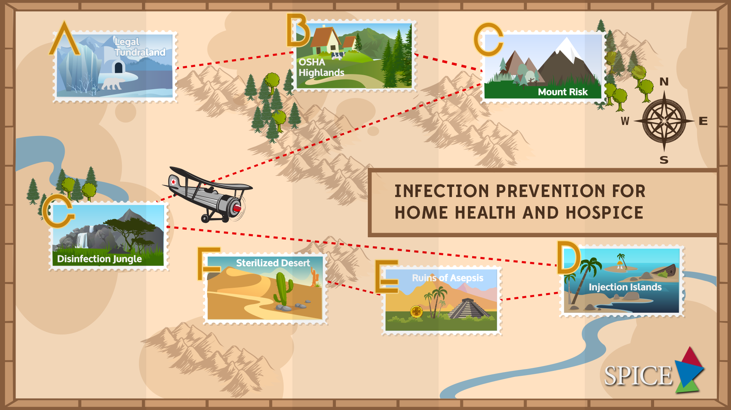
Notes:
Welcome to Infection Prevention Training for Home Health and Hospice. The purpose of this course is to provide a standard approved curriculum which meets the requirements of 10A North Carolina Administrative Code 41A.0206 (10A NCAC 41A.0206) Infection Prevention in healthcare Settings rule. This course is administered by the Statewide Program for Infection Control and Epidemiology (SPICE), which was delegated oversight authority from the NC Department of Public Health in 2000. The course consist of seven modules and a post test.
Upon successful completion you will receive a certificate.
This certificate is proof of compliance with the rule and should be kept on-site at your facility. The certificate is transferrable within NC so you need not attend the course again should you change jobs.
Because the field of infection prevention is rapidly evolving, SPICE recommends you continue to have ongoing education in infection prevention.
NOTE TO PRESENTER: Whenever you see CLICK in bold, you must click to animate in the next part of the slide. When you see AUTO, no clicks are needed, the segments will automatically advance.
If nothing is bolded there is no animation in that slide.

Slide 2
Statement of Disclosures
Learners will gain knowledge of infection control principles to systematically assess that his/her facility has the appropriate infection prevention policies, procedures, and practices in place to allow healthcare personnel to provide safe patient care consistent with North Carolina communicable disease rule 10A NCAC 41A .0206: Infection Prevention – Healthcare Facilities.
All participants must attend all 7 presentations and complete the on-line course evaluation to receive their course completion certificate and continuing education credit.
Statement of Disclosures
Learners will gain knowledge of infection control principles to systematically assess that his/her facility has the appropriate infection prevention policies, procedures, and practices in place to allow healthcare personnel to provide safe patient care consistent with North Carolina communicable disease rule 10A NCAC 41A .0206: Infection Prevention – Healthcare Facilities.
All participants must attend all 7 presentations and complete the on-line course evaluation to receive their course completion certificate and continuing education credit.
The content of this activity has no connection with any products consumed by or used on patients, so there is no conflict of interest for anyone with the ability to control the content of this activity.
This continuing nursing education activity was approved by the North Carolina Nurses Association, an accredited approver by the American Nurses Credentialing Center’s Commission on Accreditation.
Notes:
CLICK for bullets

Slide 3

Mission
  The Statewide Program for Infection Control and Epidemiology promotes prevention and control of healthcare-associated infections in North Carolina and beyond by providing evidence-based education and consultation across the healthcare spectrum.
Notes:
SPICE is an acronym for NC Statewide Program for Infection Control and Epidemiology. The Program began in 1980 and is located at the UNC School of Medicine in Chapel Hill. SPICE is not regulatory, but provides evidence- based infection prevention education, consultation and technical assistance to any NC healthcare facility. SPICE is funded, in part, by the NC Legislature.

Slide 4

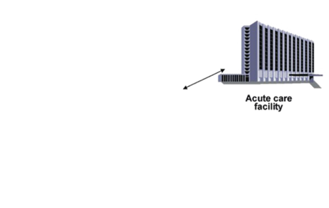
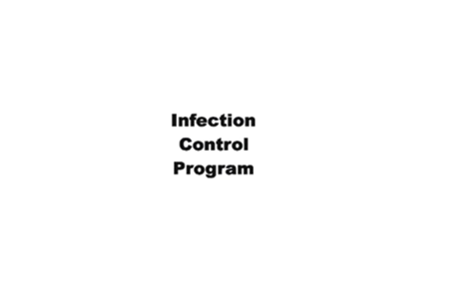



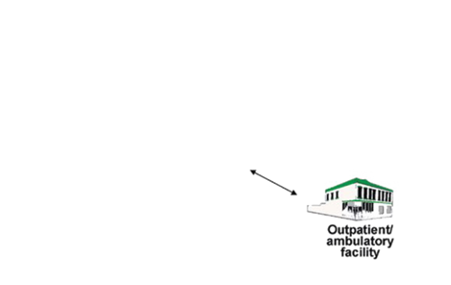
“Patients deserve effective infection Prevention wherever they receive healthcare.”
New slide
Course Theme
Adapted from: Jarvis WR Emerg Infect Dis. 2001;7:170-3. Macedo de Olivera et al. Annals of Int Med. 2005, 11
Notes:
The underlying theme for the course is “Patients deserve effective infection prevention wherever they receive healthcare.” Hospitals have established infection prevention programs to enhance patient safety and to meet regulatory and accreditation requirements, however, patient encounters now take place in outpatient care settings including dental, which are rarely subject to such requirements. This trend underscores the need for strategies to implement and maintain infection prevention programs in outpatient care and dental settings, including rigorous training and oversight of infection prevention activities.

Slide 5







Modules
A
Module A - North Carolina Laws Concerning Infection Prevention
Module B - Complying with OSHA Bloodborne Pathogen
Module C - Epidemiology and Risk of Infection
Module D - Outbreak and Safe Injection Practices
Module E - Principles and Practices of Asepsis
Module F - Principles of Disinfection and Sterilization
Module G – Application of Cleaning, Disinfection and Sterilization Principals in Home Health and Hospice Settings
C
B
E
D
G
F
https://spice.unc.edu/0206-spice-handouts/
Notes:
This course is divided into seven modules, each covering a different aspect of infection prevention.
CLICKS
Module A is an explanation of the infection prevention laws for North Carolina.
Module B discusses measure to comply with OSHA federal regulation for bloodborne pathogens;
Module C discusses the basic principles of disease transmission and methods to prevent transmission.
Module D covers the important topic of safe injection practices and how failures in these practices have led to the transmission of disease.
Module E reviews the principles and practices of asepsis and hand hygiene.
Module F discusses the principals of disinfection and sterilization per the CDC Guideline recommendations.
Finally, Module G reviews the role of the inanimate environment in disease transmission and methods to disinfect environmental surfaces and equipment appropriately.
Handouts and Resource Page are available at the link above

Slide 6
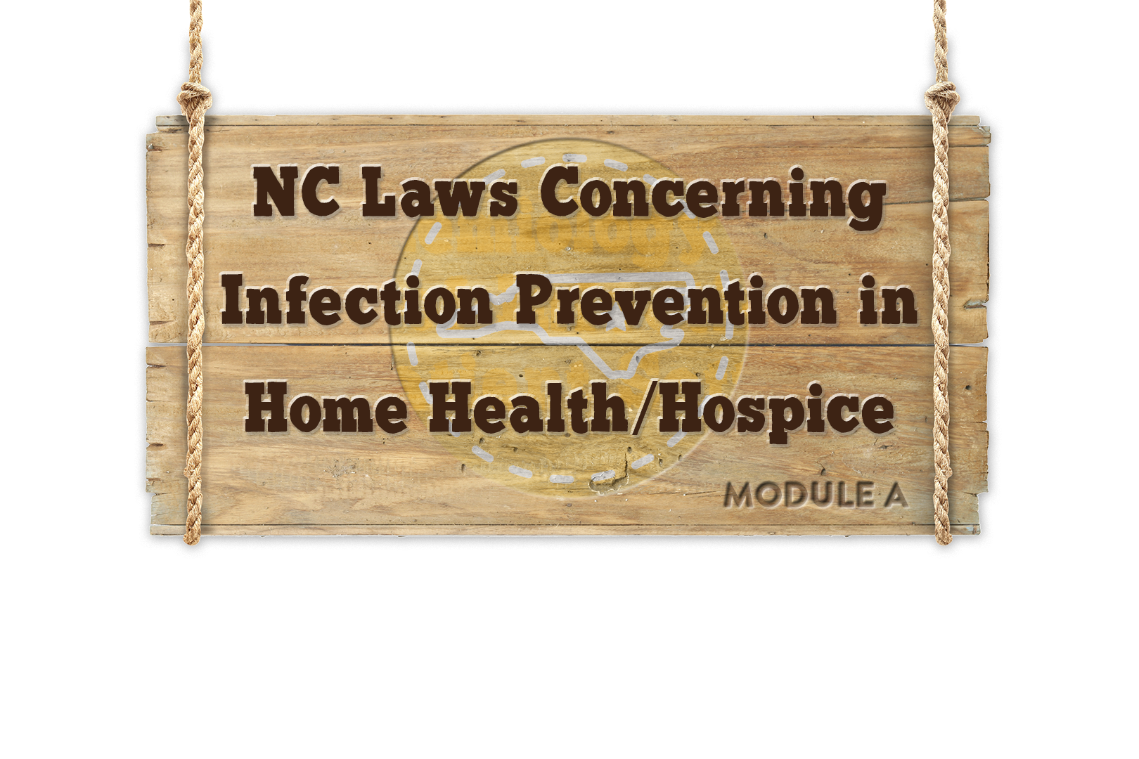


Module A

Slide 7




Objectives
10 A NCAC 41A
.0206
.0207
Describe North Carolina State Laws governing infection prevention in healthcare facilities
Discuss Control Measures for Human Immunodeficiency Virus (HIV), hepatitis B and hepatitis C
Review Communicable Disease Reporting
Describe NC Medical waste rules.
.0202
.0203
.0214
GS 130A-135
10A NCAC 41A
15A NCAC 13B .1200
Notes:
In Module A we have several objectives:
-Describe the pertinent rules for infection prevention, including a brief history of how these rules came to be, definitions of key terms, and legal requirements for compliance.
CLICKs
-Discuss control measures for HIV, hepatitis B and Hepatitis C.
-Explain North Carolina communicable disease reporting rules.
-And review medical waste rules.

Slide 8


History
1990 – CDC becomes aware of a possible transmission of HIV from a dentist to 6 patients (Kimberly Bergalis case)
July 1991 – CDC publishes Recommendations for Preventing Transmission of HIV and hepatitis B Virus to Patients During Exposure-Prone Invasive Procedures
October 1991 – Congress passes Public Law 102-141, requiring states to adopt CDC Guidelines or equivalent guidelines drafted by the state
July 6th, 2012 – CDC Updated Recommendations for Management of Hepatitis B Virus-Infected Health-Care Providers and Students
Notes:
In July 1990, Centers for Disease Control and Prevention (CDC) became aware of a possible transmission of Human Immunodeficiency Virus (HIV) from a Florida dentist to six of his patients.
CLICKs As a result, the following year, CDC published recommendations for “Preventing Transmission of HIV and HBV to Patients During Exposure-Prone Invasive Procedures”. In October of that same year Congress passed a law requiring states to adopt the CDC guidelines or state equivalent guidelines.
Updated recommendations for the management of HBV infected health-care providers and students were published in 2012. The primary goal of this report is to promote patient safety while providing risk management and practice guidance to HBV-infected health-care providers and students, particularly those performing exposure-prone procedures such as certain types of surgery. A link to the updated report can be found on your Resource Page.

Slide 9

HIV and hepatitis B Infected HCP
History
10A NCAC 41A .0207
All healthcare providers who perform or assist in:
  Surgical OR
  Obstetrical OR
  Dental procedures
And who know themselves to be infected with HIV or Hepatitis B shall notify the NC State Health Director
No requirement to notify employer
Notes:
In response to the CDC guidelines and Federal Law, North Carolina incorporated rule .0207 “HIV and HBV Infected Healthcare Workers” as part of NC Communicable Disease Laws and Rules. This rule requires all healthcare providers who perform or assist with surgical, obstetrical or dental procedures and know themselves to be infected with HIV or HBV to notify the NC State Health Director.
There is no requirement under this law for the infected healthcare provider to notify their employer

Slide 10
History
10A NCAC 41A .0207
HIV and hepatitis B Infected HCP
Once notification occurs:
Health Director is responsible to:
    Investigate provider's practice
    Evaluate clinical condition
    Determine risk of transmission to patients
    Convene expert panel
  Expert Panel shall:
    Review evidence
    Hear testimony from provider and/or their physician
    Make recommendations related to restrictions and identification of potentially exposed patients
Notes:
The rule establishes a process to review the operative and infection control practices of healthcare providers.
The health director will then:
investigate the providers practice,
evaluate their clinical condition,
determine if there is a risk to patients and
convene an expert panel to make recommendations about potential restrictions and/or identifying potentially exposed patients

Slide 11
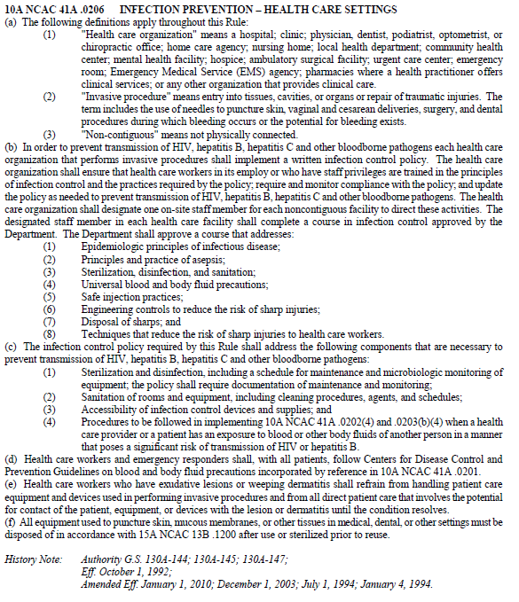

History
10A NCAC 41A .0206
10A NCAC 41A.0206
Infection Prevention-Healthcare Settings
Notes:
North Carolina also recognized that infection prevention practices were severely lacking, especially in the areas of disinfection and sterilization, patient equipment cleaning, medical waste handling and aseptic practices and in 1992 incorporated rule .0206 into the North Carolina Communicable Disease Laws.

Slide 12



History
10A NCAC 41A .0206
Each healthcare organization in which invasive procedures are performed must:
  Implement a written infection control policy addressing components necessary to prevent transmission of HIV, hepatitis B, hepatitis C and other bloodborne pathogens
  Designate one on-site staff member to direct infection control activities
Notes:
Rule .0206 has two over arching requirements:
CLICKs
First, This rule requires any healthcare organization that performs invasive procedures to have a written infection prevention policy and
Second the organization must designate an on-site staff member to direct infection prevention activities.
Here’s Doctor Zack Moore, chief epidemiologist for the North Carolina Division of Public health, recorded during an interview about infection prevention.

Slide 13
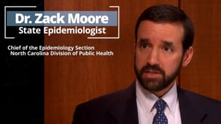
Notes:
CLICK on video to play

Slide 14

Definitions
“Healthcare organization“ means:
Hospital
Clinic
Physician Practice
Dentist
Podiatrist
Optometrist, or
Chiropractic office
Home care agency
Nursing Home
Local health department
Community health center
Mental health facility
Hospice
Ambulatory surgical facility
Urgent care center
Emergency room
Emergency medical service (EMS) agency
Pharmacies where a health practitioner offers clinical services
Or any other organization that provides clinical care
Notes:
AUTO Two main terms used in .0206 are “healthcare organization” and “invasive procedure” . It is very important that these are clearly defined and understood before we continue.
Healthcare organization includes any organization that provides clinical care, for example hospitals, physician office practices, urgent care centers, local health departments and home health hospice agencies.

Slide 15


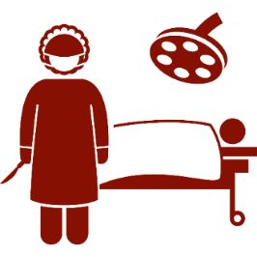

Definitions
“Invasive procedure” means entry into tissues, cavities or organs or repair of traumatic injuries.
This includes:
Use of needles to puncture skin
Vaginal and cesarean deliveries
Surgery
Dental procedures during which bleeding occurs or the potential for bleeding exists
Notes:
Invasive procedure means entry into tissues and includes
CLICKs the use of needles to puncture skin, for example
giving an injection
performing surgery or
dental procedure.

Slide 16

Infection Control Policy
  Infection control policy must include and address the following components necessary to prevent transmission of HIV, hepatitis B, hepatitis C and other bloodborne pathogens:
    Disinfection and Sterilization
    Maintenance and microbiologic monitoring of equipment
    Sanitation of rooms and equipment
      Cleaning procedures, agents used and schedules
    Accessibility of infection control devices and supplies
      Personal protective equipment (PPE), safety sharps, etc.
    A post-exposure follow-up program
Notes:
The infection control policy required by Rule .0206 must address certain infection prevention components that are necessary to prevent transmission of HIV, HBV, HCV and other bloodborne pathogens.
Those components include:
CLICKs
Sterilization and disinfection, including a schedule for maintenance and microbiologic monitoring of equipment; the policy shall require documentation of maintenance and monitoring;
Sanitation of rooms and equipment, including cleaning procedures, agents, and schedules;
Accessibility of infection control devices and supplies; and
Procedures to be followed in implementing control measures for HIV and HBV, when a health care provider or a patient has an exposure to blood or other body fluids of another person in a manner that poses a significant risk of transmission

Slide 17

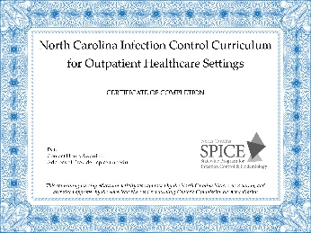

Designated Staff Member
Designated staff member must complete a State approved course in infection prevention
  Course curriculum developed by SPICE
  SPICE has oversight of course
  Course faculty must submit an application and be approved by SPICE prior to offering the course
  On the job training is not sufficient and “Train the Trainer” concept cannot be used
  Upon completion of course will receive a certificate of completion
    Serves as documentation of compliance with rule .0206
Notes:
The designated staff member, required by the rule, must complete a course in infection prevention. SPICE developed the course curriculum, (based on requirements of the rule ), has oversight of the course and all faculty must submit an application and be approved by SPICE prior to providing the course.
It is important to remember on the job training is NOT sufficient and “Train the Trainer” concept does not apply.
Once the course has been completed the attendee will receive a certificate of completion, serving as documentation of compliance with rule .0206.
Attendees should be able to provide the certificate when asked.

Slide 18

Approved Course Must Include:
  Epidemiologic principles of infectious disease
  Principles and practice of asepsis
  Sterilization, disinfection, and sanitation
  Universal blood and body fluid precautions (Standard Precautions)
  Safe injection practices
  Engineering controls to reduce the risk of sharp injuries
  Disposal of sharps
  Techniques that reduce the risk of sharp injuries to health care workers
Notes:
Rule 0206 not only specifies what must be in your infection control policy, but it also specifies what topics must be included in the required educational course. Each of the topics you see on the slide will be covered in our presentation today.

Slide 19
10A NCAC 41A .0206: 2010 Amendment
Safe Injection Practices has been added to list of topics covered in state-approved course
Hepatitis C and other bloodborne pathogens are addressed, in addition to HIV and HBV
One designated trained staff member is required for each noncontiguous healthcare facility
  Noncontiguous: when facilities are not physically connected to each other.
OSHA bloodborne pathogen training, alone, does not include all the elements required under .0206
Notes:
One more bit of history, in 2010 following several outbreaks, the .0206 rule was amended to include the following:
CLICKs
Education on safe injection practices,
Additional information on HCV and other bloodborne pathogens, in addition to HBV and HIV
Clarification that each noncontiguous healthcare facility is required to have a designated staff member trained in infection prevention. Even though the organization has multiple office or practice settings, unless they are physically connected, there needs to be a designated trained staff member at each site and
Clarification, that while there is some overlap in OSHA bloodborne pathogen and .0206 training, OSHA training alone does not meet the 0206 requirements

Slide 20

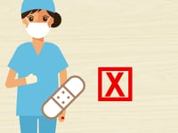
.0206 Legal Requirements
Healthcare providers with exudative lesions or dermatitis on hands/wrists shall refrain from:
Handling patient care equipment
Handling devices used for invasive procedures
All direct care activities likely to have contact with lesion
Notes:
Also included in .0206 is the requirement that healthcare provider with exudative lesions or weeping dermatitis on hands or wrists must:
CLICKs (last click plays video)
refrain from handling patient care equipment and devices used in performing invasive procedures and
refrain from all direct care that involves the potential for contact until the condition resolves.
Wearing a bandage or glove over the lesions is not acceptable. However, healthcare providers that have lesions under clothing, above the elbow and below the neck, that are covered and can be left undisturbed during the work shift may be allowed to provide patient care

Slide 21

Knowledge Check
Which of the following are included in the definition of “invasive procedure” under .0206?
Surgery
Vaginal deliveries
Dental procedures
Giving an allergy shot
All of the Above
Notes:
CLICK for answer
The Answer is E, all of the above.

Slide 22

Knowledge Check
True or False?
Rule .0206 requires all the following for healthcare organizations:
Have a written infection control policy
Conduct infection control training for healthcare providers
Have at least one person designated to have oversight of infection control
Designated person must attend a state-approved course
Compliance with infection control requirements must be monitored
True
False
Notes:
CLICK for answer
Answer a) True

Slide 23
Objectives
10 A NCAC 41A
.0206
.0207
Describe North Carolina State Laws governing infection prevention in healthcare facilities
Discuss Control Measures for Human Immunodeficiency Virus (HIV), hepatitis B and hepatitis C
Review Communicable Disease Reporting
Describe NC Medical waste rules.
.0202
.0203
.0214
GS 130A-135
10A NCAC 41A
15A NCAC 13B .1200

Slide 24


10A NCAC 41A .0202, .0203, and .0214
Control Measures HIV, HBV, HCV
3
3 Key Steps
2
Determining the risk
Following up on the source
Maintaining confidentiality
1
Notes:
Control measures for HIV, HBV and HCV as they relate to needlesticks, non-intact skin and/or mucous membranes include three key steps:
CLICKs
determining the risk to the exposed person,
following up on the source of the exposure,
and maintaining confidentiality.

Slide 25



Modules
Control measures HIV, HBV, HCV
Determine if exposure to the person constitutes a significant risk
  Needlestick most common
  For all other exposures (splashes and splatters for example) evaluate:
    The amount and type of body fluid
    Potential pathogen and
    The route of exposure (mucous membranes, non-intact skin for example)
1
Notes:
The first one is to determine if the exposure constitutes a significant risk to the exposed person. This determination is made based on the type of exposure and what the person was exposed to .
CLICKs
In healthcare the most common exposure is needle sticks.
For all other exposures consider
the type and amount of body fluid
the potential pathogen and
the route of exposure (mucous membrane or non-intact skin for example)

Slide 26




Control Measures HIV, HBV, HCV
Follow up on the source of the exposure:
  If source is known, notify their physician, test for HIV, HBV and HCV (unless already known to be infected) and offer follow up as appropriate.
2
Notify Physician
Known
Source
Test for
HIV
HBV
HCV
Notes:
The second important control measure is to follow up on the source of the exposure.
CLICK (just one click)
If the source person is known, their physician or healthcare provider must be notified; the source person must be tested for HIV, HBV, HCV unless already known to be infected and the source person must be offered follow up if positive.

Slide 27


Control Measures HIV, HBV, HCV
Follow up on the source of the exposure:
  If source unknown: offer HIV testing to exposed person, verify status of HBV vaccination and offer HCV testing
Offer tests
HIV
HCV
2
Unknown
Source
Verify HBV immunization status
Notes:
AUTO If the source person is unknown the exposed person should be offered HIV and HCV testing, and their HBV immunization status should be verified.
In 2001 CDC published “ Updated U.S Public health Services Guidelines for the Management of Occupational Exposures to HBV, HCV, and HIV and Recommendations for Postexposure Prophylaxis”. Last updated date 4/25/2014
The link to those guidelines is included on your resource page

Slide 28

Control Measures HIV, HBV, HCV
Maintain Confidentiality
  Protect confidentiality of known source person and their testing status
  Exposed person instructed to maintain confidentiality
3
  Disclosures for communicable disease reporting are protected and do not violate HIPAA regulations
Notes:
The last step is to maintain confidentiality. At all times the confidentiality of the known source person and their testing status must be maintained. The exposed person should be instructed to maintain confidentiality at all times.
Disclosures for communicable disease reporting are protected and do not violate HIPAA regulations

Slide 29
Knowledge Check
True or False:
Needlesticks are the most common route of exposure to bloodborne pathogens in the healthcare setting
True
False
Notes:
CLICK for answer
Answer a) True

Slide 30
Objectives
10 A NCAC 41A
.0206
.0207
Describe North Carolina State Laws governing infection prevention in healthcare facilities
Discuss Control Measures for Human Immunodeficiency Virus (HIV), hepatitis B and hepatitis C
Review Communicable Disease Reporting
Describe NC Medical waste rules.
.0202
.0203
.0214
GS 130A-135
10A NCAC 41A
15A NCAC 13B .1200

Slide 31
GS 130A-135; 10A NCAC 41A
Reporting Rules:
  “A physician licensed to practice medicine who has reason to suspect that a person about whom the physician has been consulted professionally has a communicable disease (CD) or condition declared by the Commission to be reported, shall report information required by the Commission to the local health director …”
  Physicians, labs & specified others must report CDs designated “reportable” by NC Commission for Public Health
https://epi.publichealth.nc.gov/cd/report.html
Notes:
The NC General Statue requires physicians to report persons suspected of having a communicable disease to the local health director and includes a list of reportable diseases and conditions declared to be dangerous to the public health. Once the disease is reasonably suspected to exist it must be reported within the specified time period outlined in the rules.
We have provided a copy of the list of reportable diseases and reporting requirements in your notebook. For additional information or resources please refer to the NC General Statutes. The web link is included on your resource page.

Slide 32
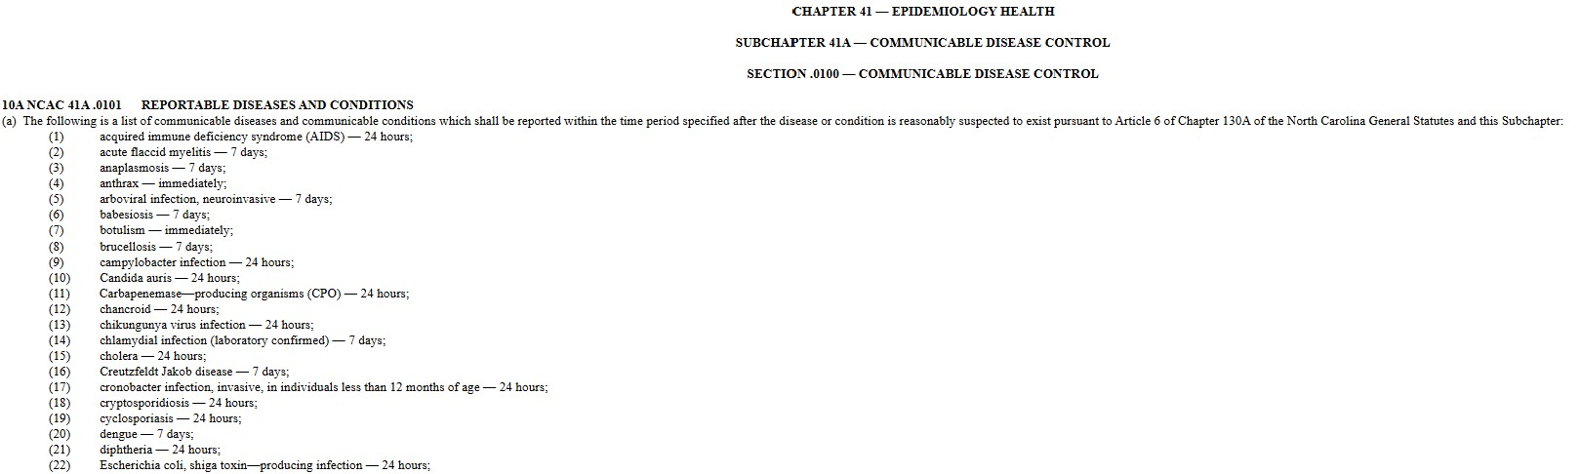
Amended November 1, 2024
Notes:
Rule was amended on November 1, 2024, to include all Carbapenemase producing organisms (CPO)

Slide 33
Objectives
10 A NCAC 41A
.0206
.0207
Describe North Carolina State Laws governing infection prevention in healthcare facilities
Discuss Control Measures for Human Immunodeficiency Virus (HIV), hepatitis B and hepatitis C
Review Communicable Disease Reporting
Describe NC Medical waste rules.
.0202
.0203
.0214
GS 130A-135
10A NCAC 41A
15A NCAC 13B .1200

Slide 34

15A NCAC 13B .1200
NC Medical Waste Rules
The NC Medical Waste Rules:
  Define types of medical waste
  Outline how medical waste should be packaged
  Dictates how medical waste should be stored and transported and
  Outlines methods of treatment and disposal
Rules are periodically updated
Notes:
NC Medical Waste Rules CLICKs define types of medical waste and include requirements for how medical waste should be packaged, stored, transported, treated and disposed of. These rules are updated periodically
A link to the current rules is included in your list of resources.

Slide 35
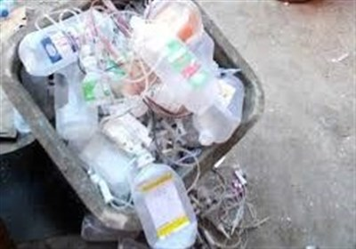
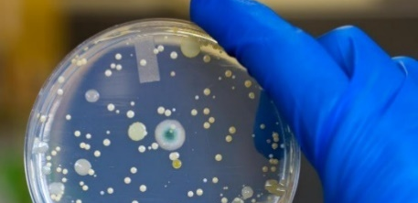
15A NCAC 13B .1200
Currently Two Types of Medical Waste
NC Medical Waste Rules
Medical waste
Regulated medical waste
Any solid waste generated in the
  Diagnosis
  treatment, or
  immunization of human beings or animals
Disposed of in the county landfill and no treatment necessary prior to disposal
Must be treated prior to disposal
Regulated medical waste and treatment methods include the following:
  Any blood or body fluids in individual containers >20ml (about size of test tube)...incineration/sanitary sewage system/steam sterilization
  Microbiological waste…Incineration, steam sterilization, microwave, ozonation, or chemical treatment
  Pathological waste…incineration/ozonation
Notes:
NC Medical Waste Rules identify two types of medical waste. CLICKs The first one is general solid waste, generated in the diagnosis, treatment or immunization of human beings or animals. This type of medical waste can be disposed of in the county landfill and does not require any type of treatment prior to disposal.
The second type of waste is regulated medical waste and includes blood or body fluids in volumes of greater than 20 ml, microbiological waste and pathological waste. Blood and/or body fluids will be the most common in the home health and hospice setting.
Regulated medical waste does require treatment prior to disposal in the landfill. The treatment depends on the type of waste and could include either discharge into the sanitary sewer system, incineration, autoclaving, or chemical disinfectants.

Slide 36
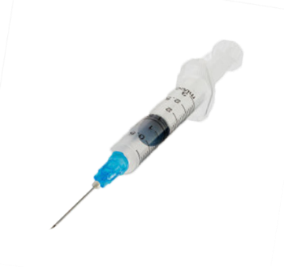
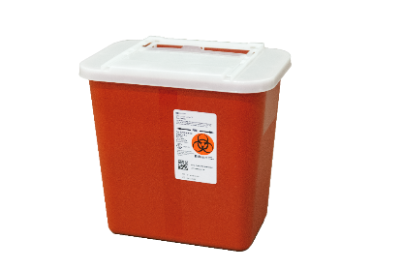

Not Defined as Regulated Medical Waste Under 15A NCAC 13B .1200:
Sharps
Miscellaneous Items
Rules do not require treatment before disposal
Must be packaged in a container that is rigid, leak-proof when upright, and puncture resistant
Shall not be compacted prior to off-site transportation
Can be disposed of with general solid waste
  Some landfills do not accept sharps
Dressings and bandages (even blood soaked), sponges, disposable instruments, used gloves, and tubing
  Disposed of as general solid waste
Household waste including injections administered at home is not included in medical waste rules
Notes:
It is important to know that there are certain items that under NC Medical Waste Rules are NOT considered regulated medical waste and do not require treatment prior to disposal.
These include sharps, needles for example, CLICK dressings and bandages, (even with blood on them) and household waste.
Sharps do need to be packaged in a container that is rigid, leak-proof when upright and puncture resistant. They should not be compacted prior to off-site transportation.

Slide 37
Knowledge Check
Which of the following is NOT classified as “Regulated” medical waste in the NC Medical Waste Rules?
Microbiological
Gowns and gloves
Pathological
Blood in quantities of >20 ml per a single unit vessel
Notes:
CLICK for answer
The answer is B. Gowns and gloves are considered to be routine medical waste that does not require treatment prior to sending to the landfill.

Slide 38
Knowledge Check
What do the NC Medical Waste Rules require for disposal of sharps?
Container for sharps is rigid, puncture resistant and leak proof when in an upright position.
Closed sharps container may be disposed of with general solid waste.
Contained sharps shall not be compacted prior to off-site transportation.
All of the above
Notes:
CLICK for answer
The answer is D. All of the above.

Slide 39
Objectives
10 A NCAC 41A
.0206
.0207
Describe North Carolina State Laws governing infection prevention in healthcare facilities
Discuss Control Measures for Human Immunodeficiency Virus (HIV), hepatitis B and hepatitis C
Review Communicable Disease Reporting
Describe NC Medical waste rules.
.0202
.0203
.0214
GS 130A-135
10A NCAC 41A
15A NCAC 13B .1200
Notes:
This concludes Module A. In summary, we have discussed:
Rules for infection prevention,
Defined key terms, and legal requirements for compliance,
Discussed control measures for HIV, hepatitis B and Hepatitis C,
Explained North Carolina communicable disease reporting rules and
Reviewed medical waste rules.

Slide 40



Notes:
Before me move on to the next module, are there any additional questions regarding NC laws and regulations?

