Slide 1


Module C
Notes:
NOTE TO PRESENTER: Whenever you see CLICK in bold, you must click to animate in the next part of the slide. When you see AUTO, no clicks are needed, the segments will automatically advance.
If nothing is bolded there is no animation in that slide.

Slide 2



Objectives:
Discuss the infectious process
Review methods for controlling transmission of infection in hemodialysis settings
    Standard Precautions
    Transmission-based Precautions
Describe steps for detecting and controlling outbreaks
Notes:
The objectives of this module are to:’
Discuss the infectious process
Review methods for controlling transmission of infection in hemodialysis settings, for both
Standard Precautions and
Transmission-based Precautions
And describe steps for detecting and controlling outbreaks

Slide 3








CHAIN OF INFECTION
Notes:
AUTO
This diagram illustrates six essential elements that are required, in order for an infection to occur, also know as the Chain of Infection.
We are going to discuss each of the six briefly, however our discussion today will focus on interrupting the means of transmission of an infectious agent, including person to person transmission or transmission from some environmental source, including medical devices.

Slide 4


Infectious Agent or “The Harmful Germ”
Bacteria (MRSA, VRE)
Viruses (Influenza, Norovirus)
Fungi (Candida, Aspergillis)
Parasites (Giardia, pinworms)
Arthropods (mites)*
    * Infestations, not infections
Notes:
The first link in the chain of infection is the infectious agent. An infectious agent is a harmful germ that causes disease Some common examples of these germs include bacteria, like MRSA; and viruses like influenza and norovirus;

Slide 5

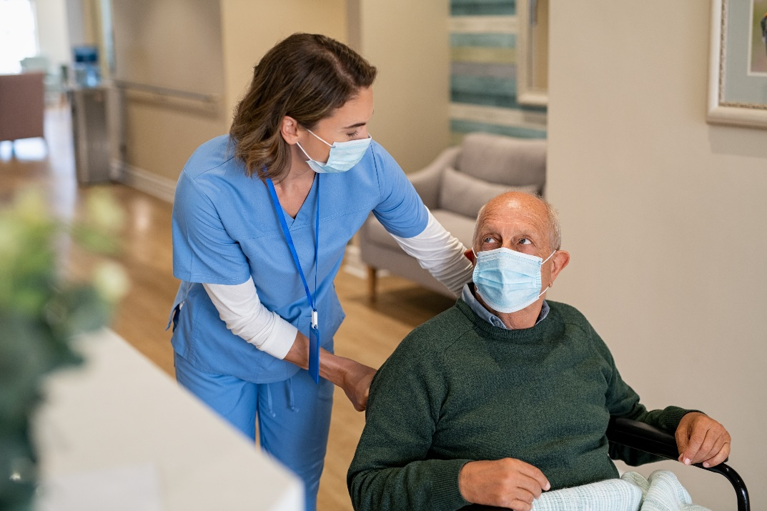
Reservoir or “Hiding Places”
Where germs live, grow, and increase in numbers
A person
Environment/Fomite
An animal
Notes:
The second link in the chain of infection is the reservoir. Think of a reservoir as a hiding place where harmful germs can live, grow, and potentially reproduce. The three reservoirs where germs like to live are in or on people; environmental sources and animals. In healthcare settings, people (patients and healthcare personnel) are considered the most common reservoir, followed by patient care equipment and environmental surfaces.

Slide 6
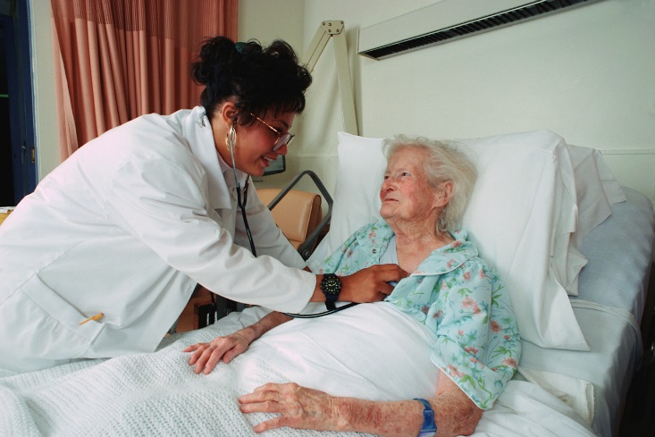
People as Reservoirs
Blood
Skin
Digestive tract
      Mouth, stomach, intestines
Respiratory tract
      Nose, throat, lungs
Urinary tract
Most Common
Notes:
When people are reservoirs, harmful germs can live in the blood, on the skin, or in the digestive, respiratory, or urinary tracts.

Slide 7


Portals of Exit and Entry
Exit or “The Way Out”
Entry or “The Way in”
Exit or “The Way Out”
Entry or “The Way In”
Nose and mouth
      Allows germs to leave in mucous droplets, and saliva or spit
Gastrointestinal tract
      Allows for germs to leave in stool and/or vomit
Skin
  Allows for germs to leave through direct contact, in blood, pus, or other secretions that come from the body.
Nose and mouth
  Allows germs to enter in mucous droplets, and saliva or spit
Gastrointestinal tract
  Allows for germs to enter via ingestion
Skin
  Allows for germs to enter through direct contact, with blood, pus, or other secretions that come from the body.
Notes:
AUTO
Other links in the chain of infection include the Portal of Exit and Entry. These are pathways that allow an infectious agent to leave an infected or colonized person and potentially enter another person. Typically, the routes by which infectious agents exit and enter the body are the same and include but may not be limited to:
Nose
Mouth
GI Tract
GU Tract
Skin

Slide 8

Susceptible Host
Age
Stress
Fatigue
Poor Nutrition
Chronic Illnesses
Not properly vaccinated
Open cuts, skin breakdown
Medications
Notes:
Another necessary link in the chain of infection is the susceptible host. This is a person who does not have an infection now but is at risk for acquiring an infection because their body does not have the ability to fight off the infection. Some of the reasons that a person might not be able to fight off an infection include age, stress, fatigue, poor nutrition, other chronic illnesses, medication (especially chemotherapy and immunosuppressants), and skin break down.

Slide 9




Mode of Transmission
Person to Person
Environmental Source
We use mode, modes and means of transmission as various times. Should we use all of these or only some and how to know when to use which?
Notes:
AUTO
The last link that must be present for an infection to occur is a “mode of transmission”.
Today we’re going to focus our discussion on interrupting the means of transmission of an infectious agent from one place to another. This may include person-to-person transmission or transmission from some environmental source, including medical devices.

Slide 10
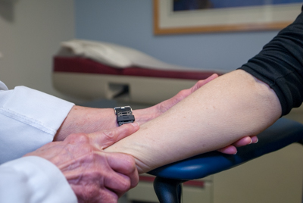
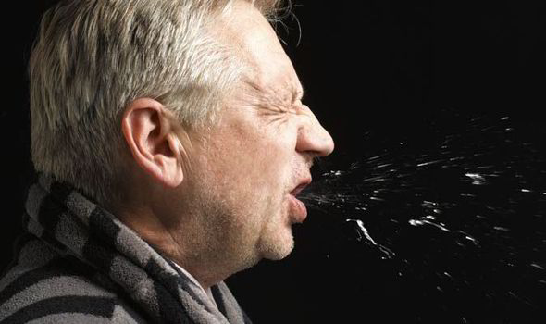
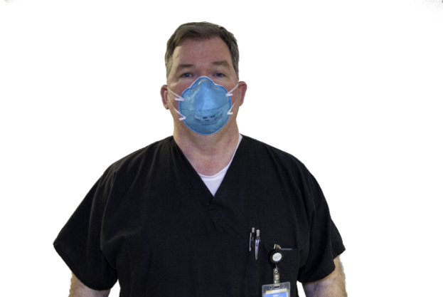



Modes of transmission
= Most Common
Contact
Droplet
Airborne
Notes:
In all healthcare settings, there are three primary modes of transmission of infectious agents:
The most common mode of transmission is direct or indirect contact between the source person or object and the susceptible host
CLICK The other two modes are via the respiratory route:
Droplet transmission and Airborne transmission.
Some infectious agents may also be transmitted by more than one or a combination of routes, and we will address this in our discussion on transmission-based precautions.

Slide 11


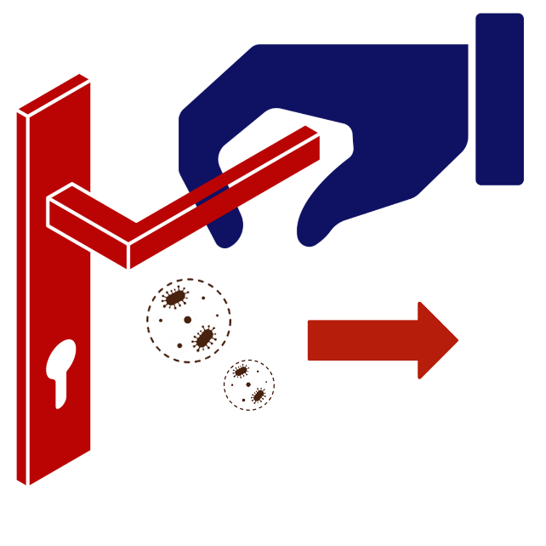
Modes of transmission
Contact
Person to person contact and physical transfer of organisms
Direct Contact
Indirect Contact
Contact with a contaminated surface or device
Contact
Notes:
As mentioned earlier the most common means of transmission in the healthcare setting is contact, either direct or indirect.
CLICK Direct contact would include physical transfer of organisms from one person or place to another. Unfortunately, we know that healthcare workers hands is the most common way organisms are transmitted due to lack of appropriate hand hygiene.
CLICK Contaminated medical devices and equipment, not cleaned and disinfected adequately, can serve as a means of transmission via the indirect contact route. The infection can be transmitted from one patient to another, even though they may not have been in the facility at the same time. An example of this might be using a medical device or piece of equipment on one patient in the morning, not adequately disinfecting the equipment/device and then using it on another patient in the afternoon.

Slide 12
Modes of transmission
Droplet – an infectious agent travels as a very large particle over a short distance by air current (usually 3-6 feet)
  Droplets may arise from speaking, coughing or sneezing
  Need to be relatively close
Droplet
Notes:
Another common mechanism for spread of infection is via droplets. Respiratory droplets, carrying infectious organisms are spread after being sprayed from the nose and mouth, when a person sneezes, coughs, sings, talks, or laughs.
An example of a respiratory infection spread via the droplet route is influenza.

Slide 13
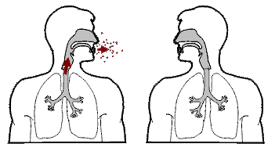
Modes of transmission
Airborne – infectious agent travels as very small particles over long distances by air current
  Small respiratory droplets, that can remain infective for long periods of time are dispersed when an infected person coughs, sneezes, laughs or speaks. May spread thru ventilation systems
Airborne
Notes:
Airborne transmission occurs when an infectious agent travels, as very small particles, over long distances by air currents. Small respiratory droplets, that can remain infective for long periods of time and distance, are dispersed when a person coughs, sneezes, laughs or speaks. They hang in the air like an invisible smoke and can travel on air currents for considerable distances. The most common example of an infection transmitted via the airborne route is Mycobacterium tuberculosis. Other infections, spread by the airborne route, would include chickenpox and measles.

Slide 14

Knowledge Check
The Chain of Infection Includes which of the following:
Infectious agent, reservoir, mode of transmission and isolation precautions
Susceptible host, portal of entry, OSHA rules, medical waste
Mode of transmission, infectious agent, susceptible host, reservoir, portal of entry and portal of exit
None of the above
Notes:
. CLICK for answer The answer is C, there are 6 elements to the chain of infection

Slide 15


Controlling transmission of infection
As long as there is a means of transmission, infection will spread to others.
Standard Precautions
Transmission-Based Precautions
Notes:
We will now discuss interventions that can potentially reduce or eliminate the opportunity for spread, or transmission, of infectious agents (germs).
In healthcare the major interventions are Standard and Transmission-based precautions.

Slide 16







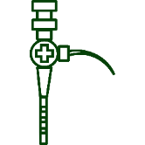
CONTROLLING TRANSMISSION
Standard Precautions
Hand hygiene
Use of personal protective equipment
Respiratory hygiene/cough etiquette
Safe injection practices
Use of a mask when injecting the epidural space
Safe handling of potentially contaminated equipment
The minimum infection prevention practice that applies to all patient care, regardless of suspected or confirmed infection status of the patient
Notes:
Standard Precautions are the minimum infection prevention practice that applies to all patient care, regardless of suspected or confirmed infection status of the patient.
These practices are designed to protect both the HCP and patients and include:
CLICKS
hand hygiene,
use of personal protective equipment (e.g., gloves, gowns, eye protection, masks),
respiratory hygiene/cough etiquette
safe injection practices
use of a mask when injecting the epidural space and
safe handling of potentially contaminated equipment or surfaces in the patient environment.
Our discussion will focus on the first three for now and we will cover the additional topics in other modules

Slide 17
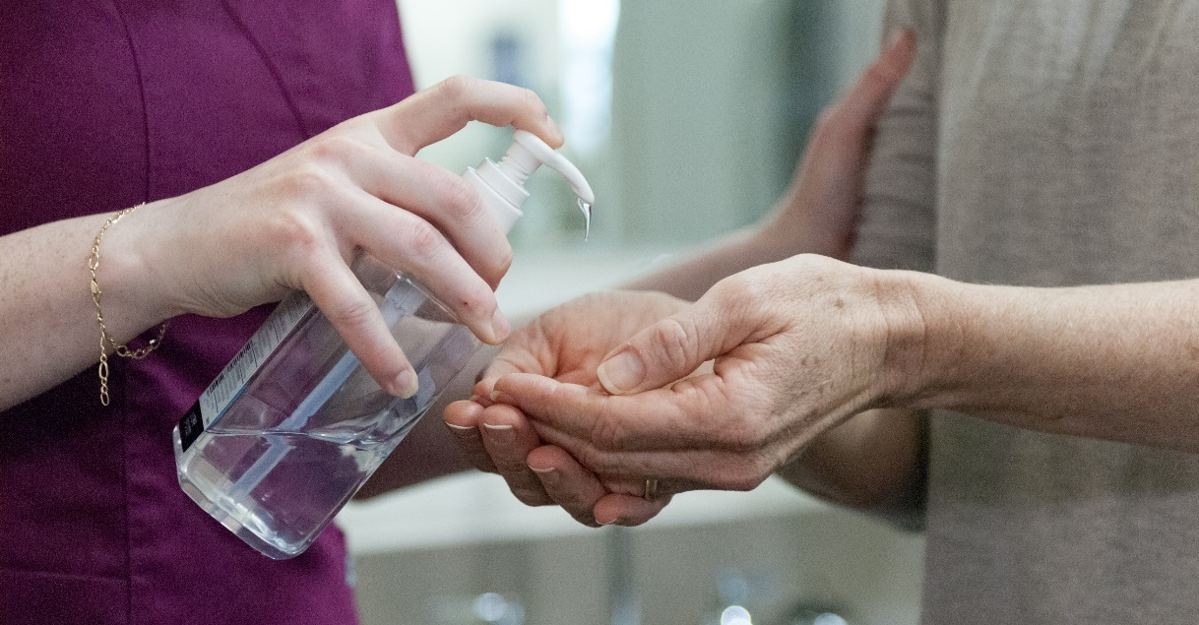


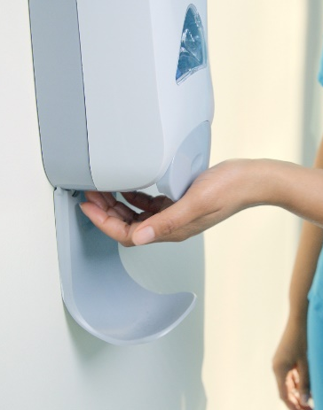


The Best Way to Stop the Spread of Infection: Hand Hygiene
Good hand hygiene, including use of an alcohol-based hand rub and washing with soap and water is critical in reducing the risk of transmission of infections in any healthcare setting
Use of an alcohol- based hand rub is recommended as primary mode of hand hygiene except when hands are visible soiled
    Dirt
    Blood
    Body fluids
    Caring for patient with infectious diarrhea
Hand Hygiene
Hand hygiene is discussed in detail in Module E, “principals of asepsis”
Notes:
Good hand hygiene, including use of alcohol-based hand rubs and handwashing with soap and water, is critical to reduce the risk of spreading infections in any healthcare setting.
CLICK
Use of alcohol-based hand rub as the primary mode of hand hygiene is recommended by the CDC and the World Health Organization (WHO) except when hands are visibly soiled (with dirt, blood, or body fluids for example), OR when the facility is experiencing an outbreak of patients with infectious diarrhea (such as C. difficile or norovirus). In that case soap and water should be used.
Hand hygiene is discussed in detail in module E, “principals of asepsis.”
Next, we have a video addressing these key points.

Slide 18
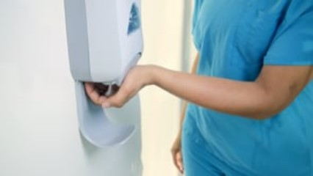
The Best Way to Stop the Spread of Infection: Hand Hygiene
Hand Hygiene
Notes:
CLICK on video to play.

Slide 19

Personal Protective Equipment
Second component of Standard Precautions is Personal Protective Equipment (PPE)
Wearable equipment that is intended to protect healthcare personnel from exposure or contact with infectious agent
Examples:
    Use of gowns to protect skin and clothing
    Use of gloves in situations involving possible contact with blood, body fluids, non-intact skin and/or mucous membranes
    Use of mouth, nose and eye protection during procedures likely to generate splashes or splatters of blood or other body fluids
Personal Protective Equipment (PPE)
Notes:
The second component of Standard Precautions is Personal Protective Equipment (PPE). This term refers to wearable equipment that is intended to protect HCP from exposure to or contact with infectious agents.
CLICKS Examples of appropriate use of PPE include:
•use of a gown to protect skin and clothing during procedures or activities where contact with blood or body fluids is anticipated
•use of mouth, nose and eye protection during procedures that are likely to generate splashes or sprays of blood or other body fluids.
•use of gloves in situations involving possible contact with blood or body fluids, mucous membranes, non-intact skin or potentially infectious material
Next we have a video to emphasize these key points

Slide 20
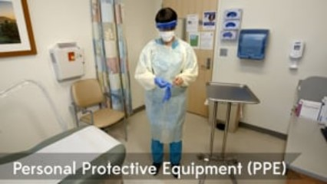
Personal Protective Equipment
Personal Protective Equipment (PPE)
Notes:
CLICK on video to play.
The second component of Standard Precautions is Personal Protective Equipment (PPE). This term refers to wearable equipment that is intended to protect HCP from exposure to or contact with infectious agents.
Examples of appropriate use of PPE include:
•use of a gown to protect skin and clothing during procedures or activities where contact with blood or body fluids is anticipated
•use of mouth, nose and eye protection during procedures that are likely to generate splashes or sprays of blood or other body fluids.
•use of gloves in situations involving possible contact with blood or body fluids, mucous membranes, non-intact skin or potentially infectious material
All PPE should be safely removed to prevent contaminating your clothing, skin or mucous membranes with potentially infectious material.
Remove all PPE before exiting the patient care area (cubicle, exam room etc.) in the following sequence:
Gloves first: Using a gloved hand, grasp the palm area of the other gloved hand and peel off the first glove. Hold that first glove in the other gloved hand; Slide the fingers of your ungloved hand under the remaining glove at the wrist and peel off the second glove over the first. Discard both gloves.
Then remove your goggles or face shield, if worn: Remove from the back by lifting the head band or earpieces, and discard
Next, remove your gown: Unfasten the gown ties; pull the gown away from your neck and shoulders. Be sure to only touch the inside of the gown; turn the gown inside out, fold or roll into a bundle, and discard
Then remove your mask: Grasp the bottom ties or elastics, then the ones at the top and remove without touching the front of the mask. Discard the mask.
And finally, wash your hands or use an alcohol-based hand rub immediately after removing PPE
Hand hygiene is always the final step after removing and disposing of PPE

Slide 21
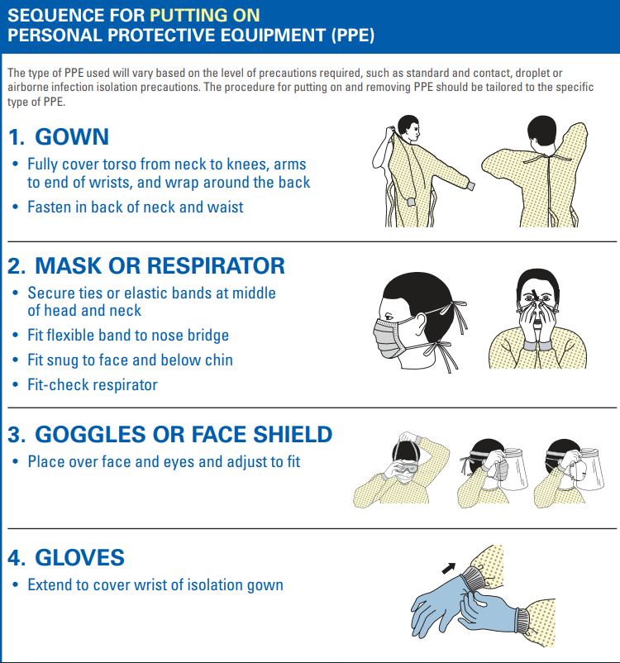

Sequence
Personal Protective Equipment (PPE)
Notes:
CDC has posters that demonstrate the sequence for appropriate donning and doffing of PPE. You can download these posters and place in central areas of your facility to assist staff with remembering the process.

Slide 22
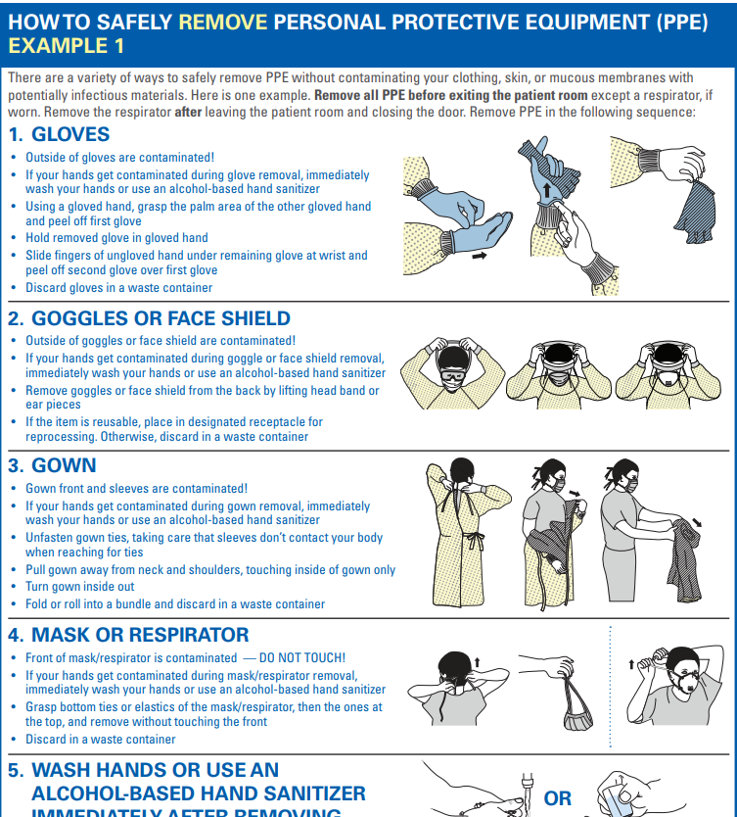

Removal example 1
Personal Protective Equipment (PPE)

Slide 23
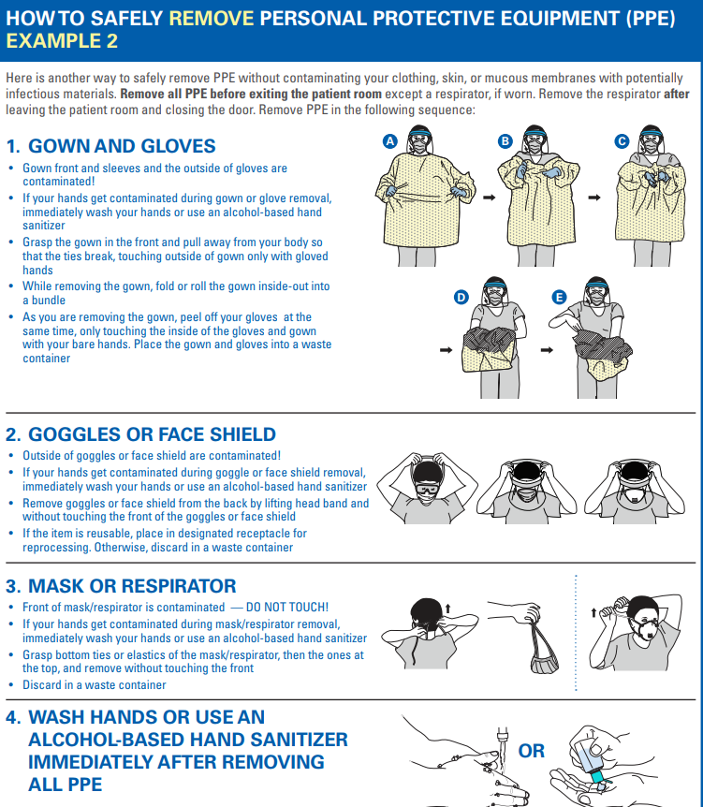
Removal example 2
Personal Protective Equipment (PPE)
Notes:
This poster is a second option for doffing gown and gloves.

Slide 24

Use of Personal protective equipment (PPE)
Three overriding principals related to personal protective equipment (PPE)
Wear PPE when the nature of the anticipated patient interaction indicates that contact with blood or body fluids may occur
Prevent contamination of clothing and skin during the process of removing PPE
Before leaving the patient’s room or cubicle, remove and discard PPE
Personal Protective Equipment (PPE)
Notes:
In review, there are three overriding principals related to use of PPE
PPE must be worn whenever the anticipated patient interaction indicates that contact with blood or body fluids may occur.
Staff should prevent contamination of clothing and skin during the process of PPE removal and
PPE must be removed prior to leaving the patient’s room or cubicle and discarded.

Slide 25


DO
DON’T
Module C
  Wear gloves to reduce risk of contamination or exposure to blood/other body fluids
  Clean hands before donning sterile gloves
  Cleans hands after removing gloves
  Cleans hands and change gloves between task (moving from one body site to another)
  Make sure gloves correct type and fit
  Follow facility policy
  Re-use or wash gloves (except for utility gloves)
  Substitute glove use for hand hygiene
  Use non-approved hand lotions
  Use gloves if damaged or visible soiled
  Touch your face when wearing gloves
  Wear the same pair from one patient to another
  Wear gloves in the hall
  Forget to remove and dispose of appropriately
Notes:
The Association for Professionals in Infection Control and Epidemiology has created a flier for Do’s and Don’ts for wearing gloves in healthcare settings.
Those recommendations are included in your slide and the web link will be included on your resource page, if you choose to use these as reminder information for your staff.

Slide 26


Controlling Transmission
respiratory hygiene/cough etiquette
Third element of standard precautions is Respiratory Hygiene/
Cough Etiquette
Strategy designed to contain respiratory secretions:
    Patients
    Accompanying individuals who have signs and symptoms of a respiratory infection
Initial point of encounter:
    Triage
    Reception area
Respiratory Hygiene/Cough Etiquette
Notes:
The third element of Standard Precautions is Respiratory Hygiene/Cough Etiquette.
CLICK This strategy is designed to contain respiratory secretions in patients and accompanying individuals who have signs and symptoms of a respiratory infection,
CLICK beginning at the point of initial encounter in a healthcare setting (for example, triage, reception and waiting areas).

Slide 27
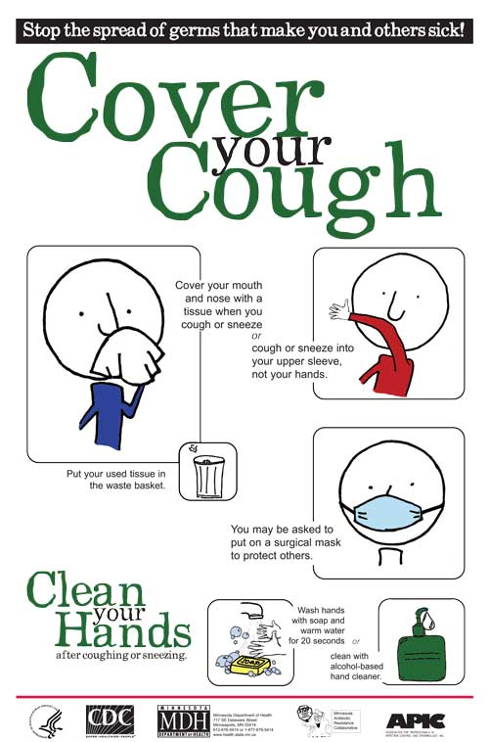

Post signs at entrances
Provide tissues and no-touch trash cans for disposal in waiting areas
Provide hand hygiene product in waiting areas
Offer mask to symptomatic patients
Encourage ill patients to sit away from others
Process must be in place year round and not just during influenza season
Notes:
Key components of respiratory hygiene/cough etiquette are to:
Post signs at all entrances to facility
Provide tissues and no-touch trash cans for disposal in waiting areas
Provide hand hygiene product in waiting areas
Offer mask to symptomatic patients
Encourage ill patients to sit away from others
Remember process must be in place all year and not just during flu season

Slide 28
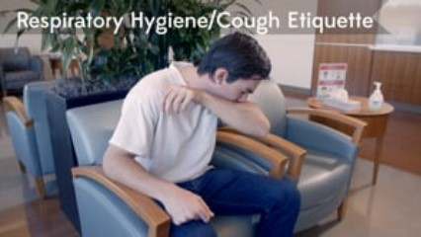
Respiratory Hygiene/Cough Etiquette
Respiratory Hygiene/Cough Etiquette
Notes:
CLICK on video to play.
We have another video summarizing these elements.

Slide 29


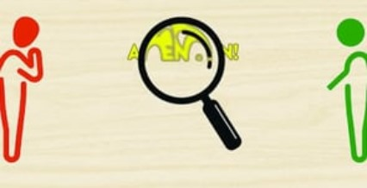
Controlling transmission
Video Clip: To start video click on image
Notes:
CLICK on video to play.
This is the narration on the video:
Now we really have to pay attention. Because in this next part of the journey Standard Precautions might not be enough to prevent the spread of infections. Standard Precautions are of critical importance at all times. However, sometimes an additional second tier of Precautions is required- Transmission Based Precautions.

Slide 30


Controlling transmission
Used for patients known or suspected to be infected with highly transmissible or epidemiologically important pathogens
Contact
Droplet
Private room
Transmission Based Precautions
Airborne
Notes:
AUTO Remember the 3 modes of transmission- Contact, Droplet, and Airborne? Well, Transmission Based Precautions are designed to interrupt those primary routes of transmission, and include contact, droplet and airborne precautions.
CLICK So in addition to Standard Precautions, Transmission-Based precautions should be used for patients known or suspected to be infected with highly transmissible or epidemiologically important pathogens for which additional precautions are needed to prevent transmission.
CLICK One of the most important elements for all these categories is to immediately place the patient in a private room or cubicle, rather than remaining in the waiting area.
We also know that some infectious agents can be transmitted via several (or a combination) of routes. For example, COVID-19 which may be transmitted via droplet and contact routes.

Slide 31
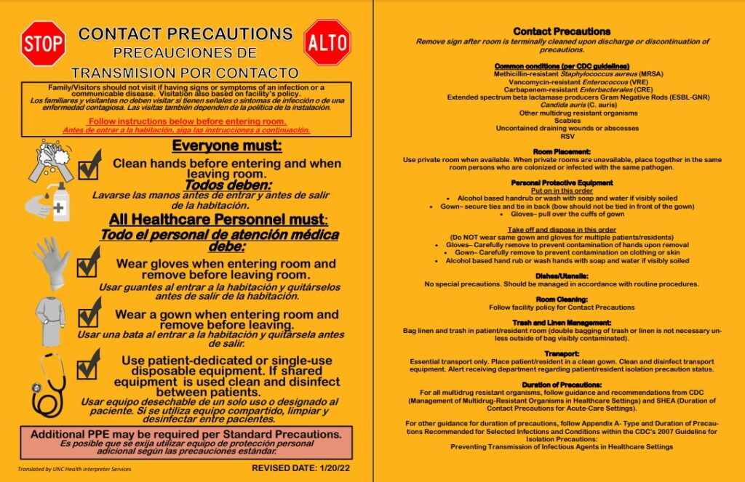
Contact Precautions
Private room or Cohort
Gown and gloves before or “upon entry”
Hand hygiene
Dedicate equipment
Disinfect shared equipment
Limit patient movement
Notes:
In 2021 SPICE updated and revised our signage for Contact, Droplet and Airborne precautions, in addition we created signage for those times when infections may be transmitted via multiple routes. All signage can be found on the SPICE website, and we have included the link on the reference slide at the end of this module.
The first category of precautions we will review is Contact:
Contact Precautions are intended to prevent transmission of infectious agents, including epidemiologically important microorganisms, which are spread by direct or indirect contact with the patient or the patient’s environment.
Contact Precautions also apply where the presence of excessive wound drainage, fecal incontinence, or other discharges from the body suggest an increased potential for extensive environmental contamination and risk of transmission.

Slide 32
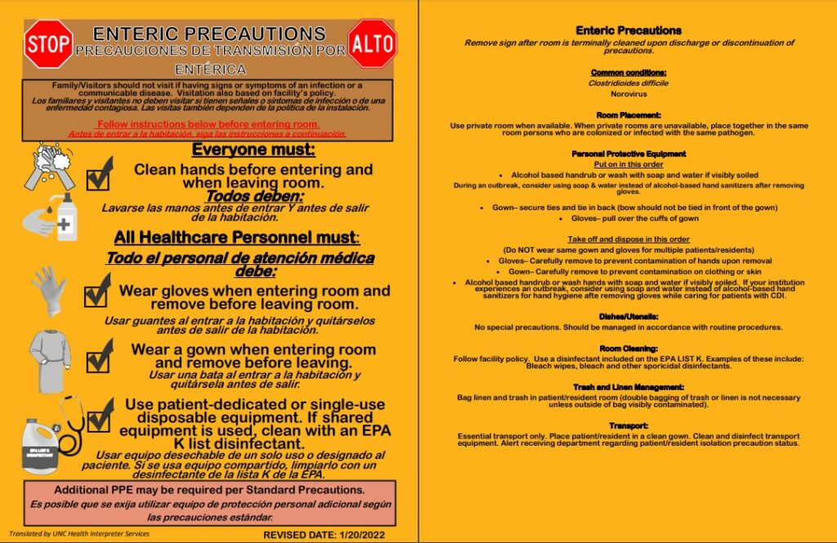
Contact (Enteric) Precautions
Special enteric precautions for C. difficile and Norovirus
Routine handwashing with soap and water or ABHR
Use of an EPA registered disinfectant with activity against C. difficile
https://www.epa.gov/pesticide-registration/list-k-antimicrobial-products-registered-epa-claims-against-clostridium
Notes:
Enteric precautions is a slightly modified version of contact Precautions and used for persons with C. difficile and Norovirus infections. There are two main differences between contact and enteric precautions:
The use of soap and water is preferred for hand hygiene, however when a hand hygiene sick is not readily available use of an ABHR should be used for hand hygiene
The disinfectant used for environmental cleaning should be an EPA registered disinfectant with activity against C. difficile. These agents can be found on EPA’s K list. We have included this link on your slide.

Slide 33
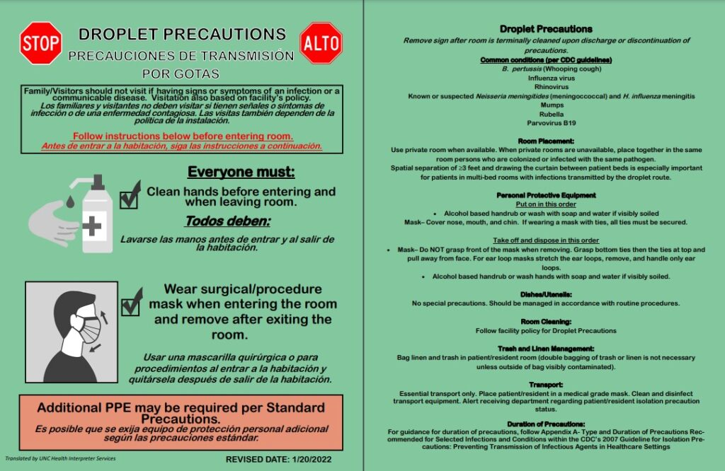
Droplet Precautions
Surgical mask prior to entry
No special ventilation
Private room or Cohort
Hand hygiene
Patients/Residents use mask outside of room
Notes:
The next category of precautions is Droplet Precautions:
Droplet Precautions are intended to prevent transmission of pathogens spread through close respiratory or mucous membrane contact with respiratory secretions.
Because these pathogens do not remain infectious over long distances in a healthcare facility, special air handling and ventilation are not required to prevent droplet transmission.
Infectious agents for which Droplet Precautions are indicated include B. pertussis (whooping cough), influenza virus, adenovirus, rhinovirus, N. meningitides, and group A streptococcus

Slide 34
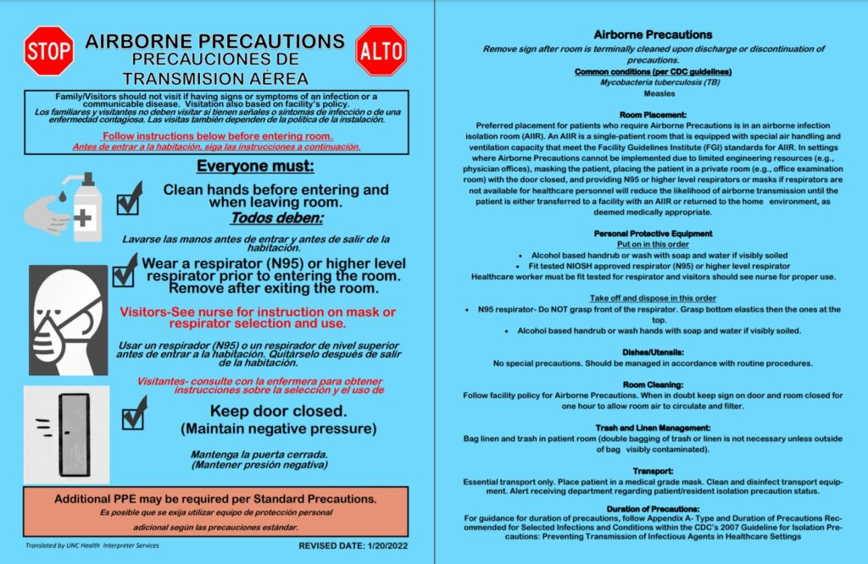
Airborne Precautions
Private room only
Room requires negative airflow pressure
Doors must remain closed
Visual air monitors
Everyone must wear an N-95 respirator or higher
Limit the movement and transport of the patient
Notes:
The third major category is Airborne Precautions, while most settings outside the hospital, cannot meet the ventilation requirements necessary to implement these precautions, we wanted to describe them briefly.
Airborne precautions prevent transmission of infectious agents that remain infectious over long distances when suspended in the air (e.g., measles, varicella virus [chickenpox], and M. tuberculosis). The preferred placement for patients who require Airborne Precautions is an airborne infection isolation room (AIIR). An AIIR is a single-patient room that is equipped with special air handling and ventilation (i.e., monitored negative pressure relative to the surrounding area, 12 air exchanges per hour for new construction and renovation and 6 air exchanges per hour for existing facilities, air exhausted directly to the outside). If your setting does not have a negative pressure room the following steps should take place:
Masking the patient upon entry
Placing the patient in a private room with the door closed,
Transfer the patient to a facility with an AIIR or returned to the home environment.
Nonimmune healthcare personnel should not care for patients with measles or chickenpox.

Slide 35
Knowledge Check
What is the single most effective way to prevent the spread of infections?
Using PPE
Cleaning patient care equipment
Hand Hygiene
Coughing into the crook of elbow or tissue
Notes:
CLICK for answer The answer is C, while all of these are important in preventing the spread of infection the single best way to prevent the spread of infection is hand hygiene.

Slide 36

Knowledge Check
True or False?
Patients who require the use of droplet precautions should be allowed to wait in the waiting room with other patients.
True
False
Notes:
CLICK for answer The answer is false; Once these patients have been identified, they should be given a mask and placed immediately in a private room. By allowing them to sit in the waiting room, you are placing other patients and their family members at risk for contracting the disease.

Slide 37






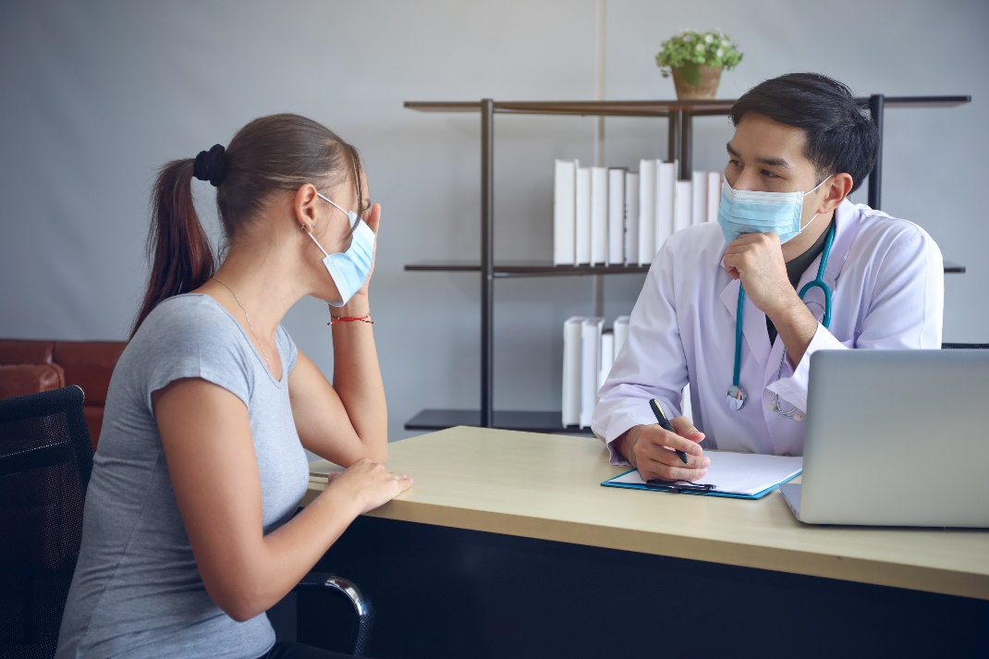





Outbreak Investigation
The goal of the investigation is to control and prevent the spread of further disease
Infection
Control
Potential
Outbreak
Determine contributing factors
Implement measures to
  stop the outbreak
  prevent future outbreaks
More common with shift to settings outside the hospitals
Notes:
When lapses in infection control occur, outbreaks can happen, and you will have to figure out how and why the outbreak occurred.
CLICK As healthcare has shifted, to settings outside the hospitals, outbreaks have become more common in those settings. Surveillance activities will assist in recognizing outbreaks or unusual disease clusters.
CLICK Sometimes a certain level of disease is expected in a group (or population) of people.
CLICK When the level of disease is above what is expected, an outbreak investigation should be performed. CLICK Similarly, if there is a single case of an unusual infection, an outbreak investigation should be performed.
CLICK The goal of the investigation is to control and prevent the spread of further disease.
This is done by determining factors that contributed to the outbreak and implementing measures to stop the current outbreak and prevent future ones.

Slide 38

Outbreaks Steps
Verify diagnosis
Establish case definition
Review for cases – case search
Create a line listing
Make an epi-curve
Develop hypothesis
Test hypothesis
Control measures
Evaluate control measures
Disseminate information
Notes:
In conducting an outbreak investigation, we follow the 10 steps shown here. The three most important things for you to remember are:
CLICK Verify the diagnosis; Gather necessary information; and Notify key individuals.
The health department is expert in managing outbreak investigations and will be able to assist your facility with all the other steps necessary to implement control measures and prevent reoccurrence

Slide 39




Outbreak Investigation
Know Who to Call for Assistance
Your Supervisor/Manager
Local Health Department
North Carolina Division of Public Health
Statewide Program for Infection Control and Epidemiology (SPICE) spice@unc.edu 919-966-3242
Determine contributing factors
Implement measures to
  stop the outbreak
  prevent future outbreaks
Notes:
In outbreaks, it is important to keep key individuals informed. Be sure to notify your supervisor as well as the local health department. Facilities are required by law to notify the local health department of any suspected or known outbreaks. The local health department will contact the NC Division of Public Health if needed. Facilities can also contact SPICE with questions.

Slide 40
Knowledge Check
Who should be notified of a suspected or known communicable disease outbreak?
Risk Management
Administration/Director
Local Health Department
All of the above
Notes:
CLICK for answer The answer is D, all of the above. It is important to keep key people in the loop regarding an outbreak, including risk management, administration and the local health department.

Slide 41
Summary
Discuss the “chain of infection”
Review standard and transmission-based precautions for controlling transmission of infections in outpatient settings
Describe the steps for detecting and controlling outbreaks
Notes:
We have covered a lot of information in this module so to summarize. We’ve discussed the chain of infection, we’ve reviewed standard and transmission-based precautions for controlling transmission of infections, and we’ve described the steps for detecting and controlling outbreaks.

Slide 42
References
List K: Antimicrobial Products registered with EPA for Claims Against Clostroidies difficile Spores
https://www.epa.gov/pesticide-registration/list-k-antimicrobial-products-registered-epa-claims-against-clostridium
NC Statewide Program for Infection Control and Epidemiology
https://spice.unc.edu/
https://spice.unc.edu/resources/signage/
Guideline for Isolation Precautions: Preventing Transmission of Infectious Agents in Healthcare Settings (2007) (cdc.gov)

Slide 43



Notes:
Before me move on to the next module, are there any additional questions?

