Slide 1




Module D

Slide 2




Objectives
Discuss the consequences of unsafe injection practices
Describe outbreaks
Discuss safe injection best practices
Describe One and Only Campaign
  Assisted blood glucose monitoring
Notes:
In this module we will:
Discuss some of the large outbreaks, (causes and consequences) that have occurred due to unsafe injection practice
Discuss recommended best practices for safe injections and blood glucose monitoring
Describe One and Only Campaign.

Slide 3

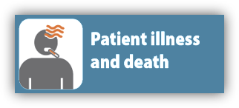




Unsafe Injection Practices
Notes:
AUTO When unexpected, adverse events, like outbreaks, happen in healthcare the results are devastating, sometimes resulting in patient illness and deaths.
Often times many patients have to be contacted and told that they may have been exposed to an infectious agent while receiving healthcare. As you can image this creates a great deal of stress and anxiety for patients and their families, even if no actual transmission has occurred.
In addition to patients being harmed healthcare providers may have their professional license revoked , be sued for malpractice and even have criminal charges filed.

Slide 4


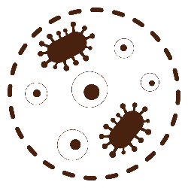

Outbreaks in Hemodialysis Settings
2019
2012-
2013
Outbreak of nonfermentative Gram-negative bacteria-likely resulted from colonization of treated reverse osmosis (RO) water, presumably through contamination via polluted filters and reprocessed dialyzers.
Outbreak of Clostridioides difficile infections occurred. The shared patient environment and lack of physical barriers between stations in OP dialysis facilities might facilitate transmission of C. difficile.
2008
Outbreak of gram-negative bloodstream infections occurred. Catheter access was associated with Gram-negative BSI. Purified water and dialysate were the likely outbreak source. Opportunities for transmission occurred through contact with contaminated prime buckets and caregiver hands.
2017
Outbreak of gram-negative bloodstream infections occurred, likely the result of hemodialyzer reuse and contamination during reprocessing.
Notes:
Here are a few examples of outbreaks and patient notifications in hemodialysis settings:
This is not an exhaustive list, but serves as a reminder of the serious consequences that can result when basic principles of infection control are not followed:
Clicks
In 2019 an Outbreak of nonfermentative Gram-negative bacteria-likely resulted from colonization of treated reverse osmosis (RO) water, presumably through contamination via polluted filters and reprocessed dialyzers
In 2017 an Outbreak of gram-negative bloodstream infections occurred, likely the result of hemodialyzer reuse and contamination during reprocessing.
In 2012-2013 an Outbreak of Clostridioides difficile infections occurred. The shared patient environment and lack of physical barriers between stations in OP dialysis facilities might facilitate transmission of C. difficile.
2008 an outbreak of gram-negative bloodstream infections occurred. Catheter access was associated with Gram-negative BSI. Purified water and dialysate were the likely outbreak source. Opportunities for transmission occurred through contact with contaminated prime buckets and caregiver hands.

Slide 5



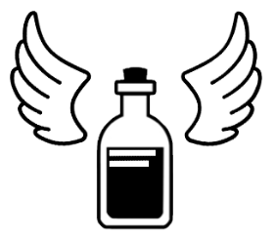
Viral Hepatitis Outbreaks Reported to CDC
The following include single cases reported and confirmed to be likely patient-to-patient healthcare-associated transmission:
2017: Two single cases of HCV were identified in two outpatient hemodialysis units in Philadelphia (unpublished data, Philadelphia Department of Health)
2017: Two single cases of HCV in two outpatient hemodialysis units in unidentified single state (unpublished data)
2016: a single HCV case in an outpatient hemodialysis unit in California (unpublished data, California Department of Health)
2015: 3 single HCV cases in 3 outpatient hemodialysis units in
New Jersey (unpublished data, New Jersey Department of Health)
2014: an HCV case in an outpatient dialysis clinic (unpublished data, State of New Jersey Department of Health) and an HCV case in an inpatient dialysis clinic (unpublished data, State of Massachusetts Department of Public Health)
Healthcare associated Hepatitis B and C Outbreaks (> 2 cases) reported to the CDC between 2008 and 2019 include:
22 outbreaks occurred in hemodialysis settings
  104 outbreak-associated cases of HCV
  3,134 persons notified for screening.
4 outbreaks occurred because of drug diversion by HCV-infected health care providers
  at least 90 outbreak-associated cases of HCV
  28,989 persons notified for screening
Reported To CDC 2008-2019
Notes:
Viral Hepatitis outbreaks have also been reported:
Healthcare associated Hepatitis B and C Outbreaks (more than 2 cases) reported to the CDC between 2008 and 2019 include:
Clicks
22 outbreaks occurred in hemodialysis settings, with 104 outbreak-associated cases of HCV and 3,134 persons notified for screening.
Four outbreaks occurred because of drug diversion by HCV-infected health care providers, with at least 90 outbreak-associated cases of HCV and 28,989 persons notified for screening
The following include single cases reported and confirmed to be likely patient-to-patient healthcare-associated transmission:
Click
2017: Two single cases of HCV were identified in two outpatient hemodialysis units in Philadelphia (unpublished data, Philadelphia Department of Health)
2017: Two single cases of HCV case in two outpatient hemodialysis units in unidentified single state (unpublished data)
2016: a single HCV case in an outpatient hemodialysis unit in California (unpublished data, California Department of Health)
Click
2015: 3 single HCV cases in 3 outpatient hemodialysis units in New Jersey (unpublished data, New Jersey Department of Health)
2014: an HCV case in an outpatient dialysis clinic (unpublished data, State of New Jersey Department of Health) and an HCV case in an inpatient dialysis clinic (unpublished data, State of Massachusetts Department of Public Health)

Slide 6

Knowledge Check
Which of the following statements is correct?
CDC reports that most outbreaks occur in the hospital
Outbreaks of HCV have NOT occurred in hemodialysis settings, only in hospitals
CDC reports that outbreaks of bloodstream infections and HCV infection have occurred in hemodialysis centers.
Notes:
CLICK for answer
C is correct, CDC has reports of bacterial BSI outbreaks and transmission of HCV in hemodialysis settings

Slide 7
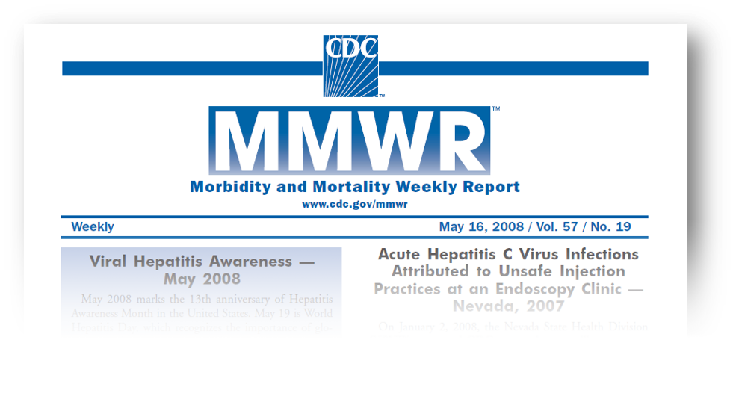
Why Do Outbreaks Happen?
Notes:
Next, we are going to go over the major reasons outbreaks happen

Slide 8






The Big Five
THE BIG 5
Syringe re-use, directly or indirectly
Inappropriate use of single dose or single use vials
Failure to use aseptic technique (contamination of injection equipment)
Unsafe diabetes care/ assisted blood glucose monitoring (ABGM)
Drug diversion
Notes:
The ‘big 5’ causes that lead to these outbreaks are:
CLICKS
Syringe re-use, either directly or indirectly
Inappropriate use of single dose or single use vials
Failure to use aseptic technique. In this case, we are referring to contamination of injection equipment
Unsafe diabetes care, specifically the assisted blood glucose monitoring.
And drug diversion
Outbreaks often involve more than one of these breaches and we are going to discuss each of these in more detail.

Slide 9
Syringe Re-use
Most common cause of outbreaks in settings outside the hospital is inappropriate use of syringes:
  Direct reuse:
    Using the same syringe to administer medication to more than one patient, even if the needle is changed or the injection was administered through an intervening length of tubing
  Indirect reuse or “double dipping”:
    Accessing a medication vial or bag with a syringe that has already been used to administer medication to a patient, then reusing the contents from the vial or bag for another patient
Syringe Re-use
Notes:
The first common cause of outbreaks, that we are going to discuss is inappropriate use of syringes, and this can include two kinds, either direct reuse or indirect reuse.
CLICK When we talk about direct reuse of syringes, just as it sounds, involves the use of a single syringe to administer medication for multiple patients, for example insulin pens or when the same syringe is used to administer vaccines to multiple patients
CLICK Indirect re-use or “double dipping” is the most common cause for large numbers of viral hepatitis outbreaks and occurs when you have taken a vial of medication, withdrawn some medicine from the vial, administered that to the patient and then you would come back and re-access that vial with the same syringe. You have now contaminated the contents pf the vial of the medication so anyone who receives medication afterwards can potentially become infected

Slide 10
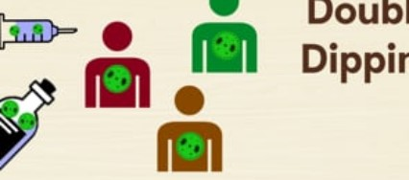
Video Clip: Start the video by clicking on the image below.
Syringe Re-use
Syringe Re-use
Notes:
CLICK to play video
This is the narration on the video:
This is a critical point, so we’re going to go over it one more time. Here’s how double dipping works. You start with a new needle, new syringe, and new vial. All good so far. You then inject a patient infected with HCV. This contaminates both the needle and the syringe. But instead of discarding both, only the needle is changed. When the vial is accessed again, the HCV virus is transferred from the old syringe into the vial. From that point forward, every patient who receives medication from that vial is potentially exposed to the virus. Just changing the needle is not enough. The needle AND the syringe must be replaced every time.

Slide 11

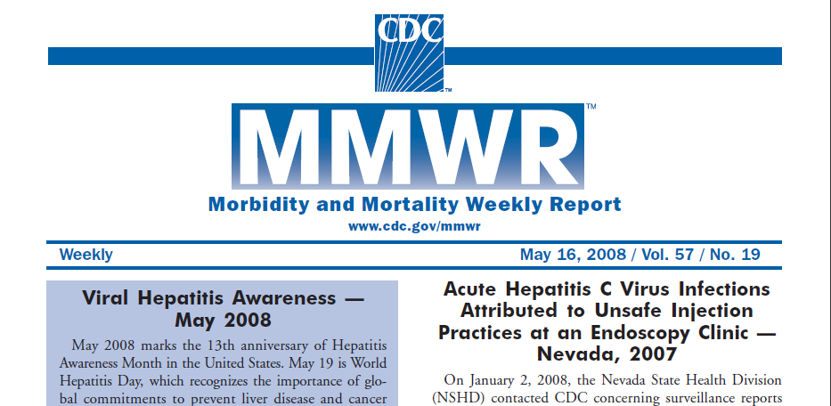
Endoscopy Center, Nevada (2008)
9 clinic-associated hepatitis C virus cases
106 possible clinic-associated cases
63,000 potential exposures
$16–21 million total cost
Syringe Re-use
Notes:
This is an unfortunate example of what can happen in this “double dipping” situation. This was a hepatitis C outbreak that occurred in 2008 in an endoscopy center in Nevada.
This outbreak resulted in 9 confirmed cases and 106 possible cases of hepatitis C. There were 63,000 people potentially exposed, and the outbreak resulted in $16 to $21 million dollars in public health costs.
The link to this outbreak has been added to your resource page

Slide 12

Dangerous Misperceptions
Changing the needle makes a syringe safe for reuse.
Syringes can be reused as long as an injection is administered through an intervening length of IV tubing.
If you don't see blood in the IV tubing or syringe, it means that those supplies are safe for reuse.
Once they are used, both the needle and syringe are contaminated and must be discarded!
Syringe Re-use
Notes:
Unfortunately, some dangerous misperceptions still exist in healthcare settings and include:
CLICKS
Changing the needle makes a syringe safe for reuse
Syringes can be reused if there is a sufficient length of tubing between the patient and the injection site and
Lack of visible blood means the syringe is safe for reuse.
All of these are false and once a needle and syringe are used, both are contaminated and must be discarded!

Slide 13
Inappropriate Use of
Single-dose/Single-use Vials
Vials labeled as single use:
  NO PRESERVATIVE
  Can be accessed one time only and for one patient only and remaining contents must be discarded
CDC is aware of at least 19 outbreaks involving single dose vial use
  All occurred in outpatient setting with almost half in pain remediation clinics
Inappropriate use of single dose/use vials
Notes:
The second cause of large outbreaks in health care setting is misuse of single-dose/single-use vials.
CLICK Vials labeled as single use do not contain ANY preservative and can be accessed one time only and for one patient only. Remaining contents must be discarded
CLICK The CDC is aware of at least 19 outbreaks involving single dose vial misuse, with seven outbreaks involving bloodborne pathogens and twelve outbreaks involving bacterial infections.
All these outbreaks occurred in outpatient settings, with almost half in pain remediation clinics where injections are performed frequently, and medications are often packaged in large-volume single-dose vials.
Link to outbreaks are included in your resource listing

Slide 14
Single Dose Vials:
CDC Position Statement, 2012
Vials labeled by the manufacturer as “single dose” or “single use” should only be used for a single patient
Ongoing outbreaks provide ample evidence that inappropriate use of single-dose/single-use vials causes patient harm.
Leftover parenteral medications should never be pooled for later administration
  In times of critical need, contents from unopened single dose vials can be repackaged for multiple patients in accordance with standards in United States Pharmacopeia General Chapter ‹797›
Inappropriate use of single dose/use vials
www.cdc.gov/injectionsafety/CDCposition-SingleUseVial.html
Notes:
As a result of outbreaks resulting from single dose vial misuse, the CDC restated its position on the use of single-dose/single-use vials in 2012.
The CDC stated that:
CLICKS
Vials labeled by the manufacturer as “single dose” or “single use” should only be used for a single patient.
Ongoing outbreaks provide ample evidence to support that this misuse results in patient harm.
Leftover medications should not be pooled or stored for later administration.
And, in times of shortage, medications can be repackaged ONLY if it’s done in accordance with established standards.

Slide 15

When Failure To Use Aseptic Technique Happens!
Two women diagnosed with HBV infection, receiving chemotherapy at the same physician practice
Multidisciplinary team investigation
Office closed; physician license suspended
2,700 patients notified
29 outbreak-associated cases of HBV
Failure to use aseptic technique
Notes:
The third cause of large outbreaks that we will discuss is failure to use aseptic technique .
In this example, two women, aged 60 and 77 years, were diagnosed with acute hepatitis B virus (HBV) infection; both received chemotherapy at the same physician’s office.
Due to suspicion of health care associated HBV transmission, a multidisciplinary team initiated an investigation of the hematology-oncology office practice.
Patients who visited the office practice between January 1, 2006 and March 3, 2009 were advised to seek testing for bloodborne pathogens.
Deficient infection prevention policies/procedures and failure to use aseptic technique were identified as primary breaches and cause of the outbreak.

Slide 16
Knowledge Check
Which of the following statements is false?
Syringes can be used on more than one patient if the needle is changed.
Single dose vials can be used more than one time if it has not been contaminated
Blood glucose meters do not have contact with patients and do not need to be cleaned
If there is no visible blood the syringe is safe to reuse.
All the above
Notes:
E is correct. All those statements are false and dangerous misconceptions

Slide 17
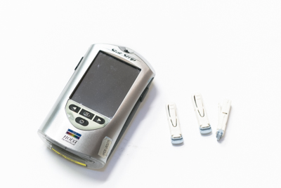


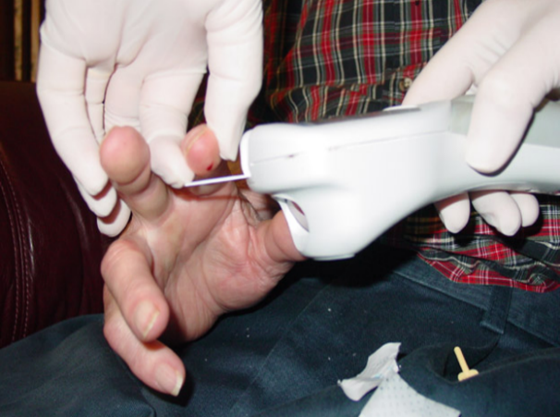
Unsafe Diabetes Care
Use of fingerstick devices or insulin pens on multiple persons
Fingerstick
Devices/Insulin Pens
Sharing of blood glucose meters without cleaning and disinfection between uses
Failure to perform hand hygiene or change gloves between procedures
Hand
Hygiene
Failure
Blood
Glucose
Meters
Diabetes care
Patel et al. ICHE 2009; 30:209-14,Thompson et al. JAGS 2010, MMWR 2005; 54:220-3
Notes:
The fourth cause of outbreaks that we are going to discuss is Unsafe Diabetes Care. This underappreciated area of risk has been the mode of transmission for many hepatitis B outbreaks.
Large numbers of Hepatitis B outbreaks, reported to CDC were associated with breeches in infection control during assisted monitoring of blood glucose (AMBG)
Outbreaks have been linked to the infection control breaches shown here, including:
CLICKS
Sharing of blood glucose meters without disinfection and cleaning between uses, this is the most common breach.
Use of fingerstick devices or insulin pens for multiple people, and
Failure to perform hand hygiene or change gloves between procedures.

Slide 18

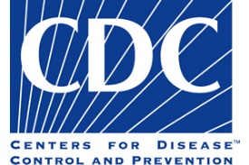
Drug Diversion
5. Drug diversion
When prescription medicines are obtained or used illegally, it is called drug diversion. Healthcare personnel who steal prescription medicines or controlled substances for their own use put patients at risk.
Substandard care delivered by an impaired provider
Denial of essential pain medication or therapy
Risks of infection
  Bloodborne pathogen
  Bacterial contaminants
CDC and state and local health departments have assisted in investigations.
Notes:
The final cause of outbreaks that we will discuss is Drug Diversion.
CLICK CDC notes the following: “When prescription medicines are obtained or used illegally, it is called drug diversion. Healthcare personnel who steal prescription medicines or controlled substances for their own use put patients at risk.”
The CDC and state and local health departments have assisted in the investigation of infection outbreaks stemming from drug diversion that involved healthcare personnel who tampered with injectable drugs.
CLICK
Drug diversion can harm patients in multiple ways.

Slide 19

New slide
Year | Cases | Outbreak
2018 | 12 | HCV infections associated with an emergency department nurse
2018 | 6 | Sphingomonas paucimobilis bacteremia associated with a nurse at a cancer center
2015 | 7 | HCV infections associated with a nurse at a hospital
2014 | 5 | Serratia marcescens bacteremia associated with a nurse in a post-anesthesia care unit at a hospital
2012 | 45 | HCV infections associated with a radiology technician at hospitals in NH, Kansas and Maryland
2011 | 25 | Gram negative bacteremia associated with a nurse at a Minnesota hospital
2009 | 18 | HCV infection associated with a surgical technician at a Colorado hospital
2008 | 5 | HCV infections associated with a radiology technician at a Florida hospital
2006 | 9 | Achromobacter xylosoxidans bacteremia associated with a nurse at an Illinois hospital
2004 | 16 | HCV infections associated with a certified registered nurse anesthetist at a Texas hospital
1999 | 26 | Serratia marcescens bacteremia associated with a respiratory therapist at a Pennsylvania hospital
1992 | 45 | HCV infections associated with a surgical technician at a Texas ambulatory surgical center
1985 | 3 | Pseudomonas pickettii bacteremia associated with a pharmacy technician at a Wisconsin hospital
Drug diversion
Notes:
Here are some of the outbreaks that have occurred due to drug diversion. Because safe injection practices may not be followed during diversion events, the greatest risk of patient exposure to infectious pathogens comes from injectable medications. Thus, drug diversion can directly expose patients to HIV, HBV, HCV or other BBPSs

Slide 20
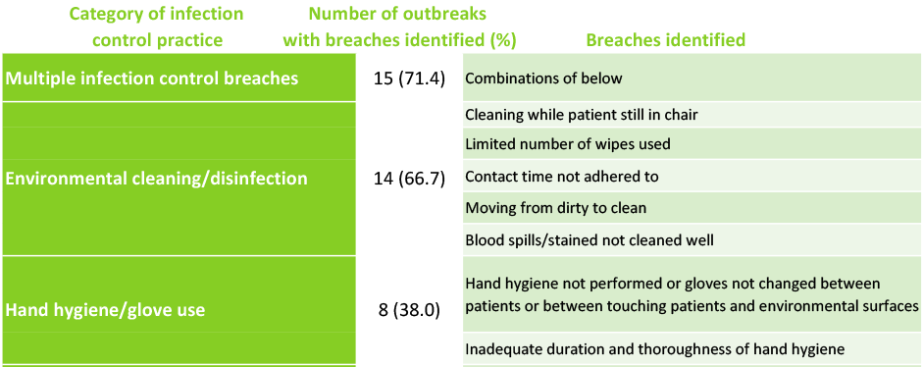
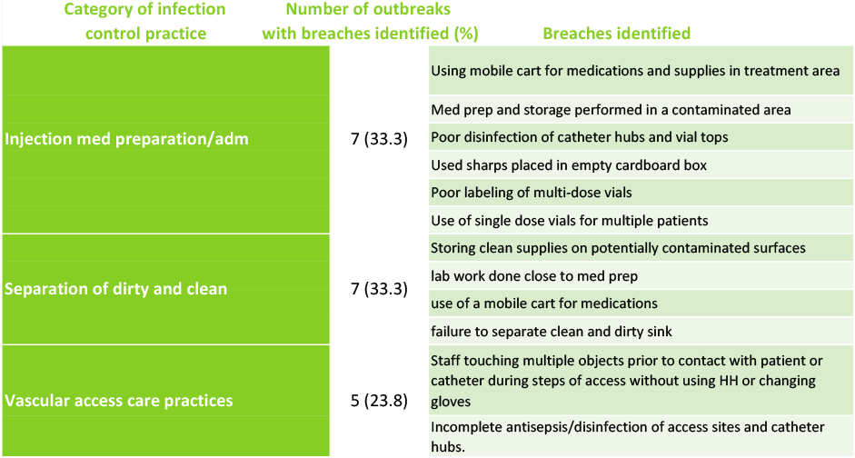
Study involving 53 US facilities
Reference ​
Semin Dial. 2019 March ; 32(2): 127–134. doi:10.1111/sdi.12761. ​
CDC Transmission of HCV in the dialysis setting and strategies for prevention
Notes:
Now we will look at some outbreaks and causes specifically in hemodialysis facilities.
In an epidemiologic study involving patients treated at 53 outpatient dialysis facilities in the US, multiple breaches in infection prevention practices were identified and associated with transmission of HCV.
Identified breaches included:
Inappropriate or inadequate environmental cleaning/disinfection,
Inappropriate or inadequate hand hygiene practices and/or use of gloves
CLICK
Unsafe injection and medication prep procedures
Lack of aseptic technique – no separation of dirty and clean
Inappropriate practices with vascular access care
Some outbreaks included a combination of multiple breaches
Reference
Reference ​
Semin Dial. 2019 March ; 32(2): 127–134. doi:10.1111/sdi.12761. ​
CDC Transmission of HCV in the dialysis setting and strategies for prevention

Slide 21
Safe Injections: Best Practices
Misuse of single-dose/single-use vials
Never administer medications from the same syringe to multiple patients
Do not reuse a syringe to enter a medication vial or solution
Limit the use of multi-dose vials and dedicate them to a single patient whenever possible
Syringe reuse (direct and indirect)
Do not administer medications from a single dose vial or IV solution bag to more than one patient, more than one time
Notes:
Because this topic is so important and can potentially save lives, we want to summarize these key points:
CLICKS
Never administer medications from the same syringe to multiple patients
Do not re-use a syringe to enter a medication vial or solution
Limit the use of multi-dose vials and dedicate them to a single patient whenever possible
Regarding single dose vials:
Do not administer medications from a single dose vial or IV solution bag to more than one patient.

Slide 22
Safe Injections: Best Practices
Failure to use aseptic technique
Use aseptic technique when preparing or administering medications
  Keep contaminated items and surfaces away from the preparation area.
  Designate a ‘clean’ medication preparation area that is not adjacent to contaminated items
  Perform hand hygiene before handling medications.
Unsafe diabetes care
Use insulin pens and lancing devices for only one patient
Dedicate glucometers to a single patient. If they MUST be shared, clean and disinfect after each use
Notes:
Use aseptic technique when preparing or administering medications.
CLICKS
Keep contaminated items and surfaces away from the preparation area.
Designate a ‘clean’ medication preparation area that is not adjacent to areas where potentially contaminated items are placed.
Perform hand hygiene before handling medications.
Insure that the rubber septum is disinfected with alcohol prior to piercing it.
And, lastly, with diabetes care –
Use insulin pens and lancing devices for only one patient.
Dedicate blood glucose meters to a single patient. If they must be shared, clean and disinfect after each use per manufacturer's instructions. If there are no instructions, it cannot be shared.

Slide 23

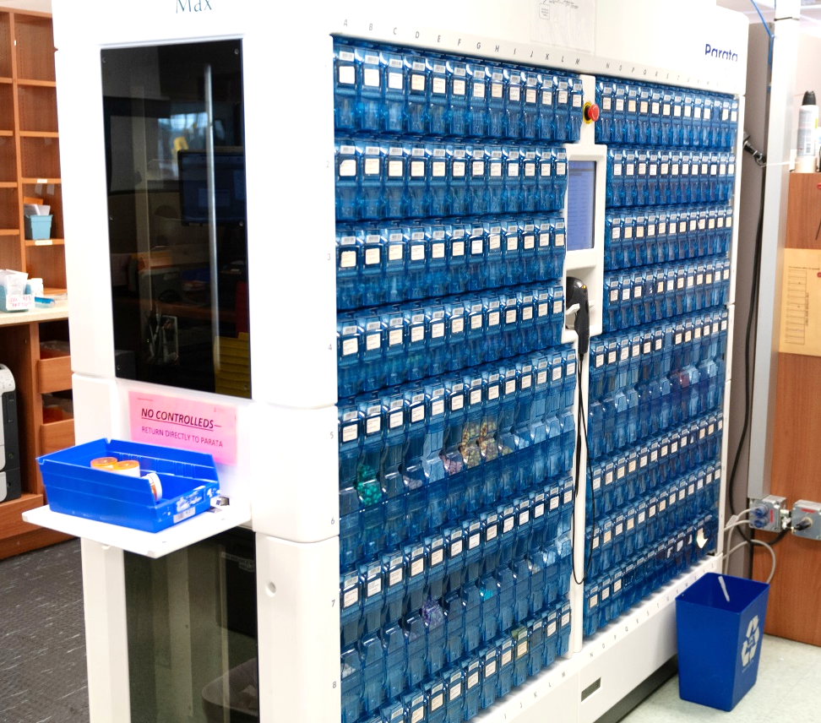
Safe Injections: Best Practices
Drug Diversion
Institue drug diversion monitoring systems and security measure to assist in averting and/or identifying diversion activity.

Slide 24





Most Outbreaks are Never Detected
Under-reporting of cases
Asymptomatic infection
Under-recognition of healthcare as risk
Long incubation period;
difficult to identify single healthcare exposure
Barriers to investigation, resource constraints
Notes:
24
Unfortunately, the outbreaks described so far are just the tip of the iceberg. Most outbreaks are never detected for a variety of reasons including:
CLICKS
Hepatitis B and C can be asymptomatic infections.
They have long incubation periods of up to 6 months, making it difficult to identify a single healthcare exposure.
Even if an infection is diagnosed, the case might not be reported and healthcare might not be recognized as a risk factor and,
There are barriers and resource constraints, making investigation of potential healthcare-associated outbreaks difficult.

Slide 25
Survey of Physician and nurse Practices around injection safety
  370 Physicians
  320 Nurses
  Eight States Included
    NC, NY, NJ, Nevada, Colorado, Tennessee, Wisconsin, Montana
  Types of healthcare settings:
    Acute care, long term care, outpatient settings
https://www.sciencedirect.com/science/article/pii/S0196655317306806?via%3Dihub
Notes:
Fortunately, most healthcare professionals do practice safe injection techniques with every injection; however, a survey published in September 2017, of physician and nurse knowledge, attitudes, and practices around injection safety produced alarming results. The survey included:
370 physicians,
320 nurses,
8 states and
All types of healthcare settings.

Slide 26
Survey findings
Topic Is Acceptable Practice | Physician Response | Nurse Response
Reuse of syringe for > one patient | 12.4% | 3.4%
Reentering a vial with a used needle/syringe | 12.7% | 6.7%
Using SDVs for multiple patients | 34% | 16.9%
Using source bags as diluent for multiple patients | 28.9% | 13.1%
Notes:
Results include the following:
12.4% of physicians and 3.4% of nurses reused a syringe on more than one patient
12.7 % of physicians and 6.7% of nurses re-enter a medication vial with a used needle and/or syringe
34% of physicians and 16.9% of nurses use a single dose vial more than one time and
28.9 % of physicians and 13.1 % of nurses use a source bag for more than one patient

Slide 27

Knowledge Check
True or False?
Because there have been so many outbreaks, ALL healthcare providers do the right thing every time with safe injection practices.
True
False
Notes:
CLICK for answer That’s right! It’s false! Unfortunately, not all healthcare providers do the right thing every time, but hopefully with modules like these we can work toward that goal.

Slide 28


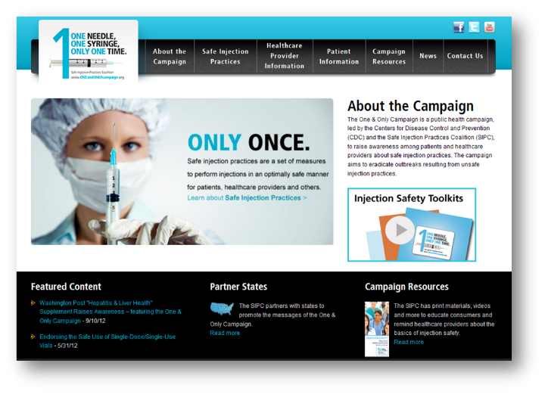

Best Practice
  Designate someone to provide ongoing oversight
  Develop written infection control policies
  Provide training
  Conduct quality assurance assessments
  Knowledge
  Prevention
Speak Up!
Notes:
By learning more and becoming more aware of these issues, we can make great strides toward preventing outbreaks.
Here are some practical policies you can implement:
CLICK
Designate someone to provide ongoing oversight
Develop written infection control policies
Provide training
Conduct quality assurance assessments
CLICK
And lastly, speak up if you see someone not following safe injection practices. You are not only protecting your patients - you are protecting your colleagues as well.

Slide 29
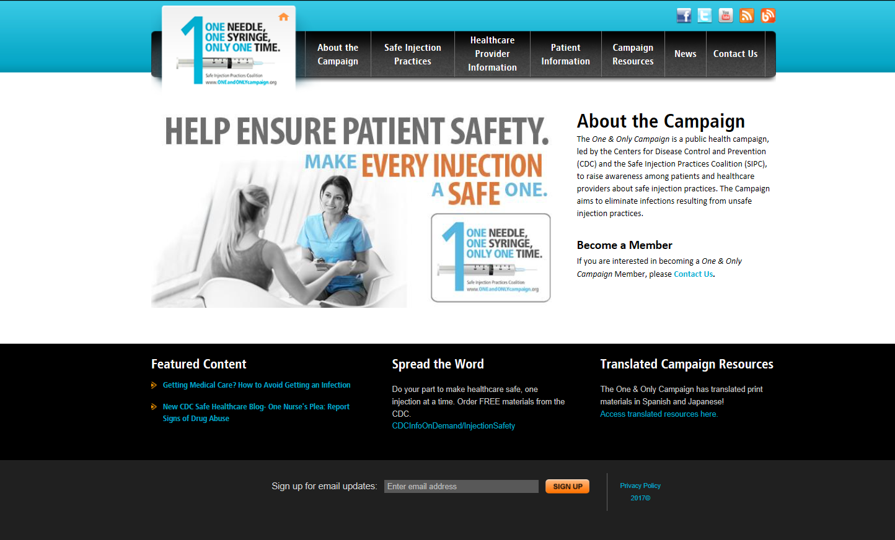
One and Only Campaign
Notes:
The One & Only Campaign is a public health campaign, led by the Centers for Disease Control and Prevention (CDC) and the Safe Injection Practices Coalition (SIPC), to raise awareness among patients and healthcare providers about safe injection practices. The Campaign aims to eliminate infections resulting from unsafe injection practices.

Slide 30
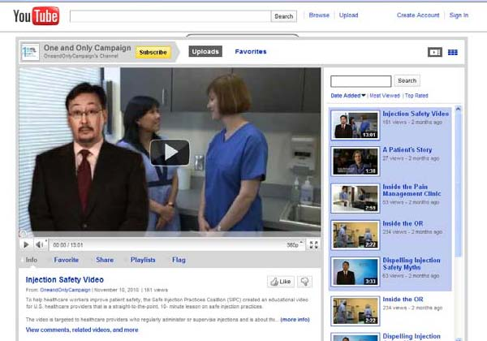

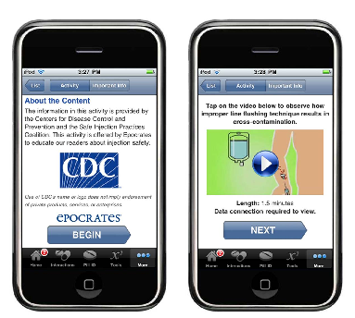
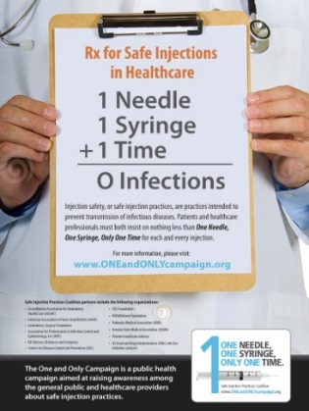

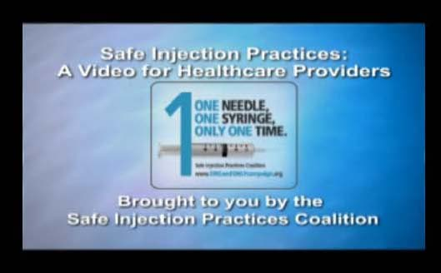
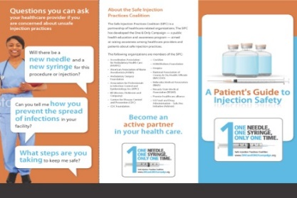
Campaign Resources
  Print Materials
  Audio & Visual
  Social Media
  Toolkits
Notes:
AUTO The campaign utilizes many mediums and materials to deliver their messages. In addition to the numerous print materials available on the website, they also have several healthcare provider videos and an injection safety “app.”
They use social media, including Facebook and Twitter, to get relevant and engaging materials out to target audience. And, recently, they have developed toolkits to help healthcare providers educate themselves and their staff.
All of the materials are free and available either on the campaign website or can be ordered through CDC Info. There are actually quite a few new resources, such as a new video, infographic and bloodborne pathogen training.

Slide 31




