Slide 1

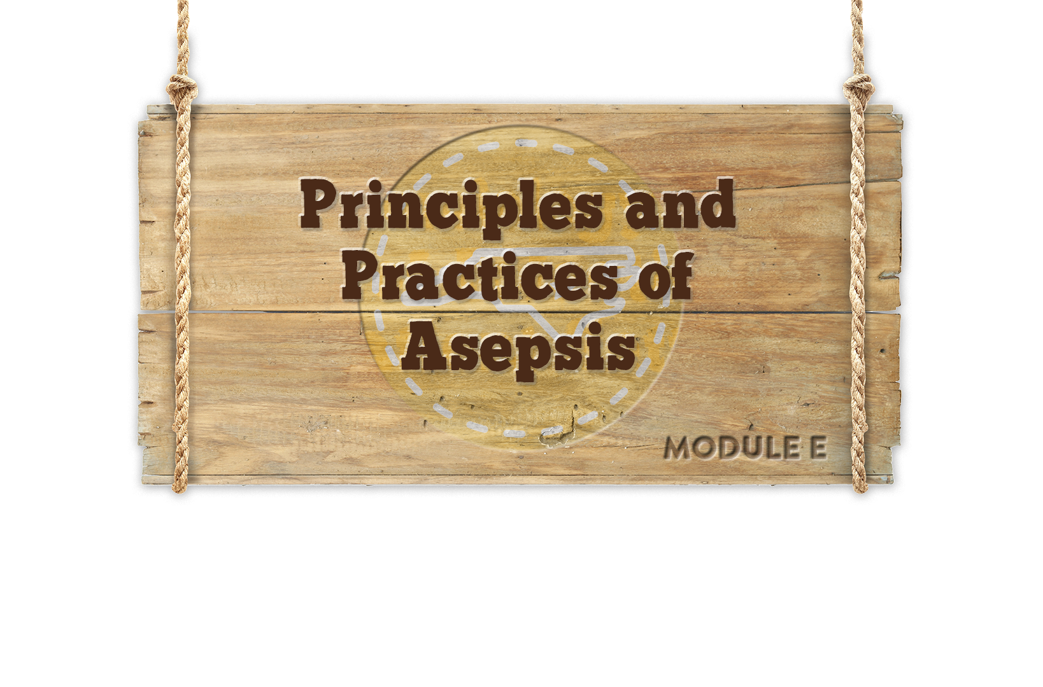


Module E
Notes:
Welcome to Principles and Practices of Asepsis

Slide 2



Objectives
Objectives
Describe the principles and practice of asepsis
Understand the role of hand hygiene in asepsis
Understand the role of the environment in disease transmission
Notes:
There are three main objectives for this module.
Describe the principles and practice of asepsis
Understand the role of hand hygiene in asepsis
Understand the role of the environment in disease transmission

Slide 3


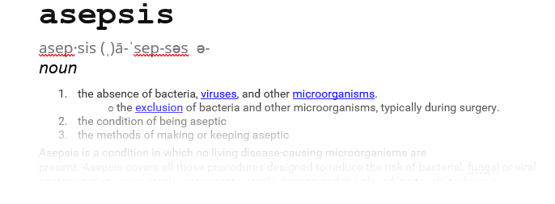
Defining Asepsis
 | Medical Asepsis | Surgical Asepsis
Definition | Clean Technique | Sterile Technique
Emphasis | Freedom from most pathogenic organisms | Freedom from all pathogenic organisms
Purpose | Reduce transmission of pathogenic organisms from one patient-to -another | Prevent introduction of any organism into an open wound or sterile body cavity
 | Medical Asepsis | Surgical Asepsis
Definition | Clean Technique | Sterile Technique
Emphasis | Freedom from most pathogenic organisms | Freedom from all pathogenic organisms
Purpose | Reduce transmission of pathogenic organisms from one patient-to -another | Prevent introduction of any organism into an open wound or sterile body cavity
Being free from disease producing microorganisms
Notes:
We need to spend a little time talking about what the term “Asepsis” means in healthcare.
CLICK
It is a broad term that is defined as “being free from disease producing microorganisms”. In all healthcare settings,, two types of asepsis may be used based on the activity.
CLICK
The first one is medical asepsis, also referred to as clean technique, used during most routine patient care activities and non-surgical procedures. In medical asepsis, emphasis is placed on removing most, but not all, of the infectious organisms, to reduce transmission from one person to another.
CLICK
The second one is surgical asepsis, also referred to as sterile technique, used only during surgical procedures. Unlike medical asepsis, the goal of surgical asepsis is to remove all infectious organisms and prevent the introduction of any organism into a normal sterile body site.
Now we are going to discuss each of these in a little more detail

Slide 4
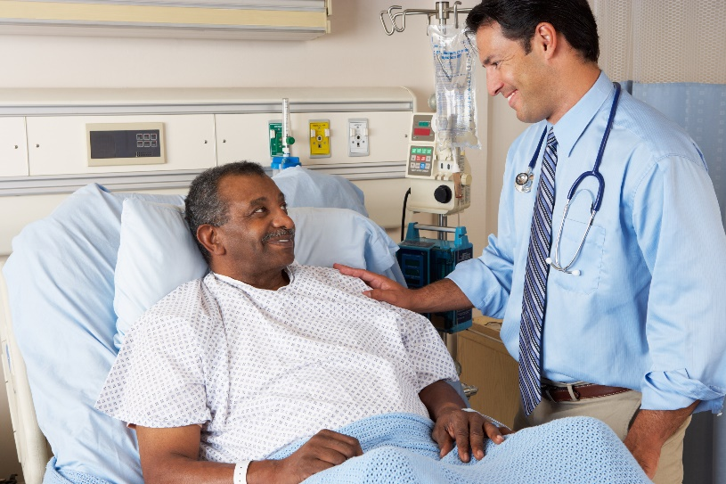
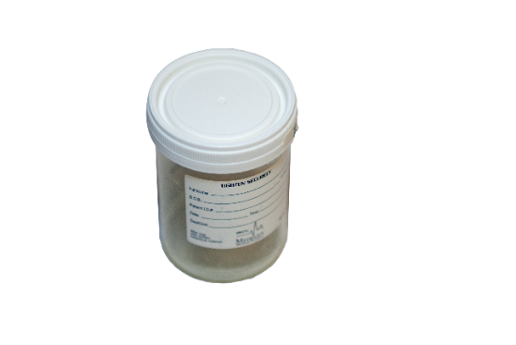
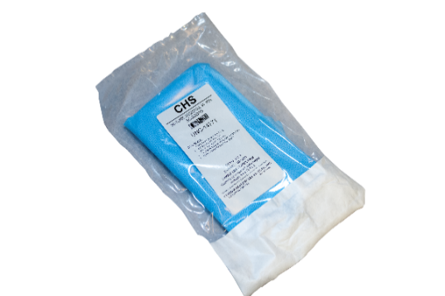
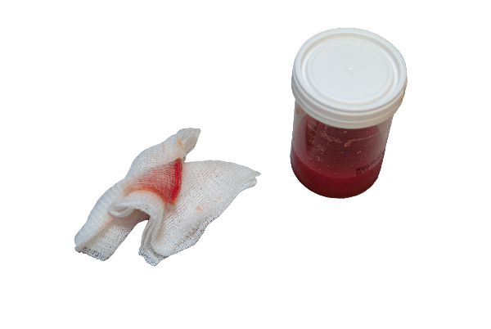

Medical Asepsis
Medical asepsis, also known as “clean technique” is aimed at controlling the number of microorganisms and is used for all clinical patient care activities.
Necessary components of medical asepsis include:
Knowing what is dirty versus clean versus sterile
How to keep the first three conditions separate
How to remediate contamination immediately
Notes:
Medical asepsis is based on several measures with the goal of controlling the number of microorganisms, not making things sterile. Medical asepsis should be used when performing any healthcare related activity.
CLICKS
To achieve medical asepsis, we must understand what is
dirty, what is clean, what is sterile,
how to keep these things separate,
and how to remediate any contamination that might occur.

Slide 5
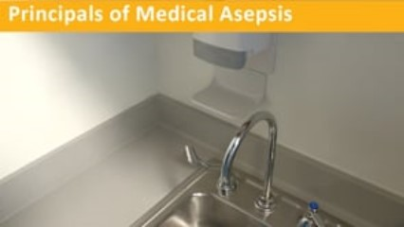
CHANGE NEEDED
Notes:
CLICK to play video
This is the narration on the video:
There are several key principles that must be applied in medical asepsis or “clean technique”. They include:
Performing hand hygiene is fundamental to the practice of medical asepsis and is key to reducing the potential for transmission of infectious agents. Hand hygiene will be discussed in detail later in this module
Use personal protective equipment if contact with blood or body fluid is anticipated. Remember if is wet and does not belong to you use appropriate PPE and perform hand hygiene
Patient care equipment can become contaminated and should be cleaned after each use and stored appropriately
Another source of contamination is the patient environment and for this reason should be cleaned and disinfected between patients
Healthcare providers can also, potentially be a source of contamination, but can reduce their opportunities for transmitting disease by staying up to date on vaccinations, not working when sick and maintaining good personal hygiene.

Slide 6

Surgical Asepsis
Notes:
Now that we have reviewed medical asepsis, let’s move on to surgical asepsis. More stringent requirements are used during sterile procedures because the risk of infection increases during surgical procedures.

Slide 7
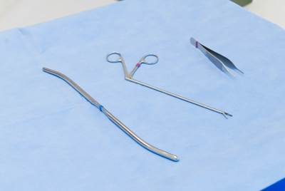
Surgical Asepsis
Surgical asepsis, also known as “sterile technique” is aimed at removing all microorganisms and is used for all surgical/sterile procedures.
Necessary components of surgical asepsis include:
Knowing what is and what is not sterile
How to keep the first two conditions separate
How to remediate contamination immediately
Notes:
Surgical asepsis is based on several measures with the goal of removing all microorganisms, thereby making things sterile. Surgical asepsis should be used when performing any surgical or sterile procedure.
To achieve surgical asepsis, we must know what is sterile, what is not sterile, how to keep these things separate, and how to remediate any contamination that might occur.

Slide 8

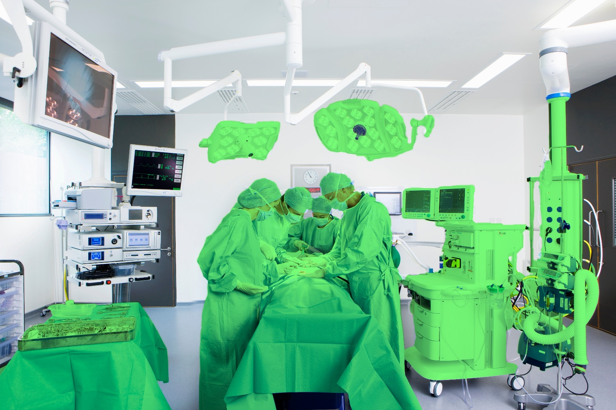
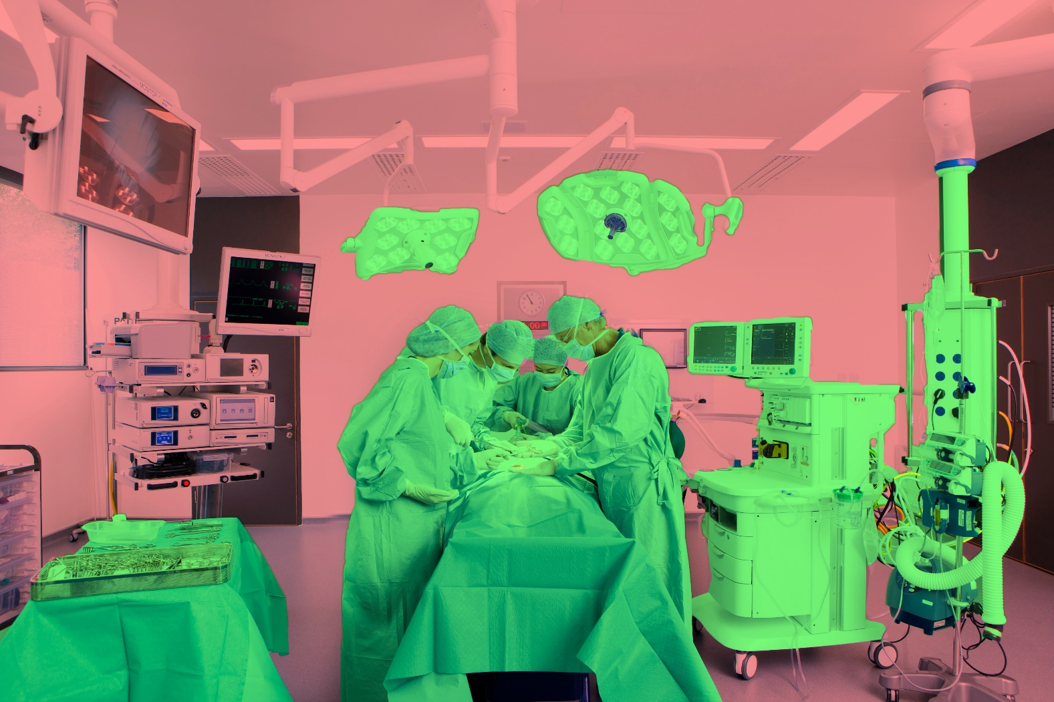
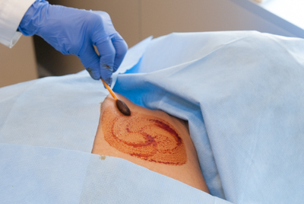
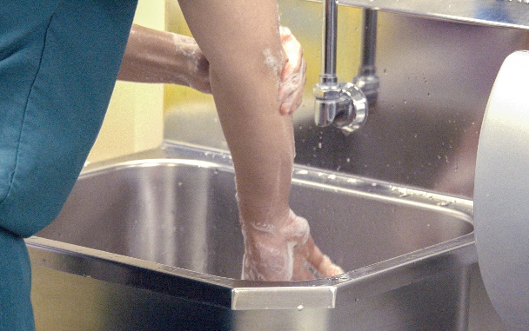
Principles of Surgical Asepsis
Non-sterile
The patient should not be the source of contamination
Healthcare personnel should not be the source of contamination
Recognize potential environmental contamination
Keep door closed
Keep traffic to a minimum
Perform surgical hand scrub/ should be done meticulously
Don sterile gown and gloves
Only contact sterile items
Sterile
Notes:
While in the surgical environment, there are several principles which help maintain a sterile environment.
CLICK
First, the patient should not be a source of contamination. The skin around the surgical site is meticulously cleaned using a chemical antiseptic, like chlorhexidine-alcohol solution, and all other areas of skin are covered by a sterile drape.
CLICK
Similarly, healthcare personnel performing or assisting with the procedure, should not be a source for contamination. Personnel working in the sterile field should:
CLICK
Perform a surgical hand scrub,
Don sterile gown and glove, and
Only contact sterile items.
CLICK
All other personnel should only contact unsterile items and should not have direct contact with personnel in the sterile field.
In the event a break in technique occurs, point it out immediately and take appropriate action

Slide 9

Knowledge Check
Which of the following is True?
Surgical asepsis should be used for all patient care activities
Medical asepsis or “Clean technique” is used when performing any healthcare related activity
Clean and dirty equipment can be stored together if they are not touching
The goal for medical asepsis is freedom from all pathogenic organisms
Notes:
CLICK for answer Answer B is true: Clean technique, or medical asepsis, is used for all healthcare related activities.

Slide 10

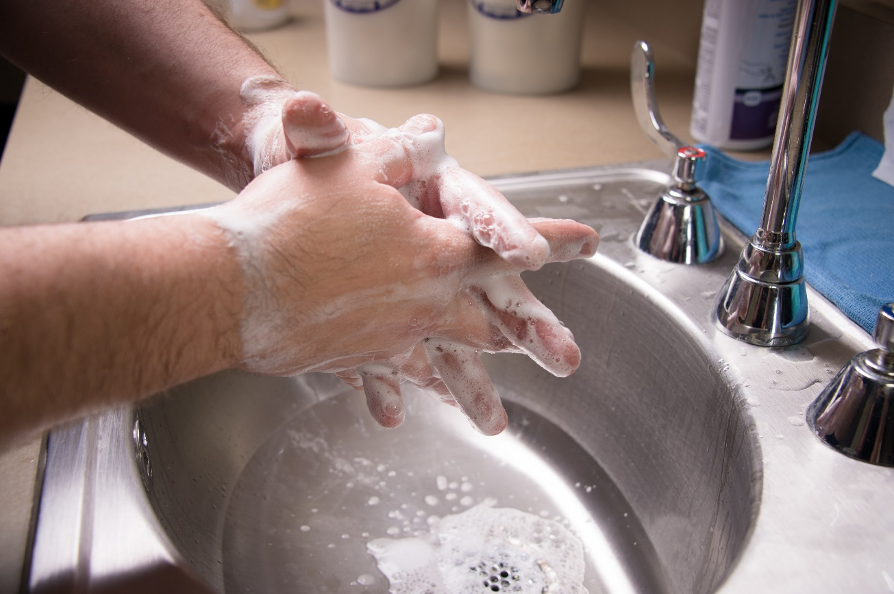
Role of Hand Hygiene
Notes:
Remember what we said, performing hand hygiene is essential to the principals and practices of asepsis and is key to reducing the potential for transmission of infectious agents

Slide 11
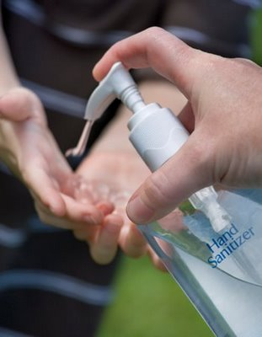
What is Hand Hygiene?
Handwashing with soap and water
Antiseptic handwash
Alcohol-based hand rub
Surgical antisepsis
Notes:
When we use the term hand hygiene it could mean or include several different things including:
routine hand washing with soap and water
antiseptic hand wash,
antiseptic hand rub,
or surgical hand antisepsis.

Slide 12

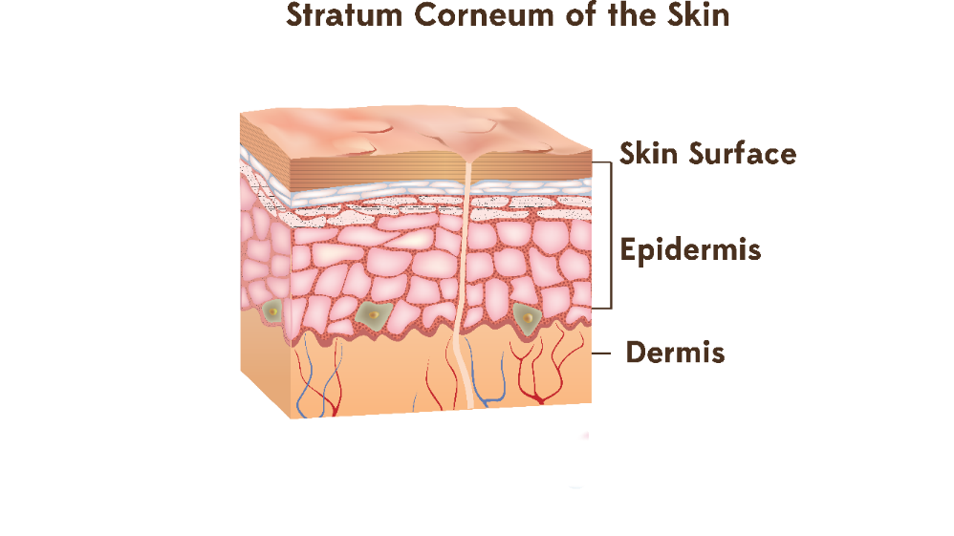

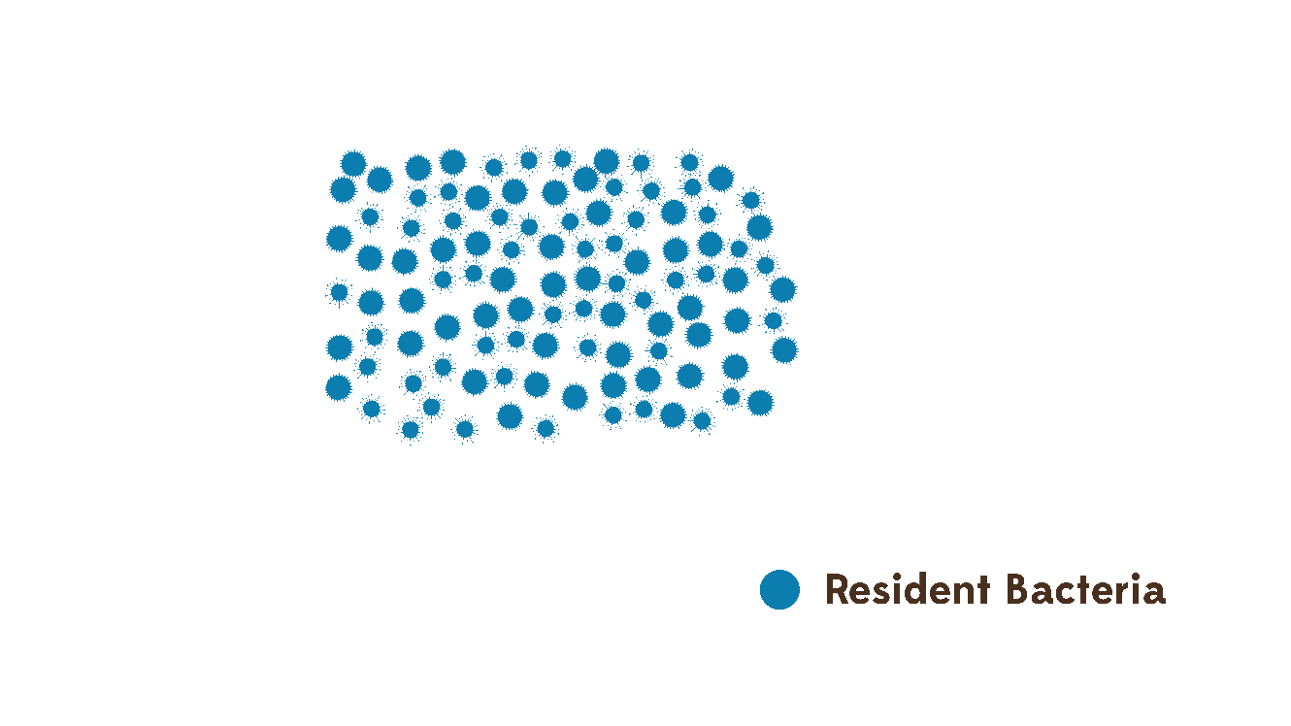
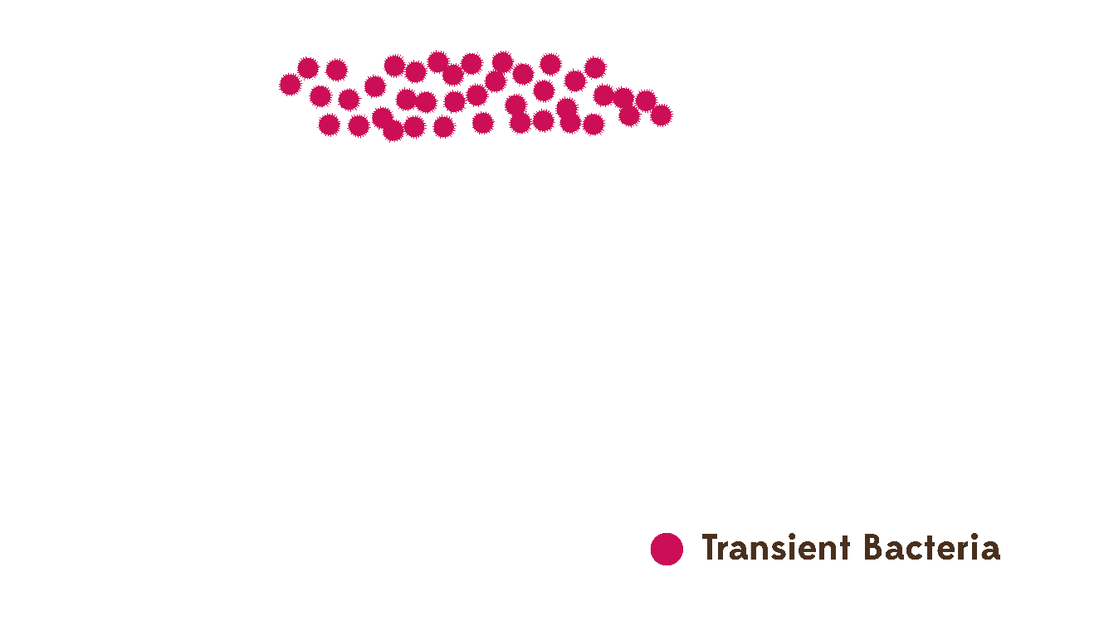


Role of Hand Hygiene
Notes:
Hand hygiene substantially reduces the number of infectious agents on the hands and is considered the most important way to prevent the spread of infection.
CLICK
All of us have two types of bacteria on our hands:
CLICKs
1. Normal resident bacteria that generally live in deeper layers of skin and are not likely to be removed during routine hand hygiene and
2. Transient bacteria that we generally pick up by touching patients, medical devices and the environment. Transient bacteria are more likely to be the cause of healthcare associated infections but can be removed by performing appropriate hand hygiene

Slide 13
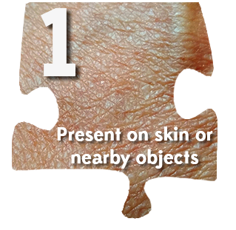




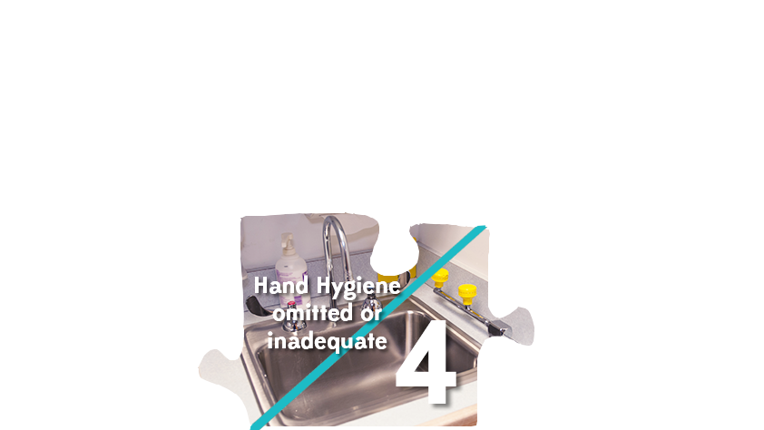
Role of Hand Hygiene
Notes:
Before the hands of healthcare providers can be implicated as the source of transmission of health care-associated infections, five elements must be in place:
CLICKs
1. Organisms are present on the patient’s skin, or have been shed onto inanimate objects immediately surrounding the patient;
2. Organisms must be transferred to the hands of the healthcare provider;
3. Organisms must be capable of surviving for at least several minutes on the healthcare provider’s hands;
4. Hand washing or hand antisepsis by the healthcare provider must be inadequate or entirely omitted, or the agent used for hand hygiene
inappropriate; and
5. The contaminated hand or hands of the caregiver must come into direct contact with another patient or with an inanimate object that will come into direct contact with the patient.

Slide 14

Reasons For Noncompliance
Hand hygiene has long been a foundational component of infection prevention in all healthcare settings; however, adherence by health care personnel to hand hygiene protocols has been an ongoing challenge, complicated by the lack
of a national standard for measurement and increasingly
complex care environments.
Inaccessible hand hygiene supplies
Skin irritation
Too busy
Glove use
Didn’t think about it
Lacked knowledge
Notes:
Hand hygiene has long been a foundational component of infection prevention in all healthcare settings; however, adherence by healthcare personnel (HCP) to hand hygiene protocols has been an ongoing challenge, complicated by the lack of a national standard for measurement and increasingly complex care environments. (Reference: 2022 SHEA/IDSA/APIC Practice Guidelines)
Some of the most frequent reasons given for the lack of hand hygiene were:
CLICKs
products were inaccessible,
the products caused skin irritation,
healthcare providers were too busy, and it interfered with patient care,
they were wearing gloves and felt hands were not contaminated,
they just didn’t think about it, and
they lacked the knowledge of when and how to perform hand hygiene.
To address some of these issues alcohol based handrubs were included in the 2002 CDC Hand Hygiene guidelines

Slide 15
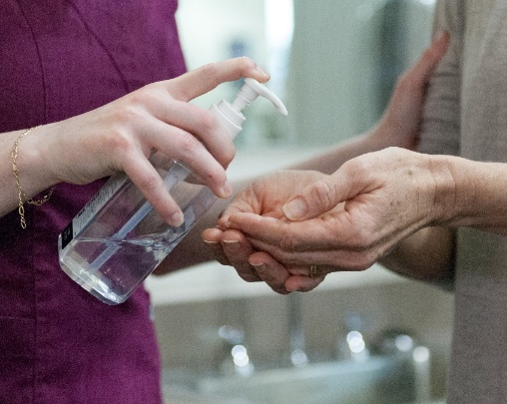

Potential Advantages Alcohol-based Handrubs
Requires less time than hand washing
Acts quickly to kill microorganisms on hands
More effective than hand washing with soap and water
More accessible than sinks
Less irritating to skin than soap and water and can even improve condition of skin
Important note:
Non-alcohol-based hand sanitizers should NOT be used in clinical settings
Notes:
Alcohol-based handrubs have several potential advantages when compared to soap and water. Some of those advantages include:
CLICKs
Less time for the entire process 50-60 seconds for soap and water versus 20-30 seconds for ABHR
Alcohol acts quickly to kill microorganisms and more effective than soap and water
Placement can be more accessible to point of care
Alcohol HBRs are less irritating to the skin and will often improve the condition of the skin
IMPORTANT TO NOTE: NON-ABHRS SHOULD NOT BE USED IN CLINICAL SETTINGS

Slide 16


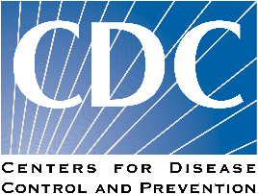
When to Perform Hand Hygiene
The 5 Moments WHO | Consensus recommendations CDC Guidelines on Hand Hygiene in healthcare, 2002
Before touching a patient | Before and after touching the patient
Before clean / aseptic procedure | Before donning sterile gloves for central venous catheter insertion; also for insertion of other invasive devices that do not require a surgical procedure using sterile gloves If moving from a contaminated body site to another body site during care of the same patient
After body fluid exposure risk | After contact with body fluids or excretions, mucous membrane, non-intact skin or wound dressing If moving from a contaminated body site to another body site during care of the same patient After removing gloves
After touching a patient | Before and after touching the patient After removing gloves
After touching patient surroundings | After contact with inanimate surfaces and objects (including medical equipment) in the immediate vicinity of the patient After removing gloves
Notes:
If you recall from module C, the World Health Organization has identified five moments of hand hygiene. The CDC issues its own guidelines. Here’s how the two compare. This table provides a comparison between the World Health Organization’s 5 Moments of Hand Hygiene and the Center for Disease Control’s Guidelines on Hand Hygiene.
Links to both recommendations are on your resource page

Slide 17
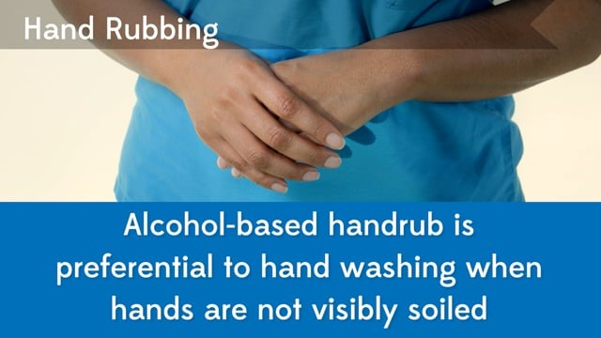
How To Hand Rub
Notes:
CLICK to play video
This is the narration on the video:
The use of an alcohol-based hand rub is preferential to hand washing when hands are not visibly soiled
Here are the proper steps for hand rubbing.
Apply a handful of product in a cupped hand and cover all surfaces.
Start by rubbing hands palm to palm.
Next place your left hand over the back of your right hand and interlace your fingers.
Repeat for the other hand.
Then rub palm to palm with interlaced fingers.
Rub the back of your fingers by bending and interlocking so the palm of each hand contacts the fingers of the other.
Grasp each thumb and rotate within the opposite hand.
Rotate the ends of your fingers in the opposite palm.
The entire hand rubbing procedure should take 20-30 seconds.

Slide 18
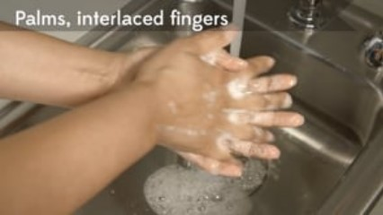
How To Hand Wash
Notes:
CLICK to play video
This is the narration on the video:
Hand washing with soap and water should be used when hands are visibly soiled or contaminated and after providing care for patients with diarrhea.
Here are the proper steps for hand washing.
Wet hands with water.
Apply enough soap to cover all hand surfaces.
Start by rubbing hands palm to palm.
Next place your left hand over the back of your right hand and interlace your fingers.
Repeat for the other hand.
Then rub palm to palm with interlaced fingers.
Rub the back of your fingers by bending and interlocking so the palm of each hand contacts the fingers of the other.
Grasp each thumb and rotate within the opposite hand.
Rotate the ends of your fingers in the opposite palm.
Rinse with water.
Dry thoroughly with a single-use towel.
Use the towel to turn off the faucet.
The entire hand washing procedure should take 40-60 seconds.

Slide 19
CDC Guideline for hand hygiene in healthcare setting
Hand Hygiene Program Additional Elements
Involve staff in evaluation and selection of hand hygiene products
Provide employees with hand moisturizers compatible with all hand hygiene products and with gloves
Do not wear artificial nails when providing direct clinical care
Provide hand hygiene education to staff
Monitor staff adherence to recommended HH practices
Notes:
Some additional elements to include in your hand hygiene program are:
Involving staff in the selection and evaluation of your hand hygiene products
Hand moisturizers that are compatible with soaps, ABHRs and gloves should be provided as well.
Artificial nails and long natural nails should not be worn when providing direct patient care
Hand hygiene education should be provided at time of hire and no less than annually
Compliance with recommended HH practice should be monitored and findings reported back to staff on a routine basis.

Slide 20
Summary of Hand Hygiene
Hand hygiene must be performed exactly where you are delivering healthcare to patients (at the point-of-care).
During healthcare delivery, there are 5 moments (indications) when it is essential that you perform hand hygiene.
To clean your hands, you should prefer hand rubbing with an alcohol-based formulation, if available. Why? Because it makes hand hygiene possible right at the point-of-care, it is faster, more effective, and better tolerated.
You should wash your hands with soap and water when visibly soiled.
You must perform hand hygiene using the appropriate technique and time duration.
Notes:
Now let’s summarize:
CLICKs
hand hygiene should occur where care is delivered,
There are 5 moments or indications when hand hygiene should be performed
Hand rubbing with an alcohol based handrub is preferred for most clinical situations
Soap and water should be used when hands are visible soiled.
You must perform hand hygiene using the appropriate technique and time duration.

Slide 21

Knowledge Check
True or False:
Hand washing with soap and water is always the preferred method of hand hygiene
True
False
Notes:
CLICK for answer The answer is false: The use of an alcohol-based hand rub is preferential to hand washing unless hands are visible soiled.

Slide 22

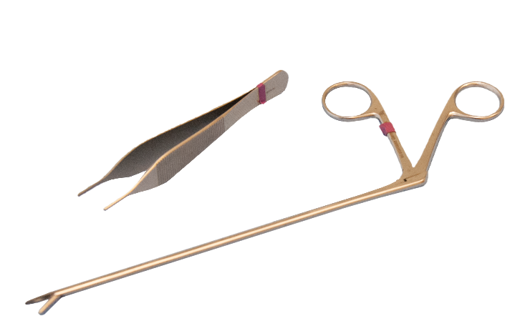
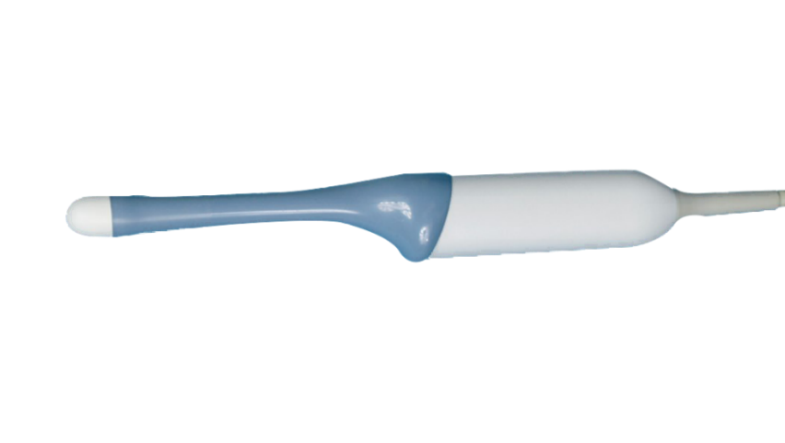
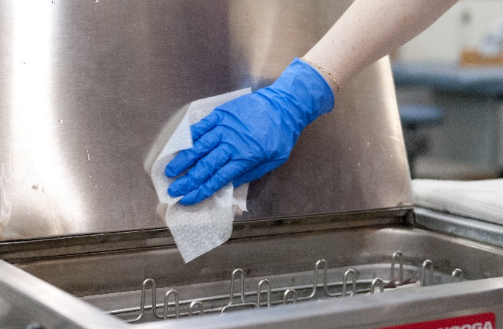
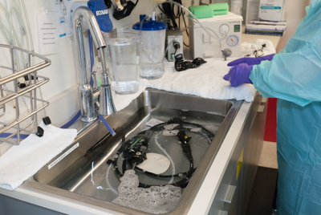
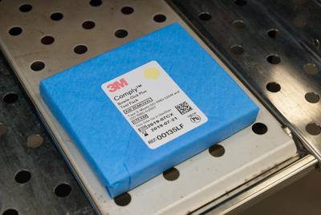
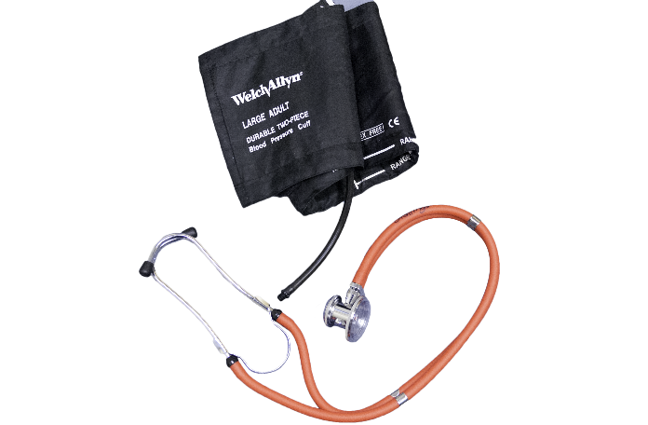
Role of the Environment
Critical
Semi-Critical
Non-Critical
Spaulding Classification of Surfaces:
– Objects which enter normally sterile tissue or the vascular system and require sterilization
– Objects that contact mucous membranes or non-intact skin and require high-level disinfection
– Objects that contact intact skin but not mucous membranes, and require low or intermediate-level disinfection
Require
Sterilization
High level
disinfection
Low level disinfection
Disinfection and Sterilization of Equipment and Environment
How to clean/disinfect: item use + item contact
Notes:
Another component of both medical and surgical asepsis is cleaning and disinfection/sterilization of patient care equipment and the environment. The easiest and most simple way to remember how to clean or disinfect a surface is to think about what that item is used for and what it comes in contact with. Disinfection and Sterilization is covered in much more detail in Module F.
CLICK
The Spaulding classification scheme is used to classify surfaces and objects in healthcare based on intended use and type of disinfection they require.
For example:
CLICKs
Critical objects, like surgical instruments require sterilization;
Semi-critical objects , like vaginal or rectal probes require high-level disinfection; and
Non-critical objects, like exam tables and blood pressure cuffs, require only low-level disinfection.
Most patient care items used by home health health/hospice are either disposable or non-critical, therefore sterilization and high-level disinfection are not typically performed.

Slide 23
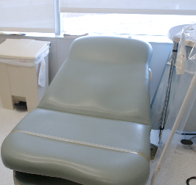
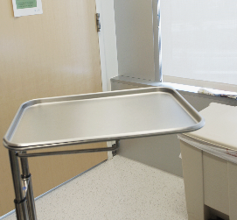
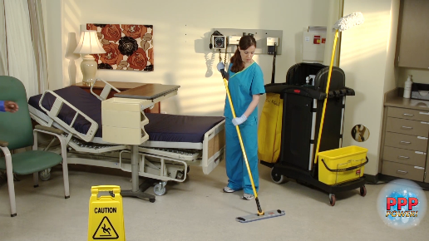
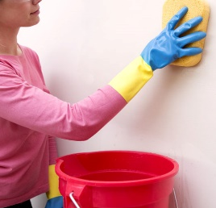
Role of the Environment
 | Housekeeping
Clinical
High potential for direct contamination
Spray or splatter
Frequent contact with healthcare personnel’s hands
No direct contact with patients or devices
Little risk of transmitting infections
It is IMPORTANT TO REMEMBER THAT WHEN items used in the care of the patient touch or fall on the floor, they are potentially contaminated and should be cleaned/disinfected prior to use. If the item cannot be cleaned (gauze dressing for example) it should be discarded.
Notes:
All healthcare facilities have both clinical contact surfaces and housekeeping surfaces.
CLICK Clinical contact surfaces have a high potential for direct contamination from both patient secretions, especially during procedures that generate spray or splatter and frequent contact with healthcare personnel’s hands.
CLICK Housekeeping surfaces generally have no direct contact with patients or medical devices and have little risk of transmitting infections.
CLICK It is IMPORTANT TO REMEMBER THAT WHEN items used in the care of the patient touch or fall on the floor, they are potentially contaminated and should be cleaned/disinfected prior to use. If the item cannot be cleaned (gauze dressing for example) it should be discarded.

Slide 24


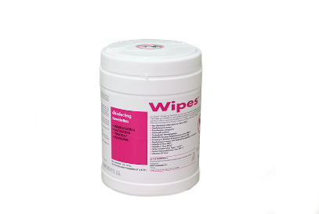
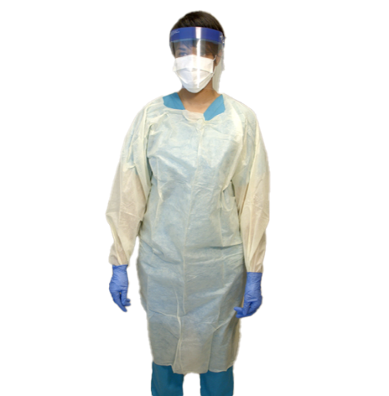
Role of the Environment
Key points to address regarding cleaning/disinfectant products:
Have policies and procedures in place on how products will be selected
Always follow manufacturer's instructions for use or IFUs, including complying with the recommended contact time
When canisters of disposable wipes are used ensure, lid remains closed when not in use
Wear appropriate PPE as directed by manufacturer's instructions for use
IFU
Notes:
We have talked about the practice of environmental cleaning but there are key points we need to address regarding cleaning/disinfectant products.
First: Your facility should have policies and procedures in place on how disinfectant products are selected. They should be EPA registered, with a kill claim against a broad range of microorganisms (i.e., MRSA, VRE). All this information will be on the disinfectant label.
Second: Always follow manufacturer’s instructions for use or IFUs, including complying with the recommended contact time. The product should keep surfaces wet enough to meet recommended contact times with a single application. This is critically important to ensure appropriate disinfection has occurred.
Third: There are many methods for disinfection available, including cotton cloths, microfiber and disposable wipes. When canisters of disposable wipes are used ensure, the lid is securely closed when not in use (i.e., to prevent wipes from drying out)
Lastly: Wear appropriate PPE as directed by the manufacturer’s instructions for use (IFUs) and based on the potential for exposure to blood /body fluids. Always use hand hygiene after PPE is removed.

Slide 25
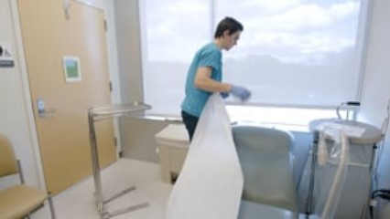
Room Cleaning
Notes:
CLICK to play video
This is the narration on the video:
When cleaning a room that has been occupied by a patient, it is important to use the correct procedure for cleaning
First cleaning/disinfecting of surfaces should move from clean to dirty to avoid possible contamination of surfaces that may not be soiled.
Prevent contamination of solutions (for example do not re-dip a cloth)
Do not use wipes that are dried out
Physical removal of soil is essential to remove organisms from the surface
Staff should know and follow the contact time recommended by the manufacturer.
Monitor the cleaning and disinfection process and report findings to staff

Slide 26
Knowledge Check
True or False:
Because of the increasing number of resistant organisms all environmental surfaces should be disinfected with bleach
True
False
Notes:
The answer is false: The type of disinfectant is determined by the specific circumstances of each situation

Slide 27
Knowledge Check
Which of the following is NOT a component of asepsis
Hand hygiene
Environmental cleaning
Droplet Precautions
Separation of clean, dirty and sterile items
Notes:
The answer is C, Droplet precautions: Hand hygiene, environmental cleaning and separation of clean, dirty and sterile items are all components of asepsis.

Slide 28



Notes:
Before me move on to the next module, are there any additional questions regarding Principles of Asepsis

