Slide 1

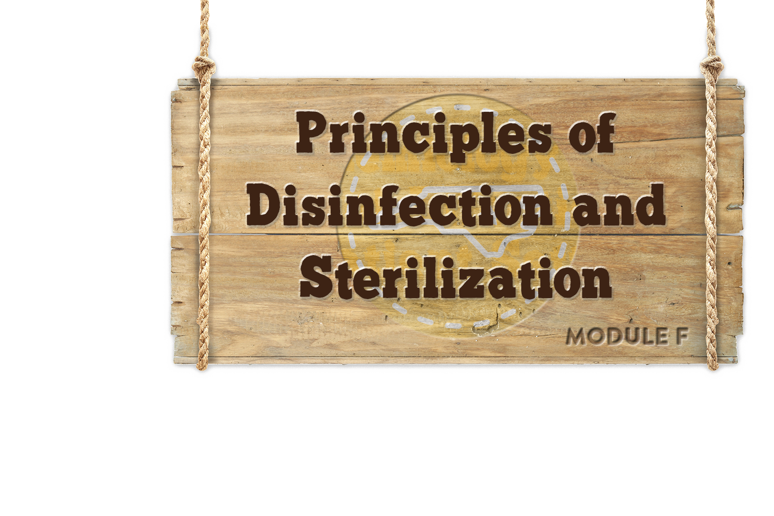


Module F
Statewide Program for Infection Control and Epidemiology (SPICE)
UNC School of Medicine
Notes:
NOTE TO PRESENTER: Whenever you see CLICK in bold, you must click to animate in the next part of the slide. When you see AUTO, no clicks are needed, the segments will automatically advance.
If nothing is bolded there is no animation in that slide.

Slide 2
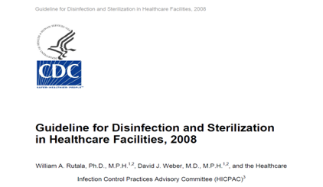



Objectives
Describe the principles of disinfection and sterilization
Provide an overview of Spaulding’s classification
Discuss training and quality control methods and required documentation
Notes:
The objectives for this module are to:
Describe the principles of disinfection and sterilization
To provide an overview of current methods for disinfection and sterilization per CDC recommendations,
And to discuss the training and quality control methods required to maintain proper standards
CLICK
In 2008 the CDC published
“Guidelines for Disinfection and Sterilization in Healthcare Facilities”. The link is included on your resource page

Slide 3


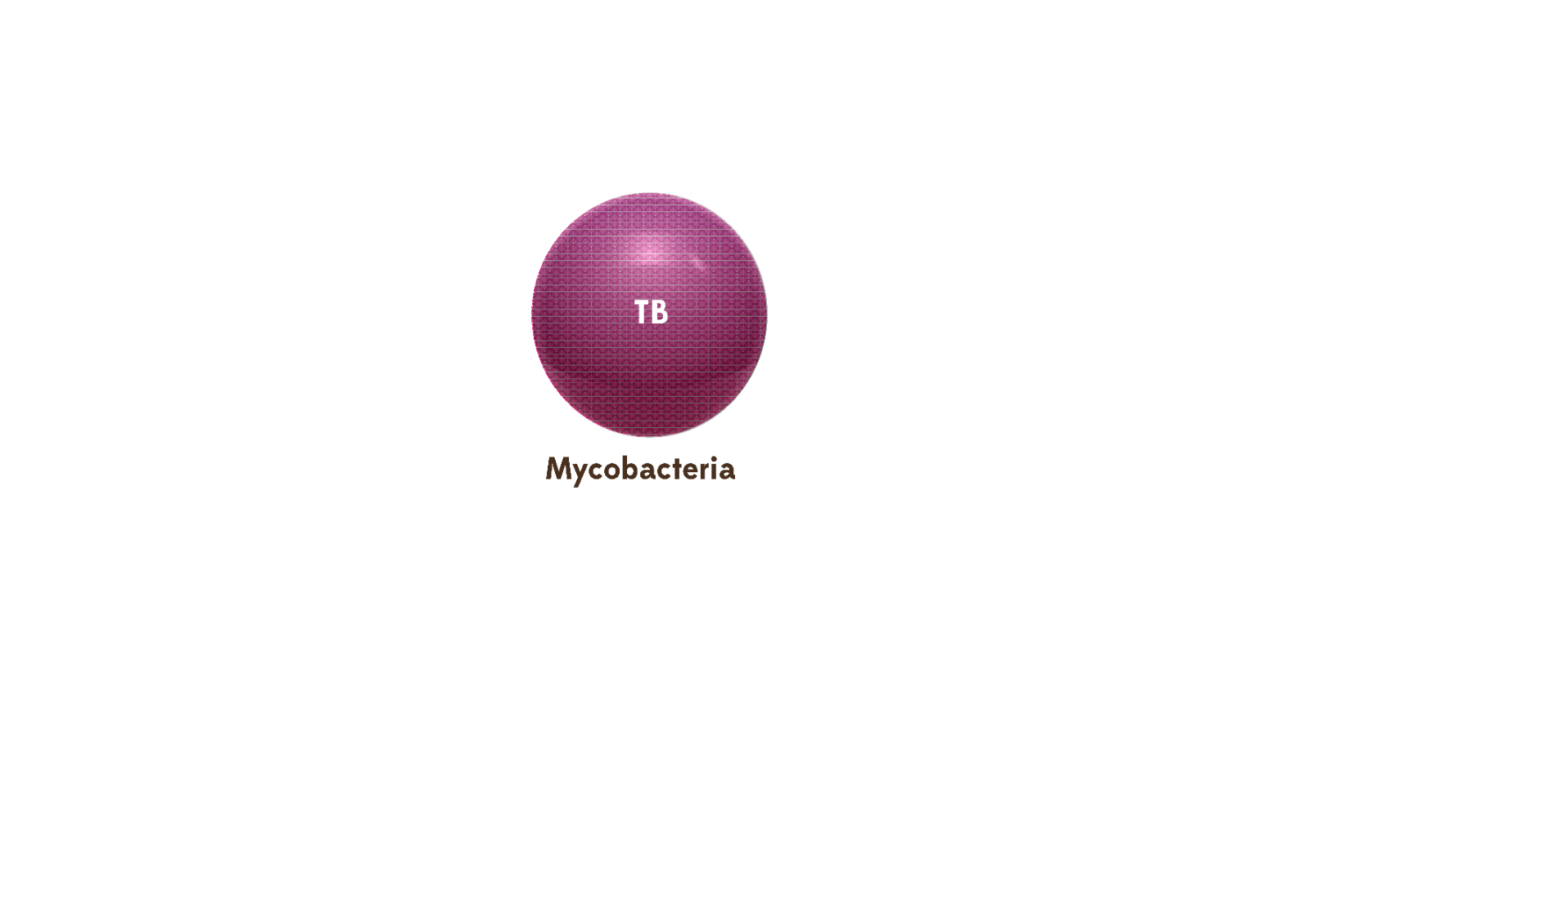
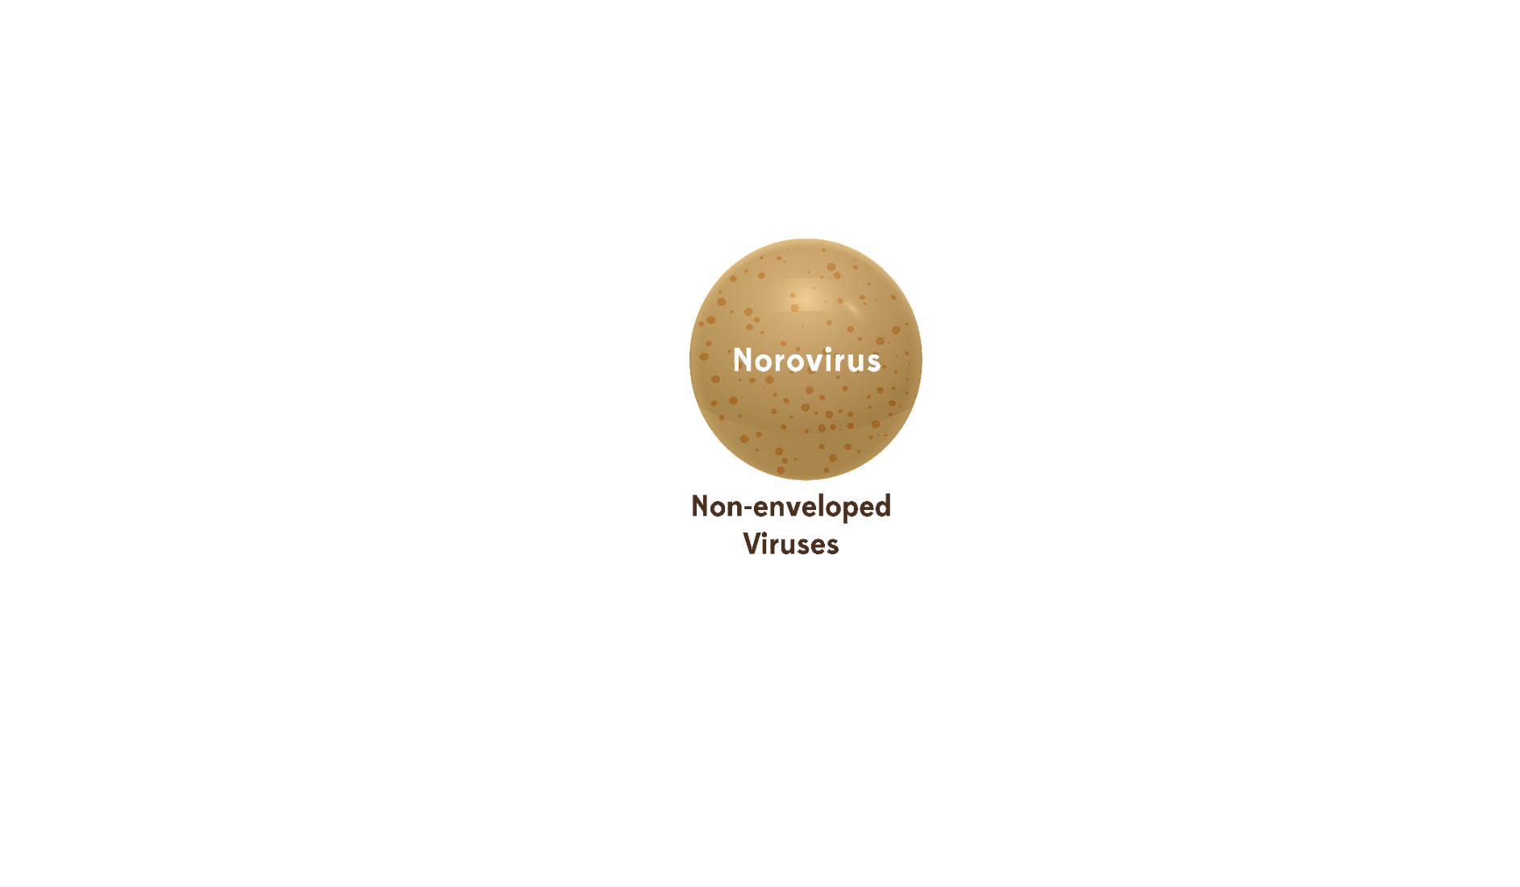
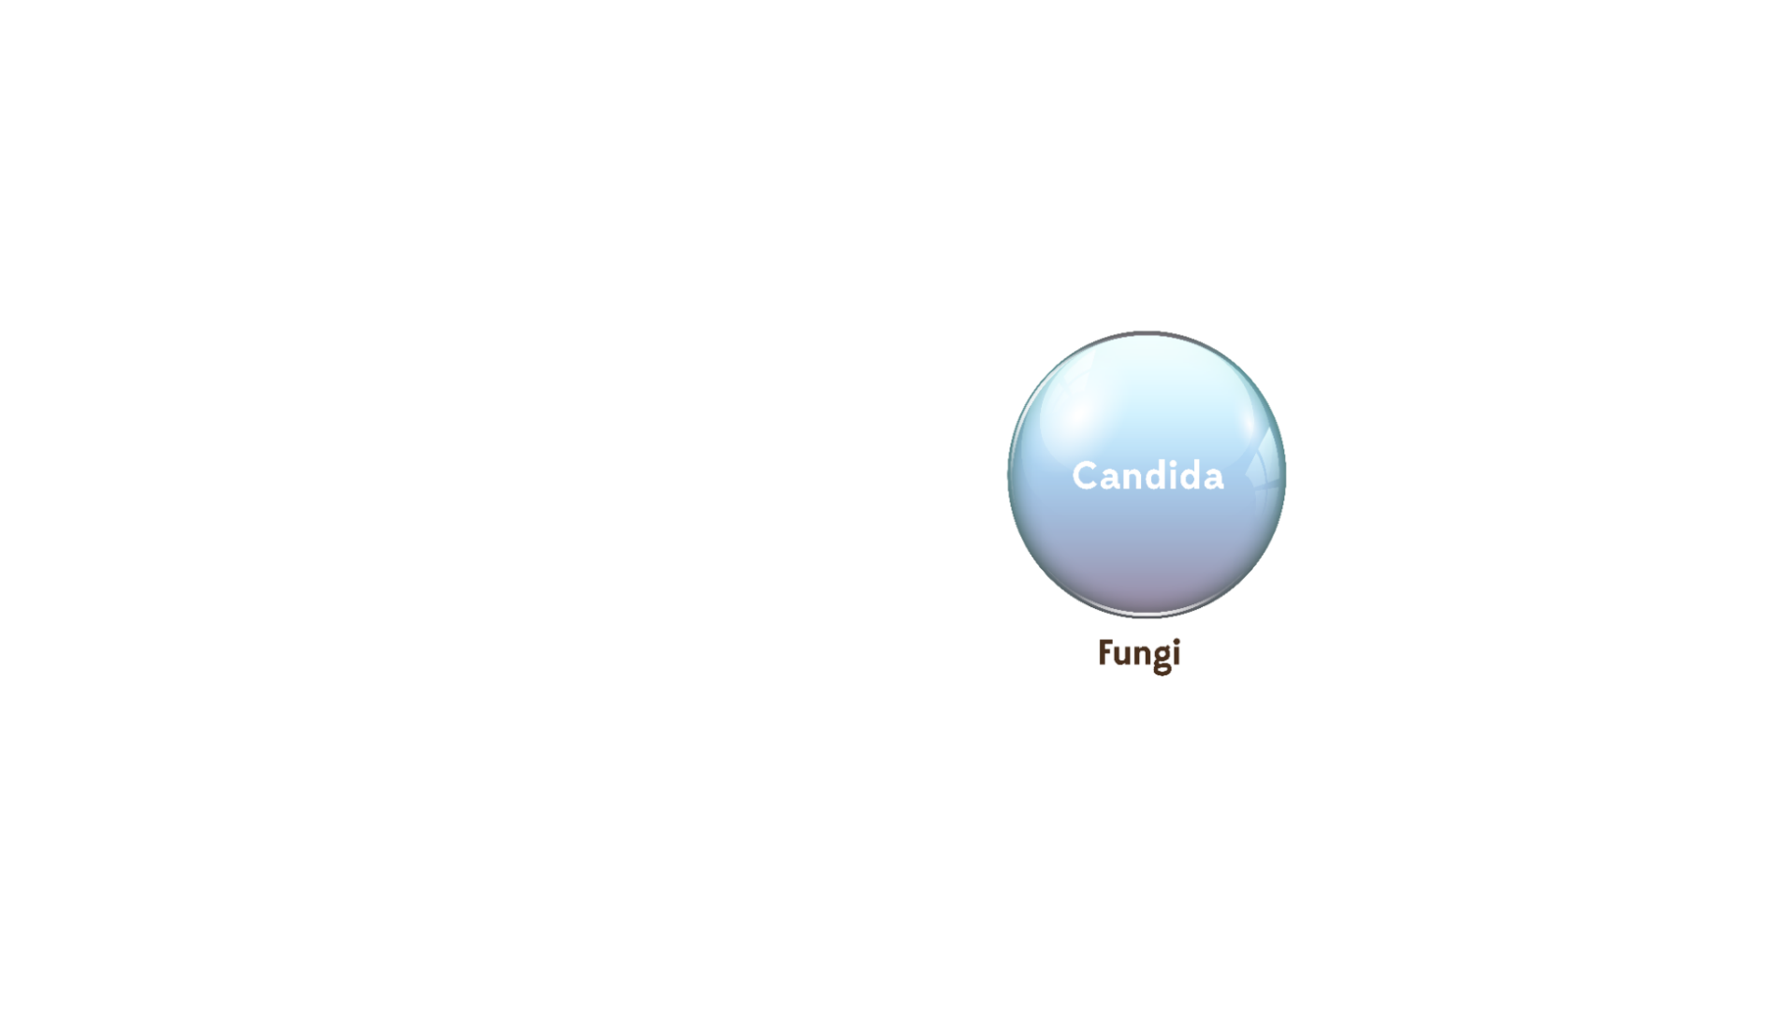
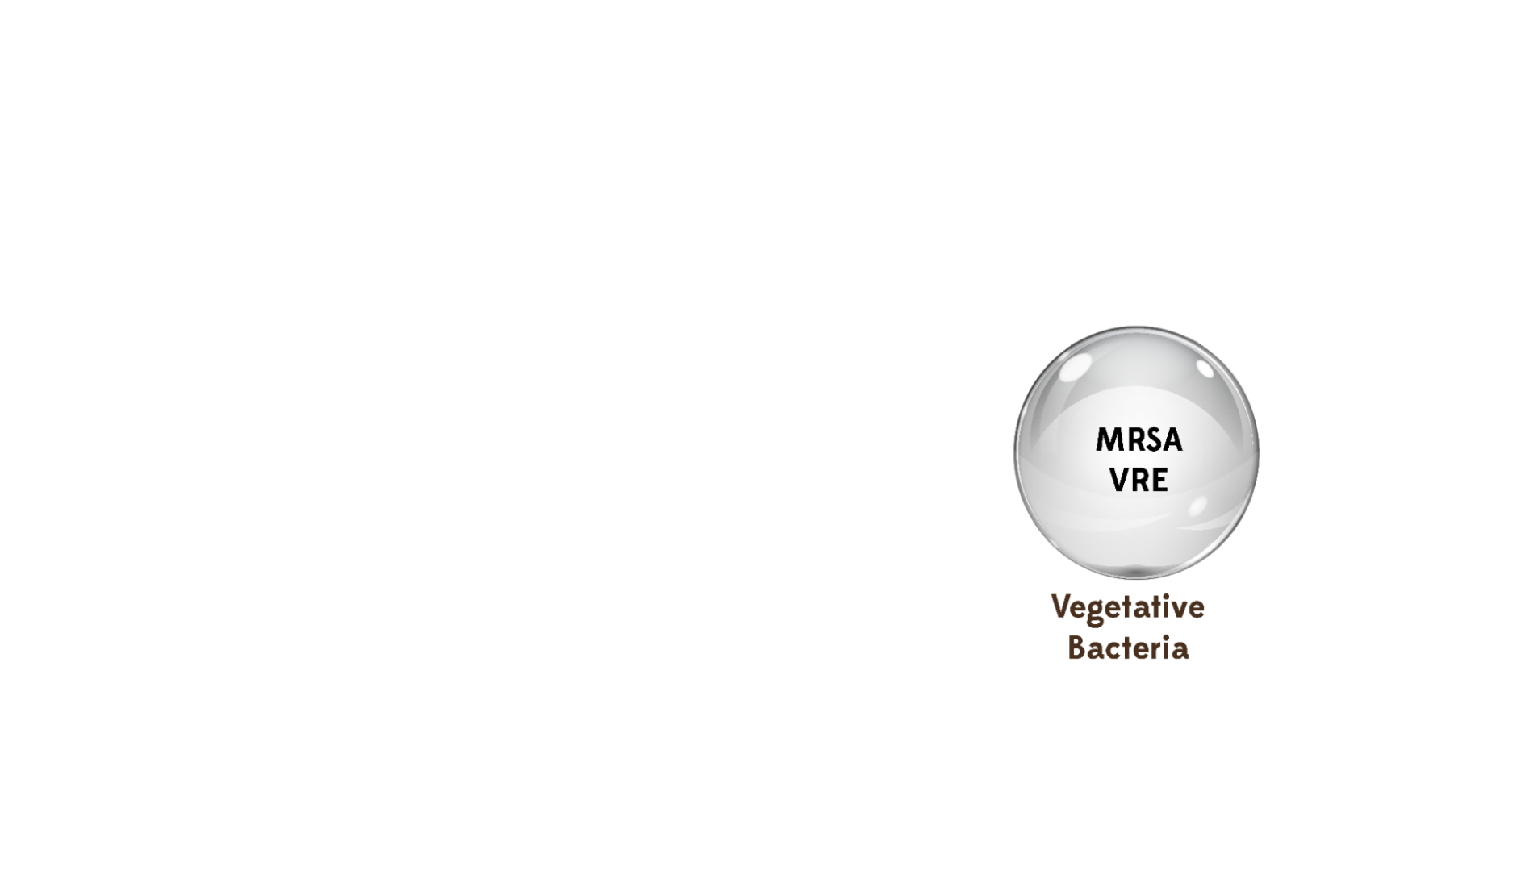
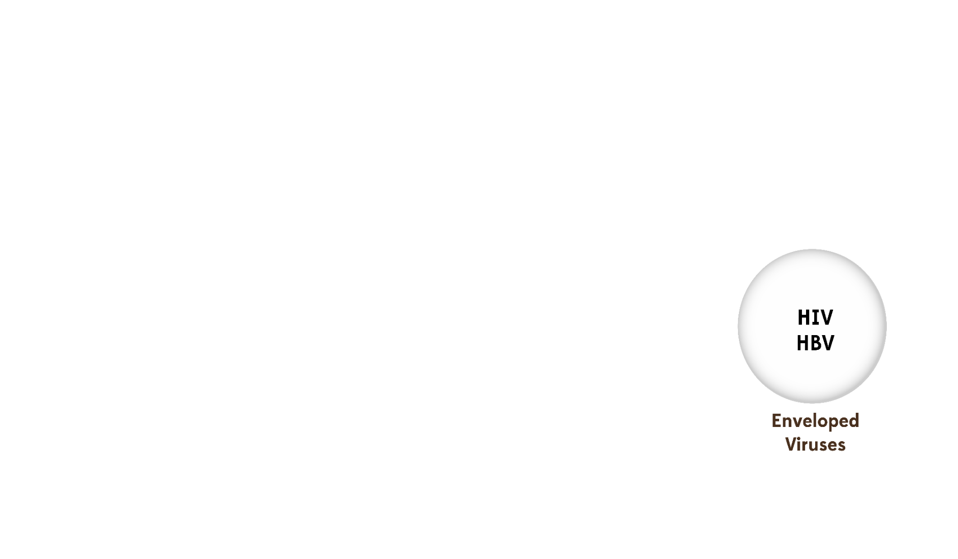




Objectives
Norovirus
Alcohol resistant
Hardest to Kill
HIV
HBV
Easiest to Kill
Prions
Spores
Resistant to
disinfectants
Notes:
As we start our discussion it is important to remember that all microorganisms are not equal. Various types of microorganisms have differing levels of resistance to disinfectants and sterilants.
CLICK
The hardest microorganisms to kill are Prions. You will not likely encounter this
CLICK
The most resistant microorganism you are likely to encounter within your practice setting will be spores. These bacteria (like C. difficile) form hard protective coverings, which allow them to survive harsh conditions and be resistant to routine environmental disinfection products.
CLICK
Certain viruses, like norovirus, are not the hardest to kill but they are resistant to alcohols. This is important to know because alcohol-based hand rubs are widely used in healthcare but are not effective against norovirus.
CLICK
HIV and Hepatitis B are among the “easiest to kill” viruses

Slide 4
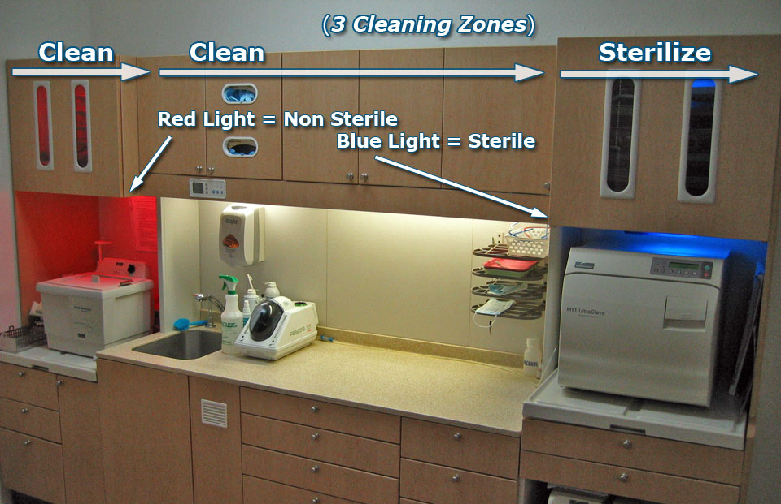






Principles
Packaging area
Inspecting
Assembling
Packaging
Sterilization/storage area
Sterilizers/supplies
Incubators
Enclosed storage
Notes:
Many facilities are challenged with space limitations when reprocessing reusable patient care items in compliance with CDC recommendations . In the next section, we will review the steps for sterile instrument processing. The room designated for sterile processing should be divided into three areas: Decontamination or instrument cleaning, instrument packaging, and sterilization and storage.
CLICKs
In the cleaning or decontamination area, reusable contaminated instruments are received, sorted, and cleaned
The packaging area is for inspecting, assembling, and packaging clean instruments in preparation for final sterilization
The sterilization and storage area contains the sterilizers and related supplies, incubators for analyzing spore tests, and can contain enclosed storage for sterile and disposable (single-use) items. Alternatively, storage can be in another designated room.

Slide 5

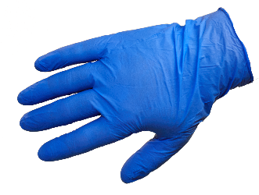
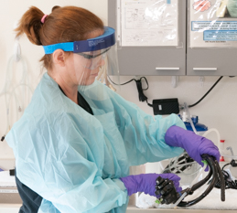
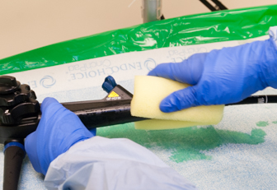
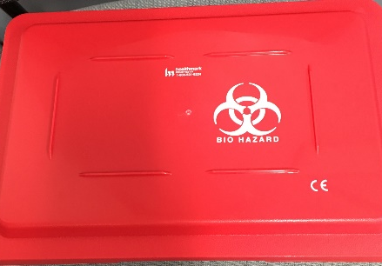
Principles
Management of reusable contaminated items:
      Handle as little as possible
      Use appropriate PPE
      Remove gross soil or debris at the point of use (gauze sponge moistened with water/disinfectant wipe for example)
      Immediately contain and transport to the decontamination area or soiled utility room where cleaning procedures can be accomplished away from patient care
Notes:
Once you have identified the location for re-processing contaminated items you need to have a policy and procedure on how those contaminated items are managed.
CLICKS
Contaminated reusable items should be:
Handled as little as possible
Staff should wear appropriate PPE
Gross debris should be removed at point of use
Soiled items should be removed immediately after use and not left in the patient care area

Slide 6
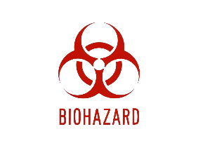
Principles
Transport of contaminated items:
Must be contained. The type of container depends on the item being transported:
  Puncture-resistant, leak-proof, closable containers must be used for devices with edges or points capable of penetrating container or skin
  Must have a bio-hazard label or be red in color (never via gloved hands alone)
Items should be kept moist during transport by adding a towel moistened with water (not saline) or a foam, spray or gel product specifically intended for this use
Avoid transporting contaminated items in a liquid
Reusable collection containers for holding contaminated items should be made of material that can be effectively decontaminated
Use separate collection containers for contaminated versus re-processed or clean items
Notes:
There are also several requirements that must be met when transporting instruments and/or medical devices that are contaminated.
CLICKs
Items must be transported in a container that is selected based on the type of contaminated item. Containers may include bins, trays and/or carts but must meet the requirements outlined on the slide
Items must be kept moist during transport but not submerged in a liquid and the collection containers should be made of material that can effectively be decontaminated
Avoid transporting contaminated items in a liquid
Reusable collection containers for holding contaminated items should be made of material that can be effectively decontaminated
Use separate collection containers for contaminated versus re-processed or clean items

Slide 7
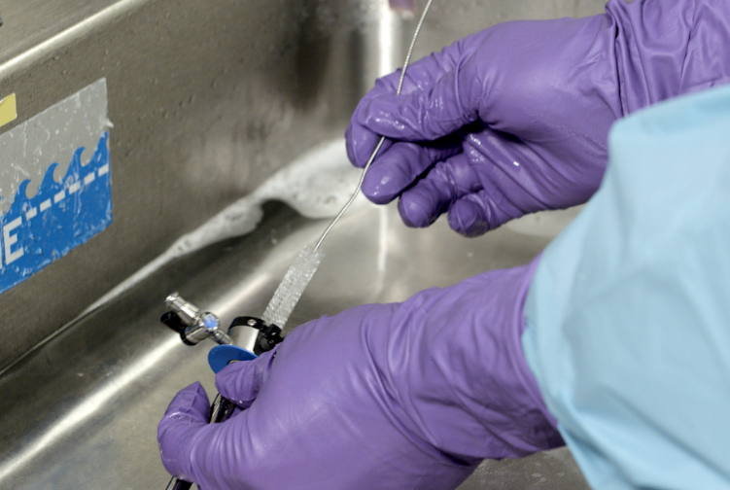
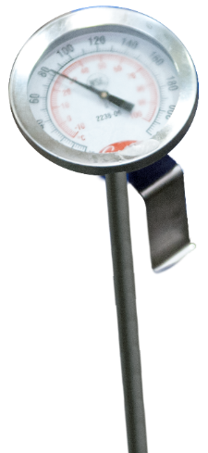
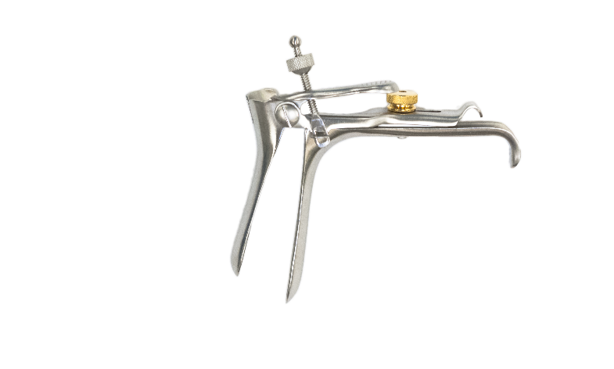
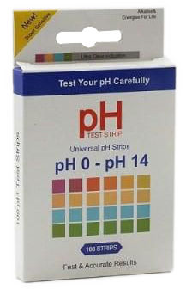
Principles
Factors influencing the efficacy of disinfection and sterilization
      How well the object is cleaned/type and amount of material
      Testing of the disinfectant
        Solution concentration
        Exposure time
      Design of object
      Temperature and pH of disinfectant
Notes:
There are numerous factors that can influence the effectiveness of the disinfection and sterilization process outcomes.
CLICKs
The most important factor is cleaning of the object to reduce the bioburden and remove the foreign materials (organic and inorganic salts) that can act as barriers and interfere with the disinfectant’s or sterilant’ s activity on the surface of the object. For instance, you would want to remove or pre-clean any instruments heavily contaminated with feces, sputum, blood or other secretions before sending it for reprocessing. Failure to do so could make it difficult to clean the items because of dried-on secretions.
Another very important factor to consider, and one that is often overlooked, is that the disinfectant or sterilant is tested to confirm that the concentration and contact time are appropriate and match the manufacturer’s instructions. Inadequate exposure to a disinfectant or sterilant can lead to residual contamination remaining on the item, which could be transmitted to another patient.
The nature of the object is also an important factor to consider when reprocessing. Does the item have hinges, crevices, lumens, or complex moving parts that require special attention or disassembly when cleaning and reprocessing?
The final factors to consider are the temperature and pH of the disinfectant or sterilant. Increases or decreases in theses factors can lead to improved or reduced activity of many disinfectants. Similarly, water hardness can reduce the rate of kill of some disinfectants. It is important these parameters are checked to ensure optimum kill activity of the disinfectant/sterilant.

Slide 8
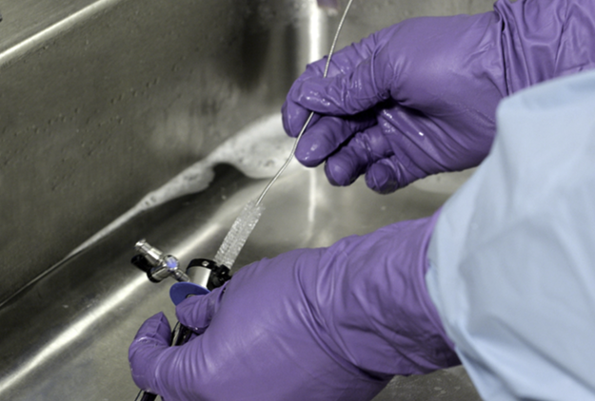
Cleaning Instruments - Manual
Medical equipment/devices MUST be pre-cleaned prior to high level disinfection or sterilization.
Contaminants such as dirt, blood or other body fluids, if present, can act as a barrier.
Notes:
Before anything is disinfected and sterilized, it is critical that the device or equipment is pre-cleaned.
When contaminants such as dirt, blood or other body fluids are present they can act as a barrier to disinfection or sterilization of the item. Cleaning and decontamination should be done as soon as possible after the items have been used to avoid allowing material to dry on the device
ALWAYS REMEMBER
Use all chemical disinfectants according to manufacturer's instructions for use, including immersion time.
A fluid-resistant gown should be worn
To avoid injury from sharp instruments, the provider should wear puncture-resistant, heavy-duty utility gloves, and proceed with care when handling or manually cleaning contaminated instruments and devices to avoid a percutaneous injury.
To protect against splashes, a facemask, and eye protection or face shield should be worn.
Medical devices may be pre-cleaned either manually or by an automated process.
In the outpatient setting manual cleaning is the most common. Steps for manual cleaning include:
Soaking the item in an enzymatic or non-enzymatic detergent solution per the manufacturer instructions
Scrubbing with a brush if necessary to remove all the material
Rinsing the equipment thoroughly
Wiping with a clean lint free towel, and
Allowing instruments to dry

Slide 9
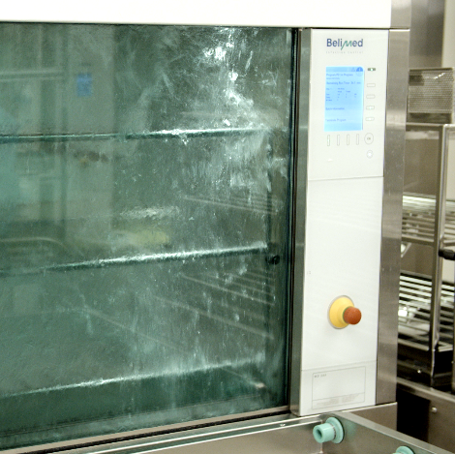
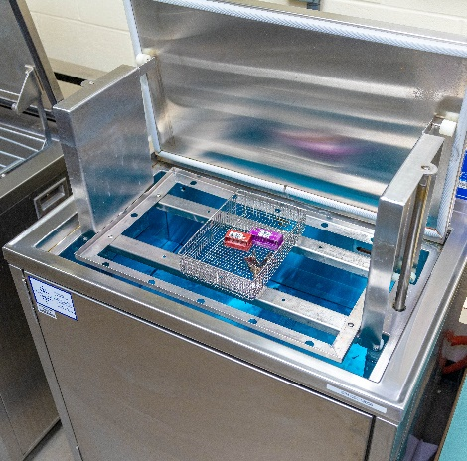
Cleaning Instruments - Automated
Benefits:
Improve efficacy of cleaning process
Reduce handling of sharp instruments
Reduce risk of employee exposure
Follow manufacturer’s recommendations:
Dilution
Temperature
Water hardness
Use
After cleaning, rinse with water
Automated cleaning equipment
Ultrasonic cleaner
Instrument washer
FDA regulated instrument washer
Notes:
The other and most efficient method of cleaning is using automated or mechanical cleaning equipment, such as ultrasonic cleaners, instrument washers, and washer-disinfectors.
CLICK
Automated cleaners:
Improve the efficacy of the cleaning process
Reduce the handling of sharp instruments.
Reduce the risk of employee exposure
CLICK
The manufacturer’s recommendations for dilution, temperature, water hardness, and use (designed for use in washer-disinfectors) should be followed.
CLICK
After cleaning, instruments should be rinsed with water to remove chemical or detergent residue.

Slide 10

Knowledge Check
Which of the following statements is true?
Manual cleaning of objects is safer than automated cleaning
Pre-cleaning is the most important factor in reprocessing objects
Objects do not need to be pre-cleaned if they are going to be sterilized
Household dishwashers can be used for pre-cleaning of instruments.
Notes:
CLICK for answer The correct response is B: precleaning is the most important factor in reprocessing objects

Slide 11
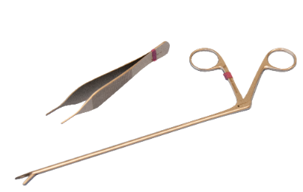
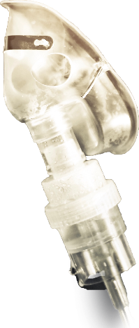
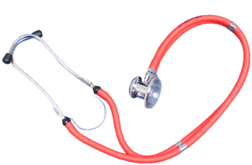
Spaulding Classification
Spaulding Classification of Surfaces:
– Objects which enter normally sterile tissue or the vascular system and require sterilization
– Objects that contact mucous membranes or non-intact skin and require high-level disinfection, which kills all but high-levels of bacterial spores
– Objects that contact intact skin but not mucous membranes, and require low-level disinfection
Critical
Semi-critical
Non-critical
Spaulding Classification
Notes:
Over 45 years ago, Dr. Earle Spaulding devised a rational approach to disinfection and sterilization of patient care items based on the item’s intended use. He categorized every patient care item into one of three categories based on risk:
CLICK
critical, semi-critical, and non-critical. The level of disinfection or sterilization depends on the categorical classification of the item. We are going to start with critical items.
CLICKs
These items contact sterile tissue, for example sterile instruments and must be sterilized
Semi-critical items that contact mucous membranes, or non-intact skin, require high-level disinfection;
and non-critical items that have contact only with intact skin, like stethoscopes, require low-level disinfection.
Sterilization and high-level disinfection are not frequently performed in the HD setting.

Slide 12
Processing Critical Instruments
Critical Items:
  Penetrate or enter normally sterile tissue or spaces, including the vascular system (Surgical instruments, cardiac catheters, IV devices, urinary catheters)
  High risk of transmitting infection if handled improperly
  Must be sterilized between uses or used as single-use disposable devices
Critical
Goal: Sterility = devoid of all microbial life
Notes:
As a reminder, critical items are those items that enter normally sterile tissue or spaces, including the vascular system. These items involve a high risk of infection and transmitting infection if handled improperly, so it is “critical” that they are sterilized between uses. Sterilization kills all microorganisms on the surface of the item being sterilized, rendering it safe to use again.

Slide 13

Knowledge Check
Patient care equipment and devices should be disinfected/sterilized based on:
Items intended use
What the item is going to contact
The number of patients you have scheduled for the day
What the physician tells you to do
Choose
1 and 4
2 and 4
1 and 2
3 and 4
Notes:
CLICK for answer The correct response is C. Use and contact are the basis for sterilization decisions

Slide 14
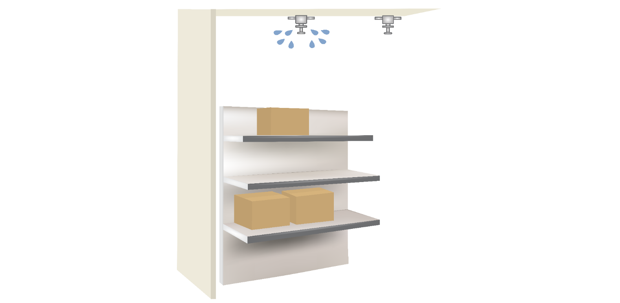




Storage Of Sterile Items
Ensure the sterile storage area is a well-ventilated area that provides protection against dust, moisture, and temperature and humidity extremes.
Sterile items should be stored so that packaging is not compromised.
Storage
Notes:
Make sure the storage area for sterile items provides protection against dust, moisture, and temperature and humidity extremes and follows these guidelines for spacing between items and the surrounding environment
CLICKs
8 inches from the floor
18 inches from ceiling if there is a sprinkler
2 inches from outside walls

Slide 15
General Guidelines
All patient care items must be stored at least 8” off the floor
Open rack storage should have a bottom shelf (plexi-glass for example) to prevent inadvertent contamination with floor cleaning
Stored at least 18” below the ceiling or the sprinkler head (according to fire code)
Stored at least 2” inches from outside wall
Items should be stored in areas of limited traffic
Stored in an area with controlled temperature and humidity
Outside shipping containers and corrugated cartons should not be used as storage containers
Items should not be stored under sinks or exposed water/sewer pipes
Windowsills should be avoided
Closed or covered cabinets are preferred
Storage
Notes:
In addition to the specific recommendations for storage of sterile items there are some general guidelines that should be followed for all healthcare equipment and supplies.
These guidelines are listed on the slide.

Slide 16
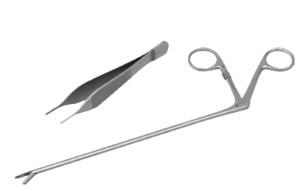

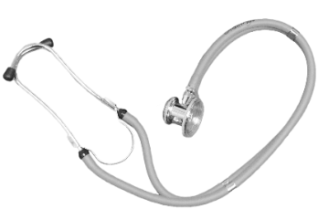
Spaulding Classification
Spaulding Classification of Surfaces:
– Objects which enter normally sterile tissue or the vascular system and require sterilization
– Objects that contact mucous membranes or non-intact skin and require high-level disinfection, which kills all but high-levels of bacterial spores
– Objects that contact intact skin but not mucous membranes, and require low-level disinfection
– Objects which enter normally sterile tissue or the vascular system and require sterilization
– Objects that contact mucous membranes or non-intact skin and require high-level disinfection, which kills all but high-levels of bacterial spores
Critical
Semi-critical
Non-critical
Semi-critical
Notes:
The next classification of medical devices/equipment we are going to discuss is semi-critical items.

Slide 17
Semi-critical Instruments
Semi-Critical Items:
  Contact mucous membranes or non-intact skin (respiratory therapy equipment etc.,)
  Risk of transmitting infection if handled improperly
  Must be high-level disinfected between uses or used as single-use disposable devices
Semi-critical
Goal: High-level disinfection = free of all
microorganisms except high numbers of bacterial spores
Notes:
Semi-Critical objects;
Have contact with mucous membranes or non-intact skin,
Risk transmitting infection if not handled properly and
Must be high-level-disinfected after each use.
The goal with respect to semi-critical objects is to remove all microorganisms except high numbers of bacterial spores

Slide 18
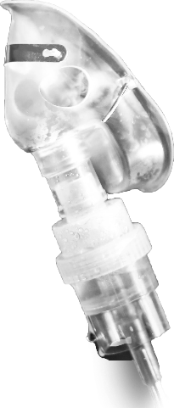
Spaulding Classification
Spaulding Classification of Surfaces:
– Objects which enter normally sterile tissue or the vascular system and require sterilization
– Objects that contact mucous membranes or non-intact skin and require high-level disinfection, which kills all but high-levels of bacterial spores
– Objects that contact intact skin but not mucous membranes, and require low-level disinfection
Critical
Semi-critical
Non-critical
Non-critical
Notes:
The final classification of medical devices/equipment is non-critical items.

Slide 19
Non-critical Instruments
Non-Critical Items:
  Objects that contact intact skin but not mucous membranes (BP cuffs, stethoscopes, dialysis bed or chair, external surfaces of dialysis machines,)
  Minimal risk of transmitting infection if handled improperly
  Must be low-level disinfected on a routine basis
Non-critical
Notes:
Non -Critical objects;
Have contact with intact skin and not mucus membranes, objects commonly seen in the hemodialysis setting include both patient care devices such as blood pressure cuffs, and stethoscopes; as well as patient environment, such as dialysis bed or chair, external surfaces of dialysis machines, and countertops.
Minimal risk of transmitting infection if not disinfected properly and
Must be low level disinfected on a routine basis

Slide 20
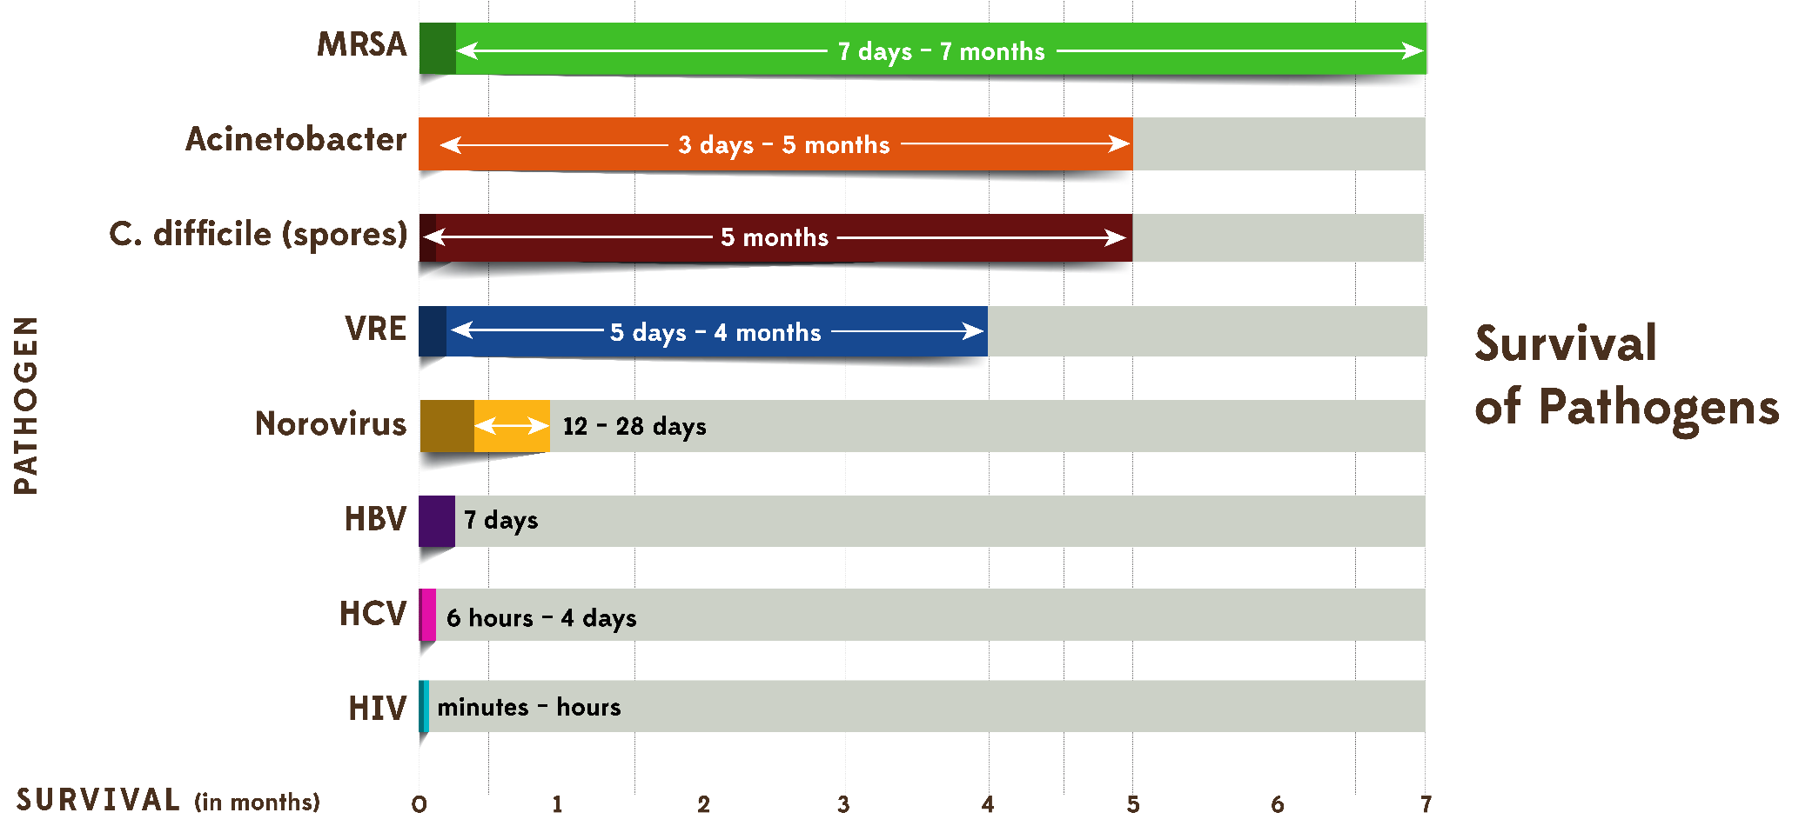
Role of the Environment
Non-critical
Notes:
According to numerous studies published in the literature, many pathogens can live from days to several months on dry surfaces. As you can see not all organisms are the same, some like MRSA can survive for long periods of time while HIV can only survive for a very short period.

Slide 21
Liquid Disinfectants
Disinfectant Agent | Use Concentration
Ethyl or isopropyl alcohol | 70% - 90%
Chlorine (bleach) | 100 ppm
Phenolic | UD
Iodophor | UD
Quaternary ammonium compound (QUAT) | UD
Improved/Accelerated hydrogen peroxide | 0.5%, 1.4%
Non-critical
UD = Manufacturer’s recommended use dilution
Notes:
These are examples of commonly used disinfectants in healthcare. A quaternary ammonium compound is a commonly used product, but there are new products on the market including an improved or accelerated hydrogen peroxide.
Most of these preparations come in ready to use forms that do not require any additional mixing of dilution.

Slide 22
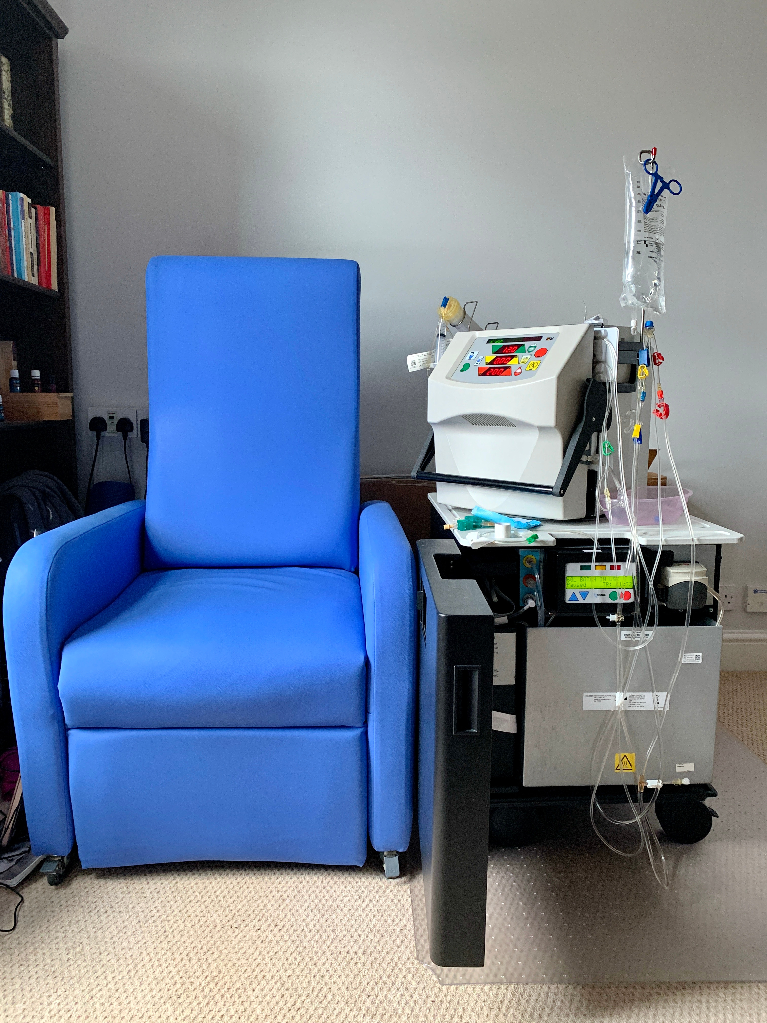
Properties of an Ideal Disinfectant
  Broad Spectrum
  Fast Acting
  Non-Toxic
  Surface Compatibility
  Easy to Use
  Acceptable odor
  Economical
Non-critical
Notes:
Here are some things to consider when selecting the “ideal” disinfectant for your specific practice:
The product should be broad spectrum and be effective against a wide range of organisms
It should be fast acting and nontoxic
It should be compatible with the surface of the object you are disinfecting
It should be easy for staff to use
It should not have any obtrusive odor and
It should be economical

Slide 23

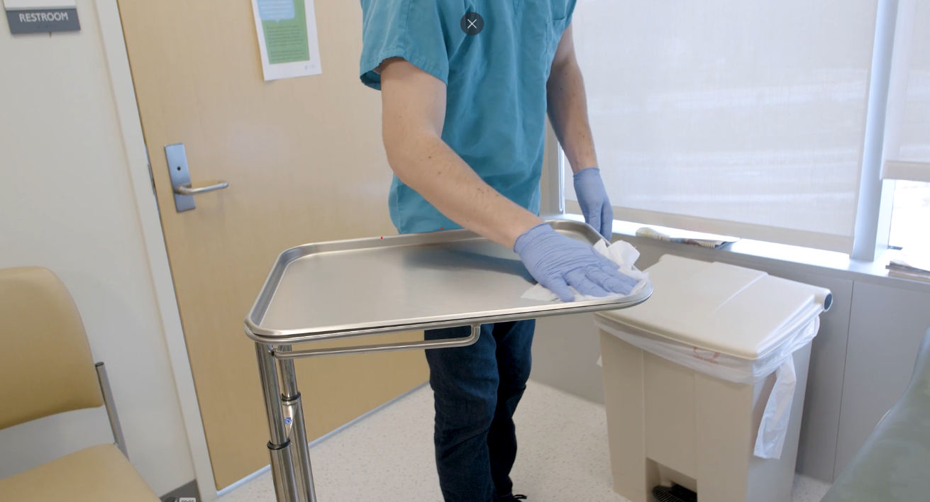
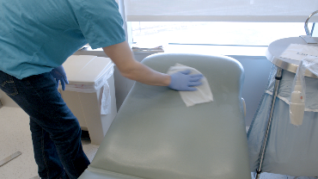
Other Environmental Issues
Blood and Body Fluid Spills
Contaminated work surfaces shall be decontaminated with an appropriate disinfectant
  After completion of procedures
  Immediately or as soon as feasible when surfaces are overtly contaminated
  After any spill of blood or other potentially infectious materials
  At the end of the work shift if the surface may have become contaminated since the last cleaning
When there are large spills of blood and/or body fluids it is important to clean or remove the spill prior to disinfecting the area
  The first step is to clean and decontaminate the area promptly.
  If the spill contains large amounts of blood or body fluids, clean the visible matter with disposable absorbent material, and discard the contaminated materials in appropriate, labeled container (treat as OSHA regulated medical waste)
  Use EPA-registered disinfectants labeled tuberculocidal or EPA registered germicides with specific label claims for HIV or hepatitis B virus (HBV) in accordance with label instructions to decontaminate spills of blood and other body fluids
  Use appropriate PPE
Notes:
Another important process to understand is how to clean-up blood and body fluid spills. OSHA requires, as part of the bloodborne pathogen standard,
CLICKs
Contaminated work surfaces shall be decontaminated with an appropriate disinfectant
after completion of procedures;
immediately or as soon as feasible when surfaces are overtly contaminated
or after any spill of blood or other potentially infectious materials;
and at the end of the work shift if the surface may have become contaminated since the last cleaning.
When there are large spills of blood and/or body fluids it is important to clean or remove the spill prior to disinfecting the area
The first step is to clean and decontaminate the area promptly.
If the spill contains large amounts of blood or body fluids, clean the visible matter with disposable absorbent material, and discard the contaminated materials in appropriate, labeled container (treat as OSHA regulated medical waste)•
Use EPA-registered disinfectants labeled tuberculocidal or EPA registered germicides with specific label claims for HIV or hepatitis B virus (HBV) in accordance with label instructions to decontaminate spills of blood and other body fluids.

Slide 24
Knowledge Check
Contaminated reusable items should be:
Handled as little as possible
Placed in a bio-hazard labeled container and left in room until end of the workday
Pre-cleaned in hand hygiene sink
Transported immediately after use and not left in the patient care area
Choose
1 and 3
3 and 4
1 and 4
1, 2, 3, 4
Notes:
CLICK for answer That’s right. Contaminated items should be handled as little as possible and transported immediately. They should never be left in the patient station

Slide 25


Training and Quality Control
  Provide comprehensive and intensive training for all staff assigned to reprocess medical/surgical instruments
  To achieve and maintain competency:
  Staff receive hands-on training
  Work with supervision until competency is documented
  Competency testing should be conducted at commencement of employment and no less than annually
  Training and competencies should be documented
Notes:
Regardless of the level of sterilization and/or disinfection preformed in your facility personnel performing these functions should receive comprehensive and intensive training.
CLICKs
For staff to achieve and maintain competency they should:
Receive hands-on-training
Work with supervision until competency is documented
Competency testing should be conducted at commencement of employment and no less than annually
Competency testing should be performed at least annually or more often if new responsibilities are introduced.
All training and competencies should be documented.

Slide 26
Training and Quality Control
Conduct infection control rounds no less than annually and more often if high risk area (dialysis stations)
Ensure all products used for disinfection and/or sterilization have been approved by infection prevention
Follow manufacturer instructions for use (IFUs)for preparation and packing of items
Notes:
As part of the quality control program:
Conduct infection control rounds at least annually in your facility and more often in your patient dialysis station
Ensure that all products used in the facility have been approved by designated individuals with oversight over infection prevention.
Follow manufacturer instructions for use for preparation and packing of items

Slide 27




