Slide 1





Module G
Module G
Notes:
Hi, welcome to Module G, Application of Asepsis, Cleaning, Disinfection, and Sterilization Principles

Slide 2

Objectives
Describe infection risks associated with home health hospice
Review infection prevention and control recommendations and guidelines for HHH settings ​
Notes:
We are going to Describe infection risks associated with home health hospice care and review infection prevention and control recommendations and guidelines for Home Healthcare and Hospice settings.
2

Slide 3
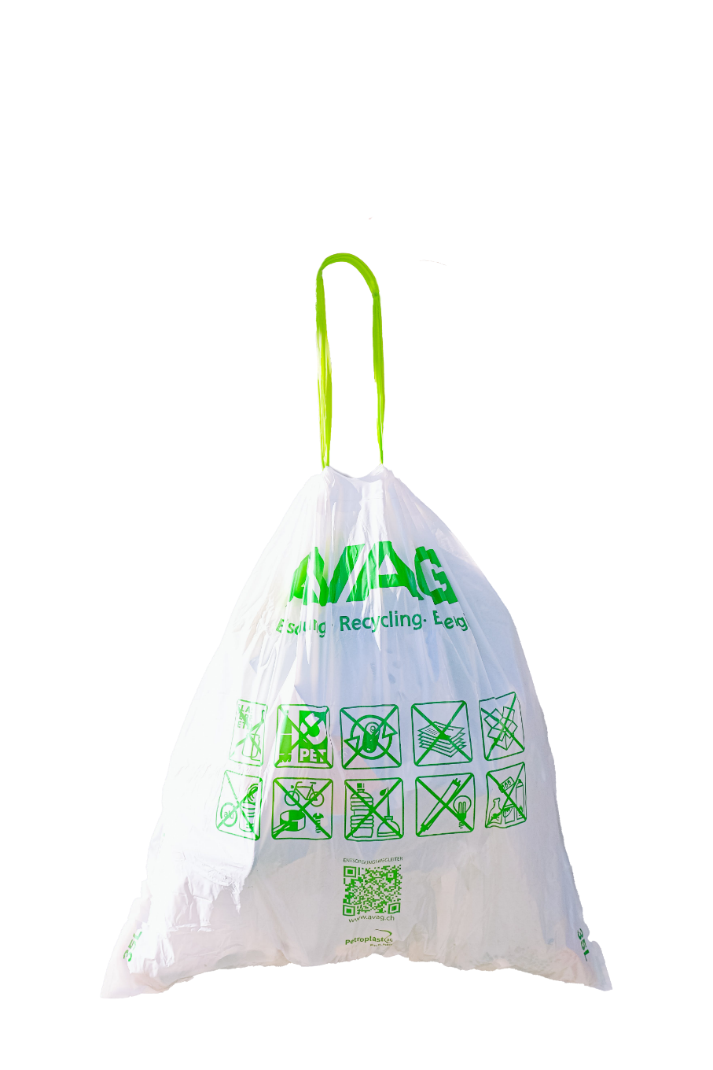


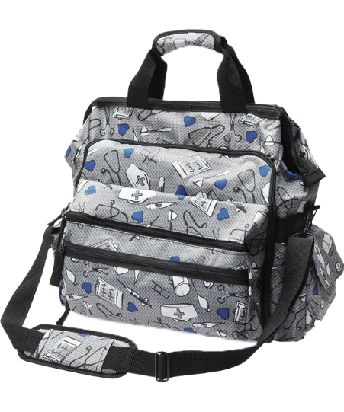
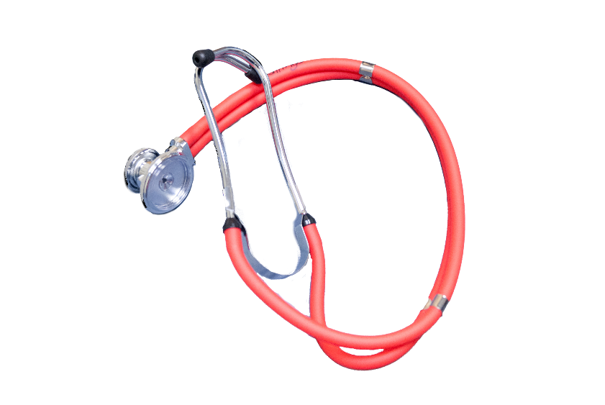

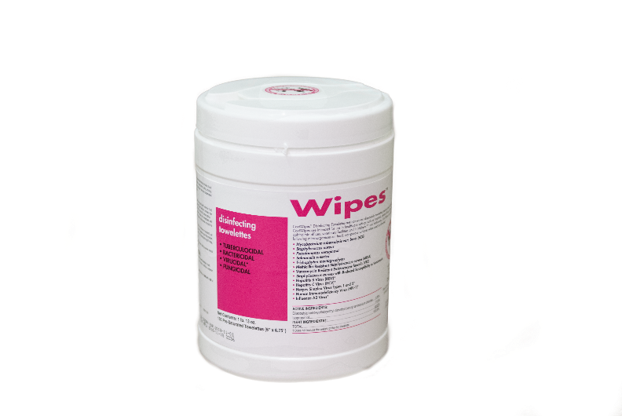




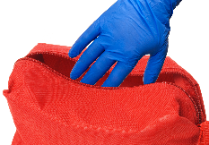
Supply and Equipment Management
If non-critical patient care equipment (such as a stethoscope) cannot remain in the home clean and disinfect items before removing using a low-to intermediate-level disinfectant.
Alternatively, place contaminated reusable items in a plastic bag for transport and subsequent cleaning and disinfection.
If the patient is known to be infected or colonized with a multi-drug resistant organism leave the equipment in the home until the patient discharges from home care services, if possible.
Sterile/clean equipment and supplies should be carried in nursing bag/plastic container
Perform hand hygiene
Carry only supplies needed
Be careful not to reach into bag with contaminated gloves
MDRO
Notes:
CLICKs
In Home and hospice care, sterile and clean supplies and equipment should be carried in a nursing bag or plastic container.
Health care workers should perform hand hygiene before removing any patient care supplies or equipment and
should only carry the supplies needed for that patient.
It is also important that providers are careful to never reach into the nursing bag with potentially contaminated gloves.
If the patient is known to be infected or colonized with a multi-drug resistant organism leave the equipment in the home until the patient discharges from home care services, if possible.
If non-critical patient care equipment (such as a stethoscope) cannot remain in the home clean and disinfect items before removing using a low-to intermediate-level disinfectant.
Alternatively, place contaminated reusable items in a plastic bag for transport and subsequent cleaning and disinfection
3

Slide 4
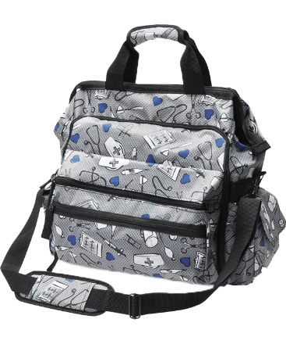



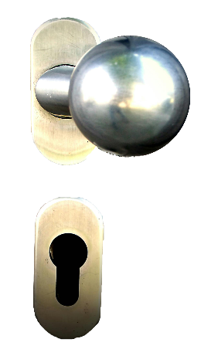


Home Care (Nursing) Bags
Non-critical item
Do not place on floor or another contaminated surface
Place on visibly clean, dry surface
If home infested place on doorknob or leave in car
If contaminated with blood/body fluids, decontaminate with EPA-registered disinfectant
Notes:
The home care bag itself is a noncritical item and does not have contact with the patient, though it may contain some critical or semi-critical items.
CLICKs
Bags should not be placed in a location where it may become contaminated such as on the floor.
Always place the bag on a visibly clean dry surface away from children and pets. There is no evidence that placing a barrier under the bag in the patient’s home prevents the transmission of infection.
If the home environment is known to be heavily infested with insects or rodents, it is best to leave the bag in car or hang it on a doorknob.
If the bag becomes contaminated with blood or body fluids, then decontaminate by using an EPA-registered disinfectant that is tuberculocidal or has activity against HBV, HIV and HCV.
4

Slide 5
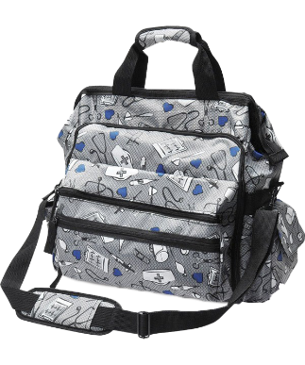

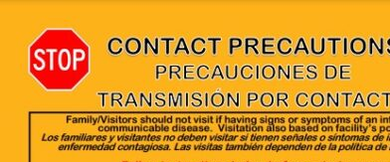
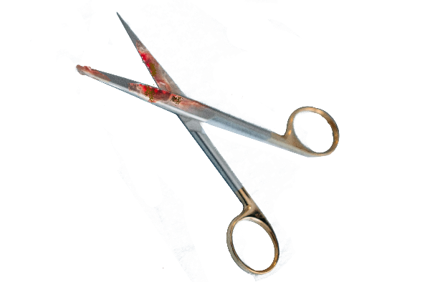
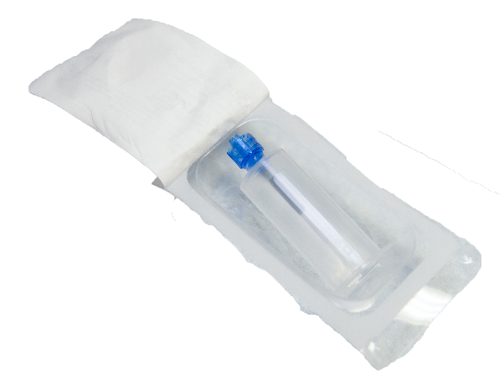
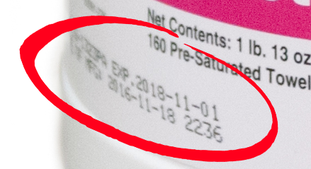
Home Care (Nursing) Bags cont’d
Unused supplies may be saved and used for another patient UNLESS:
  Item removed from the bag and patient on contact precautions
  Item was visible soiled
  Item was opened or the integrity of the package compromised
  Manufacturer’s expiration date has been exceeded
Notes:
Unused supplies may be saved and used for another patient unless:
CLICKs
The item is removed from the bag and the patient requires Contact Precautions
The item was visibly soiled
The item was opened, or the integrity of the package has been compromised
Or the manufacturer’s expiration date has been exceeded
5

Slide 6
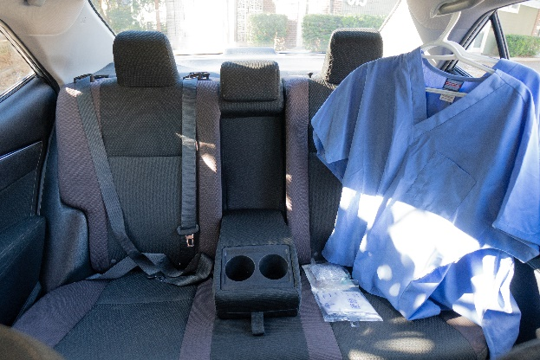


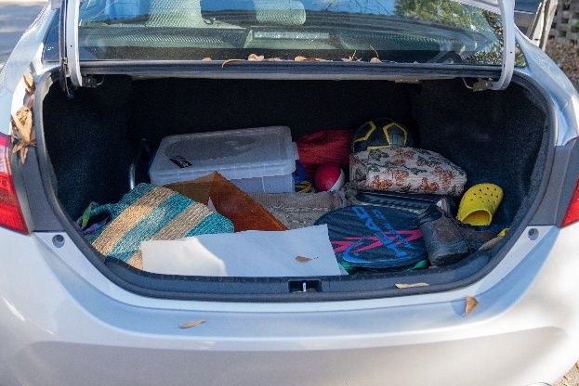
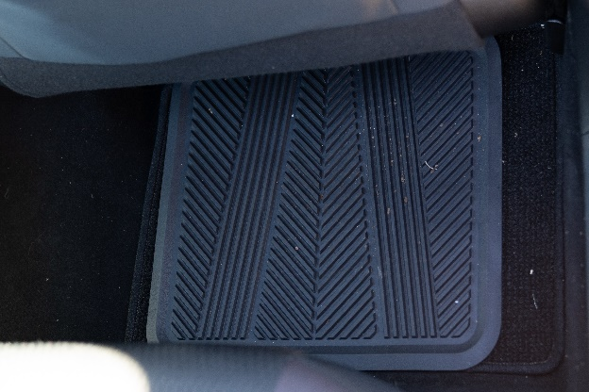
Home Care Personal Vehicle
Separation of clean and dirty in vehicle
Patient care and personal items stored separately
Clean supplies should be stored in a clean area of the car, not on floor
Store contaminated items and equipment needing cleaning in trunk (i.e., sharps containers)
Store in a manner to avoid spilling
Clean
Dirty
Notes:
Home care personnel must use their personal vehicle for transportation of clean and contaminated patient care articles.
Therefore, it is prudent to employ basic infection control principles of separation and appropriate storage of clean and dirty items within the vehicle.
As such, patient care items and personal items belonging to the employee should be stored in separate areas of the vehicle.
All clean patient care supplies, including the nursing bag, should be stored in an area of the vehicle that is clean and not likely to be become wet or soiled.
Supplies should not be stored on floor of the vehicle because the floor is heavily soiled. Items considered contaminated (such as sharps containers, equipment needing cleaning prior to reuse) should be transported in a designated “dirty” area of the vehicle such as the trunk. These items should be stored and transported so that spilling or contamination of other items is avoided.
6

Slide 7

Notes:
We’re almost through! Just one more discussion where we will review recommendations for Asepsis in procedures.

Slide 8
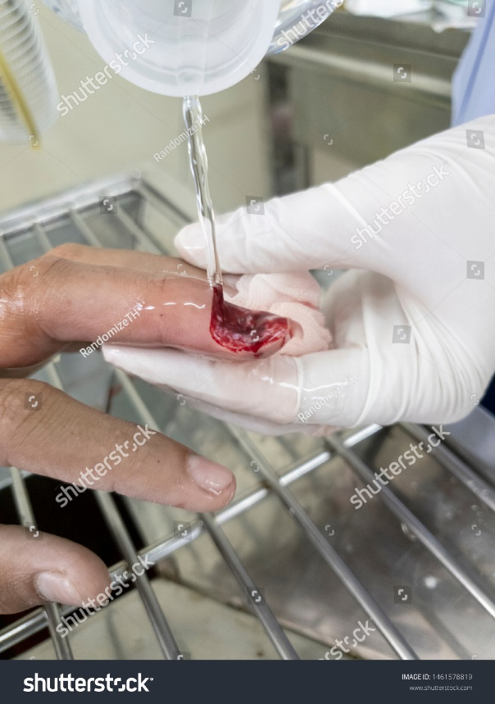
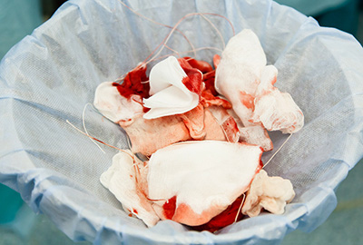
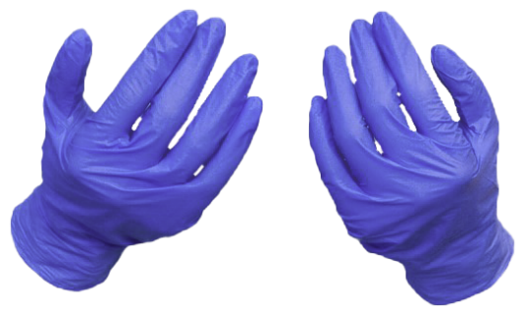
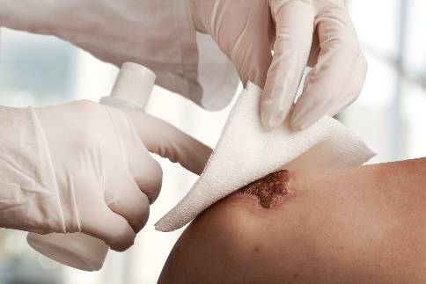

Asepsis in Procedures
Medical Asepsis
or
Clean Technique
is used for most* wound card
– Wound Care
– Decubitus Care
Use clean gloves to remove old dressings
Use only sterile irrigation solutions​
Soiled dressing should be contained in plastic bag and discarded in patient’s trash​
Remove old dressing Hand hygiene Don new gloves
*Sterile technique used if ordered by MD
*Alternatively, “No-touch” technique can be used
Notes:
Most wounds including decubitus ulcers are already colonized with the patient's own flora, therefore medical asepsis or clean technique is used for most wound care rather than sterile technique. Sterile technique is required if ordered by the MD or for fresh surgical wounds. Wound protocols include
CLICKs
Clean exam gloves should be used to remove old dressings. Hand hygiene should be performed, and new clean exam gloves are donned for the application of the new dressing. Alternatively, “no touch technique” may be used which is using the same gloves for entire dressing during wound care.
If wounds require irrigation, only sterile irrigation solutions should be used. It should be noted that these solutions are considered single-use as they have no preservative to prevent contamination after opening, so there is no safe storage time following use. All remaining solution should be discarded after care has been rendered.
All soiled dressings should be placed in a plastic bag and disposed of in patient’s trash. If this is not possible, transport soiled dressings to the facility for final disposal.

Slide 9
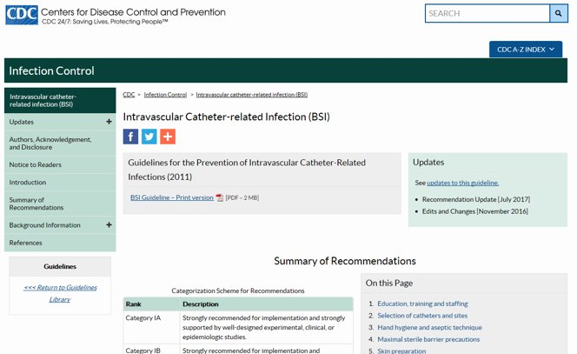

Intravascular Catheter-related Infection
Notes:
The 2011 Guidelines for Prevention of Intravascular Catheter-related Infections have been developed for healthcare personnel who insert intravascular catheters and for persons responsible for surveillance and control of infections in hospital, outpatient, and home healthcare settings. They are intended to provide evidence-based recommendations for preventing intravascular catheter-related infections.
In 2022 an expert guidance document was sponsored by the Society of Healthcare Epidemiology of America (SHEA). It is the product of a collaborative effort led by SHEA, the Infectious Diseases Society of America (IDSA), the Association for Professionals in Infection Control and Epidemiology (APIC), the American Hospital Association (AHA) and The Joint Commission (TJC).
9

Slide 10
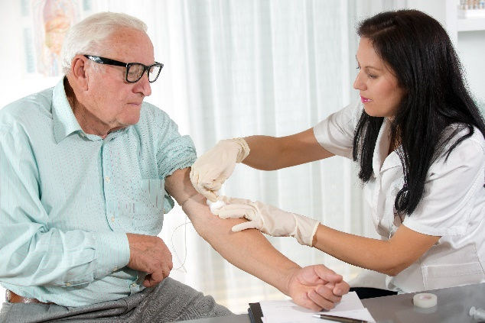
Phlebotomy
All venous access done using safety-engineered device(s)
Aseptic technique must be followed
No recapping of needles
Dispose of needles immediately in sharps container at point of use
Notes:
All venous access will be done using aseptic technique and only using safety-engineered devices, with no recapping of needles and sharps disposed of immediately at the point of use.
10

Slide 11
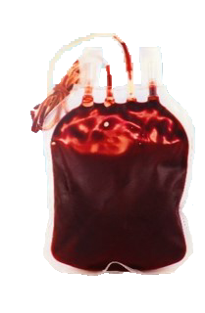
Transport Blood/Blood Products
Product
Temperature
Blood and pack red cells
Platelets
Liquid Plasma
1-10⁰ C
1-10⁰ C (if stored cold)
or 20-24⁰ C (at room temperature)
1-10⁰ C
Temperature must be monitored using temperature sensitive tags or thermometers;
Protect against direct exposure to ice packs or coolants
Notes:
The FDA requires that when transporting blood or blood products for infusion specific temperatures must be maintained and monitored. Take a moment to review these requirements.
11

Slide 12
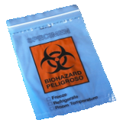

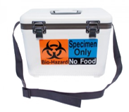

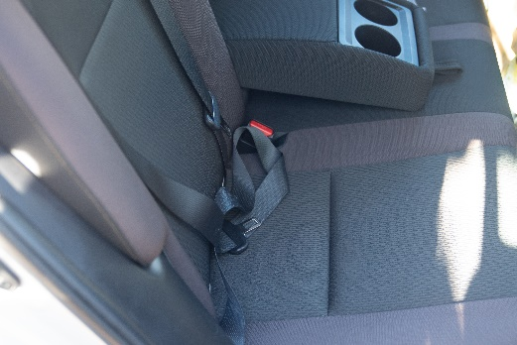
Specimen Collection and Transport
Specimens should not be hand carried to employee’s vehicle
Place in a plastic zip lock lab specimen bag with a biohazard label
Place in a secondary specimen bag for transportation (rigid container preferred)
Secondary bag may be transported in the clean section of vehicle
Notes:
CLICKs
Specimens should not be hand carried to the employee’s vehicle.
Specimens should be placed in a plastic ziplock lab specimen bag bearing a biohazard label and carefully closed. The health care provider should take care not to contaminate the outside of the specimen tubes or the bags
The specimens should then be placed in a secondary specimen bag, preferably a rigid container for transportation. This container should display a biohazard symbol.
The secondary specimen bag may be transported in the clean section of the vehicle.
12

Slide 13
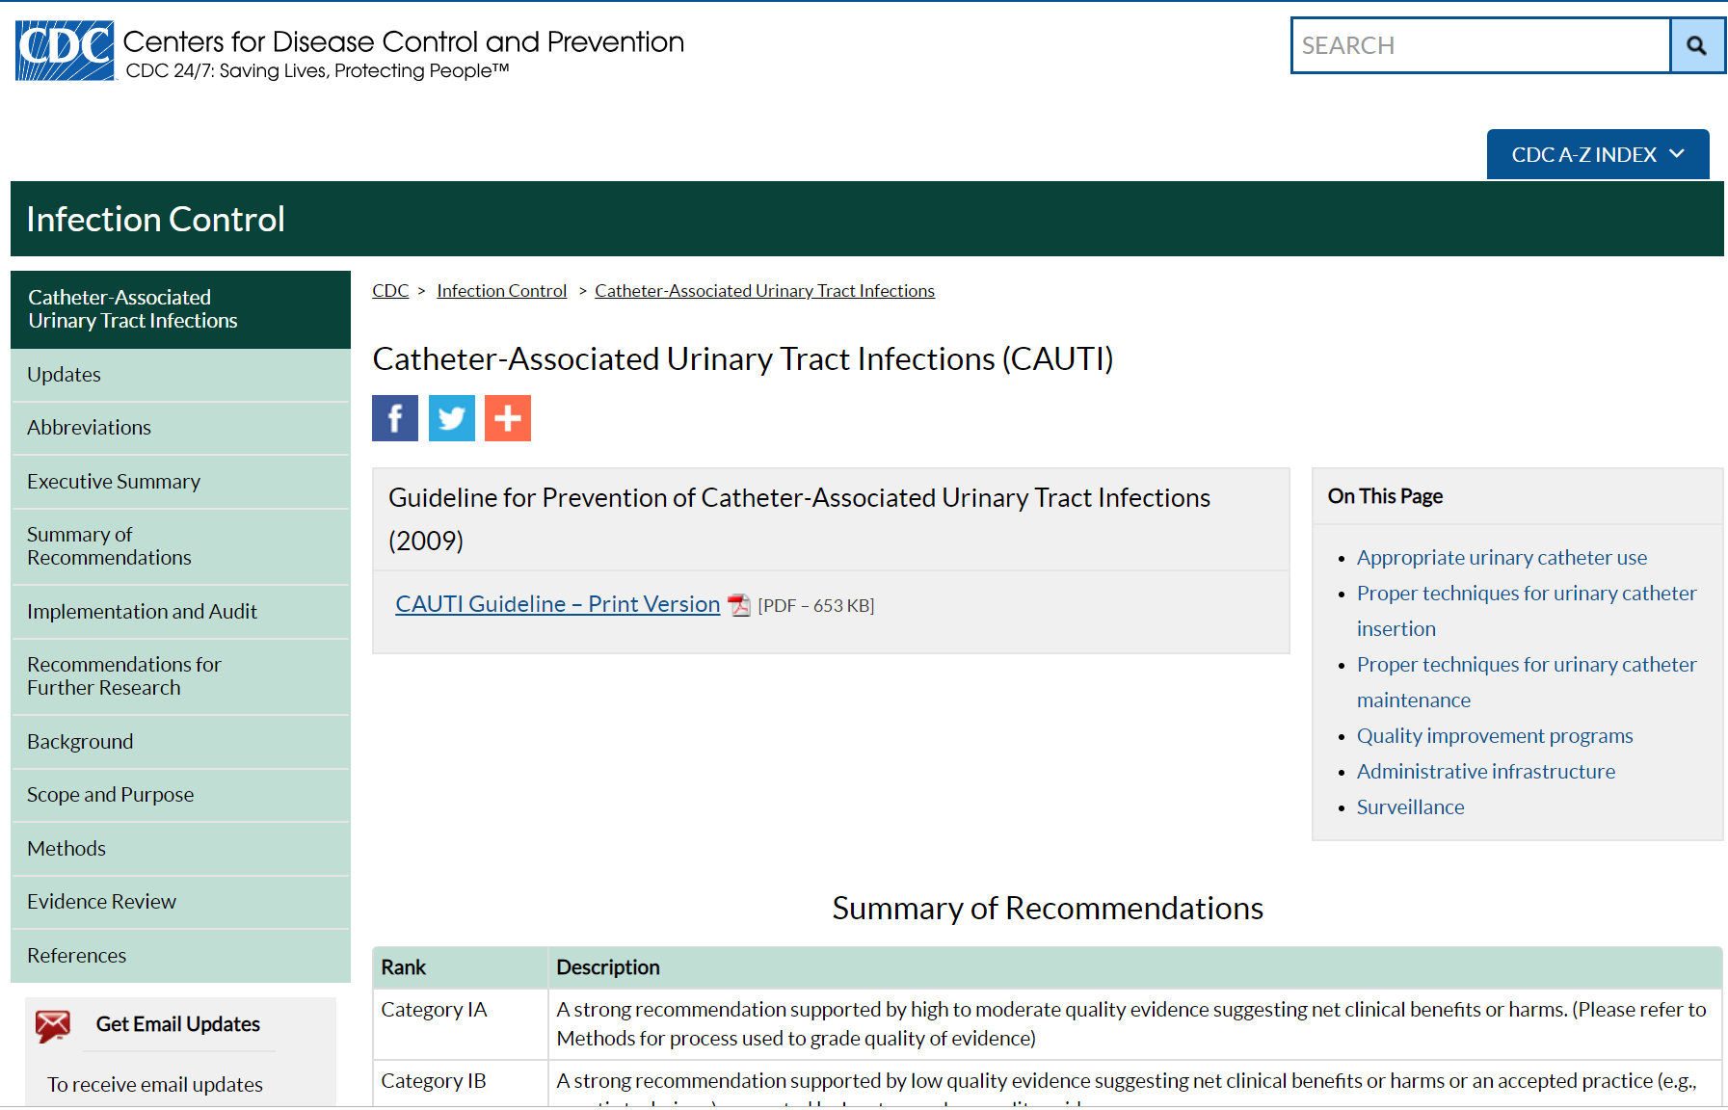
Catheter-associated Urinary Tract Infection
Notes:
This guideline updates and expands the original Centers for Disease Control and Prevention (CDC) Guideline for Prevention of Catheter-associated Urinary Tract Infections (CAUTI) published in 1981.
This revised guideline reviews the available evidence on CAUTI prevention for patients, including those requiring chronic indwelling catheters.
13

Slide 14
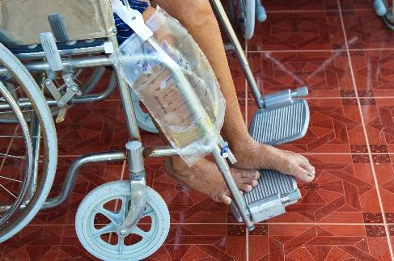

Intermittent Urinary Catheters
Clean technique is adequate for patients doing self I/O catheterization.
Leg bags are favored when the patients are ambulatory. The patients or caregivers should be taught to empty the bag at frequent intervals.
Notes:
For intermittent urinary catheterization done by the patient and patient family care givers, clean technique is considered adequate.
CLICK
Leg bags are favored when the patients are ambulatory. The patients or caregivers should be taught to empty the bag at frequent intervals. Manufacturer’s instructions should be followed for cleaning the leg bag (frequency and procedure).
14

Slide 15
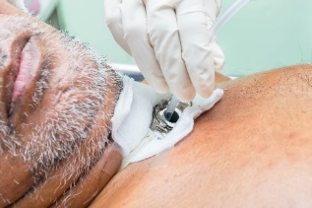
Tracheostomy Care
Clean Technique | Sterile technique
In most situations | Tracheostomy less than one month old Physician orders
Change suction catheters at least daily
Flush with saline after each use
Use new sterile suction catheter each time
  Suction canisters used for only 1 patient, emptied daily and washed with soap and water
  Suction tubing rinsed with tap water after each use
  Tubing disinfected weekly with a 1:10 bleach/water solution or a 1:3 vinegar solution
Notes:
Tracheostomy care in the home uses clean technique unless the tracheostomy is less than one month old, or the physician orders sterile care.
CLICKs
If sterile technique is used, a new sterile suction catheter should be used each time.
Alternatively the suction catheters should be changed at least daily and flushed with saline after each use.
CLICK
The suction canisters should be used for only one patient, emptied daily, and washed with soap and water to prevent buildup in the canister.
Suction tubing should be rinsed with tap water after each use and should be disinfected once a week with a 1 to 10 bleach water solution or a 1 to 3 vinegar solution.
15

Slide 16
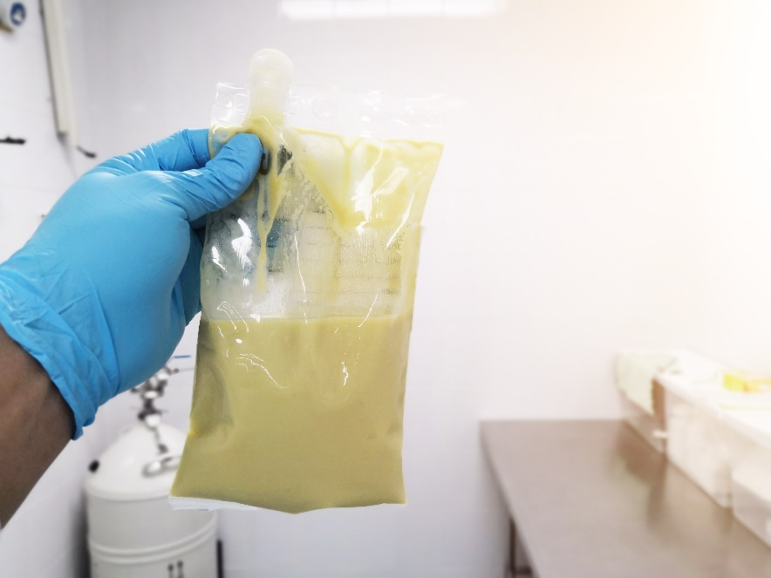
Enteral Feeding
  Feeding bag and tubing should be rinsed after each feeding
  Tap water may be used
  Do not top off an existing bag of formula with new formula
  During feeding, check bag and tubing for foreign manner, mold and leakage
Notes:
If the enteral feeds are not part of a premixed closed system, then the feeding bag and tubing should be rinsed after each feeding and tap water may be used.
Newly prepared formula should not be added to an existing formula that has been hanging. Do not top off an existing bag of formula. During the feeding, the bag and tubing should be checked intermittently for foreign matter, mold and leakage.
16

Slide 17
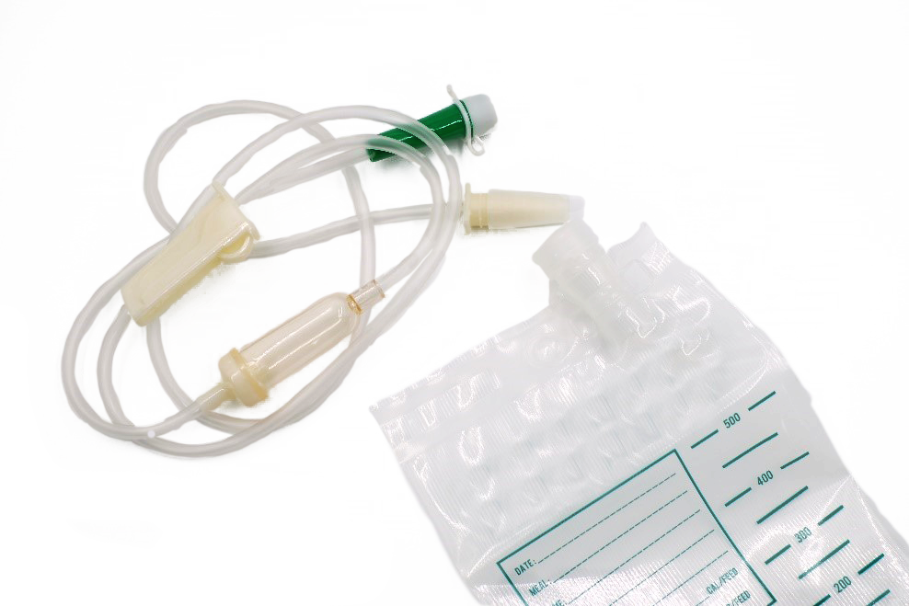
Cleaning Equipment and Supplies
Use clean technique to handle formula, equipment and supplies
Equipment used for formula preparation should be cleaned using:
  Dishwasher OR
  Hot, soapy water
Bags and tubing should not be used for
more than 24 hour
After 24 hours:
  Discard tubing OR
  Clean with soap and water, rinse, dry and air dry
Notes:
Proper handling and cleaning of enteral formula equipment and supplies using clean technique are important for reducing the risk of formula contamination.
CLICKs
Equipment used for preparation of formula should be washed in a dishwasher or using hot, soapy water. If a blender is used, all washable components should be washed as above, using a dishwasher or hot, soapy water.
Enteral feeding bags should not be used for more than 24 hours,
after which they should either be discarded or washed with soap and water, rinsed, drained and allowed to air dry.
17

Slide 18

Knowledge Check
True or False?
Enteral feeding bags can be refilled if they are half empty
True
False
Notes:
CLICK for answer That’s right! The answer is FALSE because enteral feeding bags cannot be topped off

Slide 19




Congratulations on completing the modules!
Notes:
That completes the Infection Control Course for meeting compliance with NC Rule .0206 Infection Control in healthcare Settings. Thank you for your time and attention.
Are there any questions about any of the modules?

