Slide 1




Module G
Notes:
Hi, welcome to Module G, Application of Infection Prevention and Control for Outpatient Hemodialysis Settings

Slide 2

Objectives
Describe infection risks associated with dialysis
Review infection prevention and control recommendations and guidelines for hemodialysis settings
Notes:
This module will provide an overview of infection prevention and control for outpatient hemodialysis healthcare personnel (HCP), including technicians and nurses. We will review hemodialysis associated infections, infection control recommendations and guidelines for outpatient hemodialysis
and educating patients and their caregivers.
2

Slide 3
Epidemiology of Dialysis Infections
According to the US Renal Data System 2020 Annual Data Report:
Nearly 808,000 people are living with end-stage renal disease (ESRD)
69% are on dialysis
89% hemodialysis
11% peritoneal
31% have had a kidney transplant
Notes:
According to the US Renal Data System (2020) annual data report:
CLICKs
Nearly 808,000 people are living with end-stage kidney disease also known as end-stage renal disease
Approximately 69-70% are treated with dialysis (89% hemodialysis; 11% peritoneal dialysis)
Approx 30% have a functioning kidney transplant
Reference Kidney Disease Statistics for the US
https://www.niddk.nih.gov/health-information/health-statistics/kidney-disease
3

Slide 4
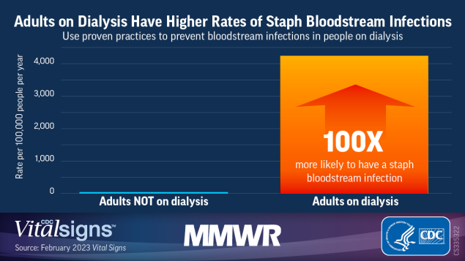
GFX change
Voice change
Text change
Epidemiology of Dialysis Infections
Infections are a leading cause of morbidity and mortality
S. aureus most common in patients reported to NHSN
Notes:
Infections are a leading cause of morbidity and mortality in hemodialysis patients. S. aureus is the most commonly isolated pathogen among bloodstream infections in hemodialysis patients reported to NHSN; 40% of those infections are methicillin resistant (MRSA)
Higher rates of invasive S. aureus infections have been observed in dialysis patients compared with nondialysis patients
Reference: Vital Signs: Health Disparities in Hemodialysis-Associated Staphylococcus aureus Bloodstream Infections — United States, 2017–2020
Weekly / February 10, 2023 / 72(6);153–159
4

Slide 5




Factors Increasing Risk of Dialysis Infections
Underlying medical problems (e.g., diabetes, high blood pressure)
Weaken immune system
Frequent healthcare exposure (inpatient and outpatient care)
Frequent use of catheters or insertion needles for access to the bloodstream
Dialysis patients are at increased risk for infections
Notes:
Why are hemodialysis patients at an increased risk of infection?
Patients who undergo hemodialysis have a higher risk of infection, due to factors which include:
CLICKs
their individual underlying medical conditions, like diabetes,
a weaken immune system,
frequent healthcare exposure, that may include hospital stays,
and frequent use of catheters or insertion needles used to access the bloodstream.
5

Slide 6
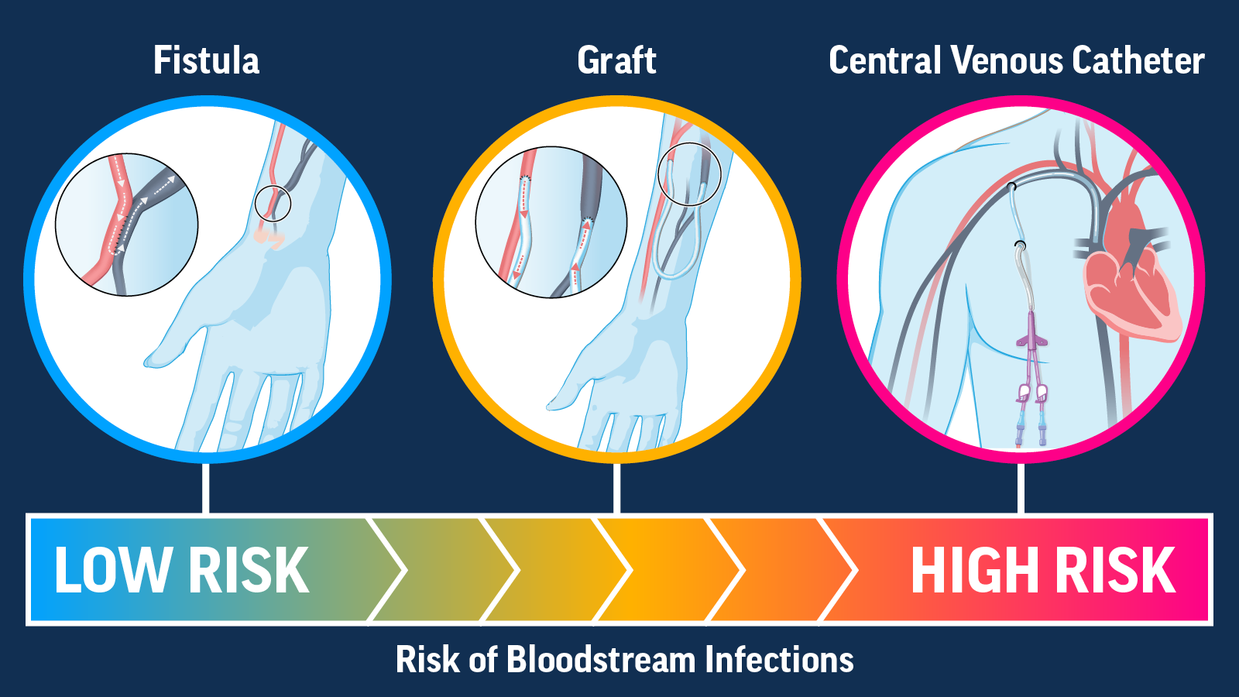
Infections in Dialysis Patients
Catheter use:
Vascular access type is the major risk factor for bloodstream infections regardless of race, ethnicity, or socioeconomic status.
Notes:
Patients with any access type can develop an infection, but fistulas have the lowest risk of infection and central venous catheters have the highest risk of infection.
6

Slide 7

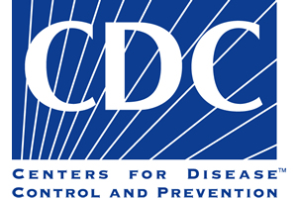
Core Interventions to Reduce Dialysis Bloodstream Infections
Conduct monthly surveillance
Perform observations of hand hygiene opportunities and share results
Catheter/vascular access care observations
Staff education and competency
Patient education/engagement
Catheter reduction
Chlorhexidine for skin antisepsis
Catheter hub disinfection
Antimicrobial ointment
Notes:
AUTO
Listed above are the CDC’s core interventions that have been proven to reduce hemodialysis bloodstream infections. CDC’s audit tools and checklist are recommended to help implement these interventions.
A link to the CDC’s website is included in your resources:
https://www.cdc.gov/dialysis/prevention-tools/audit-tools.html

Slide 8
2016 Update-2001 CDC Hemodialysis Recommendations
Some information and recommendations in the 2001 Guideline have been superseded by information that has led to more recent CDC recommendations. These topics include but are not limited to:
Testing for hepatitis C virus (HCV)
Testing for human immunodeficiency virus (HIV) infection
Standard precautions in healthcare settings
CDC recommendations and information issued after 2001 address some topics not included in the 2001 Guideline
Preventing hemodialysis catheter-related infections
Screening patients for latent tuberculosis infection
Recommended vaccinations for some vaccine-preventable diseases
Notes:
In 2016 CDC updated some recommendations included in the 2001 Guideline based on more current guidance including:
Testing for HCV
Testing for HIV
Standard Precautions
CLICK
They also included recommendations made/issued after 2001 that were not included in 2001 Guideline:
Prevention hemodialysis catheter-related infection
Screening patients for latent TB infection
Recommended vaccinations for staff and patients

Slide 9
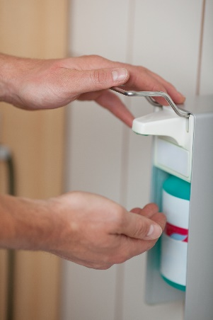

Infection Prevention Control Precautions
Perform Hand Hygiene:
Before you touch a patient
Before you inject or infuse a medication
Before you cannulate a fistula/graft or access a catheter
After you touch a patient
After you touch blood, body fluid, mucous membranes, wound dressings, or dialysis fluids (e.g., spent dialysate)
After you touch medical equipment or other items at the dialysis station
After you remove gloves
ALWAYS- between each patient AND/OR between each patient stations.
A sufficient number of sinks with warm water and soap should be available to facilitate hand washing if hands are visible soiled.
Notes:
When should healthcare personnel perform hand hygiene?
CLICKs
Hand Hygiene should always be performed
CLICKs
before touching a patient.
Before injecting or infusing a medication.
Before cannulating a fistula/graft or access a catheter.
After touching a patient
or after touching blood, body fluids, mucous membranes, wound dressings, or dialysis fluids (e.g., spent dialysate),
or after touching medical equipment or other items at the dialysis station,
and after removing gloves.
Remember that hand hygiene should be performed between each patient or station
A sufficient number of sinks with warm water and soap should be available to facilitate hand washing if hands are visible soiled.
If hands are not visibly soiled, use of a waterless antiseptic hand rub is recommended.
9

Slide 10
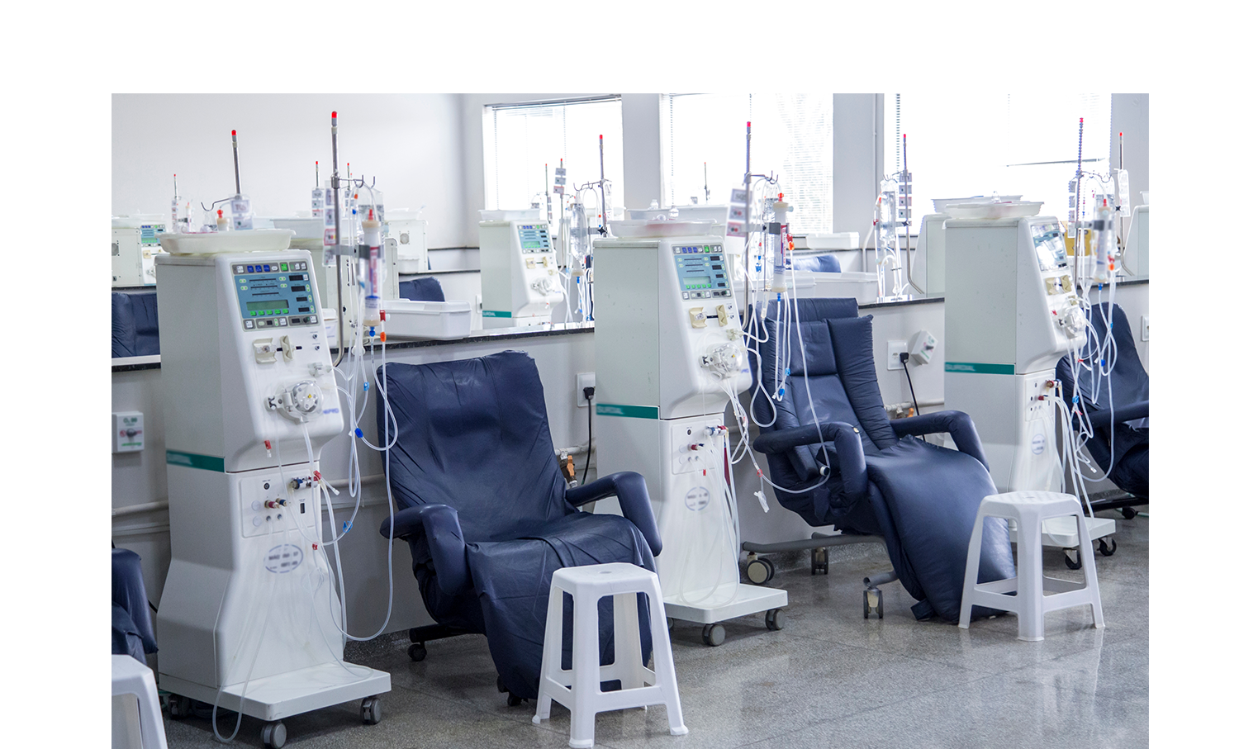

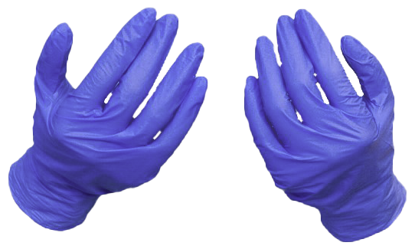



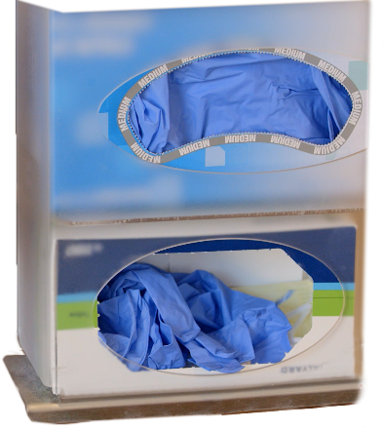


Infection Prevention Control Precautions
Wear disposable gloves when caring for the patient or touching the patient’s environment at the dialysis station; remove and wash hands between each patient or station.
Items taken into the dialysis station should either be:
Disposed of
Dedicated for use only on a single patient
Cleaned and disinfected before being taken to a common clean area or used on another patient
Non disposable items that cannot be cleaned and disinfected (e.g., adhesive tape, cloth-covered blood pressure cuffs) should be dedicated for single patient use only
Notes:
Other infection prevention precautions include:
CLICKs
Wear disposable gloves when caring for the patient or touching the patient’s environment at the dialysis station. To facilitate glove use, a supply of clean nonsterile gloves should be available near each dialysis station
Any item taken into the dialysis station could become contaminated with blood and other body fluids and serve as a vehicle for transmission to other patients either directly or by contamination of the hands of personnel.
Therefore, items taken to a patient’s dialysis station, including those placed on top of dialysis machines, should either be
disposed of,
dedicated for use only on a single patient,
or cleaned and disinfected before being returned to a common clean area or used for other patients
10

Slide 11
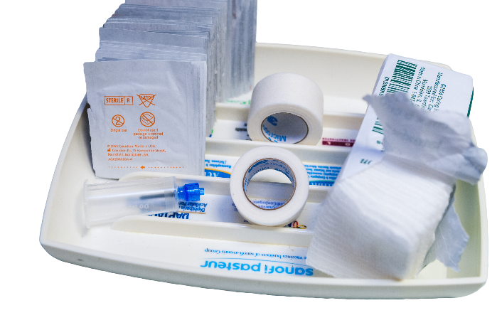

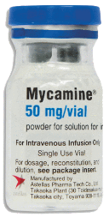

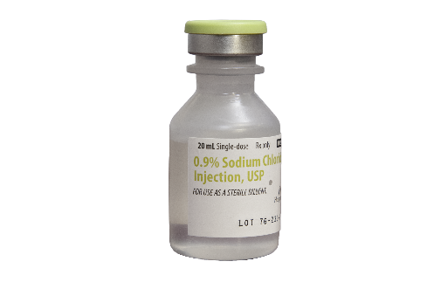


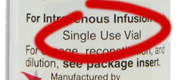

Infection Prevention Control Precautions
Unused medications including multiple dose vials or supplies (e.g., syringes, alcohol swabs) taken to the patient’s station should be used only for that patient and should not be returned to a common clean area or used on another patient.
Prepare medications in a room/area separated from treatment area and designated only for medications
Do not handle/store contaminated/used supplies in areas where medicine/clean supplies are handled
Deliver medications separately to each patient
Additional measure to prevent contamination of clean/sterile items:
Preparation
Treatment
Medications labeled as single use (including erythropoietin) should not be punctured more than one time
ONLY
ONE
ONE TIME
Contaminated
Notes:
Unused medications or supplies (for example syringes or alcohol swabs) taken to the patient’s station should not be returned to a common clean area or used on other patients.
CLICKs
Additional measures to prevent contamination of clean or sterile items include
Preparing medications in a room or area separated from the patient treatment area and designated only for medications;
Not handling or storing contaminated (i.e., used) supplies, equipment, blood samples, or biohazard containers in areas where medications and clean (i.e., unused) equipment and supplies are handled; and
Delivering medications separately to each patient. Common carts should not be used within the patient treatment area to prepare or distribute medications. If trays are used to distribute medications, clean them before using for a different patient.
Intravenous medication vials labeled for single use, including erythropoetin, should not be punctured more than once. Once a needle has entered a vial labeled for single use, the sterility of the product can no longer be guaranteed. Residual medication from two or more vials should not be pooled into a single vial.
If a common supply cart is used to store clean supplies in the patient treatment area, this cart should remain in a designated area at a sufficient distance from patient stations to avoid contamination with blood. Such carts should not be moved between stations to distribute supplies.
11

Slide 12
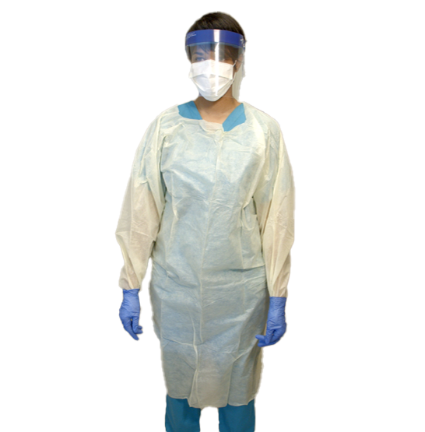
Personal Protective Equipment (PPE)
Wear gowns, face shields, eye wear, or masks when performing procedures during which spurting or spattering of blood might occur:
During initiation and termination of dialysis,
During cleaning of dialyzers, and
Centrifugation of blood
Change PPE if it becomes soiled
Notes:
Staff members should wear gowns, face shields, eye wear, or masks to protect themselves and prevent soiling of clothing when performing procedures during which spurting or splattering of blood might occur (e.g.,
CLICKs
during initiation and termination of dialysis,
cleaning of dialyzers,
and centrifugation of blood).
Such protective clothing or gear should be changed if it becomes soiled with blood, body fluids, secretions, or excretions.
12

Slide 13

Knowledge Check
True or False?
In addition to gloves, HCP should wear a gown, eye and mouth protection during initiation and termination of dialysis and change PPE if it becomes soiled or contaminated.
True
False
Notes:
CLICK for answer That’s right! The answer is TRUE. PPE should be worn and changed if it becomes contaminated for HCP protection

Slide 14
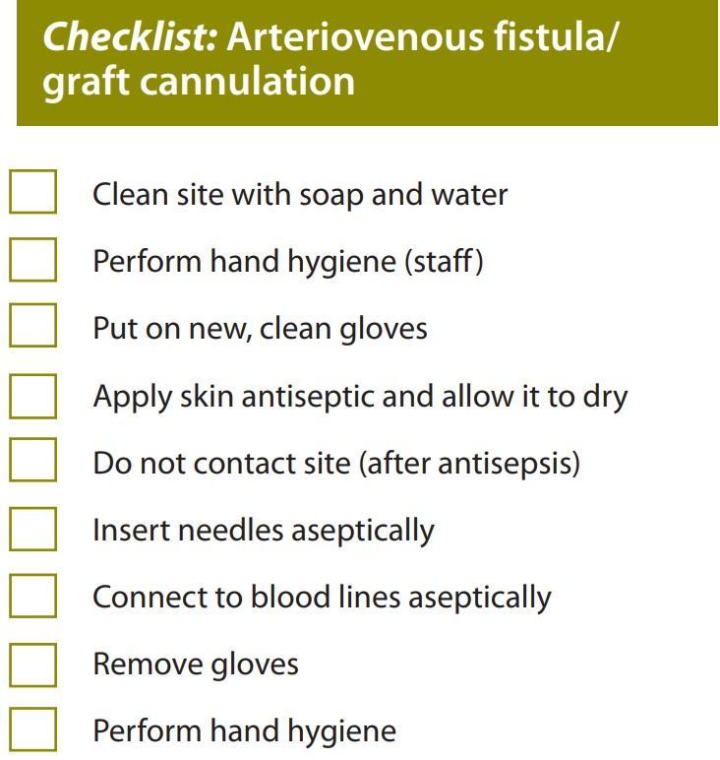
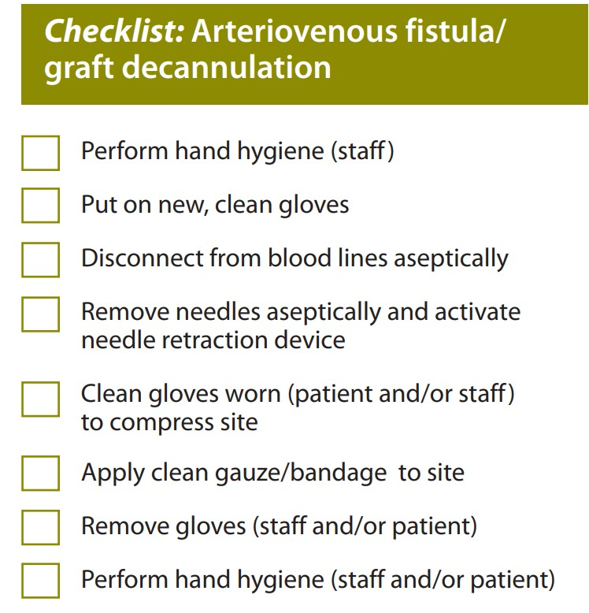
Fistula/Graft Care
Cannulation and Decannulation
Notes:
The following checklists are intended to promote CDC-recommended practices for infection prevention in hemodialysis facilities. The audit tools and checklists can be used by individuals when assessing staff practices. They can also be used by facility staff themselves to help guide their practices.
14

Slide 15
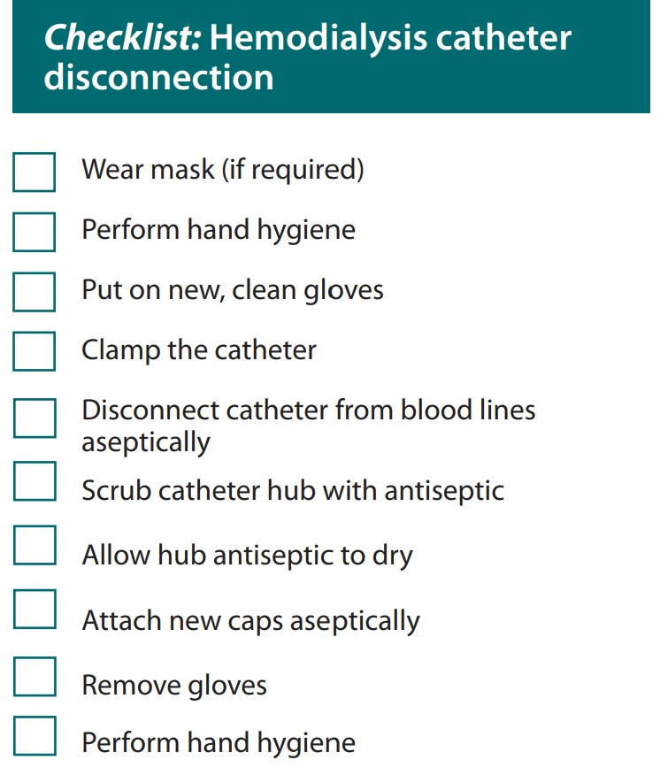
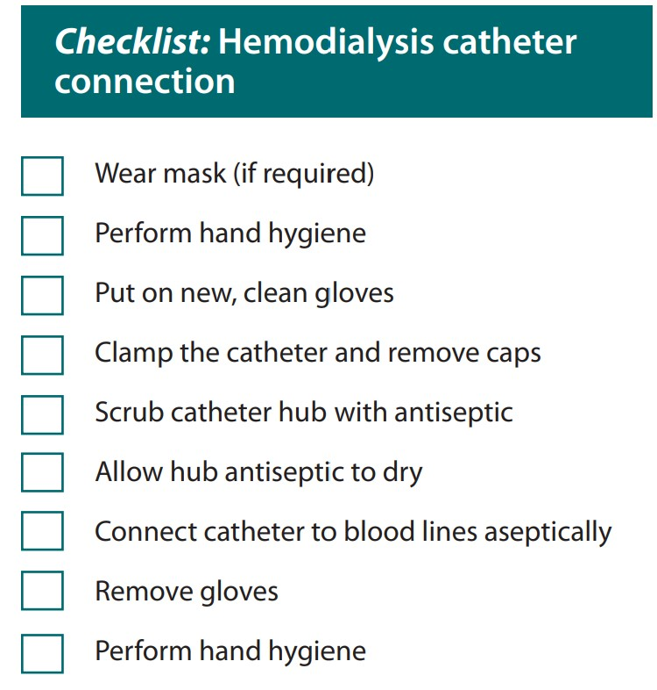
Hemodialysis Catheter Connection and Disconnection
Notes:
15

Slide 16
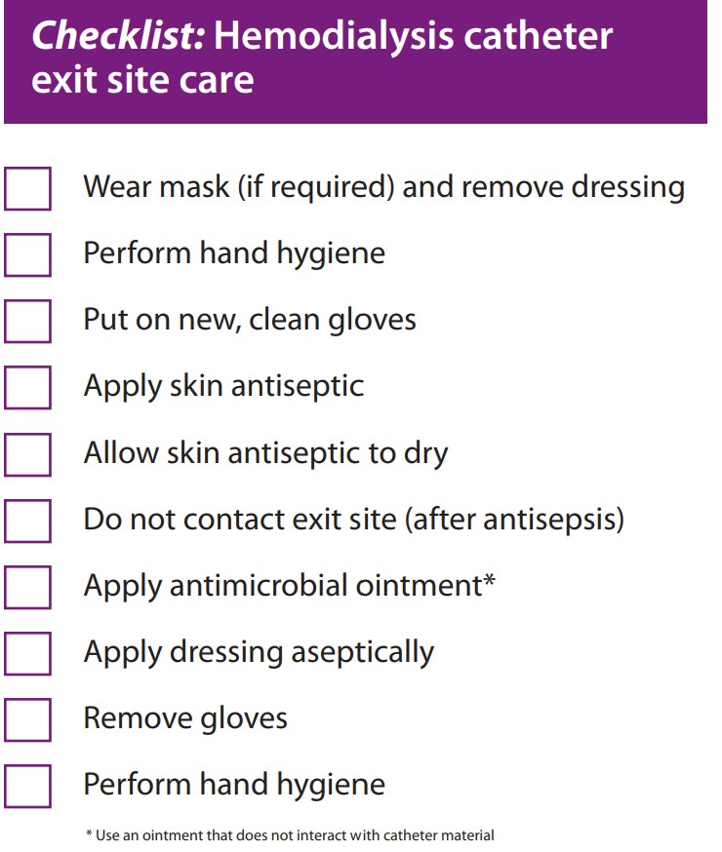
Hemodialysis Central Venous Catheter Exit Site Care
https://www.cdc.gov/dialysis/PDFs/collaborative/Hemodialysis-Central-Venous-Catheter-STH-Protocol.pdf
Notes:
In addition to the checklists shown on these slides, CDC also has a recommended protocol for Scrub-the-hub which can be found at the website included on your slide.
The CDC link to all audit tools and checklist will be included in your resource page.
https://www.cdc.gov/dialysis/prevention-tools/audit-tools.html
16

Slide 17
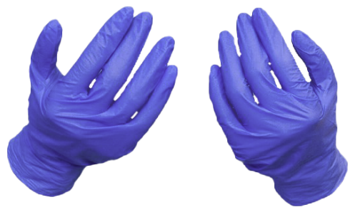
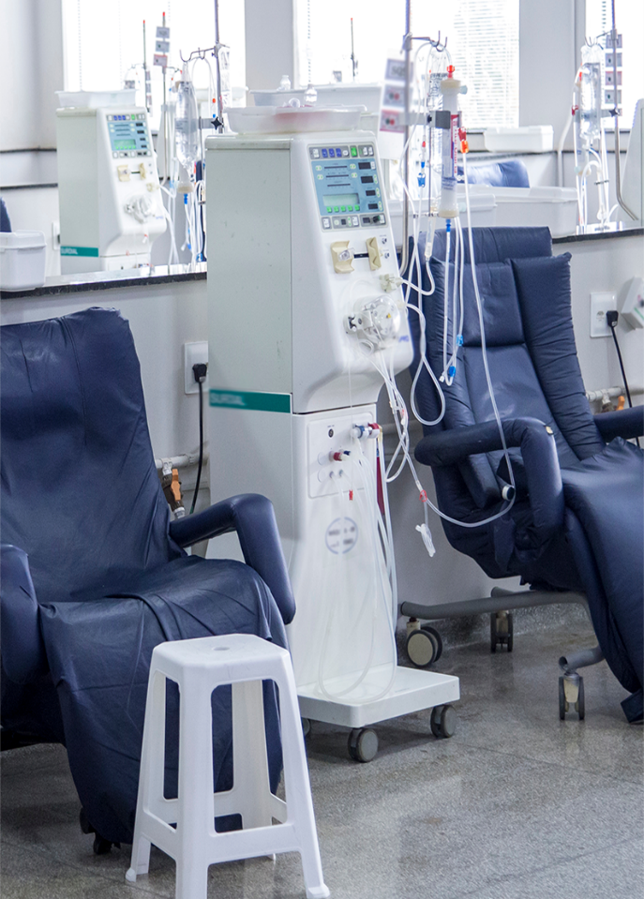






GFX change
Voice change
Text change
Cleaning and Disinfection: Dialysis Station
Routine cleaning and disinfection of the dialysis station will reduce the risk of spreading an infection
Cleaning is done using cleaning detergent, water and friction, and is intended to remove blood, body fluids, and other contaminants from objects and surfaces
Disinfection is a process that kills many or all remaining infection-causing germs on clean objects and surfaces
Use an EPA-registered hospital disinfectant and follow label instructions for proper dilution
Wear all PPE as recommended on the disinfectant label. during the cleaning/disinfection process
Germy and dirty
Notes:
Routine cleaning and disinfection of the dialysis station will reduce the risk of spreading an infection.
CLICKs
Cleaning should be done using cleaning detergent, water and friction, and is intended to remove blood, body fluids, and other contaminants from objects and surfaces.
Disinfection is a process that kills many or all remaining infection-causing germs on clean objects and surfaces.
Use an EPA-registered hospital disinfectant and follow the label instructions for proper dilution.
Healthcare personnel should wear All PPE as recommended on the disinfectant label during the cleaning and disinfection process.
17

Slide 18
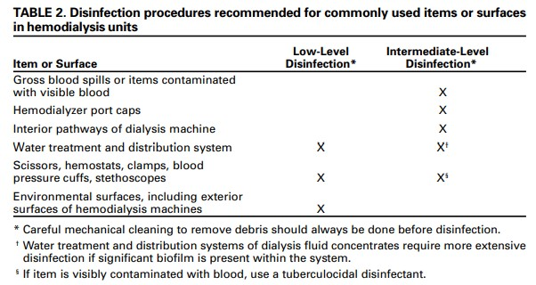
Cleaning and Disinfection: Dialysis Station
All equipment and surfaces are considered contaminated after a dialysis session and must be disinfected
After the patient leaves the station, disinfect the dialysis station (including chairs, trays, countertops, and machines)
Wipe all surfaces – Surfaces should be wet with disinfectant and allowed to air dry
Give special attention to cleaning control panels on the dialysis machines and other commonly touched surfaces
Empty and disinfect all surfaces of prime waste containers
https://www.cdc.gov/dialysis/PDFs/dialysis-Station-Disinfect-Tool-508.pdf
Notes:
The hemodialysis machine and its components can be vehicles for patient-to patient transmission of bloodborne viruses and pathogenic bacteria . The external surfaces of the machine are the most likely sources for contamination. These include not only frequently touched surfaces (e.g., the control panel), but also attached waste containers used during the priming of the dialyzers, blood tubing draped or clipped to waste containers, and items placed on tops of machines for convenience (e.g., dialyzer caps and medication vials).
The link to the CDC Audit Tool for Routine Hemodialysis Station Disinfection on your slide https://www.cdc.gov/dialysis/PDFs/dialysis-Station-Disinfect-Tool-508.pdf
18

Slide 19

Knowledge Check
Which of the following statements is true?
Any item taken to a patient’s dialysis station could become contaminated.
Use single-dose vials whenever possible and dispose of them immediately after use
Do not carry medication vials, syringes, alcohol swabs, tape or supplies in pockets
Use an EPA-registered hospital disinfectant and follow the label instruction for proper dilution
All the above
Notes:
CLICK for answer That’s right! The answer is All the above. Each of these steps is critical in reducing the risk of transmission of infections

Slide 20
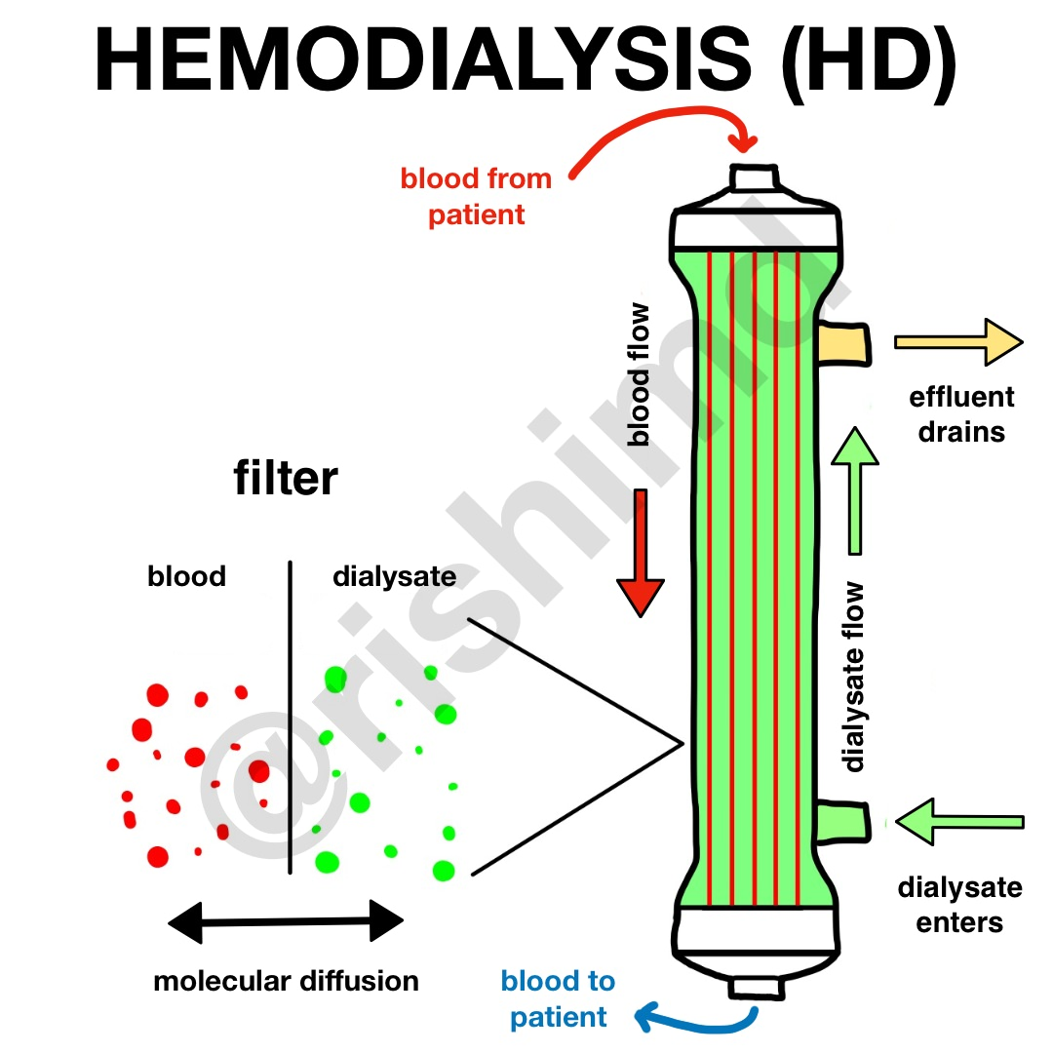
Dialyzers
Reuse of dialyzers
The dialyzer may either be discarded after each treatment or be reused
Reuse requires an extensive procedure of high-level disinfection
Reused dialyzers are not shared between patients.
As of 2020, the three largest dialysis organizations in the U.S. do not perform reuse in any of their facilities.
Notes:
The dialyzer may either be discarded after each treatment or be reused. Reuse requires an extensive procedure of high-level disinfection. Reused dialyzers are not shared between patients.
CLICK
As of 2020 the three largest dialysis organizations in the United States do not perform reuse in any of their facilities. Dialyzer reuse is now rare in the US and most resource-rich countries.
20

Slide 21
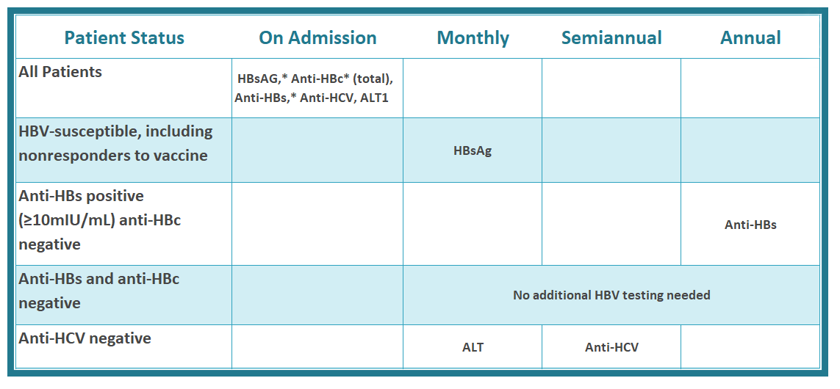
Hepatitis B Virus (HBV)
Routine testing
* Results of HBV testing should be known before the patient begins dialysis.
¹ HBsAG=hepatitis B surface antigen; Anti-HBc-antibody to hepatitis B core antigen; Anti-HBs=antibody to hepatitis B
surface antigen; Anti-HCV=antibody to hepatitis C virus: ALT alanine aminotransferase.
Notes:
The chart you see on the slide is routine testing for HBV recommended by CDC
21

Slide 22
Hepatitis B Virus (HBV)
Hepatitis B Vaccination
Vaccinate all susceptible patients against hepatitis B.
Test for anti-HBs 1-2 months after last dose.
If anti-HBs is <10 mIU/mL, consider patient susceptible, revaccinate with additional three doses, and retest for anti-HBs.
If anti-HBs is ≥10 mIU/mL, consider patient immune, and retest annually.
Give booster dose of vaccine if anti-HBs declines to <10 mIU/mL and continue to retest annually.
Notes:
This chart includes vaccination recommendations for HBV.
22

Slide 23

Preventing Hepatitis B Transmission
Dialyze hepatitis B (HBsAg+) patients in a separate room using separate machines, equipment, instruments, and supplies – Be sure to use a separate gown when treating these patients
HBsAg+ means hepatitis B surface antigen (a lab test for hepatitis B virus) was positive
Staff members caring for patients with hepatitis B (HBsAg+) should not care for HBV-susceptible patients at the same time (e.g., during the same shift or during patient change over)
HBV-susceptible means anyone who has never been infected and lacks immunity to hepatitis B virus
Notes:
CDC recommends to dialyze hepatitis B surface antigen positive (HBsAg+) patients in a separate room using separate machines, equipment, instruments, and supplies. Be sure to use a separate gown when treating these patients.
CLICKs
HBsAg+ means hepatitis B surface antigen (a lab test for hepatitis B virus) was positive.
Staff members caring for patients with hepatitis B (HBsAg+) should not care for HBV-susceptible patients at the same time (e.g., during the same shift or during patient changeover).
HBV-susceptible means anyone who has never been infected and lacks immunity to hepatitis B virus.
23

Slide 24
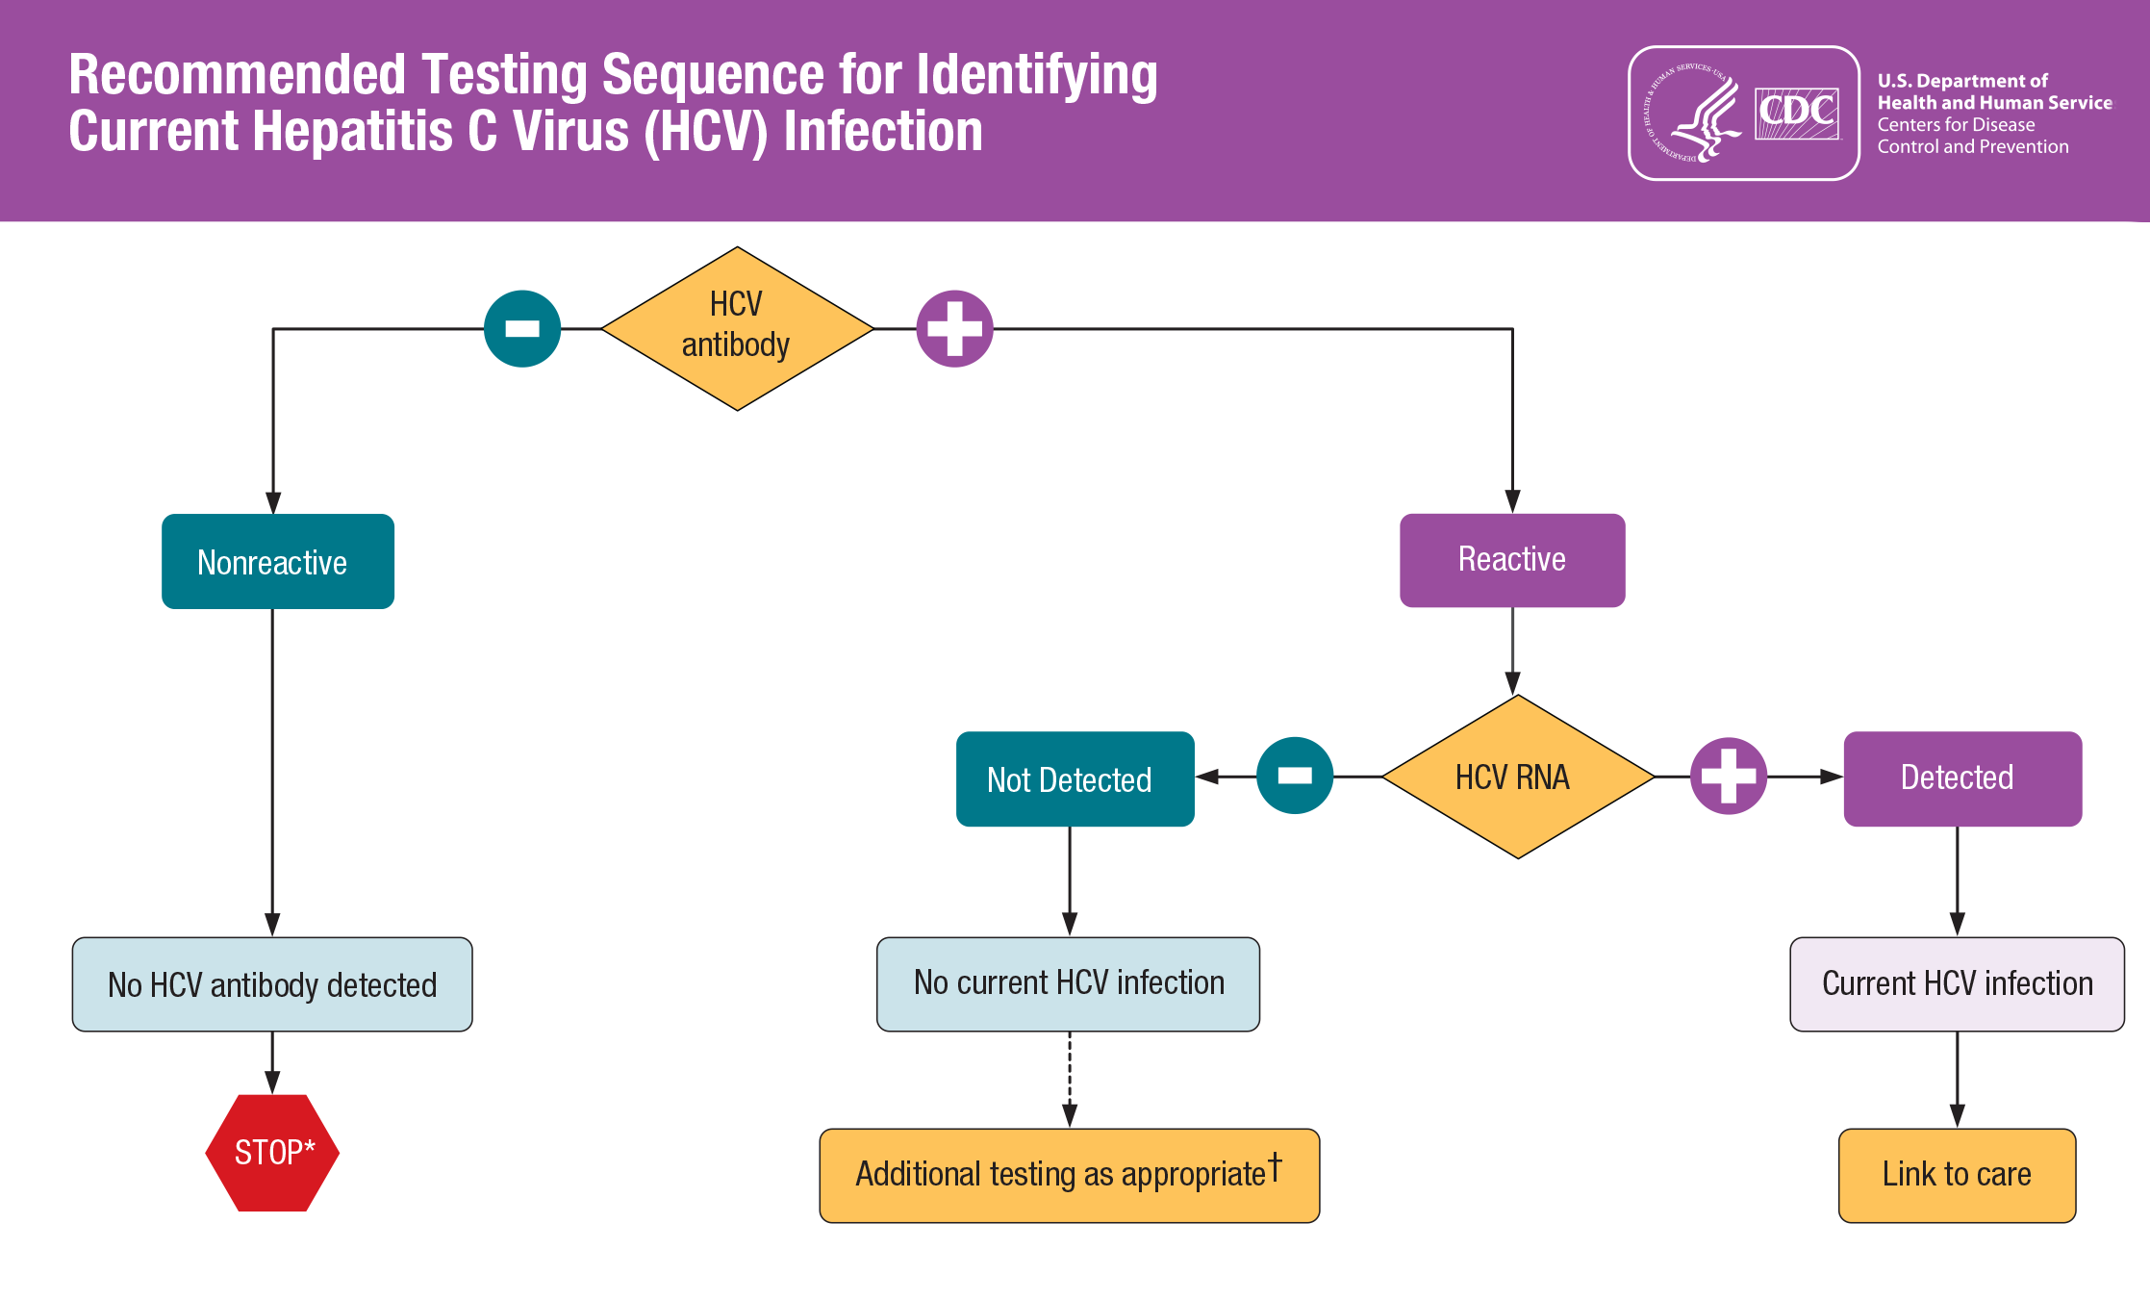
Footnotes
* For persons who might have been exposed to HCV within the past 6 months, testing for HCV RNA or follow-up testing for HCV antibody is recommended. For persons who are immunocompromised, testing for HCV RNA can be considered.
† To differentiate past, resolved HCV infection from biologic false positivity for HCV antibody, testing with another HCV antibody assay can be considered. Repeat HCV RNA testing if the person tested is suspected to have had HCV exposure within the past 6 months or has clinical evidence of HCV disease, or if there is concern regarding the handling or storage of the test specimen. Source: CDC. Testing for HCV infection: An update of guidance for clinicians and laboratorians. MMWR 2013;62(18).
Notes:
Speakers, go thru the algorithm on the chart
CLICK for footnotes
24

Slide 25




Preventing Bacterial, Respiratory Infection Transmission
Wear a gown and gloves when caring for the patient and remove the gown and gloves when finished caring for that patient
Do not wear the same gown when caring for other patients
Dialyze patient at a station with as few adjacent stations as possible (e.g., at the end or corner of the room)
Patients with respiratory illness and a fever are at risk of spreading viral infections
These patients should be dialyzed at least 6 feet away from other patient stations or any shared supplies
For these patients use the following precautions:
Hemodialysis patients at increased risk for spreading germs to other patients include those with:
An infected skin wound with drainage that is not contained by dressings
Fecal incontinence or uncontrolled diarrhea
6 ft.
Notes:
To prevent the spread of bacterial infections in the dialysis facility assess those patients who might be at increased risk for spreading germs to other patients. The following conditions are of concern: When a patient has
CLICKs
an infected skin wound with drainage that is not contained by dressings, or
fecal incontinence or uncontrolled diarrhea.
For these patients use the following precautions
Have staff wear a gown and gloves when caring for the patient and to remove the gown and gloves when finished caring for the patient.
Healthcare workers should never wear the same gown when caring for other patients.
CDC recommends to dialyze the patient at a station with as few adjacent stations as possible (e.g., at the end or corner of the room).
Patients with respiratory illness and a fever are at risk of spreading bacterial and viral respiratory infections. These patients should be dialyzed at least 6 feet away from other patient stations or any shared supplies. If tolerated the patient should wear source control during their treatment.
25

Slide 26

Educating Patients and Caregivers
When a new patient starts dialysis and on an annual basis, review the following:
Personal hygiene and hand hygiene technique
Patient responsibility for proper care of the access site and recognition of signs of infection
Recommended vaccinations (including hepatitis B, influenza, and pneumococcal)
Reasons for selecting a fistula or graft over a catheter to lower the risk of infection
Notes:
Dialysis facilities should have a plan in place for the training and education of patients and their caregivers. When a new patient starts dialysis and on an annual basis, include all the following:
CLICKs
a review of personal hygiene and hand hygiene technique;
the patient responsibility for proper care of the access site and recognition of signs of infection;
the recommended vaccinations (including hepatitis B, influenza, and pneumococcal);
and the reasons for selecting a fistula or graft over a catheter to lower the risk of infection.
26

Slide 27

Educating Patients and Caregivers
Advise patients to inform you if they notice any of the following possible signs of infection:
Fever
The access site is:
swollen (bulging)
red
warm to touch
has pus
severe pain at the access site
Remember: infections of the vascular access site can be life threatening
Notes:
It’s important to educate patients and their caregivers on how to recognize an infection. Advise patients to inform you if they notice any of the following possible signs of infection including
CLICKs
fever
or if the access site is swollen or bulging, red, warm to touch or has pus or severe pain at the access site
Remember: infections of the vascular access site can be life threatening.
27

Slide 28
Knowledge Check
True or False?
Patients who undergo dialysis should NOT receive the annual influenza vaccine due to increased risk of reaction?
True
False
Notes:
CLICK for answer That’s right! The answer is False. CDC recommends everyone aged 6 months who do not have a contraindication receive an annual influenza vaccination

Slide 29

Summary
Infections that patients can get while receiving dialysis are serious and preventable!
Healthcare workers like you following infection control precautions and other safe care practices are the key to prevention!
Infection prevention is everyone’s responsibility!
Notes:
In summary, infections that patients can get while receiving dialysis are serious and preventable!. Healthcare workers like you following infection control precautions and other safe care practices are the key to prevention. As always, infection prevention is everyone’s responsibility!
29

Slide 30
CDC Resource Links
CDC Audit Tools and Checklists https://www.cdc.gov/dialysis/prevention-tools/audit-tools.html
CDC Core Interventions https://www.cdc.gov/dialysis/prevention-tools/core-interventions.html
CDC Recommendations for Preventing Transmission of Infections Among Chronic Hemodialysis Patients (2001)https://www.cdc.gov/infectioncontrol/guidelines/dialysis
CDC Hemodialysis Central Venous Catheter Scrub-the-Hub Protocol https://www.cdc.gov/dialysis/prevention-tools/scrub-protocols.html
CDC Infection Prevention Tools https://www.cdc.gov/dialysis/prevention-tools/index.html
Notes:
30

Slide 31




Congratulations on completing the modules!
Notes:
That completes the Infection Control Course for meeting compliance with NC Rule .0206 Infection Control in Outpatient Dialysis Settings. Thank you for your time and attention.
Are there any questions about any of the modules

